Slide 1
Convergence and accuracy of coupled FV/MC codes
M. Baelmans
With research results and input from
P. Börner, W. Dekeyser, K. Ghoos,
N. Horsten, G. Samaey, T. Van Oevelen
WPCD-meeting 10-12 December 2014, Garching, Germany
Notes:
30 minutes

Slide 2
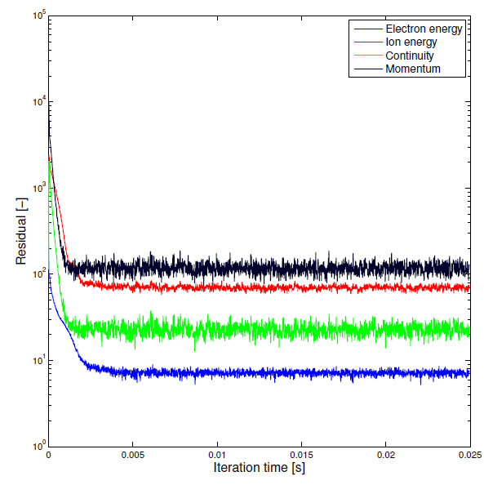
Introduction
= Present ITER choice
B2/B2.5
False time stepping
Dual time stepping (nstages)
Coupling
Full Monte Carlo
MC+ Short Cycle
Robbins-Monro
EIRENE
Random noise
Correlated sampling
Transient or not
Interpretation of results
One single solution vs. averaged solution
➔ 48 possible combinations and multiple scenarios

Slide 3
Introduction
GOAL Getting accurate results as fast as possible
OR Quickly getting results as accurate as possible
Starting point = EFDA-report on short cycle
Run time is same for Correlated Sampling and Full MC
Short cycle speed-up factor 5-100 depending on case
Questions: Which procedure to invest in?
Based on error assessment
Debottleneck simulations w.r.t. accuracy vs. run time
➔ Goal-oriented simulations
Towards ITER/DEMO-relevant conditions
➔ What kind of errors are we looking at?

Slide 4
Introduction
Model equations
Discretize
Iterate /
Solve
Data processing
n_{it}
Fluid equations
Finite
Volume
False time steps
Non-linear set of equations
Convergence
error
Averaging over:
iterations
OR independent runs
n_{r}
Kinetic
equations
Monte Carlo
Launch particles at targets
Track particles
Statistical
error
n_{t}
Assume steady state
Discretization error
Correlation error
Modelling error
Systematic error
Statistical error

Slide 5
Content
A framework for error assessment
First applications of error assessment and code speed-up
Additional attempts for code speed-up
Towards more ITER-relevant cases
Perspectives

Slide 6
A framework for error assessment
Trends in error contributions
Error assessment possibilities

Slide 7
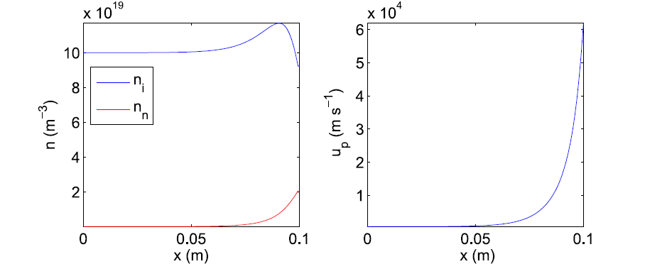




Errors at a glance
Simple case with reference solution
  kinetic equation (1D-x, 0D-v) is solved with FV at a very fine grid
  C=0; R = 0.99; T = 40 eV, 10 cm θ length
➔Why do the errors not decrease with n_{t}?
ions
neutrals
$$Γ_{n_{i},0},n_{i,0}$$
$$(1−R)Γ_{n_{i},t}$$
Upstream
$$RΓ_{n_{i},t}$$
Target
$$−Cn_{i}$$

Slide 8
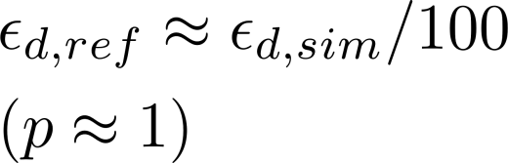
Errors at a glance
Eliminate the discretisation error by comparing with solution at coarse FV-grid for both equations
Reference grid: n_{x} = 9,900
Grid in use n_{x} = 99

Slide 9
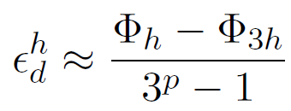
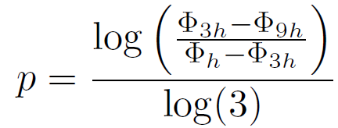
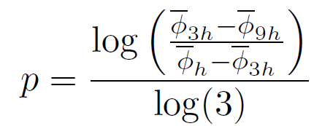
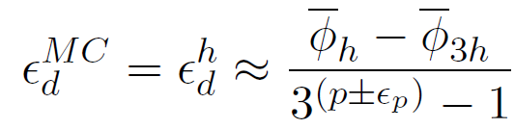



Determination of discretization errors
Use of grid refinement?
For FV-FV:
➔ Unfeasible (FV for neutral model when higher dimensions is not possible)
For FV-MC:
Possible with high number of MC particles but impractical
  In this case 10,000 particles and 500 runs used to obtain small statistical errors
  # grid cells: 11-33--99
  and
  Uncertainty ranges (rel.): for n_{i} [0.93-1.13]; u_{p} [0.83-1.22]; n_{n} [0.84-1.20]
Fast estimate: Run plasma equations with constant/scaled sources obtained from the finest grid
➔ All methods lead to same order of magnitude for

Slide 10
Errors when correlation sampling
B2/B2.5
False time stepping
Dual time stepping (nstages)
Coupling
Full Monte Carlo
MC+ Short Cycle
Robbins Monro
EIRENE
Random noise
Correlated sampling
Transient or not
Interpretation of results
One single solution vs. averaged solution
!!!!

Slide 11




Errors when Correlated Sampling (CS)
Convergence error
≈ 0
Converged up to machine accuracy, otherwise
determined from convergence rate
Correlation error
if mean of multiple CS simulations,
n_{t}: the number of MC particles
independent of n_{r} and discretization
Statistical error
with n_{r} = number of CS simulations and
the standard deviation of from 1 run

Slide 12

Error when Correlated Sampling (CS)
All error contributions can be determined
O(Δx^{p})
O($ε$_{m})
O(n_{t}⁻¹)
O(n_{t}^{-1/2}n_{r}^{-1/2})
Plasma density

Slide 13

Errors when random noise MC
B2/B2.5
False time stepping
Dual time stepping (nstages)
Coupling
Full Monte Carlo
MC+ Short Cycle
Robbins Monro
EIRENE
Random noise
Correlated sampling
Transient or not
Interpretation of results
One single solution vs. averaged solution
Too large

Slide 14
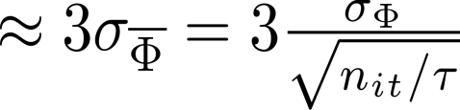


Errors when random noise MC
Convergence error
≠0
Only one timestep with relaxation is performed when random noise is renewed
Correlation error
educated guess via residuals of averaged values
~ 1/n_{t} if mean over fluctuating parameters is taken,
when convergence error is sufficient low
with n_{t}: the number of MC particles
independent of n_{it} and discretization
Statistical error
educated guess via autocorrelation functions
with :number of independent samples during iterations and the number of iterations
governing the correlation time

Slide 15
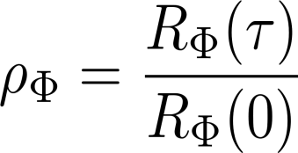
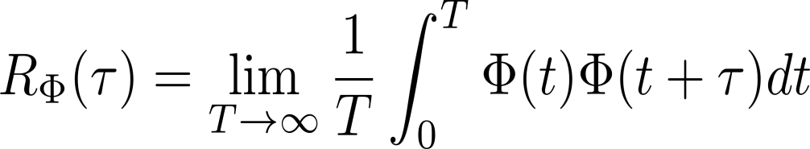


Errors when random noise MC
Autocorrelation function of the output signal is defined as:
with
CS
RN
RM
Interpretation:
RN makes use of more particles during a correlated time ( ↓)
RN: less MC result in independent samples ( ↓ ↑)

Slide 16
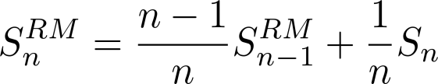
Errors when Robins-Monro (RM)
B2/B2.5
False time stepping
Dual time stepping (nstages)
Coupling
Full Monte Carlo
MC+ Short Cycle
Robbins Monro
EIRENE
Random noise
Correlated sampling
Transient or not
Interpretation of results
One single solution vs. averaged solution
The final state is taken as solution

Slide 17
Errors when Robbins-Monro (RM)
Convergence error
≠0
Only one timestep with relaxation is performed when random noise is renewed and averaged by RM
Correlation error
educated guess via residuals of averaged values?
~ 1/n_{t} if mean over fluctuating parameters is taken,
when convergence error is sufficient low
with n_{t}: the number of MC particles
independent of n_{it} and discretization?
➔ Very low value due to huge damping
Statistical error
? not yet interpreted!
The error contributions are not yet fully understood

Slide 18
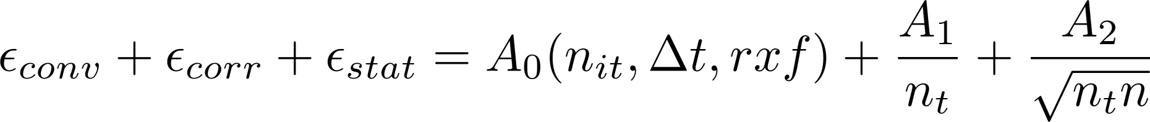



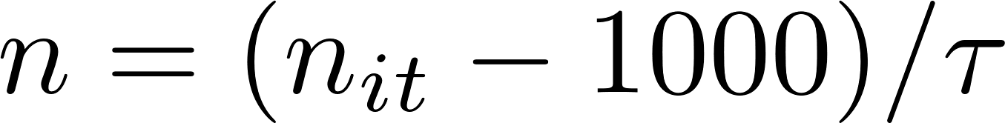
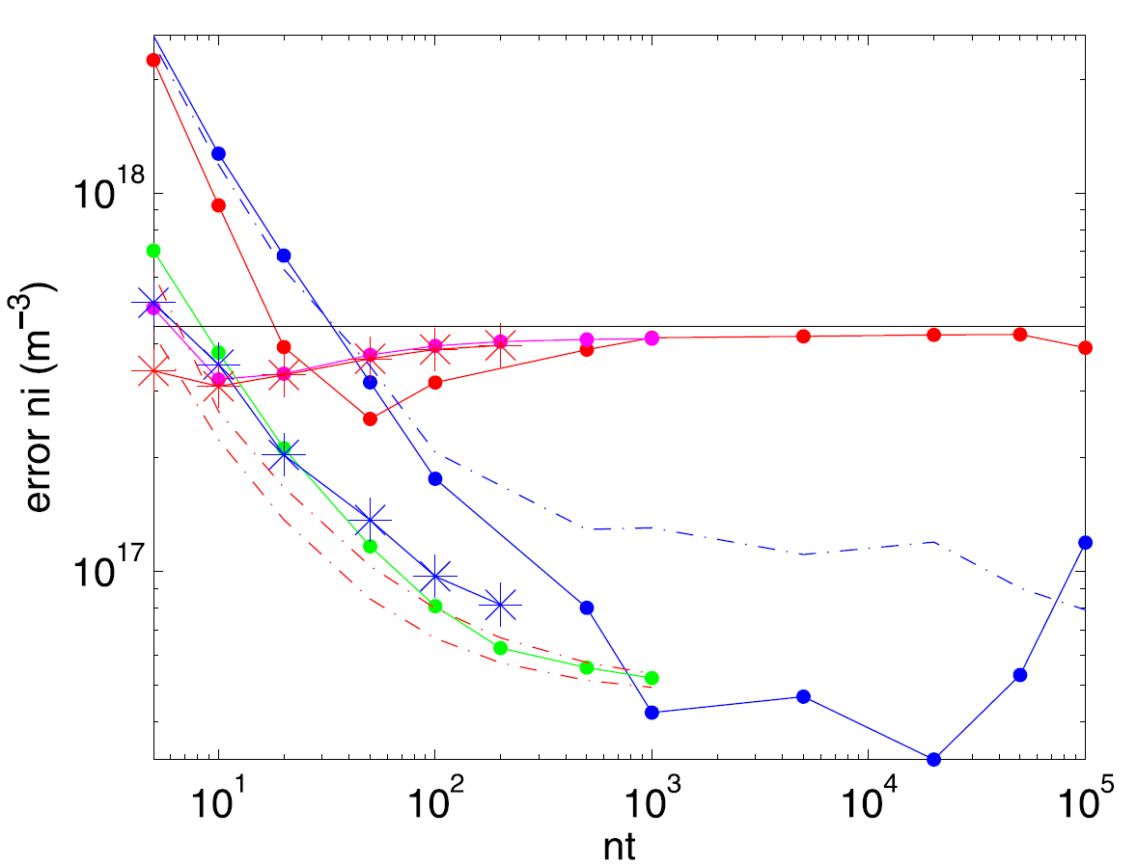
Conclusions
The numerical error, excluding the discretization error, can be written as:
For CS these contributions can be estimated ( )
For RN we can apply an educated guess (two lines: ; )
For RM no procedure (yet)
                ➔ measures can be taken
                now to optimize numerical parameters
CS
RM*
RN

Slide 19
First applications of error assessment and speed-up
Optimal numerical parameters for 1D case
Error assessment for B2-EIRENE test case

Slide 20
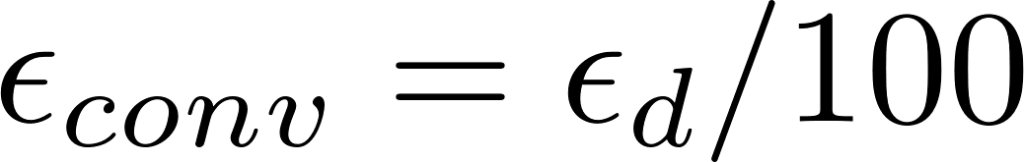
Optimal CPU-error performance
CS: machine accuracy is not required
Convergence error at it is:
For this case (use of simple SC):
only 5 MC needed for convergence to

Slide 21
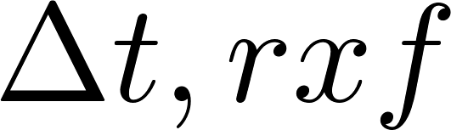

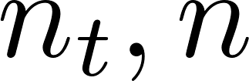
Optimal CPU-error performance
Take
Take ➔
Find optimal values for
CPU | Error CS | nt CS | n CS | Error RN | nt RN | n RN
2e4 | 1.0e18 | 4e3 | 1 | 1.2e18 | 7 | 46
5e4 | 6.7e17 | 1e4 | 1 | 7.1e17 | 14 | 64
1e4 | 4.9e17 | 1e4 | 2 | 5.0e17 | 25 | 75
2e4 | 3.6e17 | 1e4 | 4 | 3.5e17 | 42 | 94
5e5 | 2.4e17 | 1e4 | 10 | 2.3e17 | 88 | 117
1e6 | 1.9e17 | 1e4 | 20 | 1.7e17 | 147 | 145
2e6 | 1.5e17 | 1e4 | 40 | 1.3e17 | 259 | 168
CS: n_{t,max} = 1e4 ➔ take n_{t} as high as possible
RN: first 1000 iterates cannot be used
CPU is expressed in total MC particles

Slide 22
First applications of error assessment and speed-up
Optimal numerical parameters for 1D case
Error assessment for B2-EIRENE test case

Slide 23
Error assessment with B2-EIRENE
First results from B2-EIRENE runs with CS, simple case
40 runs on each grid:
11x20, 140x28, 200x40, 400x80
# = 140,000 and 35,000
10 cm
target
10 m
Plasma flow
wall
recycling
Plasma
core
B
Major radius = 2-6 m
Well enough converged?
from 40 test, more than 30 converged to machine accuracy, 10 other excluded
target

Slide 24
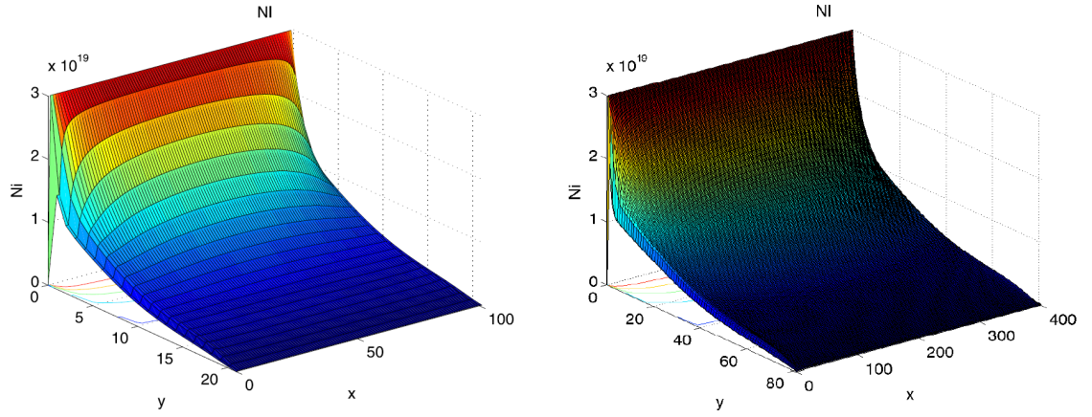
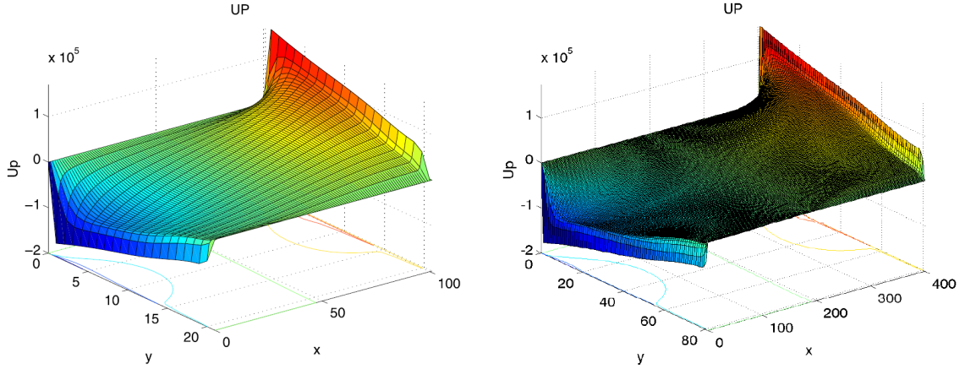
Error assessment with B2-EIRENE
First results from B2-EIRENE runs with CS, simple case
Status:
enough correlated runs
not yet accurate order detection (p)
target with R = 0.3
n_{i}
10 cm
10 m
Plasma flow
wall
recycling
Plasma
core
u_{p}
B
Major radius = 2-6 m
(distance to torus center)
target with R = 0.3
100x20
400x80

Slide 25
Additional improvements
Neutral velocity based short cycle
Residual-based time-stepping

Slide 26
Neutral velocity based short cycle model
Use of more advanced short cycle (keeping v_{n} constant)
First results indicate even smoother convergence
A certain critical SC number is reached for convergence
To be further test in B2-EIRENE
1D test case

Slide 27
Residual-based time-stepping
Use of residual-based time-stepping during SC?
B2-EIRENE test case
Once the convergence is exp. the speed-up is very strong
Constant time step
Time step ~ 1/Res when Res < 1e-3

Slide 28
Towards more ITER-relevant cases
Test cases and strategy
1D OSM-ITER

Slide 29
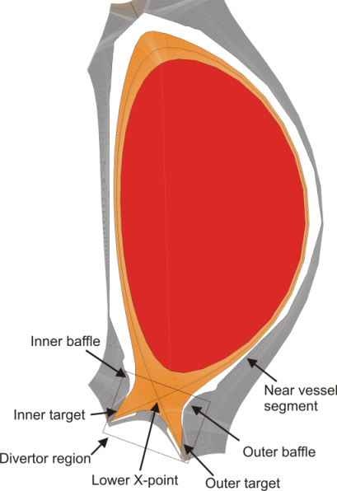
Test cases and strategy
10 cm
target
10 m
Plasma flow
ions
neutrals
wall
recycling
Plasma
core
$$Γ_{n_{i},0},n_{i,0}$$
$$RΓ_{n_{i},t}$$
$$(1−R)Γ_{n_{i},t}$$
Upstream
$$−Cn_{i}$$
Target
B
Major radius = 2-6 m
TOY PROBLEM
1D-x & 0D/1D-v
SLAB
B2-EIRENE
2D-x & 3D-v
target
ITER
ITER 2011
OSM
1D-x & 1D-v
ITER
B2-EIRENE
2D-x & 3D-v

Slide 30
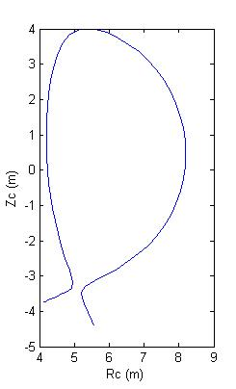
ITER 2011 - OSM
Consider 1 flux tube from a B2-EIRENE run
Fluxtube from ITER 2011
0,5 m

Slide 31



ITER 2011 - OSM
with
Start from B2-EIRENE run
Start with B2-plasma profiles for unknown quant.
  E.g. take T_{e} and T_{i} from B2-EIRENE along a flux tube
  OSM-approach: get radial transport from B2-EIRENE
  Solve only n_{i}, u_{i} and f_{n}
Essential features
  Flux tube expansion and pitch
  Gas puff, radial transport via C, pumping via R
  Atomic processes via T

Slide 32
ITER 2011 - OSM
B2-EIRENE used to find n_{i} and u_{p} in 1D OSM case
next step leaving sources free is in progress

Slide 33
ITER 2011 - OSM
1D model:
with S and T from B2-EIRENE on coarse and fine grid
changes in profile near target indicate profiles
are sensitive to grid refinement
exact = 6,000 cells
B2 = 9 grid cells

Slide 34
Further perspective

Slide 35
Further perspectives
Investigate the cause of convergence failure for correlated sampling in 2D test runs and study improved techniques for correlated sampling (e.g. double background, filtering techniques
Make use of error framework to further elaborate (optimize) the most favorable short-cycle and time iteration procedures in B2-EIRENE
Further explore residual based time stepping and preconditioning techniques for further code speed up
Further conduct 2 approaches towards ITER-runs

Slide 36
Questions?
or suggestions …
are welcome

Slide 37
Additional slides
Error assessment
Speed up factors
Success rate for CS
Error assessment Kristel

Slide 38
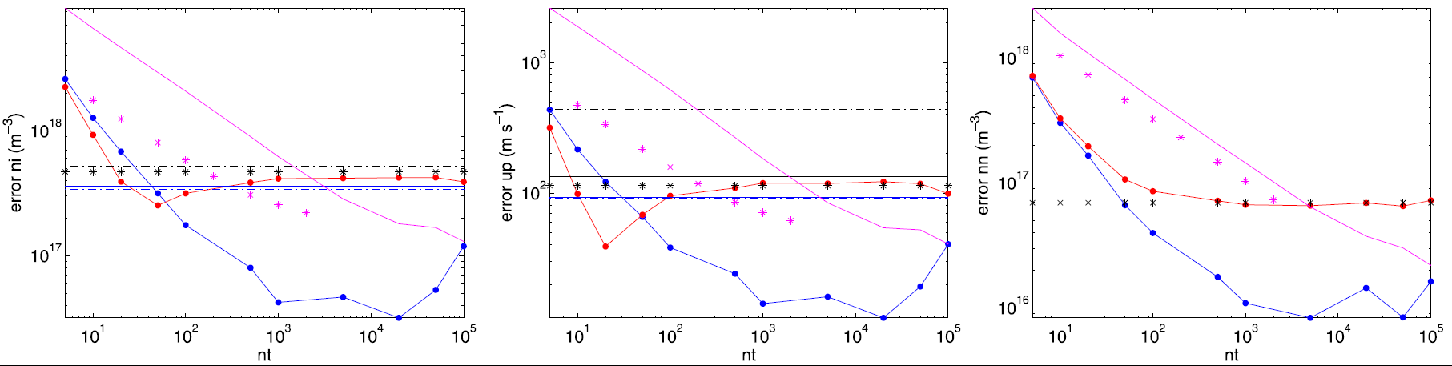
Discretization error when CS
Different estimates for discretization order lead to similar results

Slide 39
Correlation errors
Berekend op basis van residu’s en dan A-1
Plasma density Parallel velocity Neutral density

Slide 40
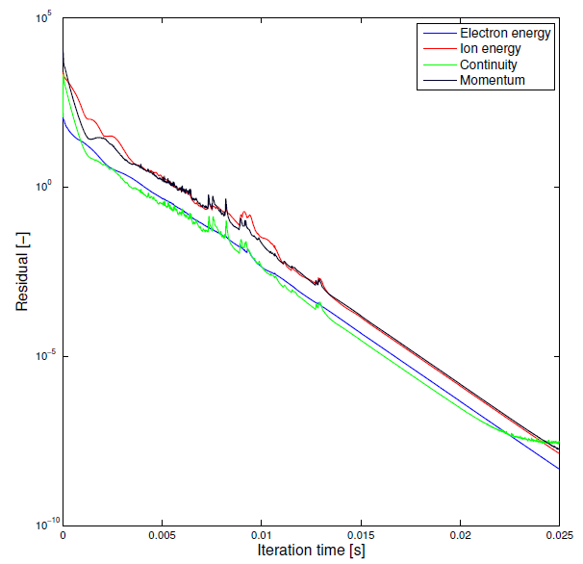
Code speed up
Assessing speed
For B2-EIRENE (here slab geometry; R=0.3)
Correlation sampling
Converged up to machine precision
Random noise
Not converged

Slide 41
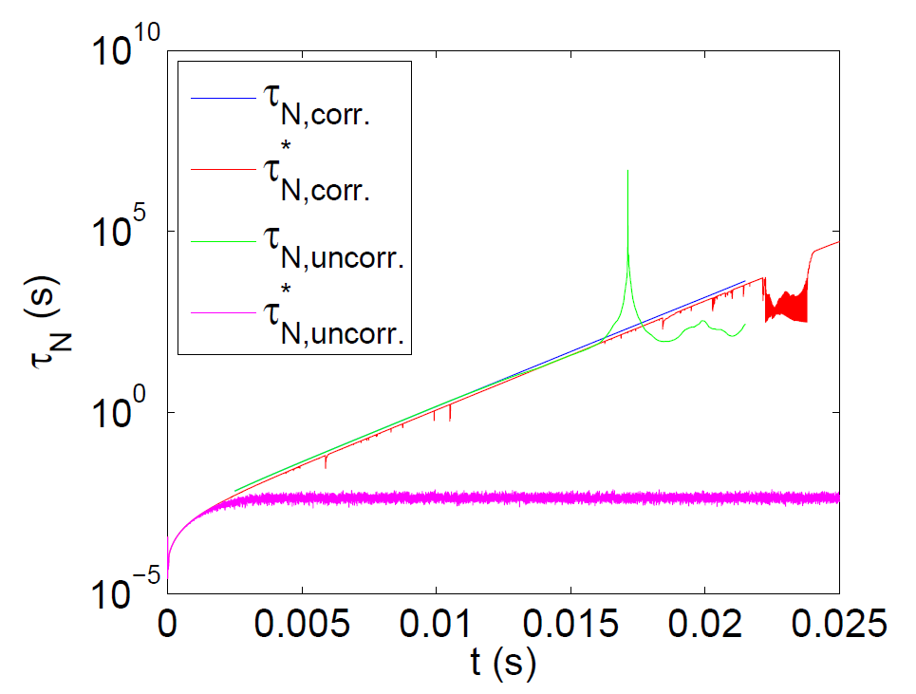
Code speed up
Assessing speed
1D model
Kukushkin’s metric behaves similar for CS and random noise
Unless accuracy gets stuck by noise

Slide 42
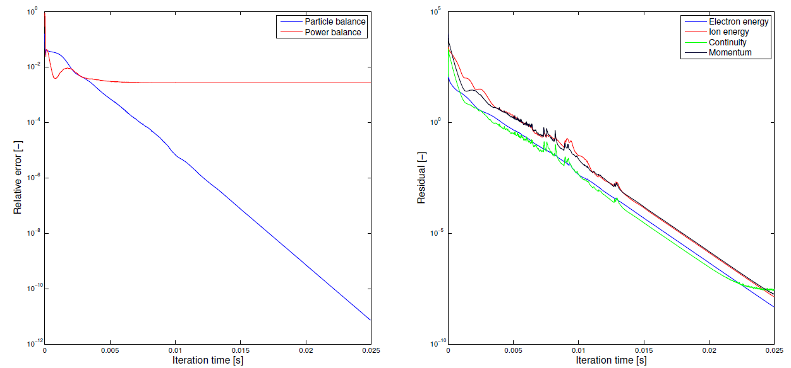
Code speed up
Assessing speed
2D test case, slab - CS
Balances for energy are problematic in this case
B2 is well-converged ➔ no balance error
EIRENE unbalance due to track length estimator

Slide 43
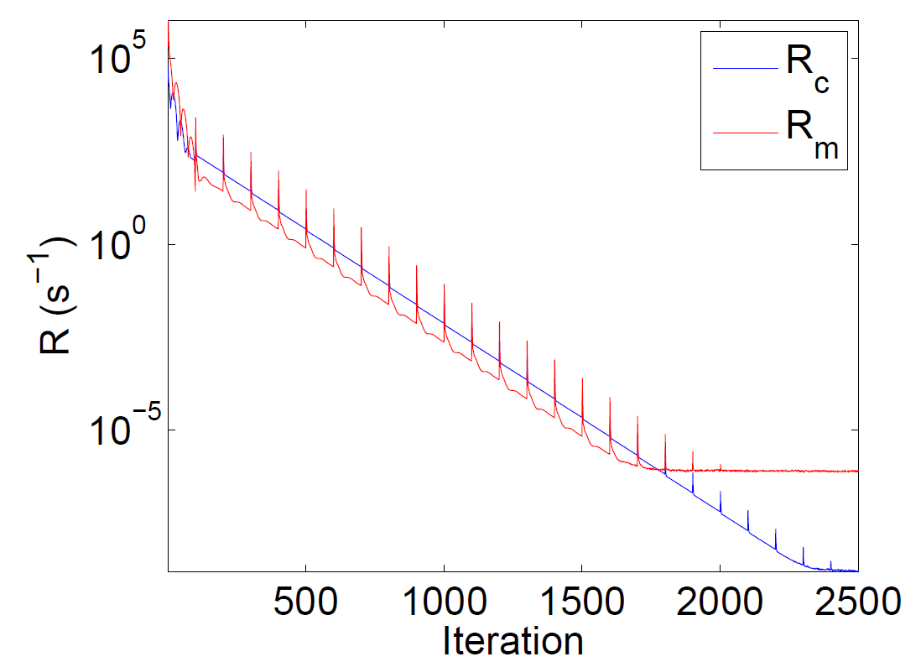
Code speed up
Assessing speed
Short cycle, similar behavior for CS and random noise
1D model

Slide 44
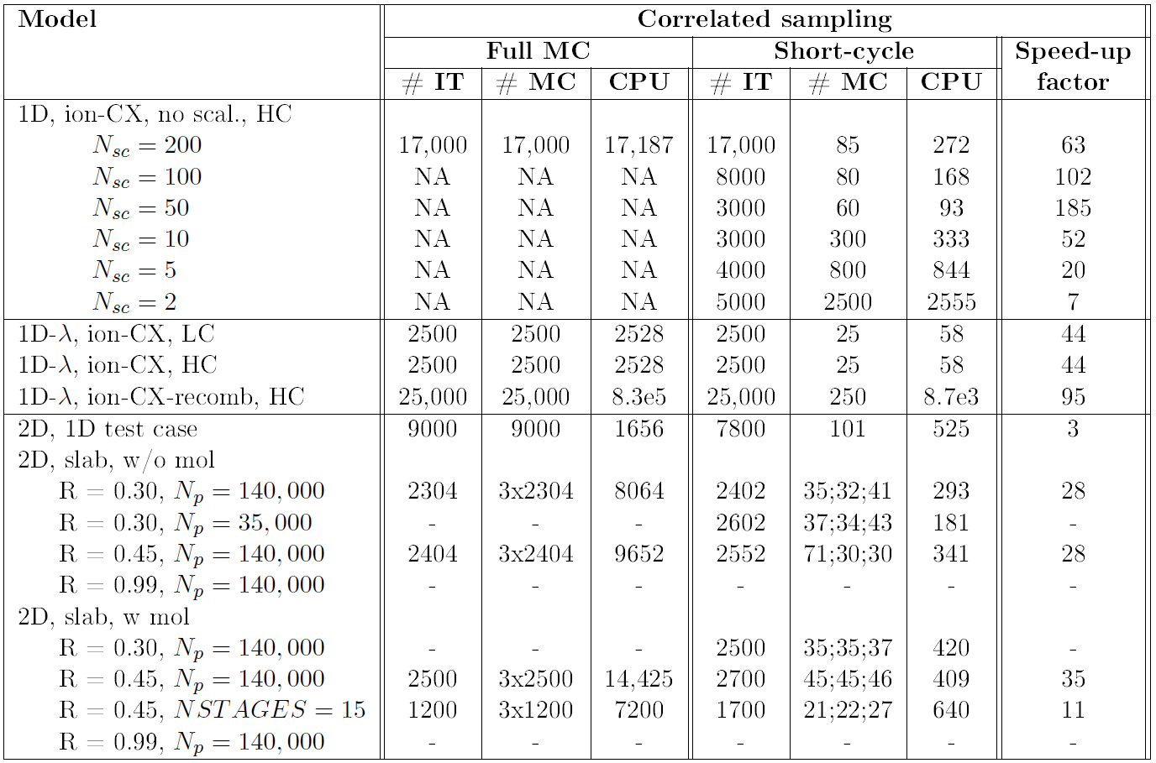
Code speed-up
Strict convergence criterion (CS only!)

Slide 45
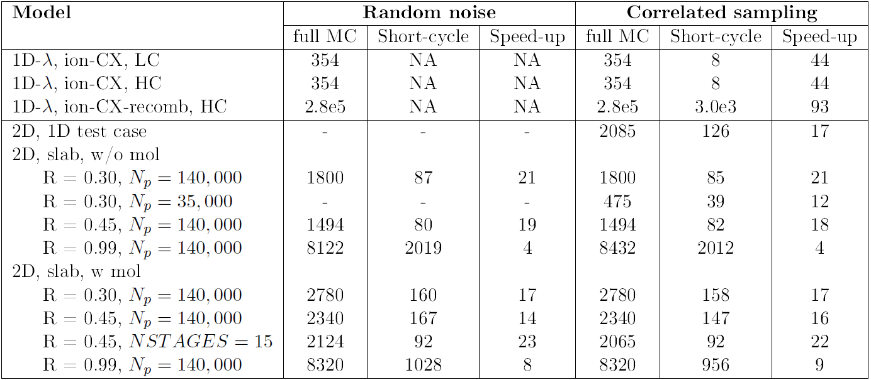
Code speed-up
Following Kukushkin’s metric

Slide 46
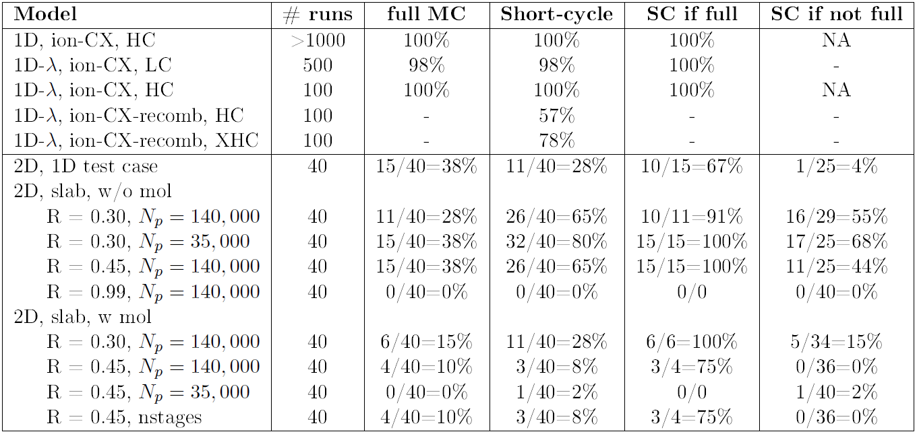
Success rate for correlated sampling
Success rate decreases with increased complexity:
Dimensionality, number of atomic processes, recycling,...
Success rate increases with increased correlation:
One seed versus all seeds fixes, fixed source sampling, (fixed trajectories?)
➔ Improved correlation techniques needed

