Slide 1







SoledGE2D-EIRENE
Contributions to SOLPS OPTIMIZATION
Y. Marandet¹, H. Bufferand², G. Ciraolo² et al.
¹ PIIM, CNRS, Aix-Marseille Université, Marseille
² IRFM/CEA

Slide 2
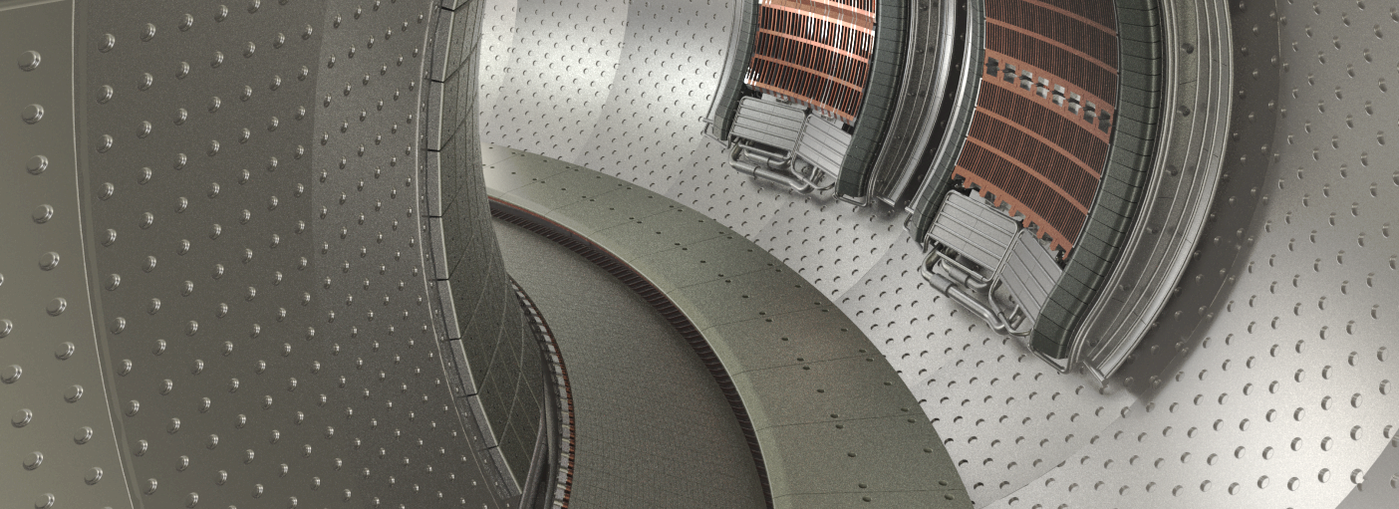
Why a new transport code ?
Need for a test bed in the context of the development of
3D turbulence codes (TOKAM3X): IRFM/M2P2
test new ideas first on a reduced model: Soledge2D
Build an in-house modelling capability for WEST
Coupling to EIRENE initiated

Slide 3
SolEdge2D Equations – pure deuterium case
Notes:
Les termes verts sont problématiques aussi Krashelninikov/Havlickova

Slide 4
Numerical aspects
Mixed explicit/implicit scheme
Parallel advection and perpendicular transport explicit
CFL condition: Δt = 10⁻⁸ s, wall clock time/step = 10 ms
100 Δt = 10⁻⁶ s in 1s wct
Discussions on optimization going on (G. Latu)
Tricks used on Soledge2D might be helpful in situation where
Δt ~ 10⁻⁷ s in SOLPS (drifts, internal iterations for particle balance)
9 points stencil
OpenMP parallelisation on domain decomposition, MPI for EIRENE

Slide 5
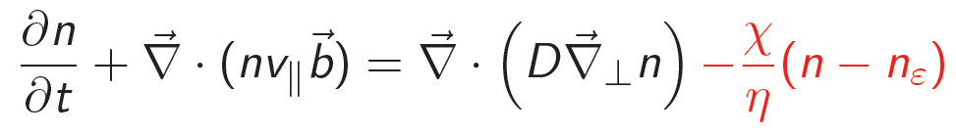
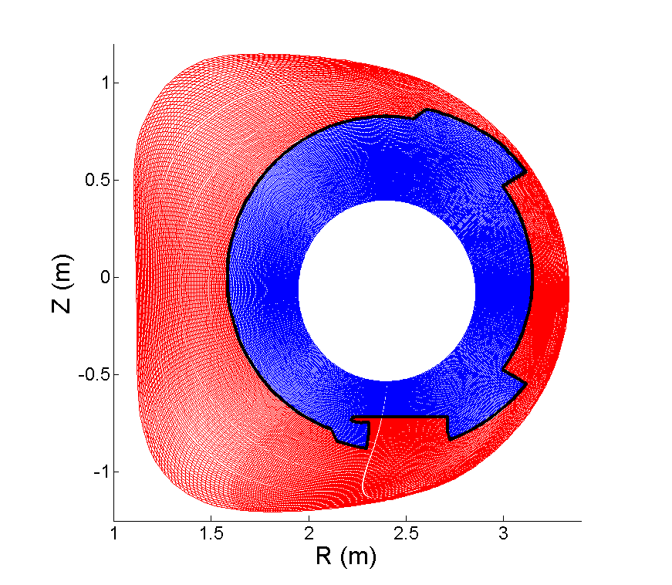
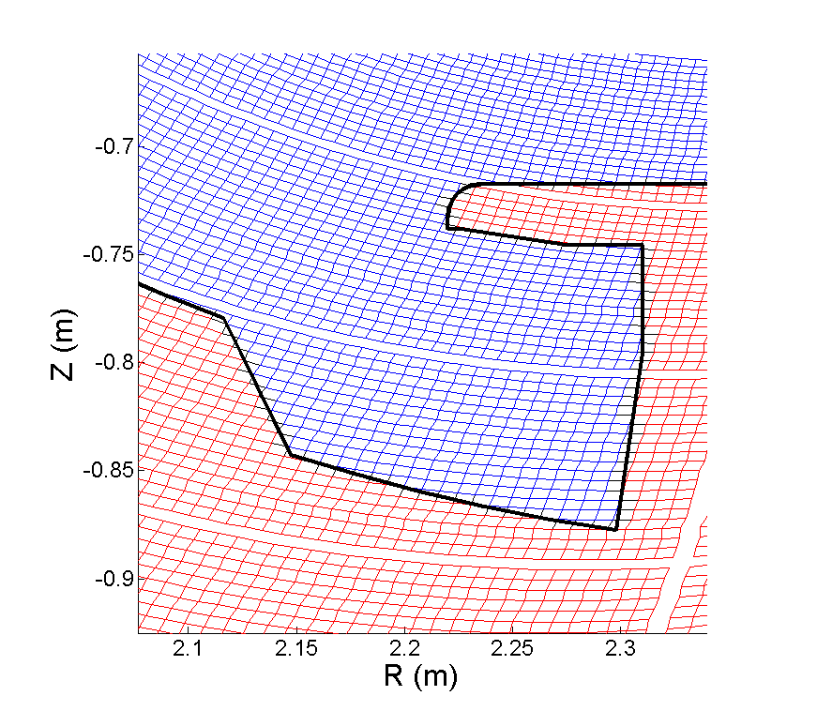
Penalization technique
A strong sink in the wall simulates plasma recombination there
η<<1
Tore Supra geometry
Plasma ( χ = 0 )
Solid ( χ = 1 )
Bohm boundary condition spontaneoulsy recovered
Now modified to be more robust (Bufferand 2015)

Slide 6
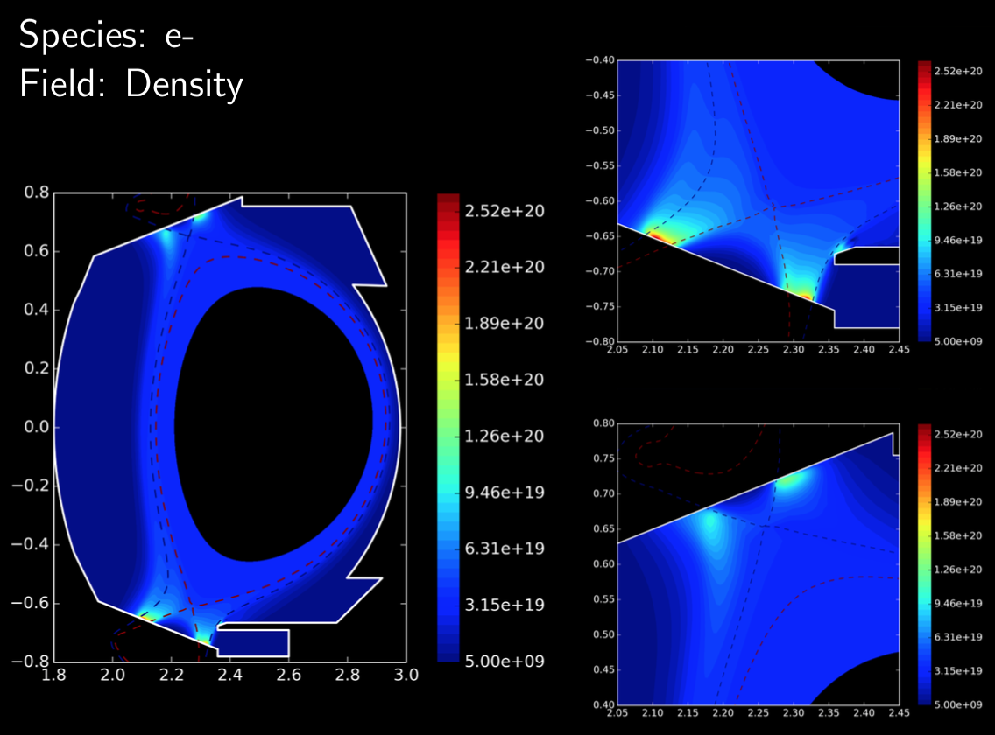
Applications of Soledge2D-EIRENE
H. Bufferand, WEST Geometry
Role of pumping
baffle

Slide 7
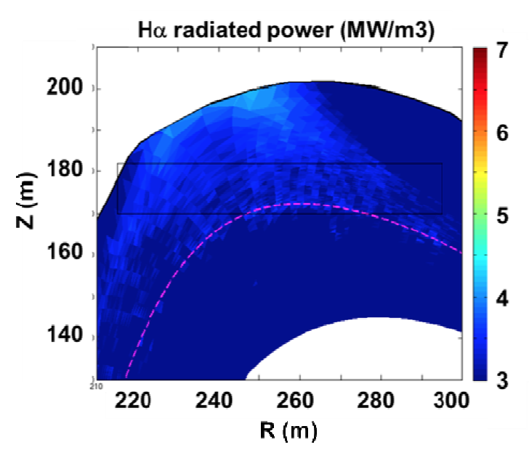
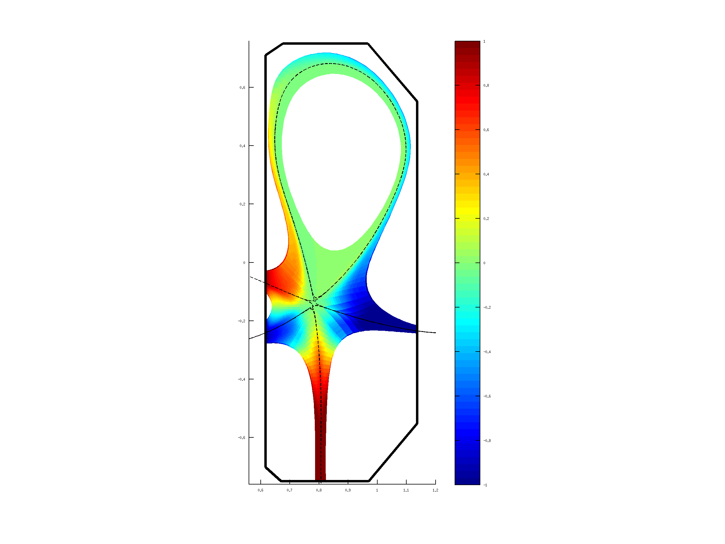
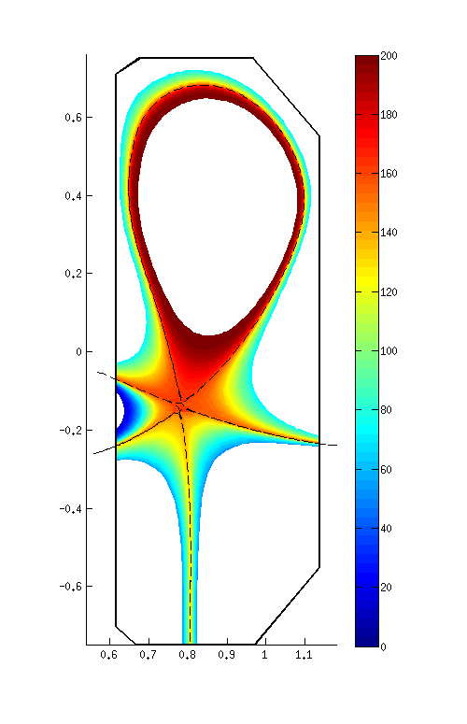
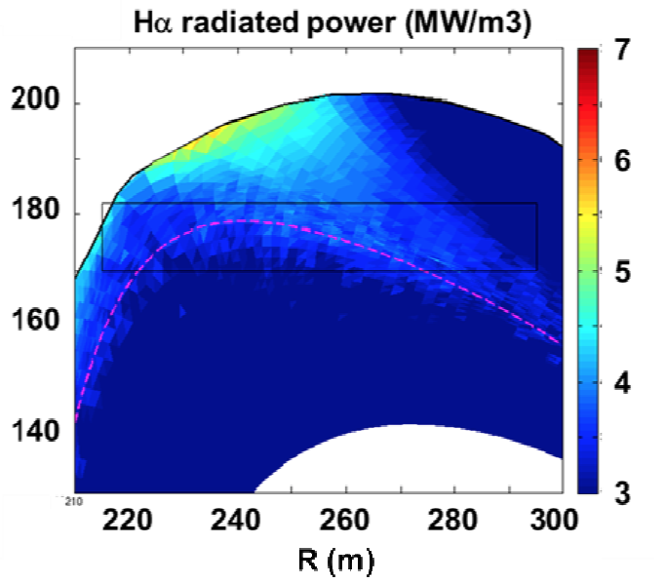
Applications of Soledge2D-EIRENE
TCV snowflake
M
T_{e} (eV)
1
200
0
100
-1
0
Analysis of JET hybrid scenarios
Proof of principle only
(E. Joffrin et al., EPS 2014)
Notes:
SF+

Slide 8
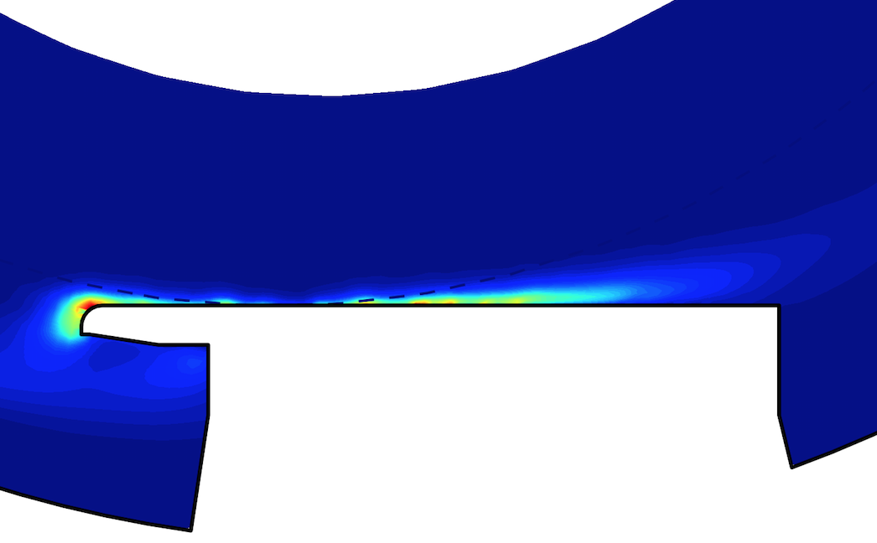
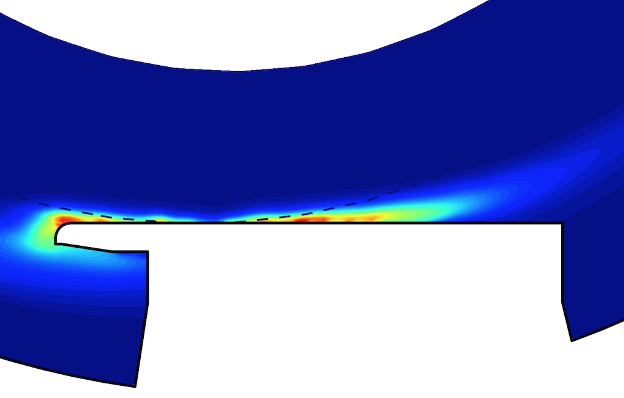
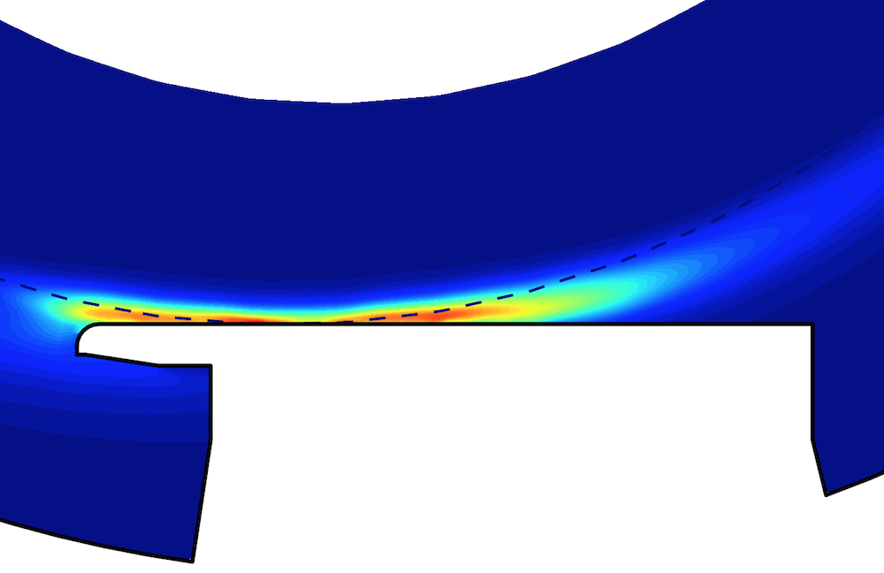
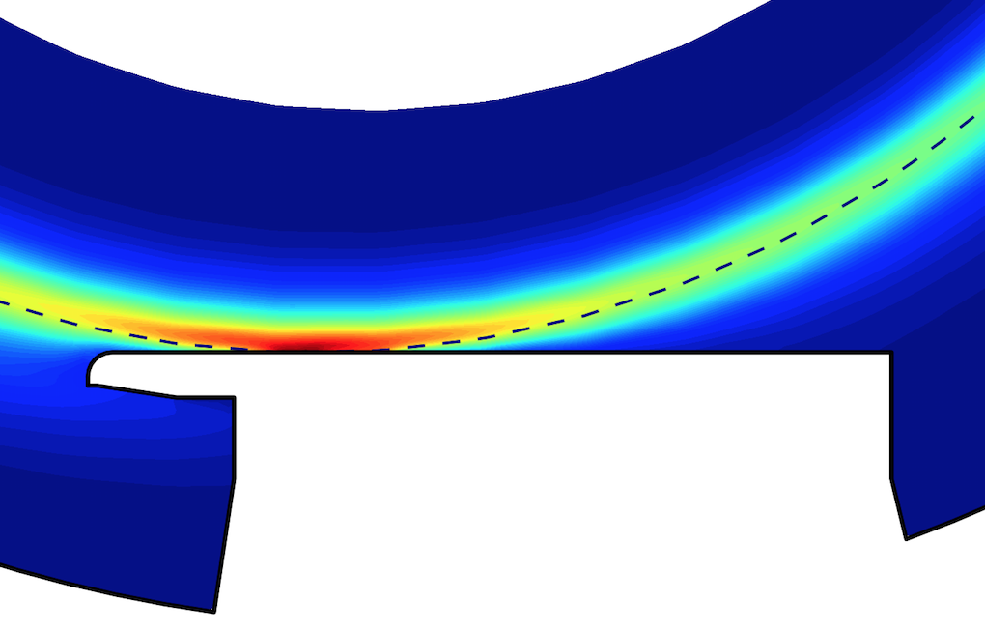
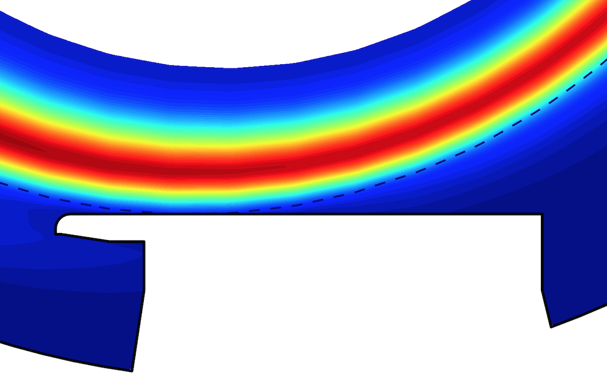
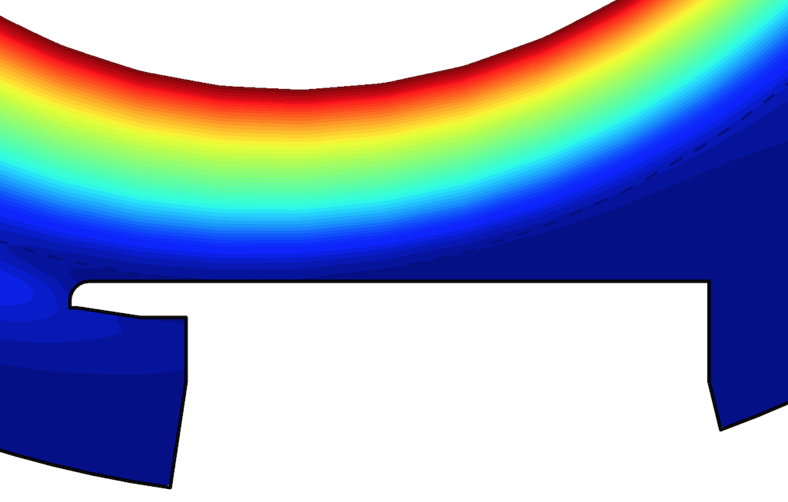
Recent developements: impurities
Solving for n_{α}, u_{α} and T_{α} for each ionization stage
Proper fluid closure for multi-species plasmas ?
Tore Supra case, focus on the toroidal pumped limiter
C⁺
C²⁺
C³⁺
C⁴⁺
C⁵⁺
C⁶⁺
Parallelisation strategies under discussion (on species) …

Slide 9
Speeding up rate coefficients calculations
Multivariate polynomial regression on ADAS data
8x9/2 = 36 terms < 81 from Janev
C_{ij} given together with fitting range, restricted to this range
Not an issue as long as it is not widely distributed …
Done at every time step for every ions, so computation time
critical here. In SOLPS context, reduce EIRENE overheads ?

Slide 10
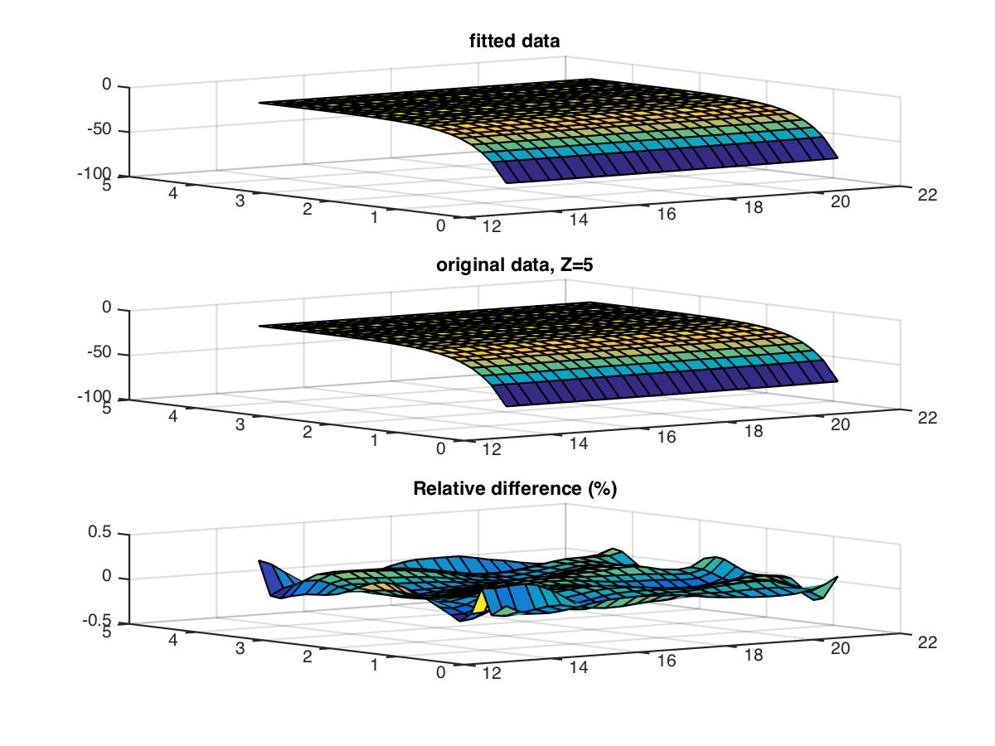
Examples of fitting

Slide 11
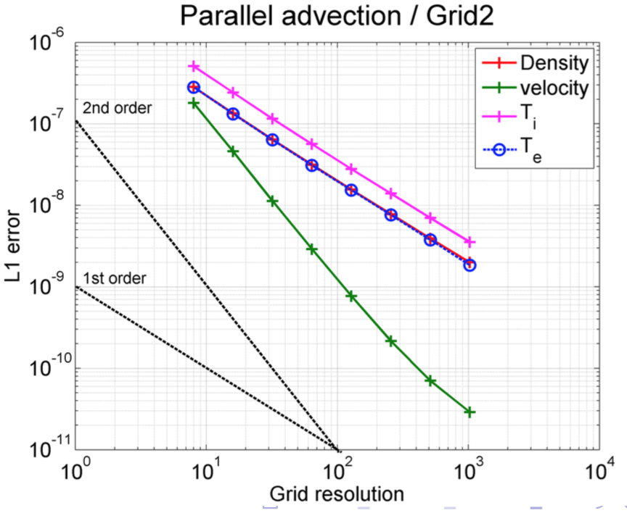
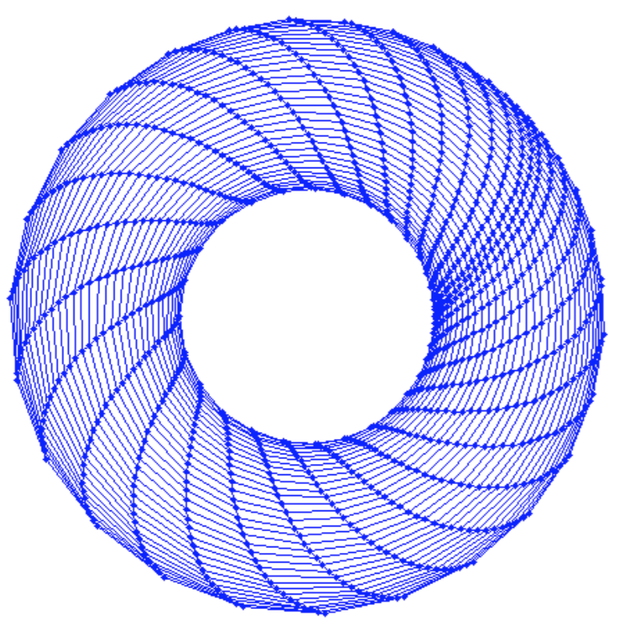
Numerical verification
How to make sure that a complex numerical code :
solves the equations we think it solves ?
solves them correctly ?
Answer : Method of Manufactured Solution (MMS)
Grid increasingly refined
Implementation of automated non-regression tests
Notes:
Transition : uniquement sur la partie fluide …

Slide 12
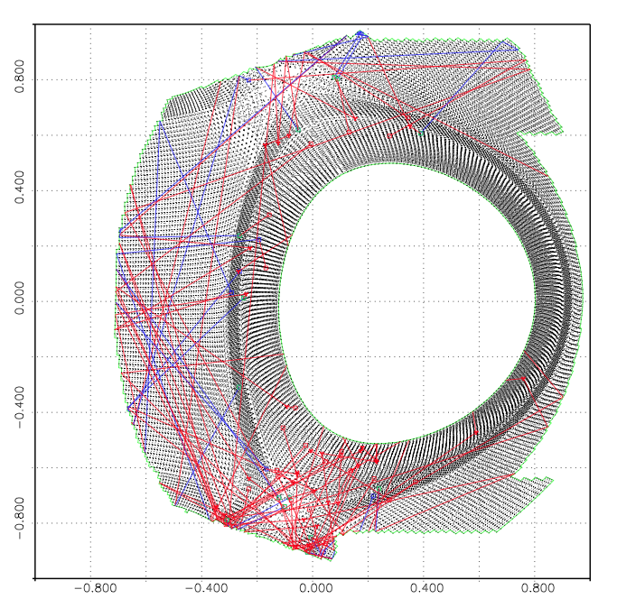
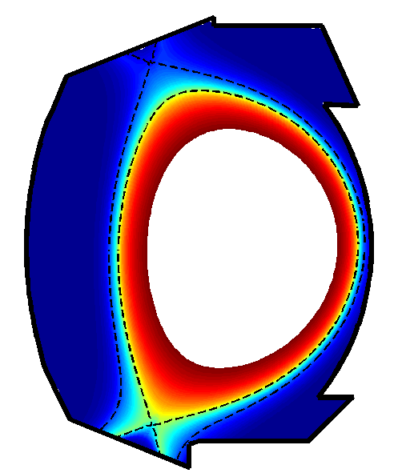
Coupling to EIRENE : general principle
Particle fluxes on the boundary
plasma parameters
Γ_{α} ,n_{α}, u_{α}, T_{α}
Soledge2D
EIRENE
SC
S_{nα}, S_{mα}, S_{Eiα}, S_{Ee}
n_{0β}, u_{0β}, T_{0β}
S_{nα}, S_{mα}, S_{Eiα}, S_{Eε}
direct coupling vs pre-averaged coupling: a powerful check
Short cycling scheme essential for code speed-up

Slide 13
Pre-averaged coupling scheme
Sources are recalculated from neutral particle density, …
Exact if velocity dependance of rate coefficients is neglected
Enforced in this mode to avoid consistency issues
Used in between calls to EIRENE

Slide 14
Available short cycling modes
Rescale n₀ according to particle flux evolution (stratum
wise, so usually for recycling stratum only)
Recalculate the sources periodically, no linearization.
Experience from the simulations made so far:
good stablity when calling EIRENE every 1-5x10³ Δt and
refreshing sources every 20-50 Δt.
Call to EIRENE every Δt_{E}=10⁻⁴-10⁻³ s, i.e. wct = 10s-1min
Recombination is exact in this scheme, so problems there
should show up too …

Slide 15
Plans for 2015
Rely on the Guillemaut density ramp in JET (pure D)
Evaluate robustness of S.C. for increasingly difficult cases
using simple AM data model
Extend S.C. to cases where rate coefficient velocity dependence
is taken into account
Can these things be useful for internal iterations too ?
Drifts and currents should be functionnal early in 2015
Progress done in 2014 on the effect of noise on the solution (ER)

Slide 16
Job Market
F. Guzman looking for a job (molecular and atomic physics)
2 year post-doc position @ PIIM : neutrals in TOKAM3X
contact : yannick.marandet@univ-amu.fr
3 others 2 years positions @ IRFM
- He beam
olivier.meyer@cea.fr
- synthetic diagnostic for IR
marie-helene.aumeunier@cea.fr
- instrumented tile
yann.corre@cea.fr
Eligibility : no previous link with Aix-Marseille University

