Slide 1
GRAY
EC quasi-optical ray-tracing code
for ECRH&ECCD calculations in tokamaks
L.Figini, D. Farina
IFP-CNR, EURATOM-ENEA-CNR Assoc.
Milano,Italy

Slide 2
Physics model
Propagation of EC Gaussian beams is dealt with in the framework of the compex eikonal approximation
Gaussian beam:
wave equation solution of the form:
S(x) complex eikonal function S = S_{R} + i S_{I}
beam propagation
beam shape
λ wavelength, w beam width, L system dimension: λ << w << L
asympotic expansion wave equation -> QO cold dispersion relation has additional terms (grad S_{I}) with respect to geometric optics (GO)
coupled ray equations describing diffraction effects
Absorption coefficient computed solving either the fully of the weakly relativistic EC dispersion relation
CD efficiency computed using the adjoint method (Cohen model or momentum conservation model from Marushenko, not yet in ITM version)

Slide 3
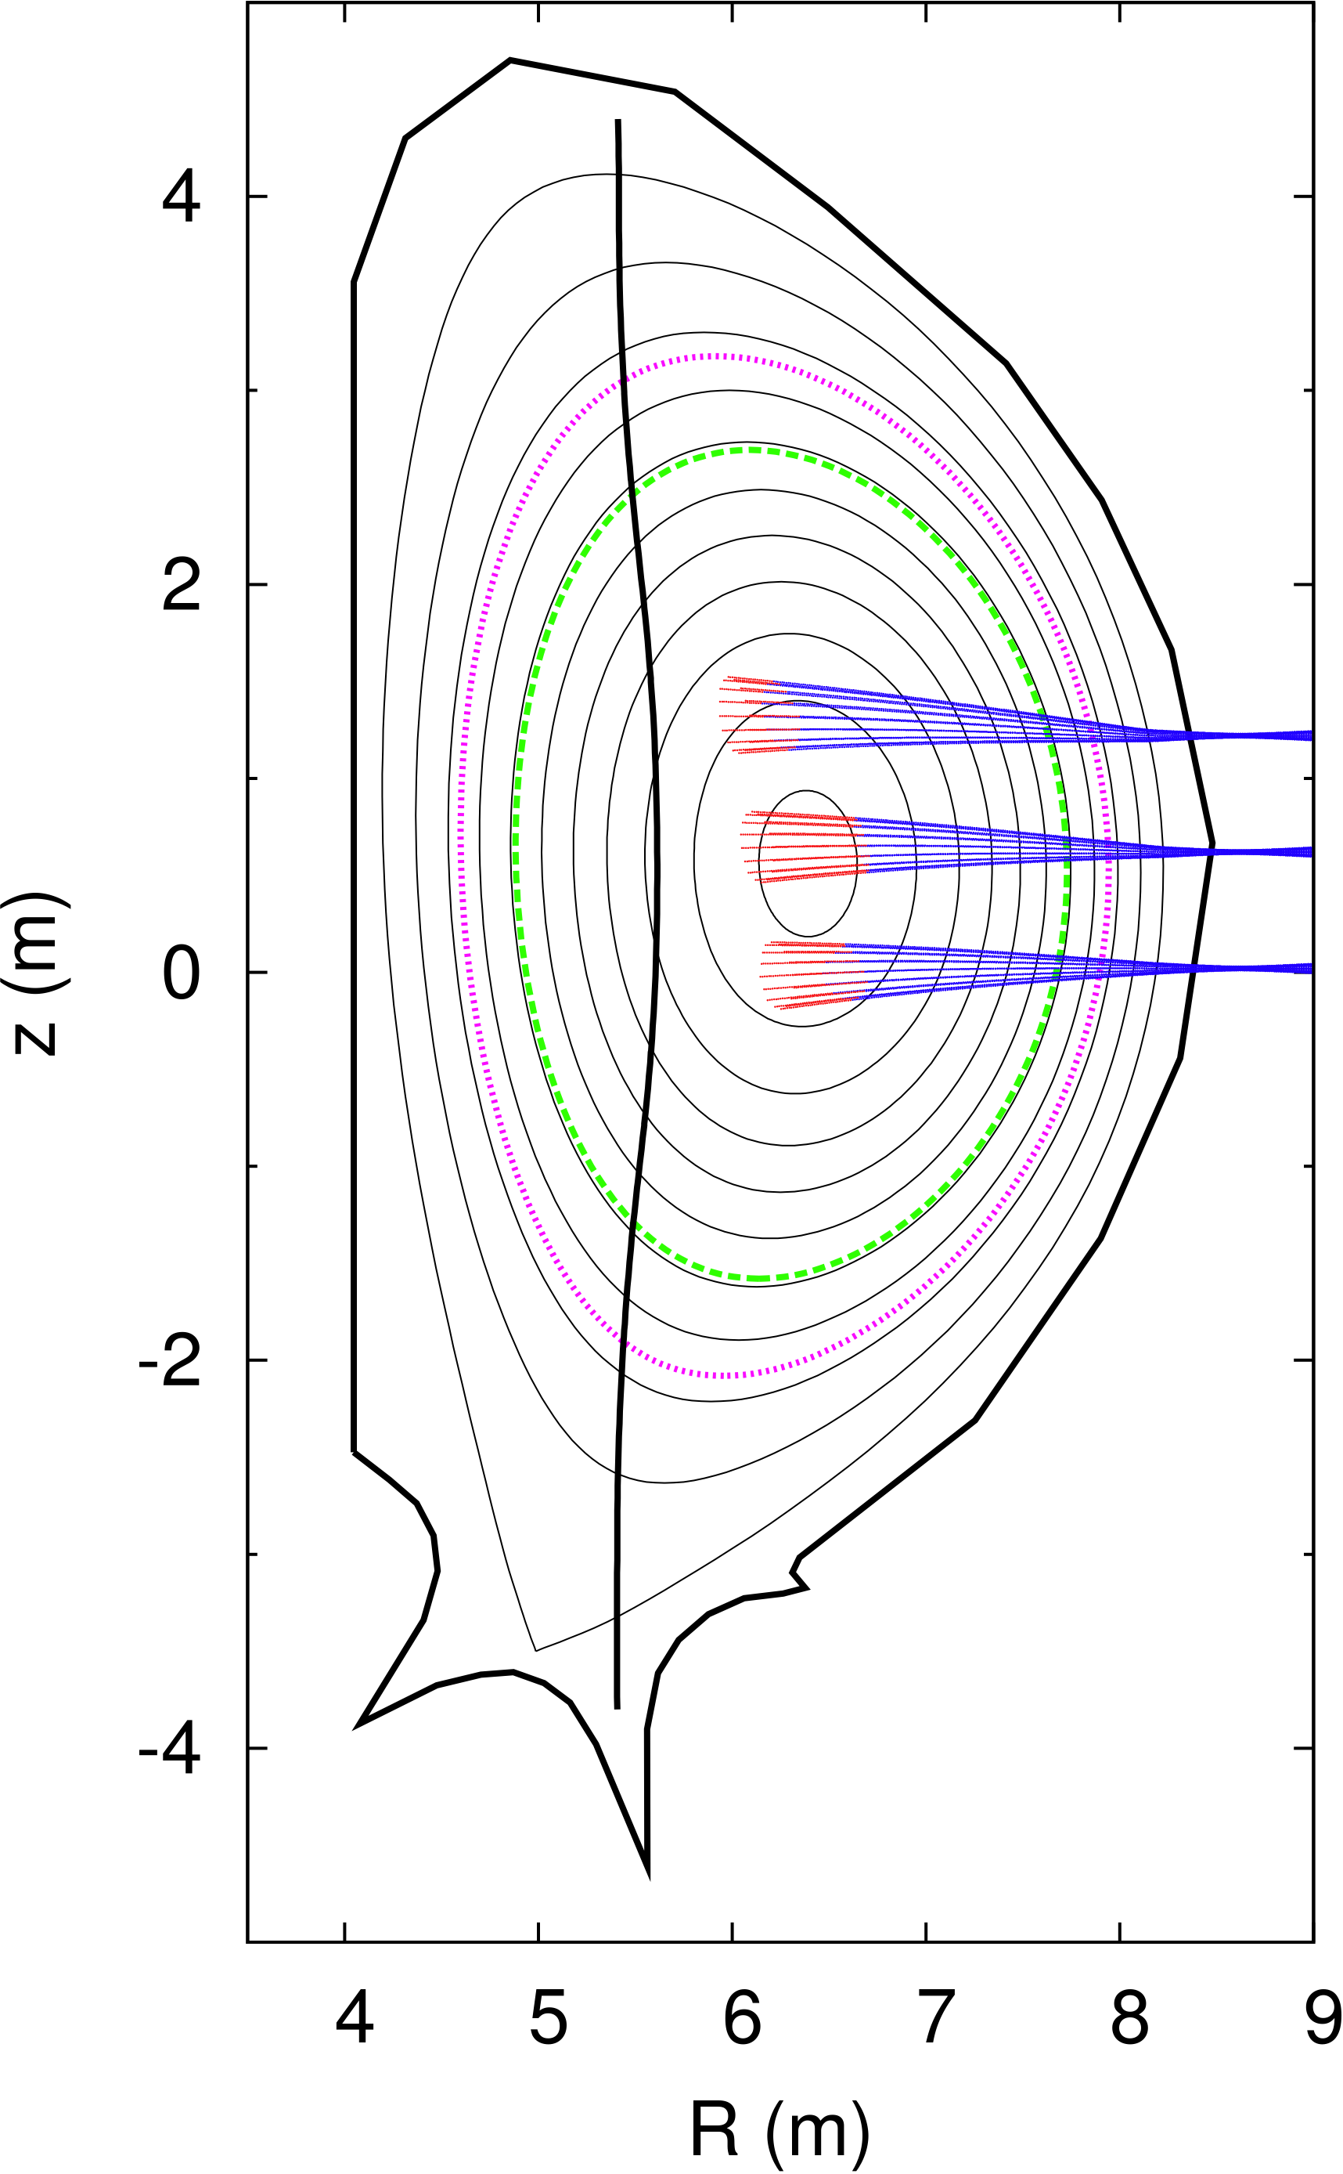
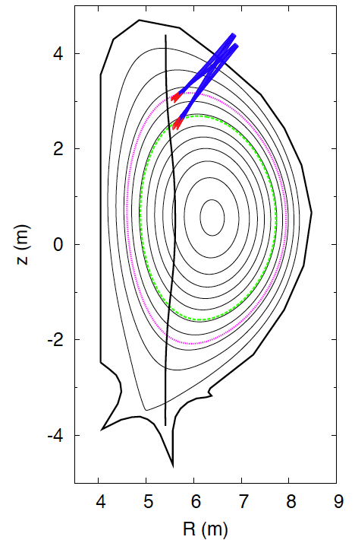
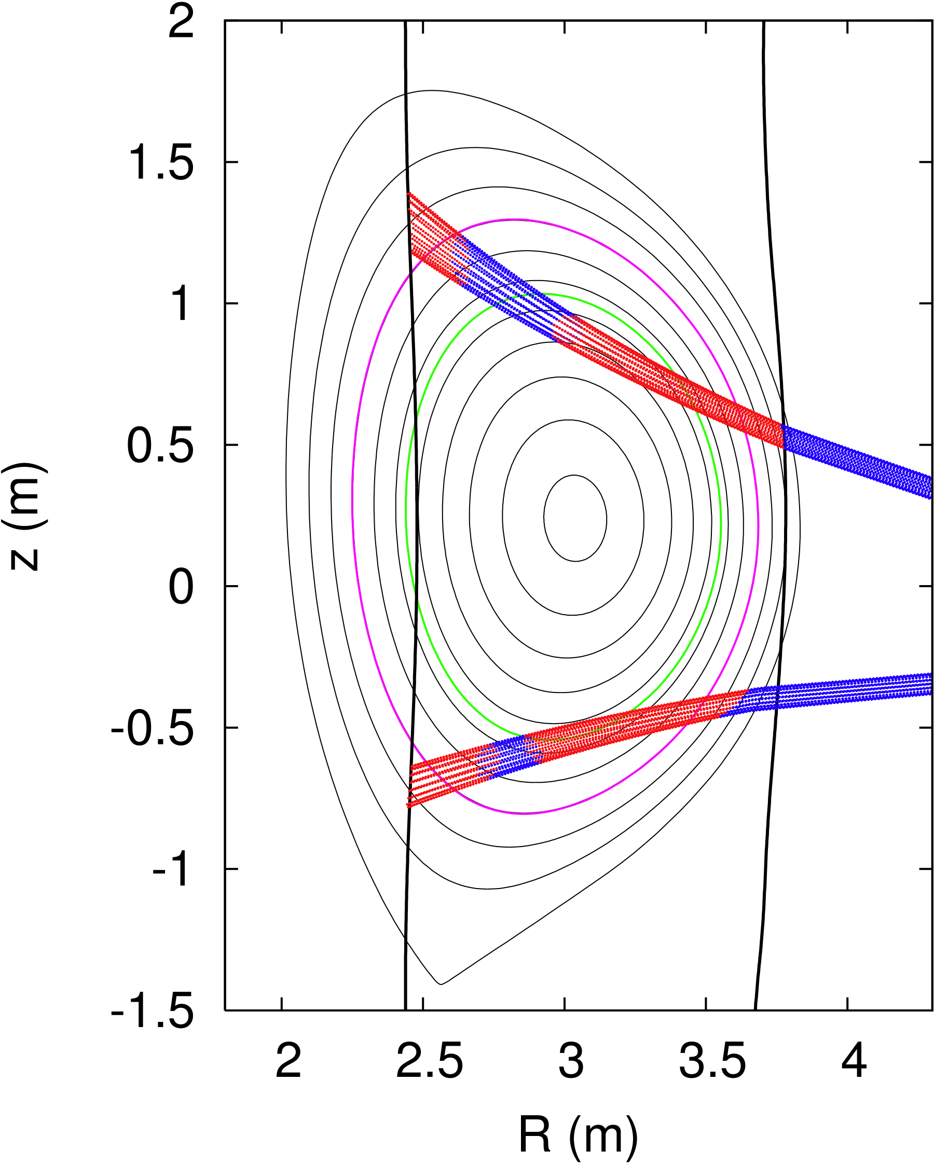
Standalone version
Fortran 77 code. Input files:
Magnetic equilibrium description (G EQDSK format)
n_{e}, T_{e}, Z_{eff} profiles
Code parameters (including initial conditions for beamtracing) and options
ITER
JET
E4J project
EC Eq. launcher
EC Upper launcher
D. Farina, L. Figini, NF 50 (2010) 095007 G. Ramponi, et al., NF 48 (2008) 054012

Slide 4
GRAY on the ITM Gateway
On the ITM Gateway:
subroutine communicating with the calling routine through CPOs (4.08a)
Input CPOs:
equilibrium
coreprof
antennas
Output CPO:
waves
code parameters stored in XML format, and passed to GRAY in a codeparam structure
Kepler actor is now available
interface
subroutine gray(equilibrium,coreprof,antenna,wave,codeparam)
use euitm_schemas
type(type_equilibrium), pointer :: equilibrium(:)
type(type_coreprof), pointer :: coreprof(:)
type(type_antennas), pointer :: antenna(:)
type(type_waves), pointer :: wave(:)
type(type_param) :: codeparam
end subroutine gray
end interface
<?xml version="1.0" encoding="UTF-8"?>
<?xml-stylesheet type="text/xsl" href="./input_gray.xsl" charset="ISO-8859-1"?>
<parameters>
<code_specific>
<i_warm> 2 </i_warm> <!-- 0=no absorption, 1=weakly rel, 2=fully rel w/ asympt expansion, 3=fully rel w/ num integration -->
<i_larm> 5 </i_larm> <!-- order of larmor expansion -->
<i_eccd> 1 </i_eccd> <!-- 0=no, 1=yes ECCD calculation -->
<i_grad> 0 </i_grad> <!-- 0=raytracing, 1=gaussian beam -->
<n_rad_ray> 11 </n_rad_ray> <!-- radial # of rays -->
<n_ang_ray> 16 </n_ang_ray> <!-- angular # of rays -->
<rho_max> 1.0 </rho_max> <!-- beam truncation radius -->
<ds> 0.1 </ds> <!-- beamtracing step (cm) -->
<n_steps> 8000 </n_steps> <!-- max # of beamtracing steps -->
</code_specific>
<output_control>
<i_rho> 1 </i_rho> <!-- profiles w/ constant 0=dpsi, 1=drhop -->
<n_proj_ec> 501 </n_proj_ec> <!-- points in EC profiles -->
<i_step_proj> 100 </i_step_proj> <!-- beam shape data density -->
<i_step_ray> 5 </i_step_ray> <!-- ray data density -->
</output_control>
<data_adjust>
<i_x_pos> 0 </i_x_pos> <!-- -1=lower, 1=upper, 0=no X-point -->
<psi_ne_bnd> 1.05 </psi_ne_bnd> <!-- density boundary -->
<spline_psi> 0.0001 </spline_psi> <!-- psi smoothing coeff -->
</data_adjust>
</parameters>
will be removed if equilibrium%eqgeometry%boundarytype and equilibrium%eqgeometry%xpts are available

Slide 5
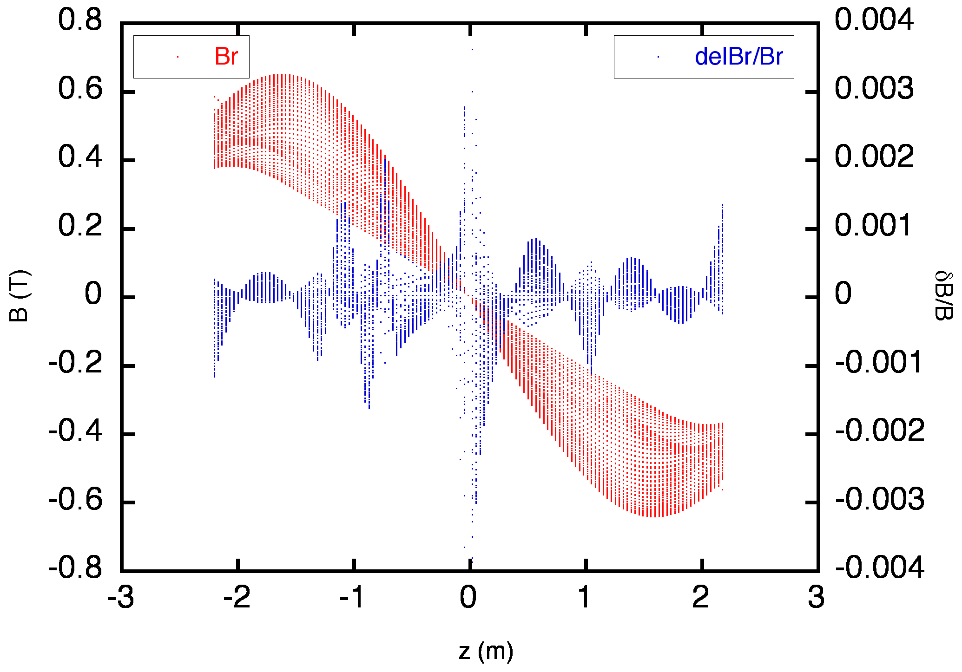
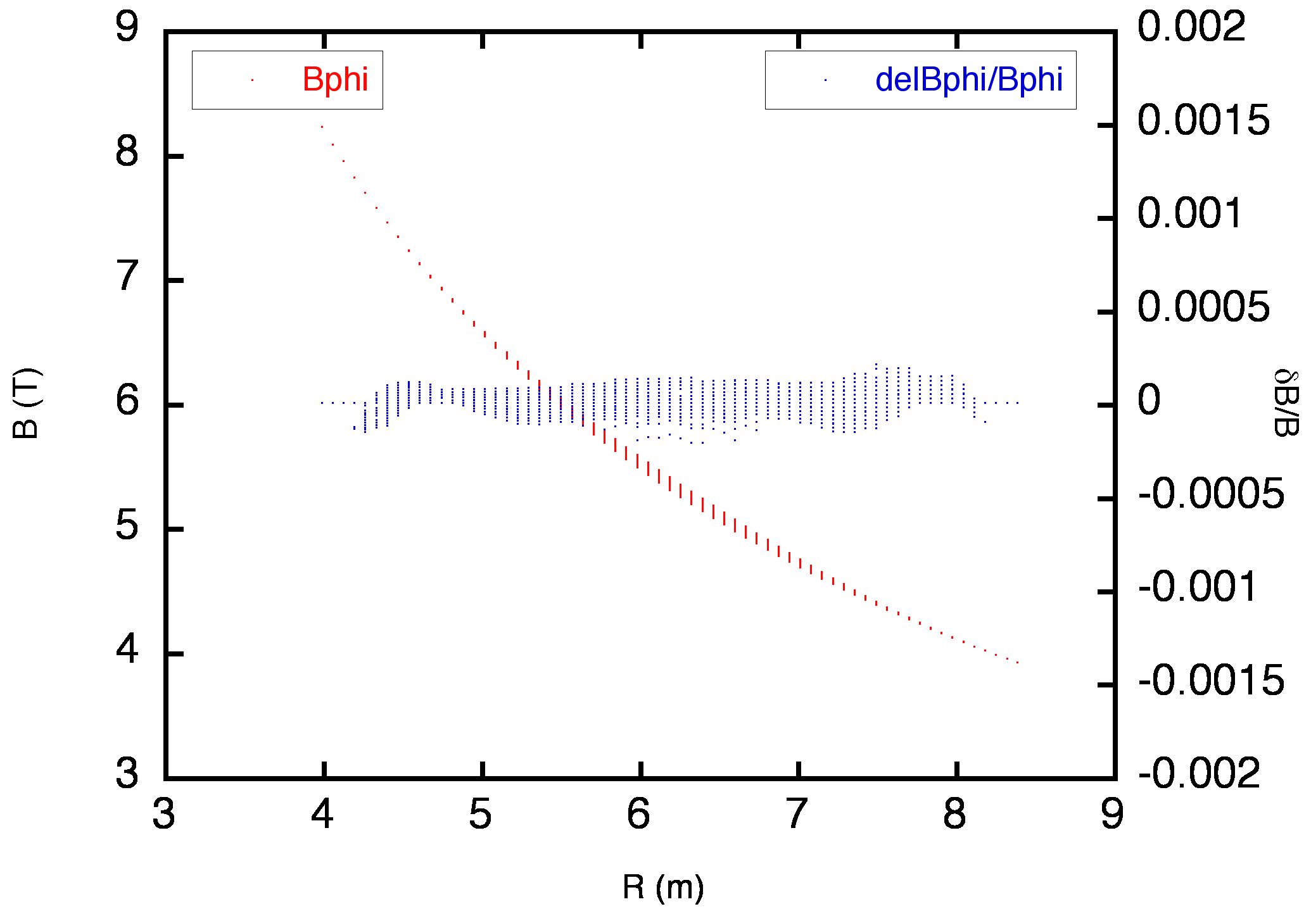
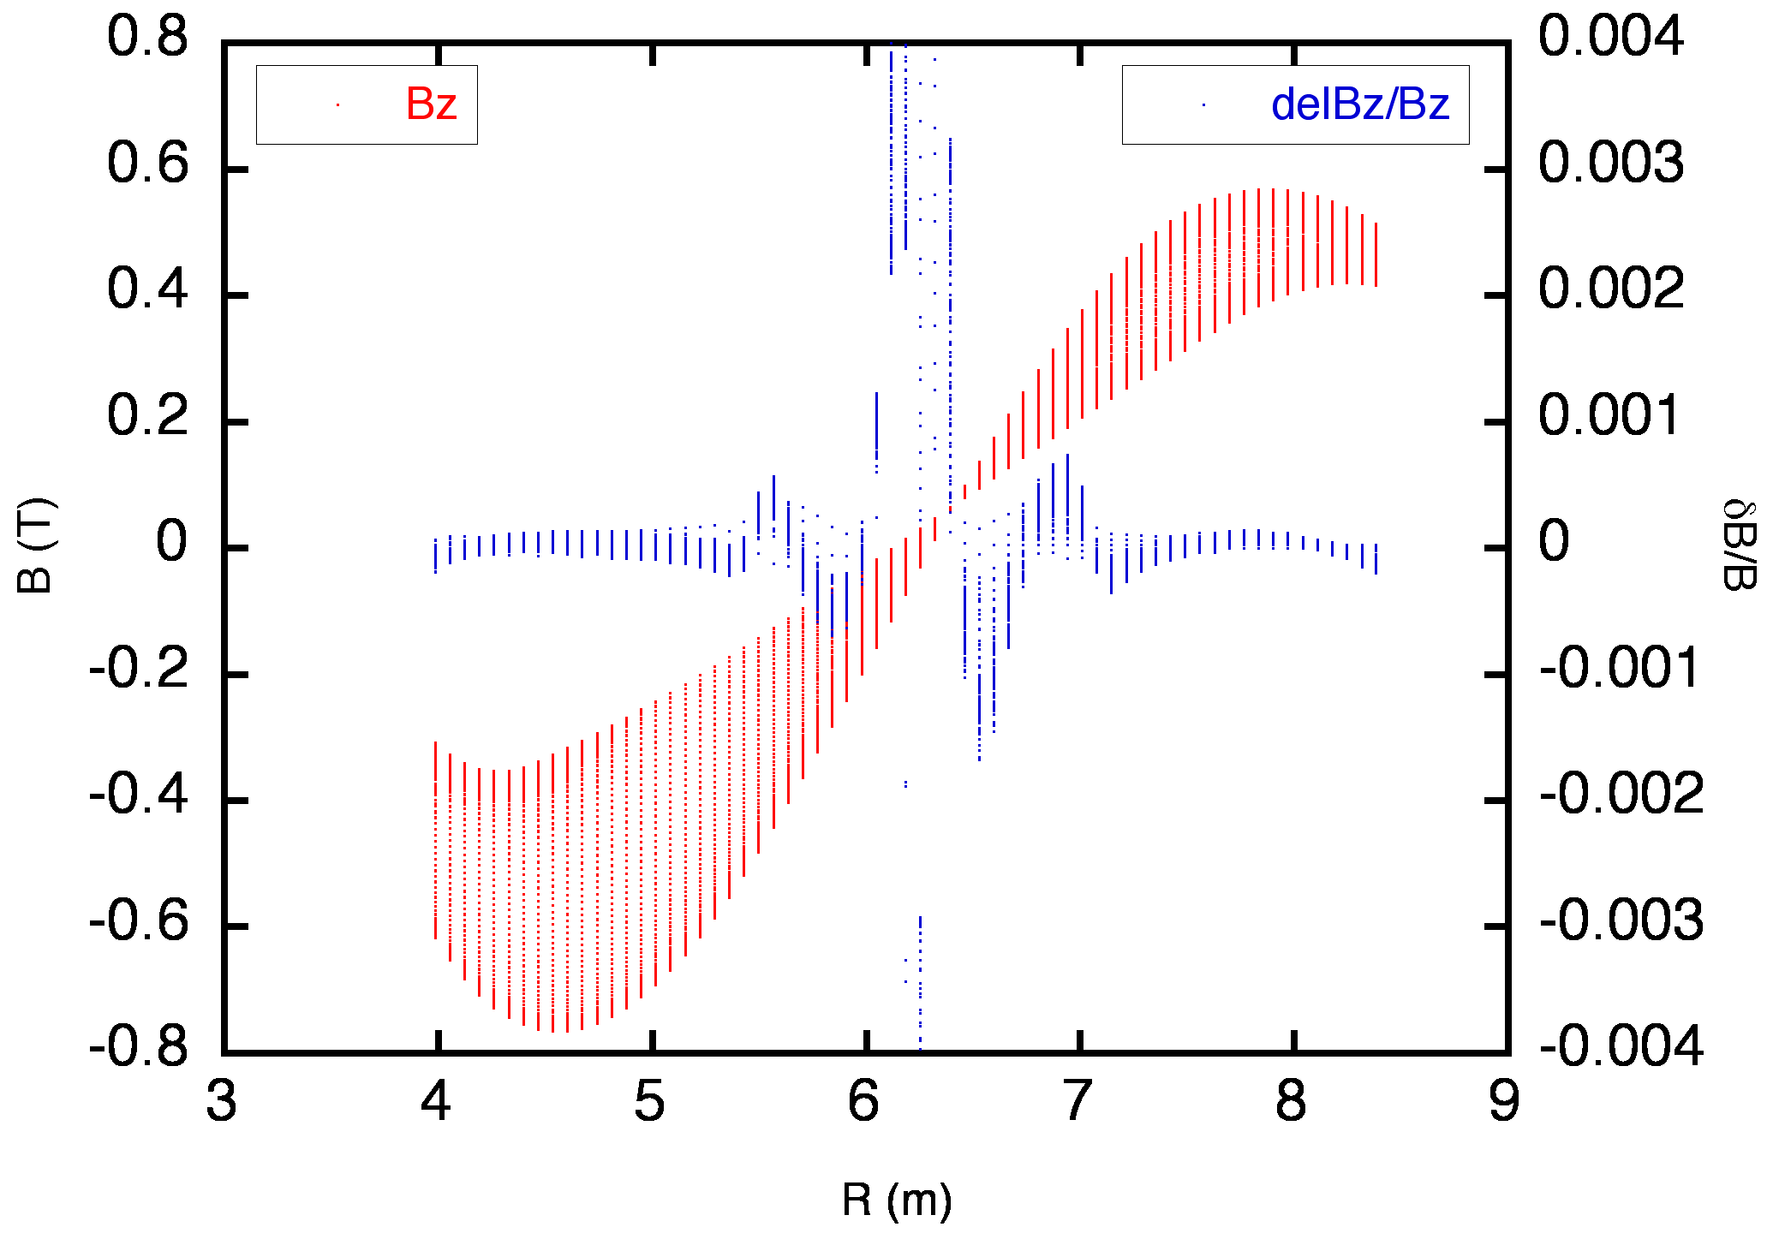
Equilibrium CPO: B components
B components are computed internally from F_{dia} and ψ derivatives:
Dierckx routines used for F_{dia} and ψ interp., and for ψ derivatives calculation
Test on shot 5/67 (Helena + equilibrium_augmenter)
Results coincide with values in equilibrium%profiles_2d%bphi, %br, %bz

Slide 6
Equilibrium CPO: extrapolation
2 types of mesh for equilibrium%profiles_2d
Rectangular coordinates (R, z).
Usually it extends outside LCFS, favourite choice for ray-tracing.
Straight field lines coordinates (ψ, χ).
More natural for fixed boundary equilibrium solvers, but it does not provide information outside LCFS.
GRAY needs a smooth transition from vacuum to plasma volume
ψ values is needed also outside LCFS
The type of mesh is guessed from psi values along grid%dim1 and emptiness of profiles_2d%position%r, %z
If straight field coordinates, grid points are considered as scattered, and an extrapolating spline is computed (Dierckx)
no constraints, same approach as equilibrium_augmenter?
Tested successfully on cases 5/64 (ψ, χ), 5/67 (R, z)

Slide 7
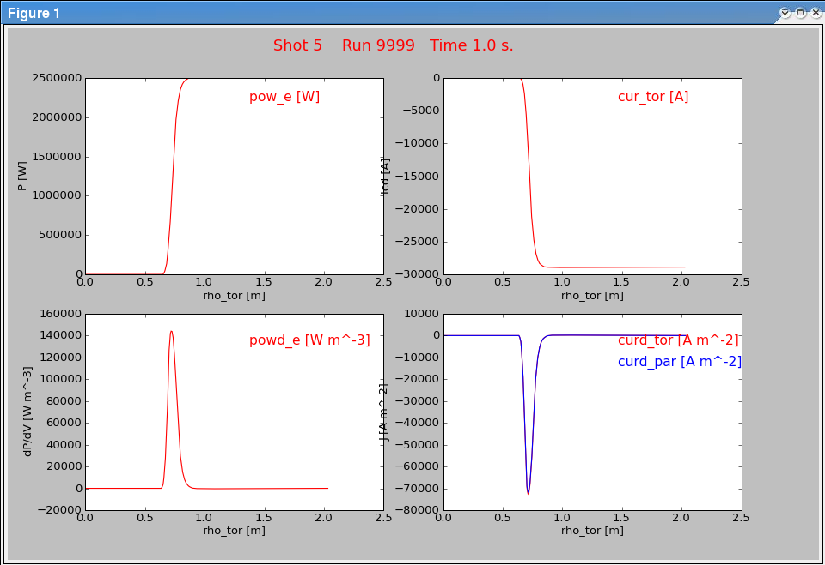
Waves CPO: current status
Power density (dP/dV) and EC driven current profiles (J_{tor}, J||) written in waves CPO (together with the corresponding integrated quantities P, I_{tor})
A module should be developed to write coresource CPO from waves

Slide 8
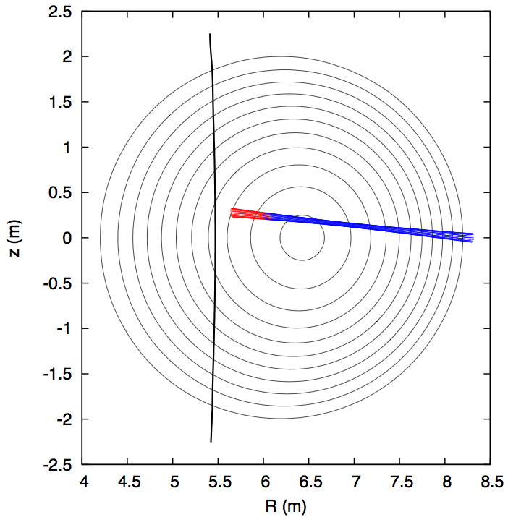
Waves CPO: still to be done
Shot 5, run 67, t=1.0s
Detailed beamtracing data still written on disk only
Beam trajectory
Evolution along the beam of
Power
Wave vector
Polarization

Slide 9
Antennas CPO
! initial wave power (MW)
p0mw = antenna%antenna_ec%power%value(iant)*1.e-6_dp
! wave frequency (Hz)
fhz = antenna%antenna_ec%frequency(iant)
! wave mode: sox=-1/+1 -> OM/XM
sox = -dble(antenna%antenna_ec%mode(iant))
! beam shape data
wxt = antenna%antenna_ec%beam%spot%waist(iant,1)*1.e2_dp
wyt = antenna%antenna_ec%beam%spot%waist(iant,2)*1.e2_dp
phiw = antenna%antenna_ec%beam%spot%angle(iant)/cvdr
rcixt = antenna%antenna_ec%beam%phaseellipse%invcurvrad(iant,1)*1.e-2_dp
rciyt = antenna%antenna_ec%beam%phaseellipse%invcurvrad(iant,2)*1.e-2_dp
phir = antenna%antenna_ec%beam%phaseellipse%angle(iant)/cvdr
! antenna position and launching angles
phi0 = antenna%antenna_ec%position%phi(iant)
r00 = antenna%antenna_ec%position%r(iant)*1.e2_dp
x00 = r00*cos(phi0)
y00 = r00*sin(phi0)
z00 = antenna%antenna_ec%position%z(iant)*1.e2_dp
alfac = antenna%antenna_ec%launchangles%alpha(iant)/cvdr
betac = antenna%antenna_ec%launchangles%beta(iant)/cvdr
An antennas CPO is needed to provide the initial conditions for the beamtracing
A complete case with an antennas CPO is not yet available
The module write_ec_ant has been built to fill the antenna_ec part of an antenna CPO
Values used to fill the CPO are read from XML file
A Kepler actor has been generated (no CPOs in, antennas CPO out)
<?xml version="1.0" encoding="UTF-8"?>
<?xml-stylesheet type="text/xsl" href="./input_gray.xsl" charset="ISO-8859-1"?>
<parameters>
<mirror>
<alpha> -5 </alpha> <!-- poloidal angle (deg) -->
<beta> 20 </beta> <!-- toroidal angle (deg) -->
<x0> 830 </x0>
<y0> 0 </y0>
<z0> 34.5 </z0> <!-- mirror coordinates (deg) -->
</mirror>
<beam>
<frequency> 170 </frequency> <!-- (GHz) -->
<power> 2.5 </power> <!-- (MW) -->
<i_mode> 1 </i_mode> <!-- 1=OM, 2=XM -->
<w0_x> 2 </w0_x>
<w0_y> 2 </w0_y> <!-- waist dimensions (cm) -->
<dist_w0_x> 160 </dist_w0_x>
<dist_w0_y> 160 </dist_w0_y> <!-- mirror-waist distance (cm), >0 towards plasma -->
<spot_rot> 0 </spot_rot> <!-- spot ellipse rotation (deg) -->
<phase_rot> 0 </phase_rot> <!-- phase ellipse rotation (deg) -->
</beam>
</parameters>

Slide 10
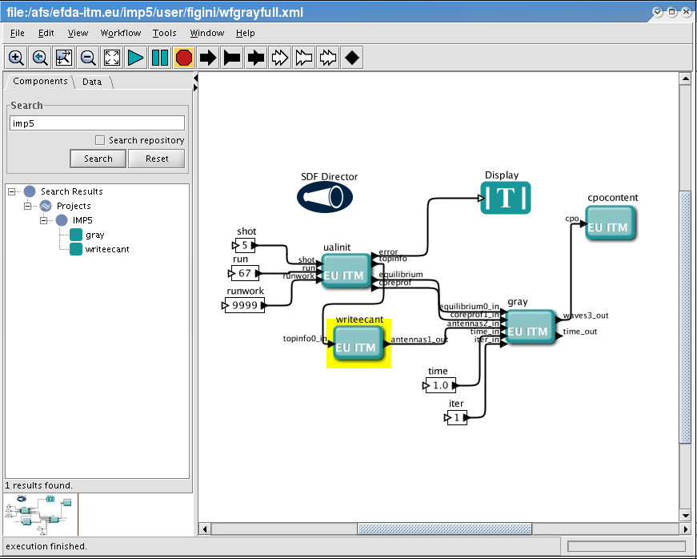
Kepler workflow

Slide 11
Benchmarking
ITM version of GRAY has been benchmarked against the original F77 version
Test case: ITER standard scenario 2
Data read from file and passed to the F77 version
Data read from file, used to fill the corresponding CPO structures and passed to the ITM version
Results match
Benchmark has started against TORBEAM beamtracing code
Test case: test machine, shot 5, run 67
Work in progress

Slide 12
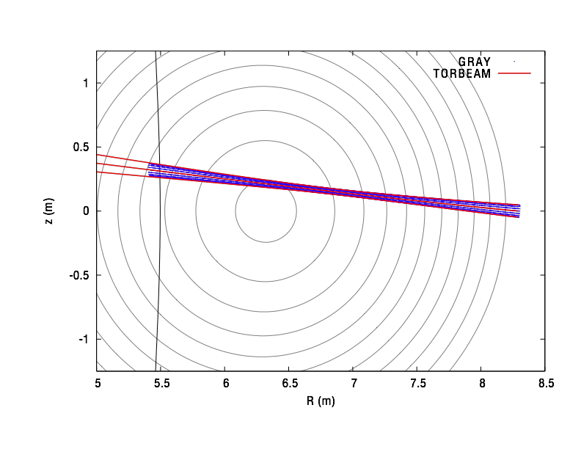
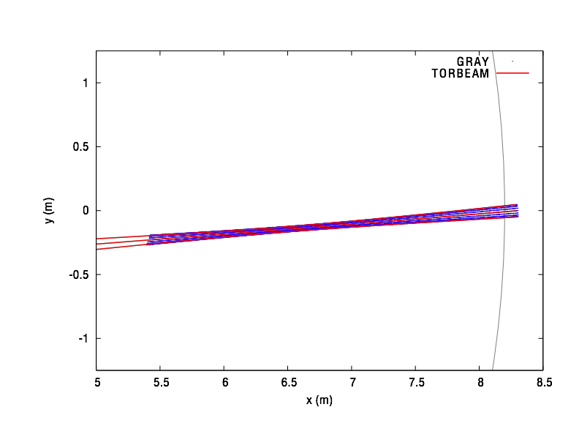
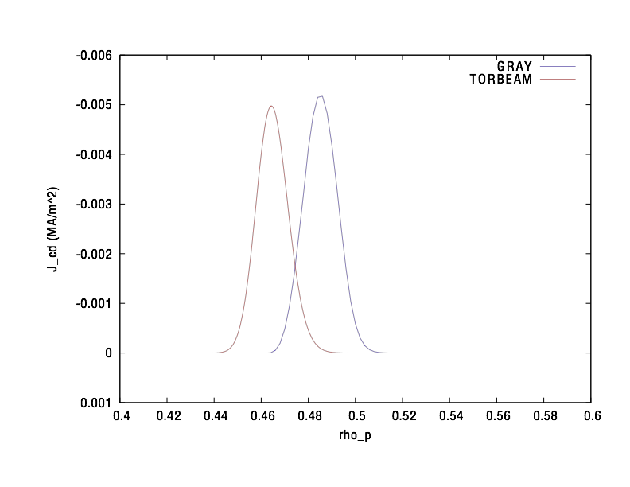
GRAY vs TORBEAM: preliminary results
Shot 5, run 67, t=0.0s
psi grid interpolation issue?

Slide 13
Future work
Fill waves CPO with all the available data (→ coresource CPO)
Replace physical constants values with ITM_constants module
Use flux averaged quantities from equilibrium CPO, when available (no more need of internal computation)
Test code robustness
try other shots and machines
Continue benchmarking with TORBEAM
investigate profiles displacement
compare approaches to vacuum-plasma transition
Benchmark with TORAY-FOM and TRAVIS when ready
Include momentum conservation method (from Maruschenko) for CD computation also in ITM version
Use SVN for revision control
Write code documentation

Slide 14
Physics model
Propagation of EC Gaussian beams is dealt with in the framework of the compex eikonal approximation
Gaussian beam:
wave equation solution of the form:
S(x) complex eikonal function S = S_{R} + i S_{I}
beam propagation
beam shape
λ wavelength, w beam width, L system dimension: λ << w << L
asympotic expansion wave equation -> dispersion relation:
cold dispersion relation
N_{s} : local cold refractive index OM/XM
solution of the Appleton-Hartree
dispersion relation

Slide 15
Quasi-optical ray equations
D. Farina, Fusion Sci. Techn. 52 (2007) 154.
Real and imaginary part of the QO dispersion relation:
additional terms with respect to
geometric optics (GO) approximation:
⇒ diffraction effects
QO ray equations at dominant order in δ
formally equal to GO ray eqs.
with D_{R} depending also on ∇S_{I}
⇒ ray eqs are coupled together
partial differential eq.
coupled to ray eqs.
15

Slide 16
ECRH&CD
D. Farina, Fusion Sci. Techn. 52 (2007) 154.
EC power evolution along the ray
absorption coefficient α computed solving either the fully or the weakly relativistic EC dispersion relation
EC driven current along the ray
Current drive efficiency computed using the adjoint method
X reponse function: Cohen model & momentum conservation model (from Marushenko, not yet in the ITM version)

