Slide 1
IMP5 tools in 4.09a
IMP5 has a number of tools for generating and manipulating CPOs, e.g. ANTENNAS generator and a merger generating CORESOURCE
All of them are now running in 4.09a
New tools written: mergers for the CPOs DISTRIBUTION, DISTSOURCE and ANTENNAS
Allowing us to combine results from
ion / electron Fokker-Planck,
NBI / Alpha source
IC / EC / LH antennas
Testbed written for mergers
Datastructures:
Additional data for NBI sources added to distsource CPO (with Mirelle)
Suggestions for improvements antenna CPO
EC-antenna; adopt to EDRG and to include antenna data (not ray-tracing input) (with Rui and Lorenzo)
restructuring of array of structures (suggestion from Nicolai)

Slide 2
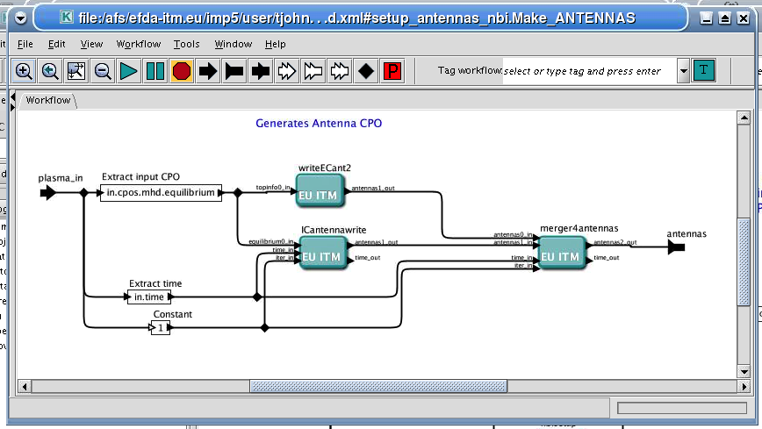
IMP5HCD
imp5hcd workflow in 4.09a
New actor Risk added (Mireilles NBI Fokker-Planck actor)
New mergers added
Present workflow combines:
merged EC & IC antennas
merged sources from NBI & alpha heating (waiting for alpha sources from ACT6; Erik & Simppa)
merged EC & IC wave codes (simplified IC code)
merged upcoming ion & electron Fokker-Plack code (problems with FPSIM; waiting for Yves or Egberts)
Still problems with the datajoiner hcd2coresource

Slide 3
(R,Z) ➔ (ρ,τ)
(R,Z) or (ρ,τ)

