Slide 1
JETTO simulations of q profile during ramp up and ramp down
E. Barbato
Associazione Euratom-ENEA sulla Fusione, C.P. 65-I-00044-Frascati, Rome, Italy

Slide 2
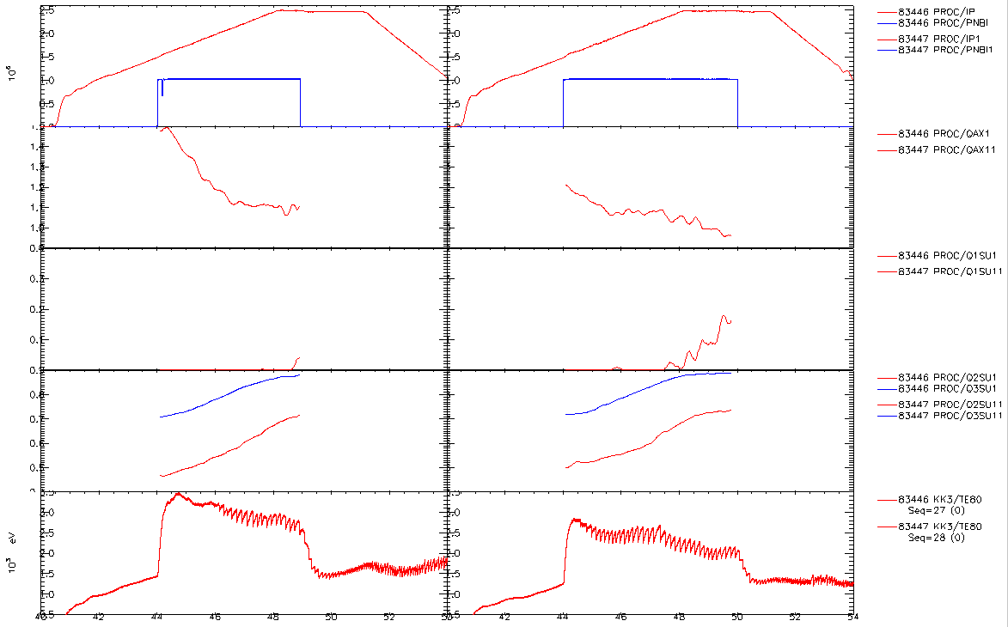
MSE in r-u: 83446 (left, low ne) Vs 83447 (right, high ne)
Ip
NBI
NBI
1.6
qax
q=1
0.9
0.4
R(q=1)
0.0
0.9
R(q=3)
R(q=2)
0.4
ST start
ST start
Te(0) from KK3
Sawteeth seen on Te when MSE has q(0) ~ 1.1-1.2
High density case: faster current diffusion: ST appear 1 s earlier; q(1) ~ 0.1 lower at end of RU (Calabro` Hogeweij, TF 23 July 2012)

Slide 3
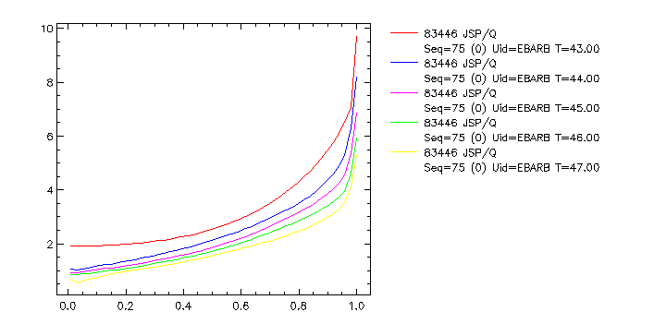
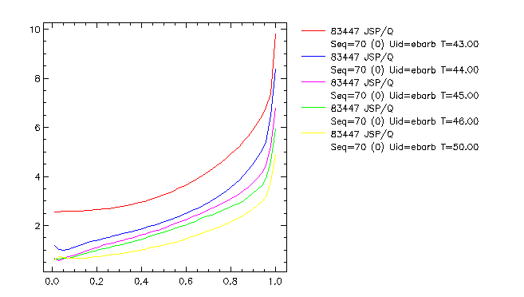
Predictive JETTO simulation of current diffusion in shot 83446 /47 (NBI during ramp up at low/high ne)
Te, Ne, Zeff fixed @ exp. values
Neoclassical evolution of the simulated q profile
Faster diffusion in the first phase
more extended q<1 region at the same time of 82446
Consistent with the earlier ST appearance

Slide 4
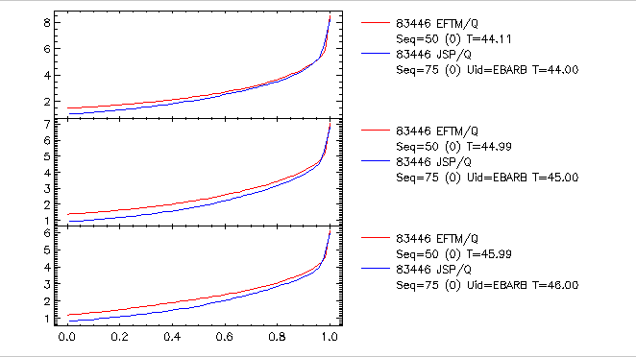
q profile comparison simulation/EFTM: faster current penetration by neoclassical diffusion (83446)

Slide 5
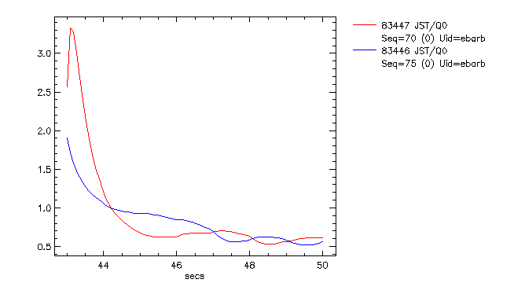
Simulated q₀ passes through the q=1 surface at t=44.3 sec but a more extended region q<1 appear only later on. In 83447 (high density-low Te) q₀ lowers below 1 at the same time of 83446 but later on it goes faster under 1.

Slide 6
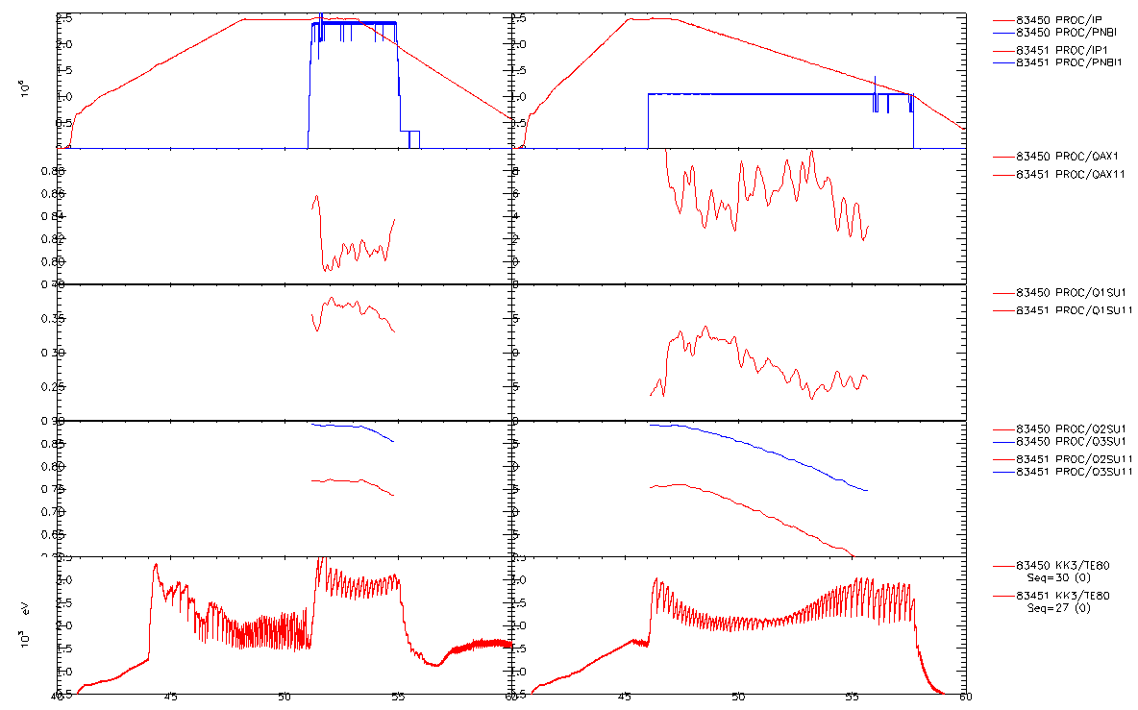
MSE in r-d: 83450 (left, fast ramp) Vs 83451 (right, low ramp)
Ip
NBI
0.9
qax
delay
0.8
0.4
delay
R(q=1)
0.2
0.9
R(q=3)
R(q=2)
No delay for q=2, 3 surfaces
0.6
Te(0) from KK3
Sawteeth seen on Te consistent with MSE data (q(0) clearly < 1)
After start of Ip ramp-down: shrink of q=1 surface delayed and even more delayed start of
rise of q0 (best seen in slow ramp case) – may well be consistent with neo-class current diff.

Slide 7
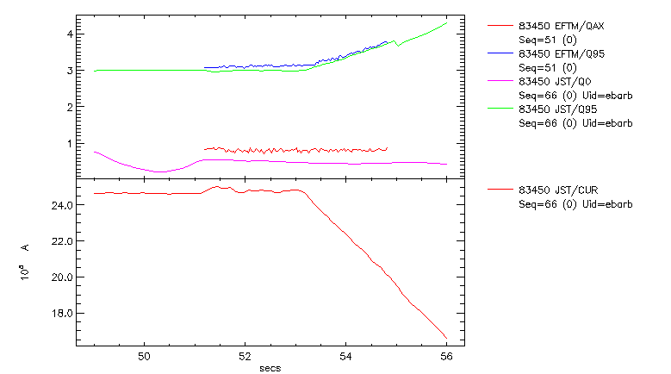
NBI during ramp down: shot 83450 (fast ramp down) Comparison q₀, q₉₅ sim/ expt
Comment:
q₀ is cte,
q₀ simulat < q_{0ex}

Slide 8
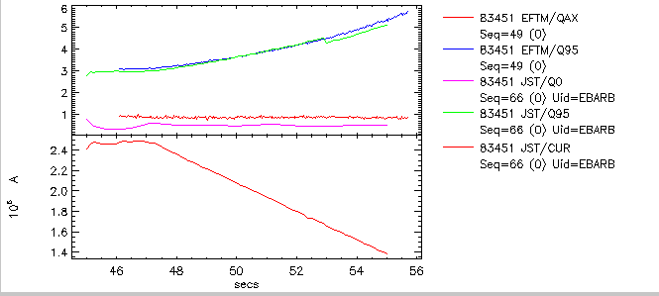
83451 (slow ramp down)
Comment:
q₀ is cte,
q₀ simulat < q_{0ex}

Slide 9
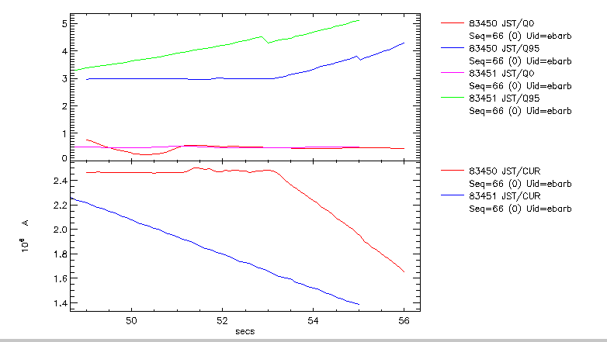
Comparison q₀, q₉₅ between the 2 simulations Comment:no difference in q₀.

Slide 10
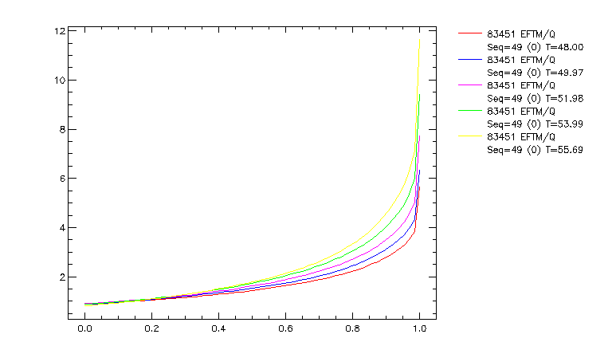
The q=2 e q=3 surface shrink are clear both in expt

Slide 11
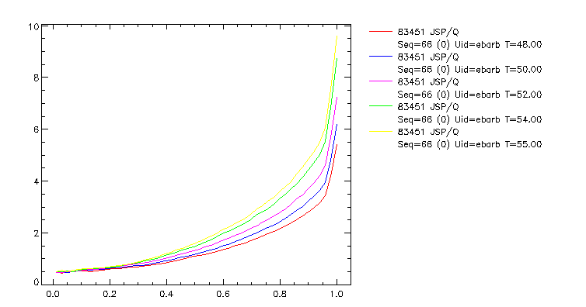
… and in simulations

Slide 12
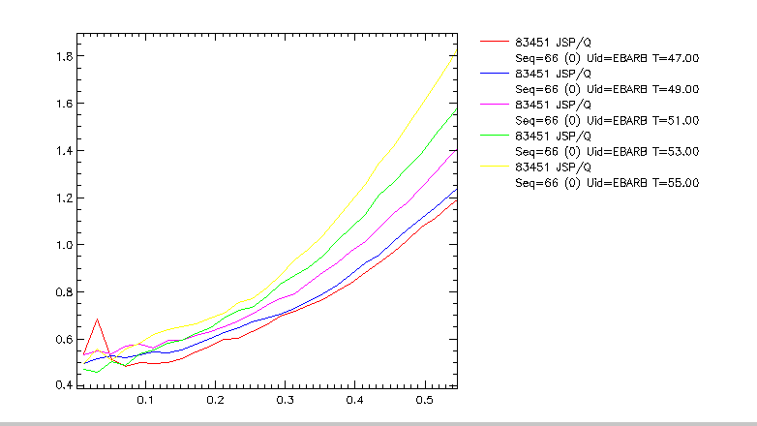
q-profile: q sim/expt
Comment: in the simulation a
shrink of the q=1 surface can be seen clearly

Slide 13
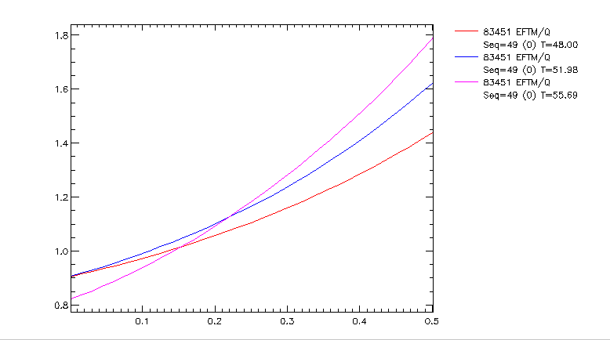
In the experiments this is not as clear as in sim

Slide 14
Conclusions
Faster diffusion at low ne during the ramp up
q<1 region deeper at low ne, consistent with the earlier ST appearance
q₀ always lower in simulation than in experiments

Slide 15
ASTRA/FRTC simulation of LHCD JET discharges: comparison of q profile between simulation and experiment (MSE, POLARIMETRY)
E. Barbato, I. Voitsekhovitch, A. Saveliev and N. Hawkes, F.Orsitto

Slide 16
≠77601 LHCD during the ramp
FROM ASTRA
IP
PLH_LAUNCH
ILH
PLH_ABS
t=43s
t=41.5s
t=42s
Times chosen for the comparison

Slide 17
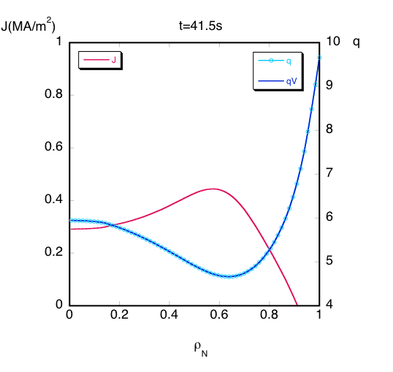
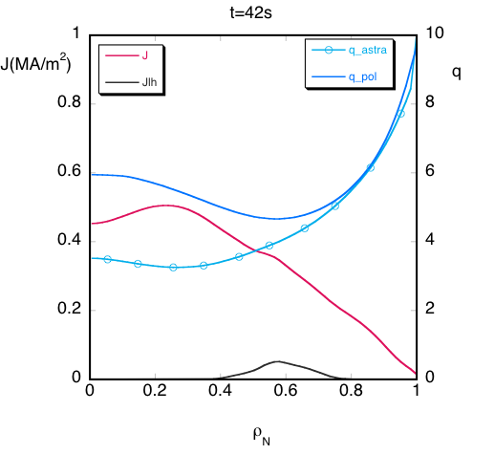
Neoclassical current diffusion much faster then measured during the current ramp
ASTRA starting q-profile taken from EFIT polarimetric measurement
Remarkable difference in the sim./meas.q-profile 0.5 s after the start.

Slide 18
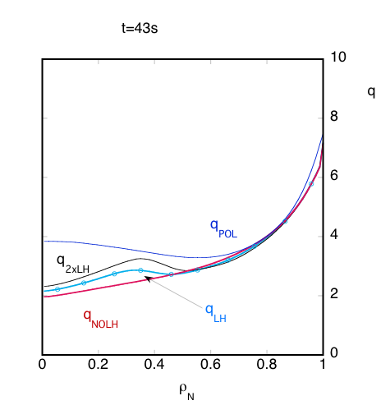
Exercise: changing the LHCD power
3 different ASTRA runs
(followed in time and taken at t=43s)
at 2x P_{LH} (1MW)
at P_{LH} (77601, 500kw)
at P_{LH}=0

Slide 19
Main heating phase:≠77893
FROM ASTRA
IP
ILH
PLH_LAUNCH
PLH_ABS
t=44,4s
t=46s
t=50.2s
Times chosen for the comparison

Slide 20
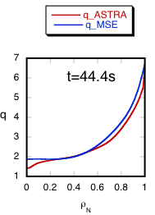
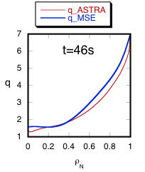
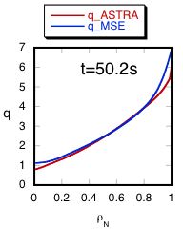
General good agreement in the current flat-top

Slide 21
Conclusions (q-profile during LHCD)
During the current ramp (≠77601) there is a remarkable difference in the simulated and measured q-profile 0.5 s after the start (where q profile are chosen equal) indicating that neoclassical current diffusion is much faster then measured during the current ramp.
On the contrary during the current flat top, simulated and measured q profiles are in good even though q₀ is always lower in the simulation
In 77601 LHCD (271KA) induces a small shear reversal. The effect of changing LH power is investigated

