Slide 1
Analysis of current diffusion with ILW
J. Garcia, Clive Challis

Slide 2
Dedicated analysis of current diffusion was done with Carbon wall experiments
q profile evolution well simulated during flat-top phase with Carbon wall only with neoclassical resistivity
First MSE measurement taken as initial condition
Identity experiments with ILW can be used to check the same evolution with ILW
Is the evolution of current the same with both walls?

Slide 3
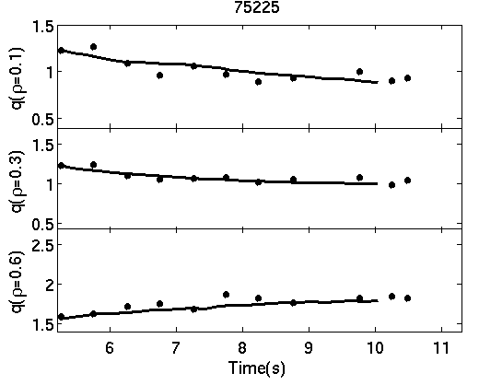
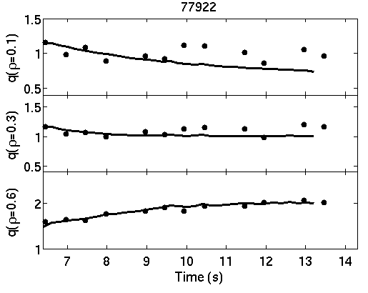
For hybrid shots 75225 and 77922 the q profile is well reproduced

Slide 4
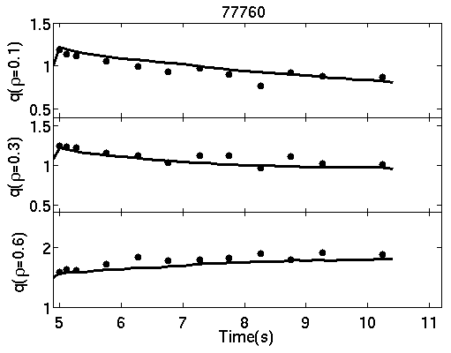
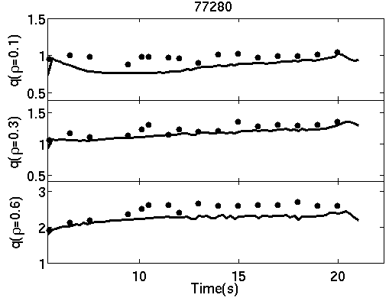
For hybrid shots 77760 and 77280 (2 resistive times) the q profile is well reproduced

Slide 5
Comparison between Carbon wall and ILW: shots 76899 and 82794
CX and MSE measurements for both discharges
Same methodology applied

Slide 6
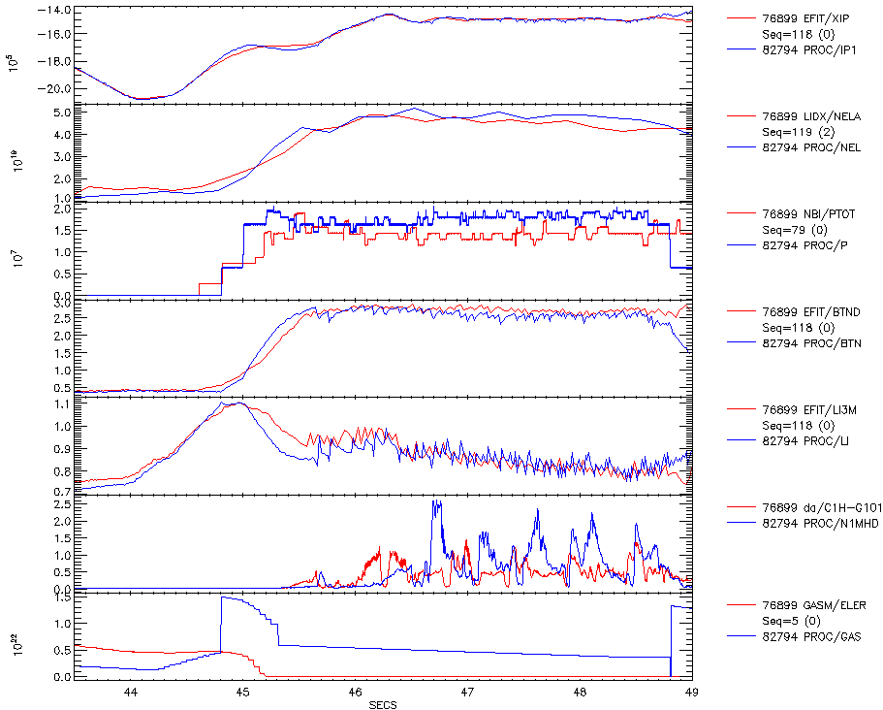
I_{P}
n_{e}l
P
betaN
l_{i}[3]
n=1 MHD
gas
t₈₂₇₉₄+0.4s

Slide 7
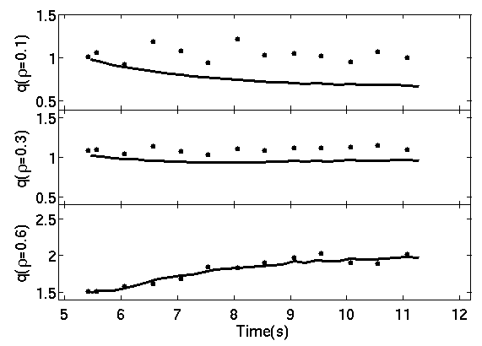
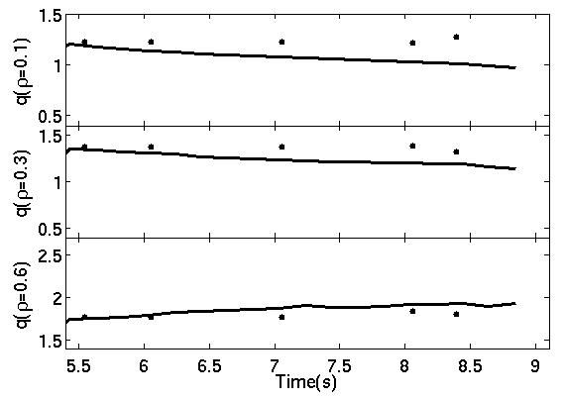
Shot 76899 (left) seems to have sawteeth. Not good agreement for q evolution at q(ρ=0.1)
Similar trend for shot 82794 (right).
MSE measurements for shot 82794 seem weird. Very high q(ρ=0.1) during the full discharge?

Slide 8
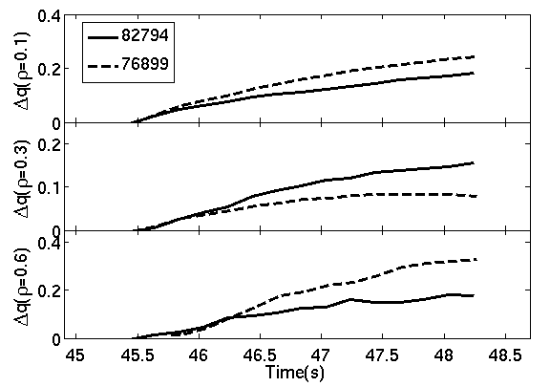
The time evolution of q profile with respect the initial q value does not show any regular trend for new wall.
At ρ=0.1 and ρ=0.6 the carbon wall q profile seems to go faster whereas the opposite for ρ=0.3

Slide 9
Conclusions
No trend has been found regarding current diffusion with ILW
Are the MSE measurements (and Ti and Zeff) reliable for shot 82794?
More experimental data is needed.
Another pair of shots?

