Slide 1
Bx-2.1.1: ITER ramp-up and ramp-down
Dick Hogeweij and Giuseppe Calabrò
with inputs from Irina Voitsekhovitch and Florian Köchl
Goals of Program
Comparison C – ILW :
look for identical pairs
differences between C – ILW?
what is missing
what should modelling tell us

Slide 2
Bx-2.1.1 = ITER-like RU & RD: goals
Ramp-up: study effect on l_{i} and flux consumption of
Variation of dI_{P}/dt
Varying density in L-mode
Varying power in L-mode
H-mode during RU
Ramp-down: study effect on l_{i} and flux consumption of
Variation of dI_{P}/dt after H-mode in flat-top with ohmic ramp-down
Variation of dI_{P}/dt after H-mode in flat-top with H-mode ramp-down
Reduction of elongation with fast ramp down rate
[both ohmic and heated ramp-down]
For all these points: Comparison ILW ←→ C wall
Dick Hogeweij TF E1E2-Meeting 20 November 2012 2

Slide 3
Ramp-up: identical pairs
Theme ILW C-Wall Remarks
Ref. Ω RU 83223 72504
Ref. H-mode RU 83224 72512
(83444)
Density scan L-mode 83447 72516 Density could no be increased enough;
(83446) New discharges went to H-mode early
ICRF pow. scan L-mode 83449 72507 Only 1.5 MW of ICRF could be delivered
(72509)
Higher RU rate in Ω RU 83451 72464
(83225) (72460)
Higher H-mode RU rate 83226 --
What is missing:
Density scan L-mode
Lower RU-rate, both Ω and H-mode
Dick Hogeweij TF E1E2-Meeting 20 November 2012 3

Slide 4
Ramp-down: identical pairs
Theme ILW C-Wall
Ref. Ω RD 83224 72203
Ref. H-mode RD 83225 72242
Higher RD rate in Ω RD after H-mode FT 83226 74396
Reduction of elongation in fast Ω RD 83446 72459
83447 72462
83449 72204
What is missing:
Slower RD rate in Ω RD after H-mode FT
Slower & faster RD rate in H-mode RD after H-mode FT
Reduction of elongation in fast H-mode RD
Dick Hogeweij TF E1E2-Meeting 20 November 2012 4

Slide 5
Data analysis and Modelling issues in the comparison ILW ←→ C-wall
Data analysis issues :
li evolution → next slide
flux consumption
H-mode threshold
Modelling issues :
Can q profile evolution be modelled with flat Zeff assumption? → later slide
C-impurity profiles could give a clue …
Is flux consumption treated correctly in models? → to be addressed by Florian
Transport properties during RU and RD
Propose to concentrate on the pairs given in previous slides,
Starting with ohmic and H-mode reference shots
Dick Hogeweij TF E1E2-Meeting 20 November 2012 5

Slide 6
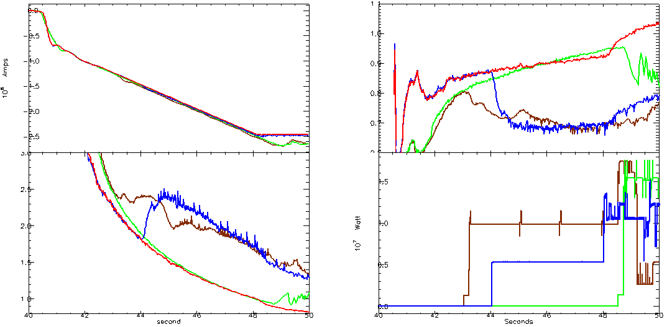
Data analysis – li evolution comparison ILW ←→ C-wall
Ip
li
q0
P_NBI
Red/Green: Ohmic ILW / Ohmic C-wall
Blue/Brown: H-mode ILW / H-mode C-wall
First impression – good match
Dick Hogeweij TF E1E2-Meeting 20 November 2012 6

Slide 7
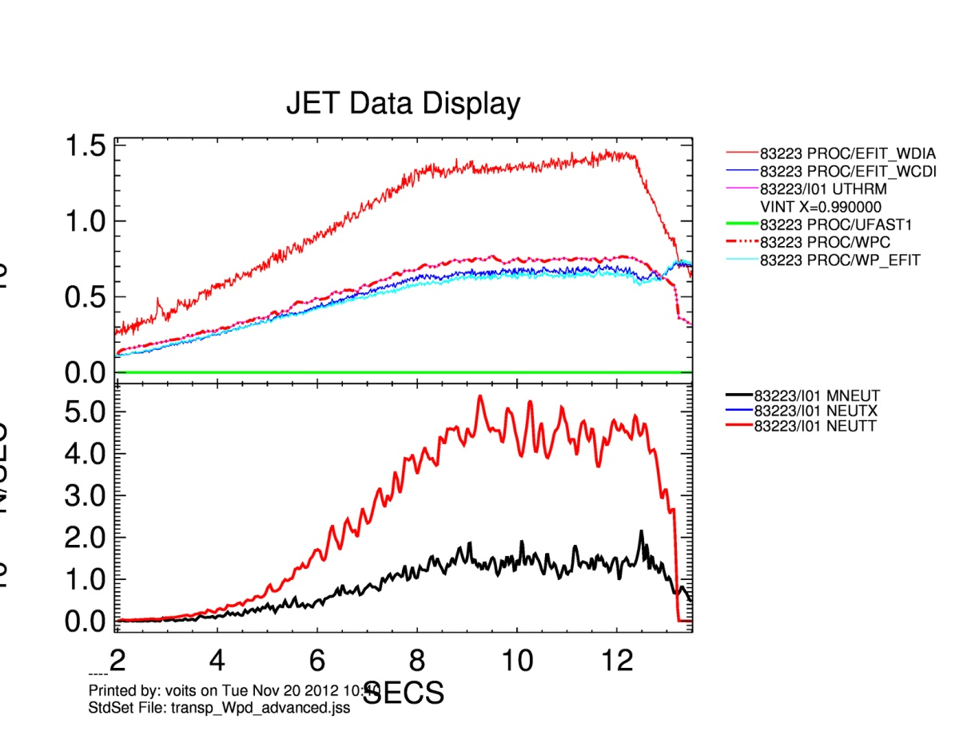
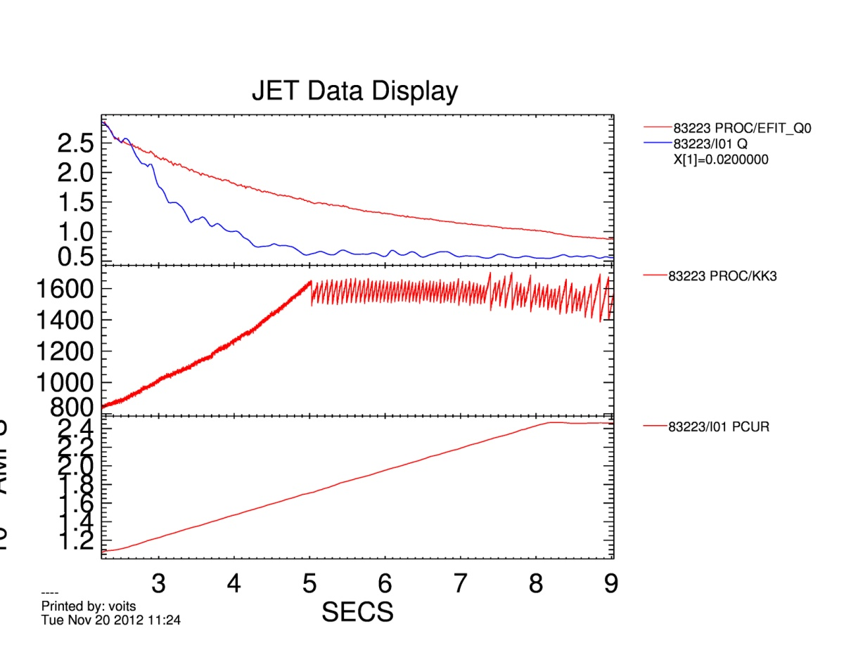
Modelling: TRANSP analysis of JET current ramp up/down discharges started (Irina)
EFIT W_{dia}
q0_EFIT
Wdia, MJ
TRANSP Wdia
q0_TRANSP
EFIT WP&WCDI
KK3
TRANSP
Measured
Ipl
OH discharge 83223
KS3/ZEFH, flat Zeff profile, Be impurity only
Ti=Te, zero toroidal rotation
usual problem with EFIT at low βpol
TRANSP Wdia is close to EFIT/WP (or WCDI)
EFIT/q is initial profile at 2.5 s
current diffusion with NCLASS
simulated q0 drops too fast (q0~0.6 at the time of the 1st sawtooth crash)
similar q0 behaviour has been obtained for C wall. Possible solution: Zeff(r)
Dick Hogeweij TF E1E2-Meeting 20 November 2012 7

Slide 8
JETTO Modelling – first results (Florian)
JETTO only simulation of ohmic current ramp-up (#83223, #83225)
Simulation conditions:
fully predictive (ne, Te, Ti, jz)
EFIT equilibrium
L-mode Bohm/gyroBohm model
sawteeth: Kadomtsev model
neutral gas flux feedback control (target density: <ne>)
no impurities, assumption of peaked Zeff
Dick Hogeweij TF E1E2-Meeting 20 November 2012 8

Slide 9
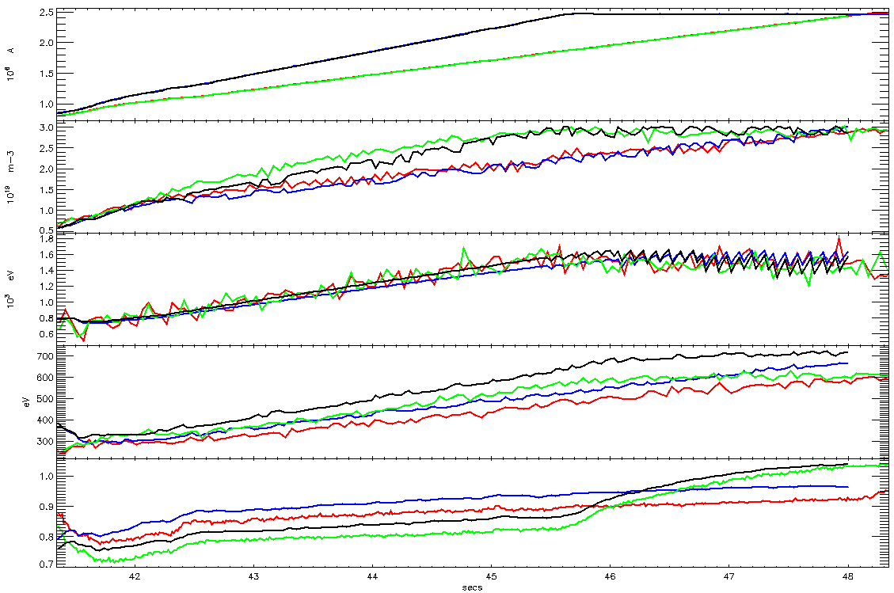
JETTO Modelling – first results (Florian)
Ipl
#83223 exp
#83223 sim
#83225 exp
#83225 sim
n_{e avg}
T_{e ax}
T_{e avg}
li(3)
trends in li(3) well matched
li(3) agreement in absolute values seems to depend strongly on Zeff, radiation (pedestal in H-mode) → impurity modelling
Dick Hogeweij TF E1E2-Meeting 20 November 2012 9

