Slide 1
JET AND JT-60U CURRENT PROFILE MODELLING WITH IDENTITY PLASMA EXPERIMENTS
Paula Sirén¹, Tuomas Tala¹, Gerard Corrigan², Jeronimo Garcia³, Xavier Litaudon³, Antti Salmi¹
¹Association Euratom-Tekes, VTT, PO Box 1000, 02044 VTT, Finland
²CCFE, Euratom Association, Culham Science Centre, Abingdon OX14 3DB, UK
³CEA, IRFM, F -13108 St-Paul-Lez-Durance, France
OUTLINE
Identity plasma experiments:
Observations and data analysis
Current diffusion modelling: Data, Tools and Validation
Predictive current diffusion simulations
Impact of NBI current
Impact of $∇n_{e}$
Effects of other externally produced current components (in JET)
Conclusions

Slide 2
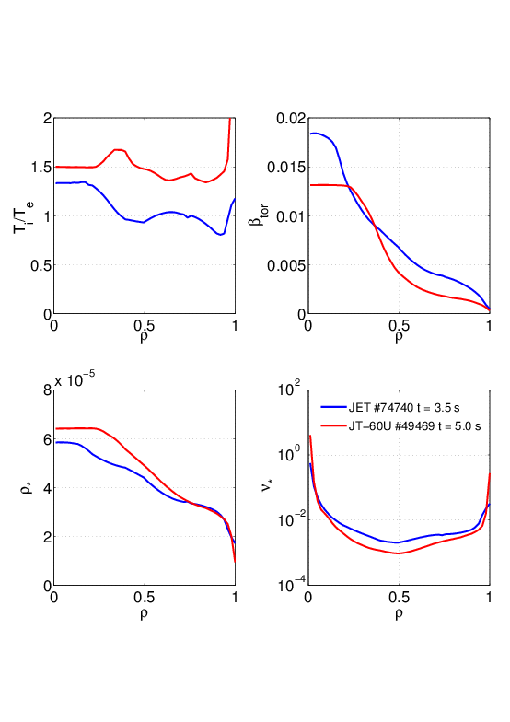
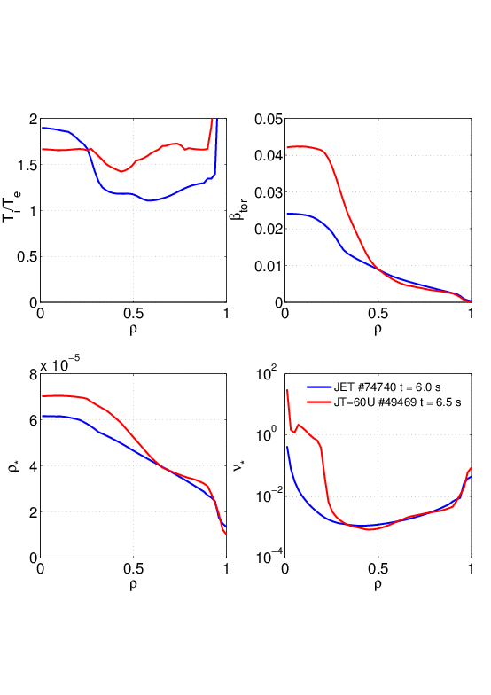
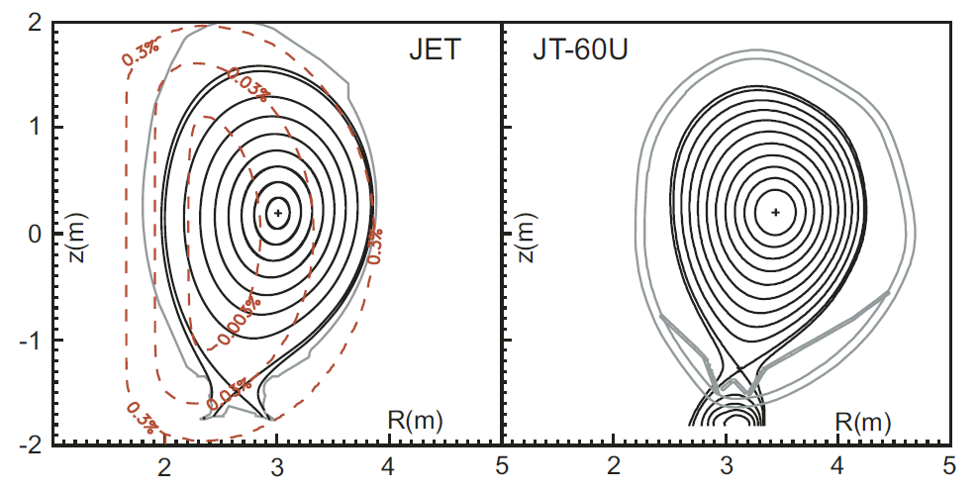
Identity plasma experiments (2008) 1/4
JET #74740
JT-60U #49469
Dimensionless plasma parameters and profiles
($q, {{T_{i}}/{T_{e}}, ρ}^{∗}\sim T_{e}^{1/2}$(RB)⁻¹, $β_{tor}\sim p/B$, $υ^{∗}\sim T_{e}^{−2}$n_{e})
Same size and plasma shape
Different pressure profile
Matched plasma shapes in identity experiments. P.C. de Vries et al. 2009 Plasma Phys. Control. Fusion 51 124050

Slide 3
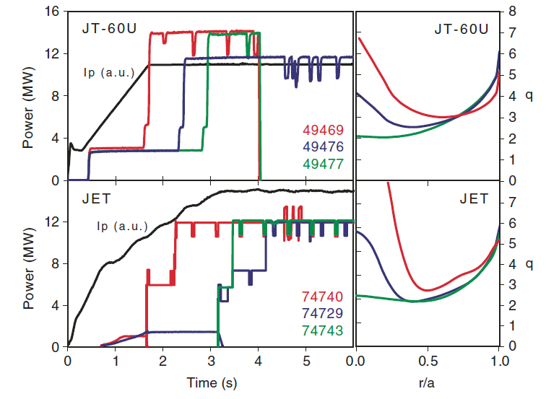
Identity plasma experiments 2/4
BEGINNING
t = 5.0s
END
t = 6.5 s
(Time axis shifted)
Shot pair
#49469 (JT-60U)
#74740 (JET)
was selected due to the reverse initial q
P.C. de Vries et al. 2009 Plasma Phys. Control. Fusion 51 124050
BEGINNING
t = 3.5 s
END
t = 6.0 s

Slide 4
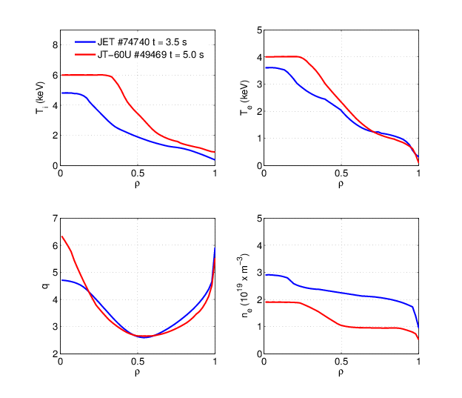
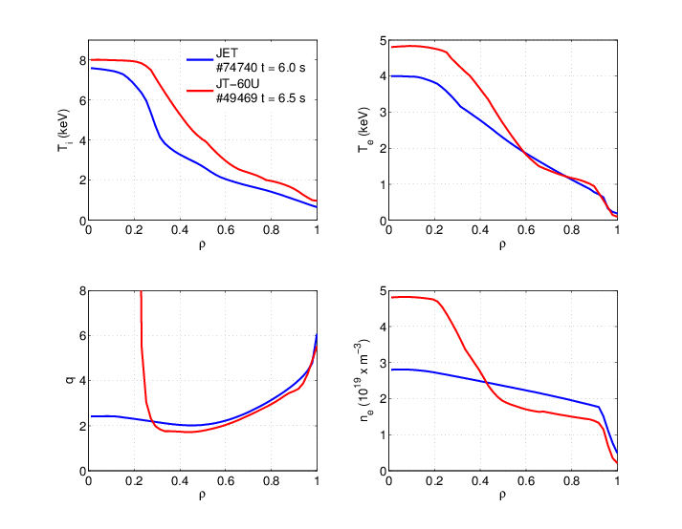
Identity plasma experiments – plasma profiles 3/4
BEGINNING
END
The best match
in the q-profile
The reverse shape has disappeared in JET after 6.0 seconds

Slide 5
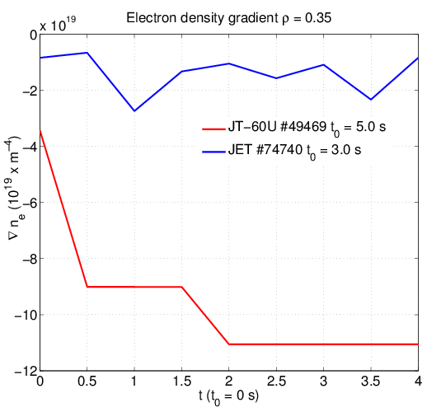
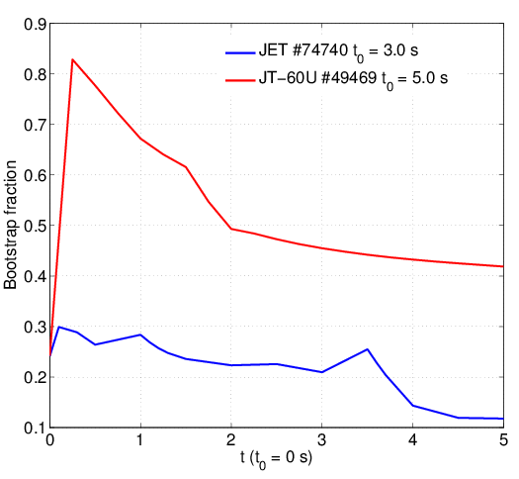
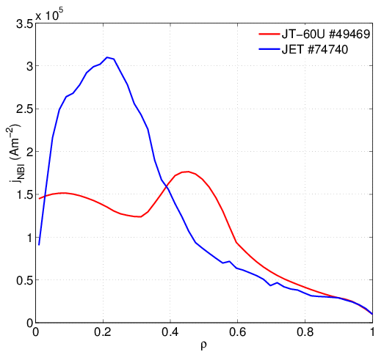
Identity plasma experiments – different properties 4/4
Electron density profiles did not match
q profile in JET becomes flat before 6 seconds
From simulation input file
Bootstrap fraction is significant in JT-60U (due to favourable density gradient)
NB current density profile (fraction is approximately same, 22-25%)
From ASCOT
From NCLASS

Slide 6
Current diffusion modelling: Data & Tools & Codes
Input data:
JET: Smoothed diagnostic data profiles have been used (cxfm, hrts, eftm). Data profiles every 0.5 seconds.
JT-60U: diagnostic data profiles from 5 time points
Current diffusion: JETTO
G. Genacchi, A. Taroni. Rapporto ENEA RT/TIB/88/5
Neutral beam current density: ASCOT (time-averaged) J. A. Heikkinen et al. 2001 Journal of Computational Phys. 173 527-548
Equilibrium: ESCO
Neoclassical resistivity and bootstrap current: NCLASS
W. A. Houlberg et al. 1997 Phys. Plasmas 4 3230

Slide 7
Testing of NBI computing options (in JET) 1/2
Time-dependent ASCOT connected to JETTO Equilibrium: EFTM
Time-averaged ASCOT profile
Fokker-Planck code PENCIL
does not work due to non-desirable interactions with equilibrium code ESCO)
(

Slide 8
Testing of NBI computing options (in JET) 2/2
The time-averaged (3.5 – 7.0 s) NBI current density profile was selected to the JET current profile studies due to the best comparability with JT-60U (only one NBI current density profile available)
Using time-averaged or time-dependent ASCOT profiles does not cause differences in the results of predictive current simulations
Changes in electron density profiles (gradients) do not cause significant effects to NBI current density profiles calculated by ASCOT

Slide 9
Current diffusion model validation (JETTO)
JT-60U
JET

Slide 10
Predictive current diffusion simulations
Impact of NBI current density
$j_{NB}$in JET replaced with $j_{NB}$ from JT-60U
$j_{NB}$in JT-60U replaced with $j_{NB}$ from JET
Impact of electron density profile
$n_{e}$in JT-60U replaced with $n_{e}$ from JET
$n_{e}$in JET replaced with $n_{e}$ from JT-60U
Effect of different density gradients in JET
Effect of added externally produced current components in JET
Case 1
Case 2
Case 3
Case 4

Slide 11
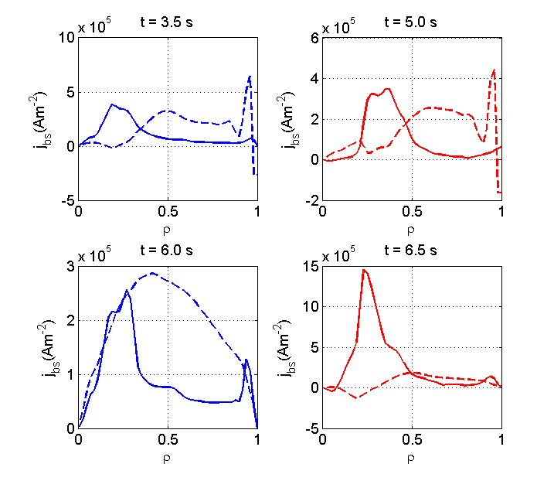
Bootstrap current, critical bootstrap current
Steady-state properties can be described by critical bootstrap current
JET
JT-60U
$$j_{bs}^{crit}=ε^{1/2}\frac{\frac{E_{φ}}{η}+j_{cd}}{ε^{1/2}−1}$$
J. Garcia, G. Giruzzi. 2012 Plasma Phys. Control Fusion 54 015009
Bootstrap current
Critical bootstrap current

Slide 12
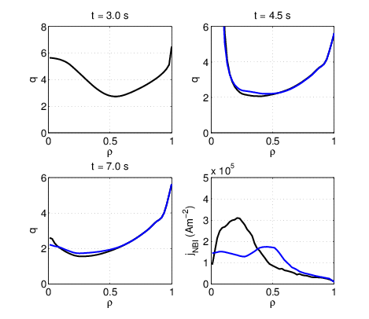
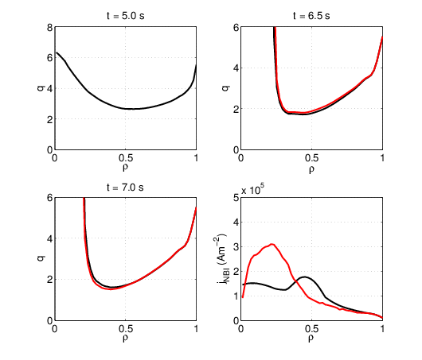
NBI current density profile replaced with profiles JET$⟺$JT-60U
NBI fraction
JET 22%
JT-60U 24%
JET
JT-60U
Reference simulation with data from #74740
NBI current density replaced with profile of JT-60U
Reference simulation with data from #49469
NBI current density replaced with profile of JET
NBI profile does not have a noticeable effect

Slide 13
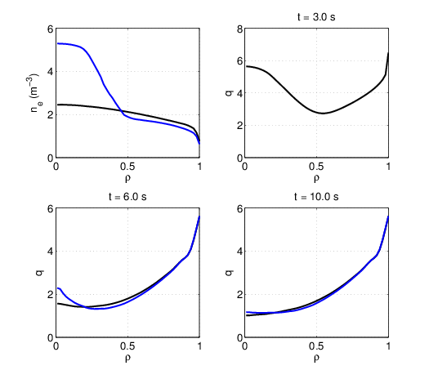
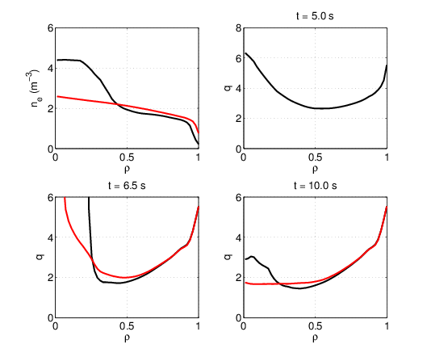
$n_{e}$profile replaced with profiles JET$⟺$JT-60U 1/2
JET
JT-60U
Reference simulation with data from #74740
Electron density replaced with profile of JT-60U at t=7.0 s
Reference simulation with data from #49469
Electron density replaced with profile of JET at t = 3.5 s

Slide 14
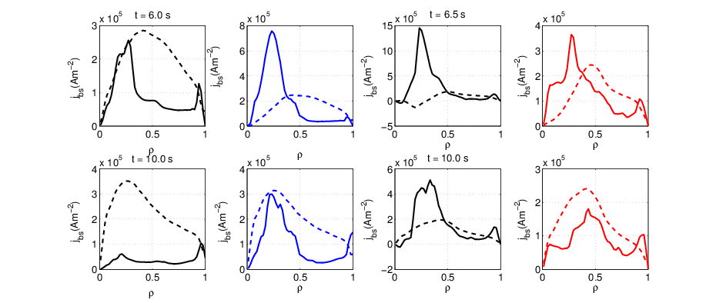
$n_{e}$profile replaced with profiles JET$⟺$JT-60U 2/2
JET
JT-60U
Bootstrap current
Critical bootstrap current
Reference simulation with data from #74740
NBI current density replaced with profile of JT-60U
Reference simulation with data from #49469
NBI current density replaced with profile of JET
Bootstrap fractions
6.0 s : 20%
10.0 s: 11%
6.0 s : 33%
10.0 s: 23%
6.0 s : 62%
10.0 s: 42%
6.0 s : 38%
10.0 s: 27%

Slide 15
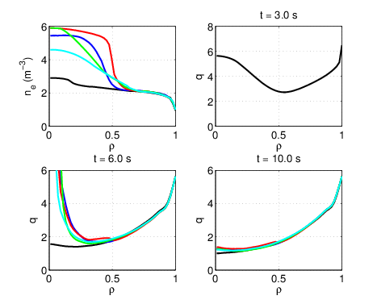
q profile time evolution in JET with different $n_{e}$profiles (gradients) 1/2
Experimental electron density profile is replaced with density profiles with 5 different density gradients at 3.5 s
Reverse shape stays longer than in the reference but it has been disappeared before 10.0 s in every case (bootstrap fraction has decreased by 32% or less)

Slide 16
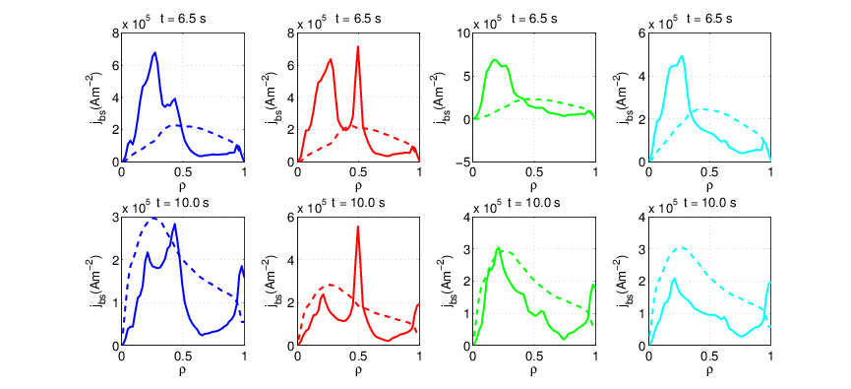
$n_{e}$profile replaced with profiles JET$⟺$JT-60U 2/2 – critical bootstrap current 2/2
Condition of critical bootsrap current is not fulfill any cases after 6.5 seconds
Bootstrap current
Critical bootstrap current
Bootstrap fractions
6.0 s : 38%
10.0 s: 28%
6.0 s : 43%
10.0 s: 38%
6.0 s : 38%
10.0 s: 28%
6.0 s : 32%
10.0 s: 25%

Slide 17
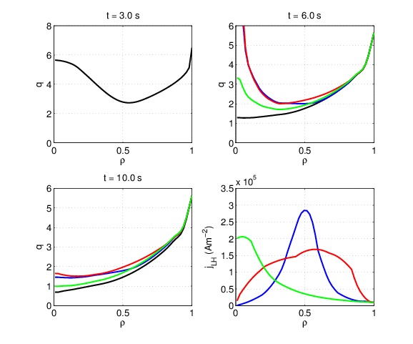
Effect of added LH (externally produced) current component 1/2
Externally generated current density components have added at 3.0 s
Reverse shape stays longer than in the reference simulation but it has been disappeared before 10.0 s in every case (bootstrap fraction has decreased by 38% or less)
LH current fractions
23% (blue)
31% (red)
9% (green)

Slide 18
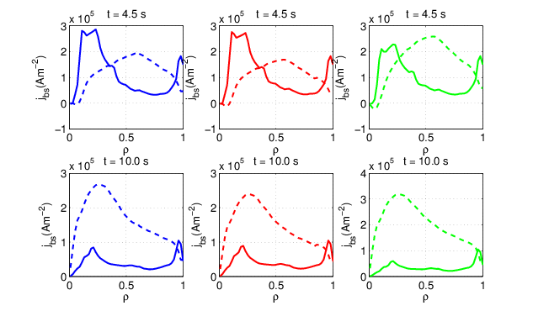
Effect of added LH (external produced) current component 2/2 – critical bootstrap current
Condition of critical bootsrap current is not fulfill any cases after 4.5 seconds
Bootstrap current
Critical bootstrap current
Bootstrap fractions
6.0 s : 38%
10.0 s: 28%
6.0 s : 43%
10.0 s: 38%
6.0 s : 38%
10.0 s: 28%

Slide 19
Conclusions
The density gradient has the most important role in maintaining the shape of the q profile.
The same density gradient produces larger bootstrap component in JT-60U than in JET. This behaviour is also noticed by studying critical bootstrap current.
The reason why density peaks is not understood and the interaction between the density ITB and sustaining reversed q-profile not known. Self-consistent simulation between predictive density and predictive current profile planned may help to understand the issue.

