Slide 1
Preparation of B13-10 experiment (Hybrid with LHCD prelude)
E. Barbato
Associazione Euratom-ENEA sulla Fusione, C.P. 65-I-00044-Frascati, Rome, Italy

Slide 2
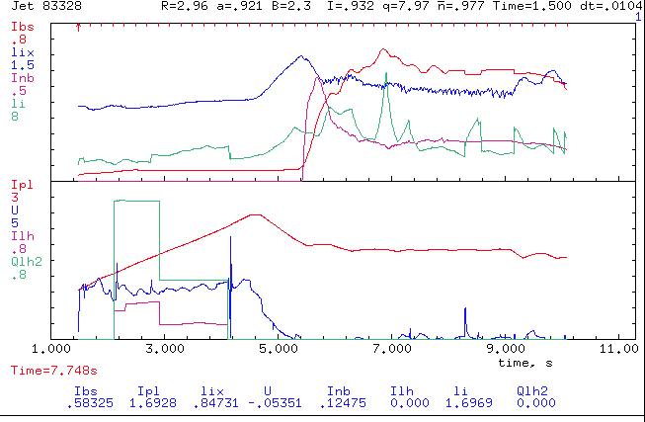
Simulation test of #83328
Exp. data and NBI sources to ASTRA from TRANSP run
Solve LHCD and current diffusion eq. (initial q prof. from EFIT at t=1.5)
IBS
INBI
PLH
IP
ILH

Slide 3
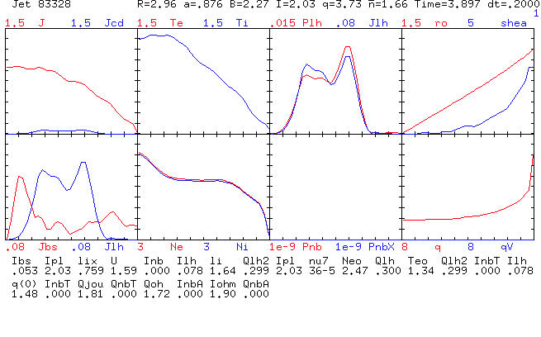
t=3.9s LH on during the ramp, perfect LH BS alignment!
LH
LH
BS

Slide 4
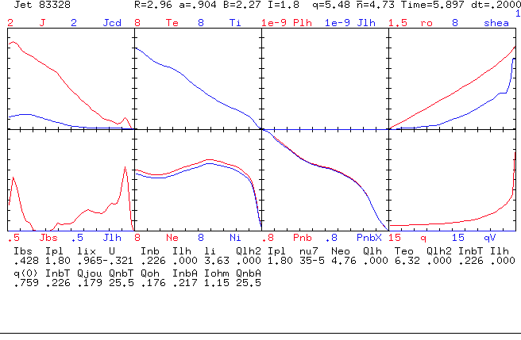
t=5.9s NO LH, NBI phase

Slide 5
Next step
Li?
Vloop exp?
Make simulation at PLH=0 and compare q profile and li
Rise the PLH power to the maximum level and see the effect on the q (hybrid)
Change n|| spectrum
…

