Slide 1
Comparative transport analysis of JET and JT-60U discharges
J. Garcia, N. Hayashi
Main goal: Modeling of JET and JT60U plasmas
Predictive and interpretative simulations of JET and JT-60U plasma scenarios using both the EU and JA suites of codes.
Benchmark of JA and EU codes and models on discharges of both tokamaks.
Find predictive capability of three transport models: glf23,Bohm-GyroBohm and CDBM
Find key physics similarities and differences between both devices
Use this information to design JT60SA scenarios

Slide 2
List of shots
JT60U
Standard H-mode : SN33654, SN33655
Advanced Inductive : SN39713 (high performance High β_{p} H-mode), SN 48158 (Long pulse High β_{p} H-mode)
Steady State with ITB : SN43046, SN45903 (RS, long pulse), SN48246 (higher β_{N}, lower q_{min})
JET
Standard H-mode : #73344 (high triangularity at 0.8 Greenwald density), #74175 (low triangularity), #77070 (low triangularity) and #73342 (high triangularity at high density above the Greenwald limit)
Advanced Inductive : #77922 (high triangularity), #77914 (low triangularity), #77280 (20s long pulse Hybrid, low triangularity)
Steady State with ITB: #77895(high triangularity), #76063 (high β_{N}), # 53521 (low triangularity strong ITB)

Slide 3
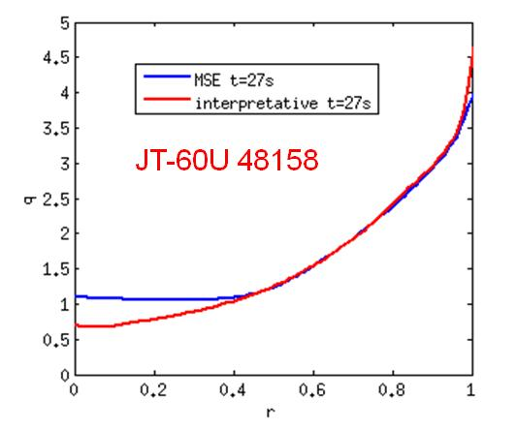
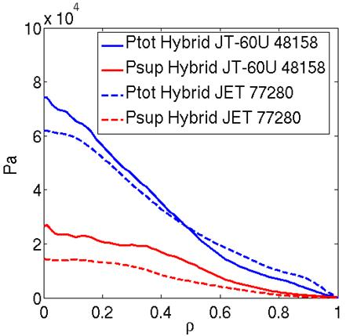
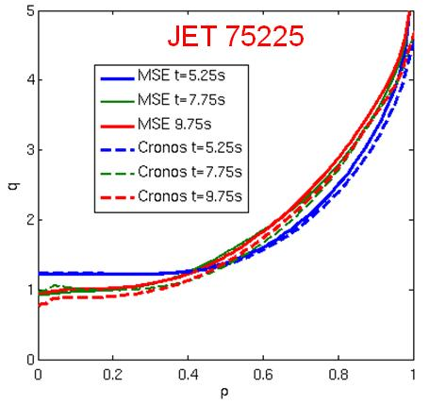
Key physics differences between JT-60U and JET
q profile evolution well simulated for JET hybrid 75225.
For JT-60U hybrid 48158, neo-classical resistivity cannot explain q profile
Fixed MSE measured q profiles are used for JT-60U predictive simulations
Fast ions contribution to the total pressure is very important for advanced scenarios in JT-60U. Can reach 45% of the total pressure
The fast ion pressure effect is included in the CDBM model. The original heat diffusivities are mended as follows, with G(κ)=(2κ^{1/2}/(κ²+1))^{3/2} and κ the elongation

Slide 4
SIMULATION OF JET DISCHARGES
Profiles calculated by 1.5D transport code CRONOS
- Given density profile from experiment
- Q profile and equilibrium calculated with CRONOS
- Ti and Te solved in ρ < 0.9
- Temperature pedestal profile given as fitted profile in exp.
- Neoclassical transport by NCLASS
- NB profile (heating and pressure) calculated by SPOT including fast ion pressure profile (no fast ion density)
- Experimental toroidal rotation
- Experimental Zeff

Slide 5
SIMULATION OF JET DISCHARGES
General good agreement for the H-mode discharge 73344 for both electrons and ions, with some slightly lower temperatures for CDBM transport
Bohm-GyroBohm transport overestimates both electrons and ions and CDBM slightly underestimates both for JET hybrid shot 77280.
GLF23 is the model that gets closer to experimental data, although it also overestimates the ion temperature for hybrid shot 77280

Slide 6
SIMULATION OF JT-60U DISCHARGES
Stationary profiles calculated by 1.5D transport code CRONOS and TOPICS
- Given density profile
- Given MHD equilibrium and q profile
- Ti and Te solved in ρ < 0.85
- Temperature pedestal profile given as fitted profile in exp.
- Neoclassical transport by NCLASS for CRONOS
NB profile (heating and pressure) calculated by F3D-OFMC including fast ion density and pressure profiles
Experimental toroidal rotation
- Uniform Zeff

Slide 7
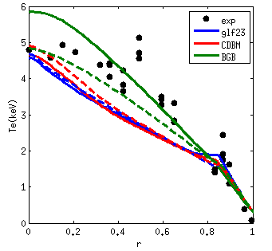
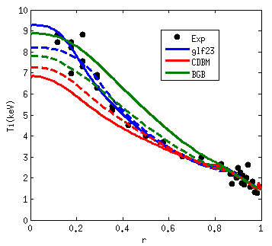
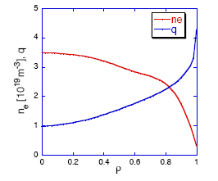
H-mode SN33654
Low density H-mode with a relatively high population of fast ions
CRONOS and TOPICS give very similar results except for BGB
CDBM and GLF23 give lower Te. BGB right Te for CRONOS and lower for TOPICS
GLF23 gives very good ion temperature agreement, CDBM gives slightly lower and BGB slightly higher for CRONOS
Additional bechmark for BGB should be done

Slide 8
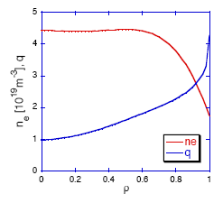
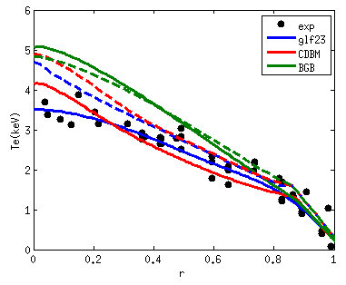
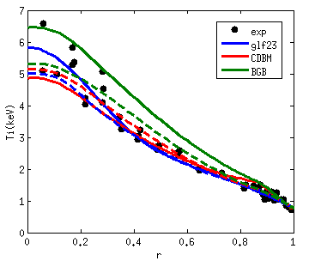
H-mode SN33655
High density H-mode with a low population of fast ions
BGB overestimates the electron temperature whereas CDBM and GLF23 tends to be ok for CRONOS
Slightly higher electron temperatures for TOPICS due to higher electron temperature pedestal considered. Differences between two codes can be explained by pedestal differences
GLF23 and CDBM give very good ion temperature for both codes. BGB overestimates ion temperature for CRONOS
The trend for electron temperature is opposite to 33654; Is this a general trend?
Not confirmed by JET shots.

Slide 9
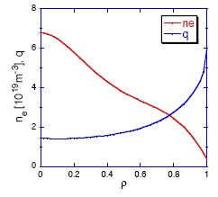
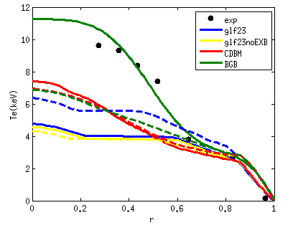
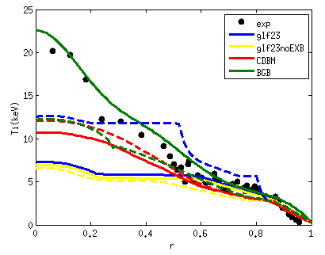
hybrid 39713
Hybrid scenario with a high population of fast ions
No stationary discharge
Very low temperatures with GLF23 even with ExB effect. Very flat temperatures obtained in high density gradient region
GLF23 results very similar for TOPICS and CRONOS w/o EXB. Some difference with EXB
Temperatures obtained with CDBM are also lower. Very similar for both codes
BGB give right temperatures in CRONOS very low in TOPICS. No reduction of anomalous transport considered in TOPICS.
For NB calculations stationary profiles are assumed. NB deposition are doubtful. Should we choose another hybrid scenario for comparison?

Slide 10
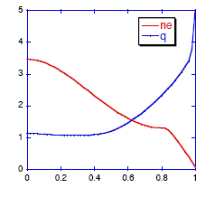
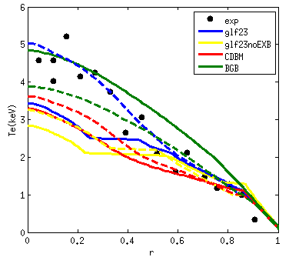
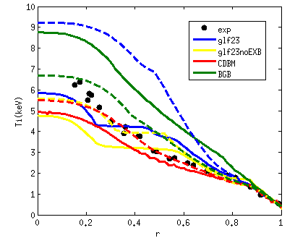
Hybrid 48158
Hybrid scenario with a high population of fast ions
Truly stationary discharge
Strange temperatures obtained with GLF23 w/o EXB, with flat regions like in the previous shots. EXB removes it for TOPICS but not for CRONOS. Good Te for TOPICS but too high Ti. Too low temperatures for CRONOS even with EXB.
Temperatures obtained with CDBM are slightly lower than experimental. Good agreement for both codes
BGB give higher temperatures than experiment for CRONOS.

Slide 11
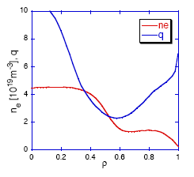
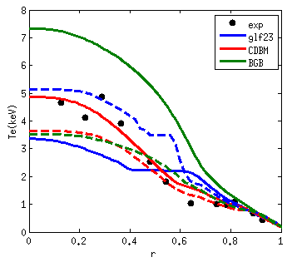
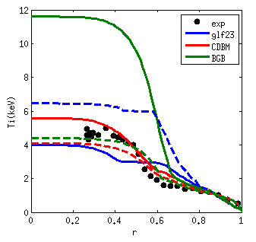
Steady-state 48246
Steady-state scenario with high reversed shear
Strange temperatures obtained with GLF23 , with flat regions like in the previous shots. ExB seems to be play a role but not able to remove flat temperatures region.
Temperatures obtained with CDBM are in good agreement for CRONOS and slightly low for TOPICS. Possible difference on neoclassical transport?
BGB give higher temperatures than experiment and much higher than TOPICS

Slide 12
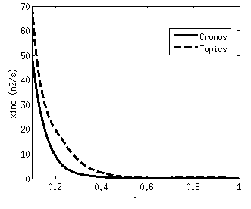
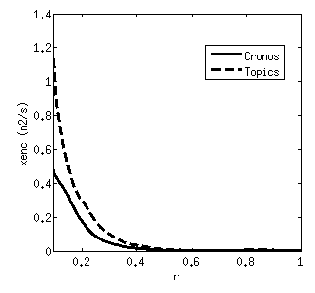
Neoclassical transport
NCLASS is used in CRONOS
Electron and ion diffusivities are usually lower than those obtained in TOPICS
This can be important in scenarios with low anomalous transport

Slide 13
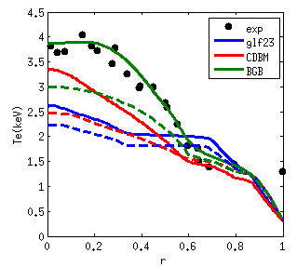
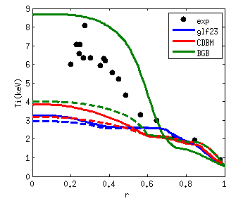
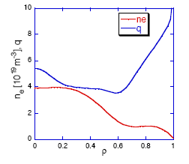
Steady-state 45903
Steady-state scenario with mild reversed shear
Strange temperatures obtained with GLF23 , like in previous case
Temperatures obtained with CDBM are also lower than experiment
BGB give higher ion temperature than experiment and much higher than TOPICS
This shot must be carefully analyzed

Slide 14
Simulations including particle channel

Slide 15
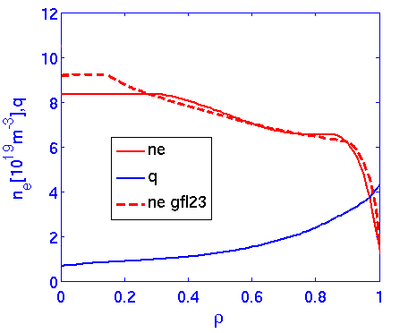
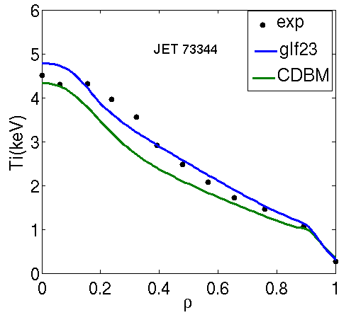
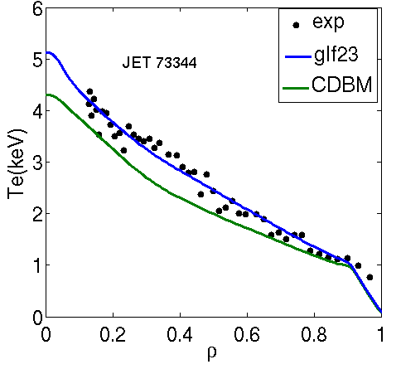
H-mode JET 73344
JET discharges have been simulated including density profile with GLF23
The simulation of density does not dramatically change the results with fixed density
NBI particle source calculated with CRONOS
Density well simulated for H-mode

Slide 16
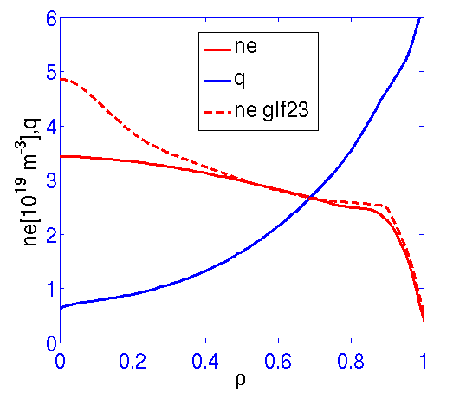
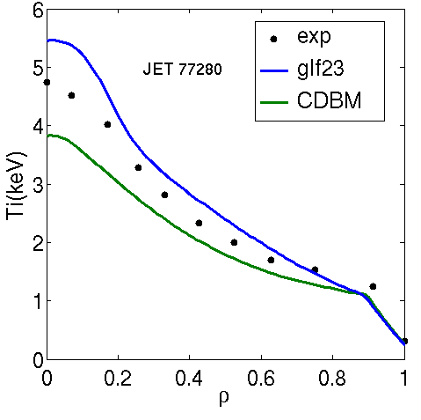
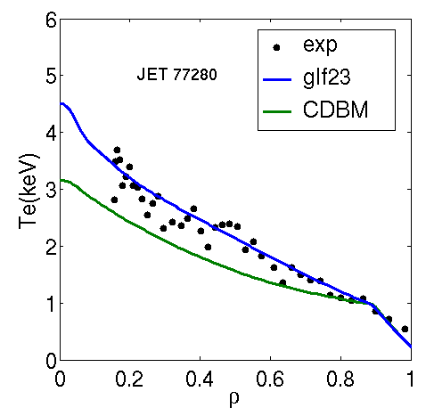
Hybrid JET 77280
Density peaking is slightly overestimated for hybrids (following Luca’s work) but has not big impact on temperature simulations which remain close to experimental data
Density will be simulated for the JET shots already simulated with fixed density profile

Slide 17
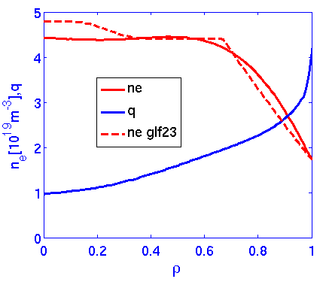
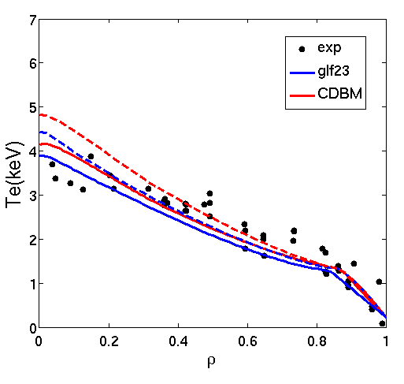
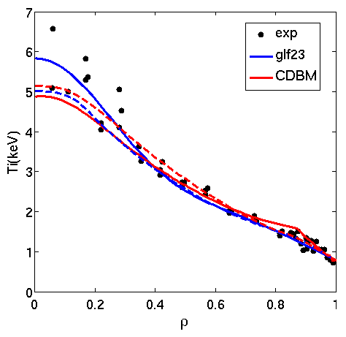
JT-60U H-mode 33655
Particle transport in reasonable agreement for JT-60U H mode shot 33655
Temperatures obtained are very similar to those obtained with fixed density profile

Slide 18
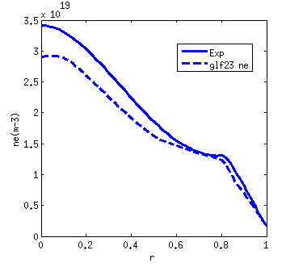
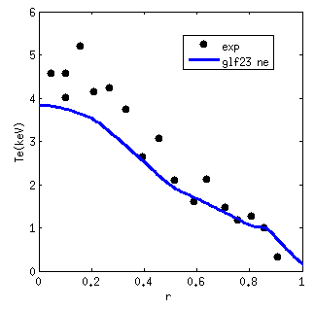
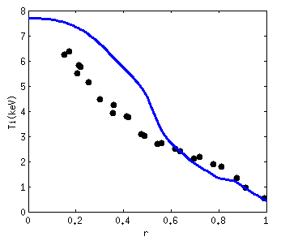
JT-60U hybrid 48158
3 channels also simulated for JT-60U hybrid discharge 48158
NBI particle source calculated with CRONOS
Density is well simulated. Highly peaking factor recovered
By simulating density the flat temperature regions are removed, and he profiles get closer to experimental data (and to TOPICS). A weak ITB is formed
Density will be simulated for the JT-60U shots already simulated with fixed density profile (already done for H-modes with very good results)
This shot gives good opportunity to analyze the relative importance for developing weak ITB on hybrid regimes and compare to ITER: q profile shape, rotation, EXB shear, Fast ion pressure and density. Comparisons with JET will be carried out. Good test for TGLF
A similar shot without ITB could be analyze ?for instance 48159 or 45436 found in N. Oyama et al., Nucl. Fusion 49 (2009) 065026

Slide 19
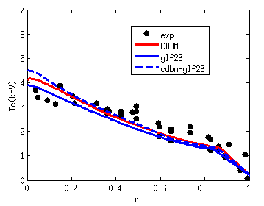
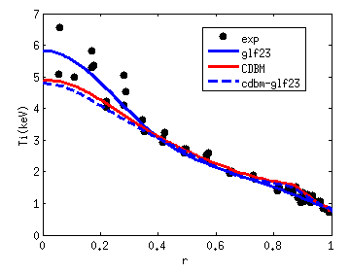
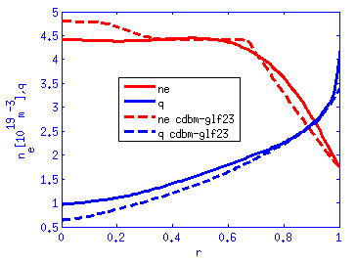
Full simulation of JT-60U H-mode 33655
Full simulation of particle, temperatures, current and pedestal height.
cdbm for heat, glf23 for density, neoclassical resistivity for current and scaling for temperature pedestal height
The shot is well simulated
This type of simulation will be carried for the main shots of each device for extrapolation to JT60SA

Slide 20
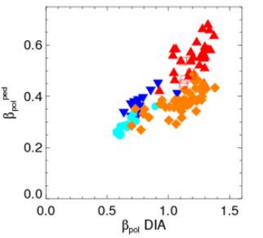
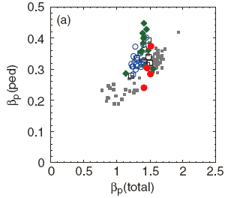
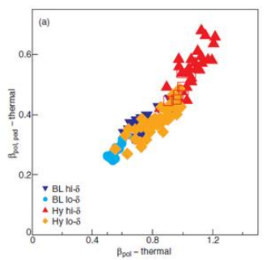
Hybrid scenario similarities between JET and JT60U
Beurskens et al., to be published
Oyama N.et al ., Nucl. Fusion 49 (2009) 065026
Similar behaviour of Betap for hybrids in JT60U and JET
There is a high impact of fast ions
The impact of fast ions in both devices is going to be analyzed with GENE next year. JT60U plasmas are particularly suited because some of them have low torque as in ITER conditions
A similar analysis will be done for JT60-SA and ITER plasmas.

Slide 21
Conclusions and perspectives
H-modes are reasonably well simulated for both devices with the models available, GLF23, Bohm-Gyrobohm and CDBM for JET and JT-60U
Advanced regimes seem to be more difficult to reproduce. GLF23 leads to the most reliable results for JET, although it starts to deviate from experimental data mainly for ions
Simulations of hybrid scenarios on JT-60U seem difficult. Strange shapes obtained with GLF23. Additional benchmark for BGB must be done
This can be overcome by simulating density. These simulations also require experimental rotation profiles, fast ion pressure and fast ion particle sources.
A similar shot to 48158 without ITB could be analyzed in order to discriminate the importance of the different mechanism and compare to JET.
Another hybrid scenario could be considered since 39713 is not stationary.
Similar problems obtained in stead-state shots for JT-60U. Simulation of density will be carried out. Possible differences on neoclassical transport can be an issue in these regimes.
TGLF simulations will be carried out
Possible simulations with CDBM for heat channel and GLF23 for particles can be done
The work shown here is just the initial step towards a full analysis of the physics differences between JT-60U and JET plasmas

