Slide 1
Analysis and modelling of JET and JT-60U discharges
J. Garcia
11 March 2013

Slide 2
Context
Main goal: Modeling of JET and JT-60U plasmas towards full JT-60SA scenarios simulations
Analyze key physics similarities and differences between both devices
Benchmark of JA and EU codes and models on discharges of both tokamaks.
Predictive and interpretative simulations of JET and JT-60U plasma scenarios using both the EU and JA suites of codes.
Find predictive capability of three transport models: glf23,Bohm-GyroBohm and CDBM
Use this information to design JT60SA scenarios

Slide 3
Framework
Benchmark of heat transport models has been carried out with TOPICS and CRONOS using fixed profiles JT-60U discharges
Predictive temperatures profiles calculated with the same transport models with both codes
The experimental density is taken from experiment
Temperatures and densities at the pedestal taken as boundary conditions
q profile obtained from MSE measurements when possible
NB profile (heating and pressure) calculated by F3D-OFMC and SPOT including fast ion density and pressure profiles
Experimental toroidal rotation
Predictive capabilities of transport models for temperatures have been also tested with CRONOS using JET discharges
Physical analysis of the results done

Slide 4
Framework
Final goal is predicting JT-60SA scenarios…
…so the complexity of the simulations has been increased: particle transport, current diffusion, and pedestal pressure also included
JET and JT-60U discharges simulated this way
Best combination of models for predicting both devices discharges is proposed
With this scheme some JT-60SA predicitve simulations will be carried out
The results give an operational window of the expected performance for JT-60SA

Slide 5
Analysis of Physics differences and similarities between JT-60U and JET: state of knowlegde

Slide 6
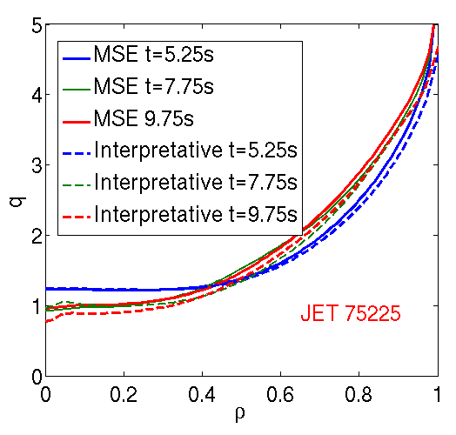
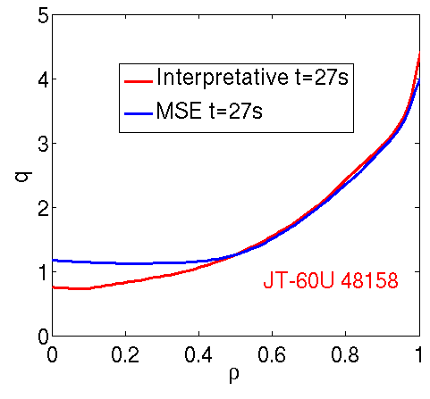
Analysis of Physics differences and similarities between JT-60U and JET: Current Diffusion
Two hybrid discharges compared: JET 75225 and JT-60U 48158
q profile evolution well simulated for JET hybrid 75225 during flat-top phase.
For JT-60U hybrid 48158, stationary solution with neo-classical resistivity cannot explain q profile
Fixed MSE measured q profiles (when available) are used for JT-60U predictive simulations

Slide 7
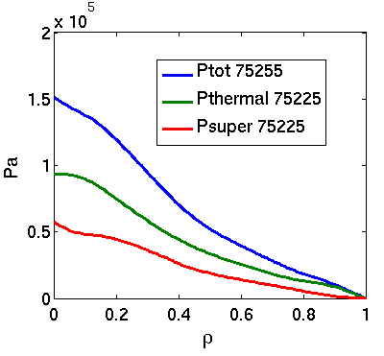
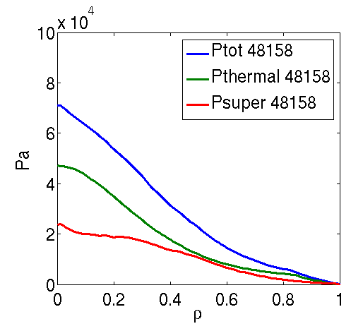
Analysis of Physics differences and similarities between JT-60U and JET: Fast ions
Discharge | JT-60U #48158 | JET #75225
Ip (MA) | 0.9 | 1.7
Bt (T) | 1.5 | 2.0
q₉₅ | 3.0 | 4.1
κ/δ | 1.40/0.33 | 1.64/0.23
β_{N}/β_{p} | 2.6/1.50 | 3.0/1.30
f_{Gw} | 0.5 | 0.45
H₉₈(y,2) | 1.1 | 1.30
P_{nbi}(MW) | 7.5 | 17
Wfast/Wdia | 45% | 35%
Fast ions contribution to the total pressure is very important for hybrid scenarios in JT-60U and in some JET shots. Can reach up from 35% up to 45% of the total pressure
The fast ion pressure effect is included in the CDBM model. The original heat diffusivities are mended

Slide 8
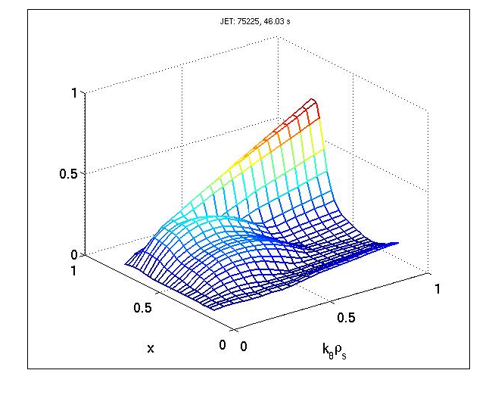
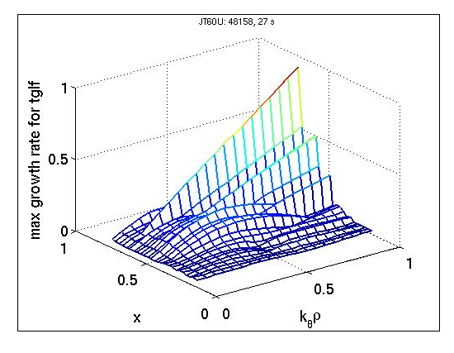
Analysis of Physics differences and similarities between JT-60U and JET: Turbulence
Turbulence regimes analyzed with TGLF with Miller geometry and electromagnetic effects
For JET 75225 ITG modes dominate the plasma core. TEM appear close to the pedestal region
Due to the high density peaking of the JT-60U shot 48158, TEM appear at ρ=0.5

Slide 9
JT-60U and JET H-modes

Slide 10
H mode shots
Discharge | q₉₅ | κ/δ | Bt (T) | β_{N} | n/n_{Gw} | Ip (MA) | Pin (MW)
H-mode JT-60U #33655 | 3.0 | 1.53/0.16 | 3.1 | 1.1 | 0.48 | 1.8 | 10
H-mode JT-60U #33654 | 3.0 | 1.53/0.16 | 3.1 | 1.0 | 0.40 | 1.8 | 8
H-mode JET #73344 | 3.5 | 1.75/0.40 | 2.7 | 1.5 | 0.75 | 2.5 | 12
H-mode JET #74175 | 2.7 | 1.68/0.21 | 3.0 | 1.5 | 0.55 | 3.8 | 25
Wide range of H mode discharges selected for both devices
Differences on plasma parameters allow to check the goodness of the models for extrapolation

Slide 11
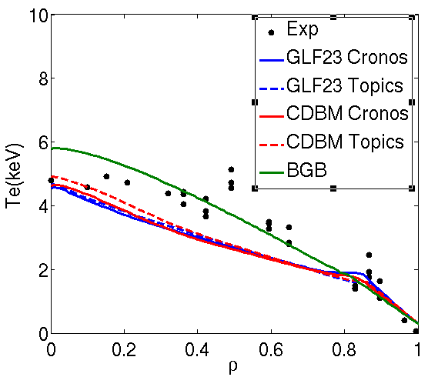
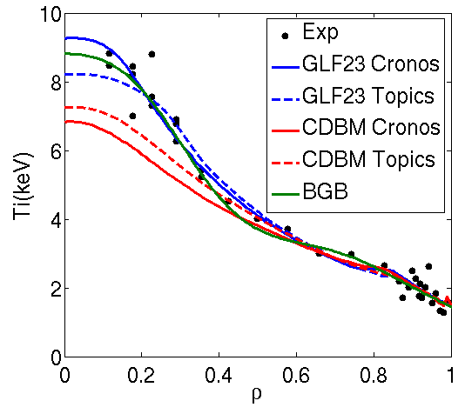
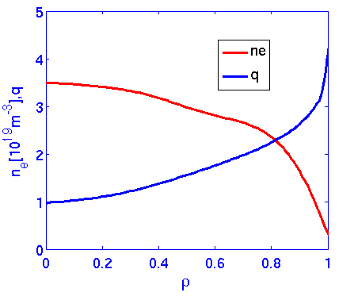
JT-60U H-mode: 33654
Low density H-mode with a relatively high population of fast ions
Density peaking is low
CRONOS and TOPICS give very similar results
CDBM and GLF23 give lower Te. BGB right.
GLF23 and BGB give very good ion temperature agreement, CDBM gives slightly lower

Slide 12
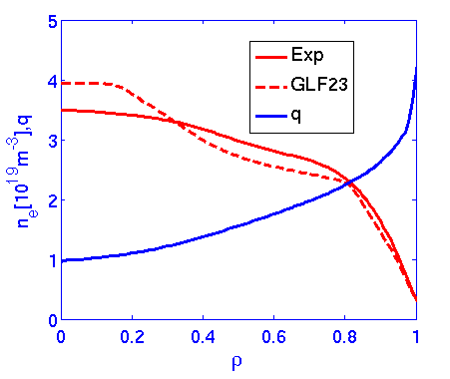
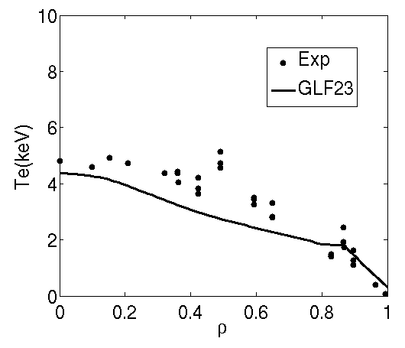
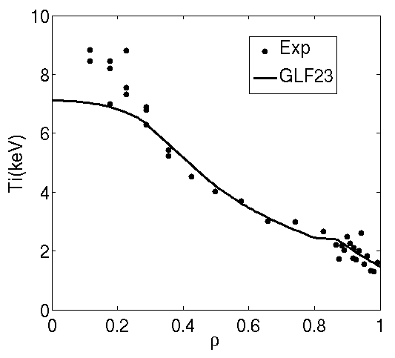
JT-60U H-mode: 33654
Density is simulated with GLF23. Density pedestal is fixed to experimental value
Only NBI particle source considered
Density is simulated with reasonable agreement(slightly more peaked)
Temperature profiles are similar than fixed density simulations,
Sligltly lower central temperature obtained due to higher central density.

Slide 13
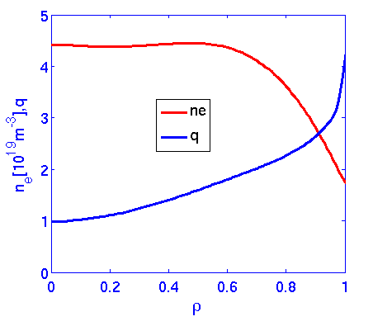
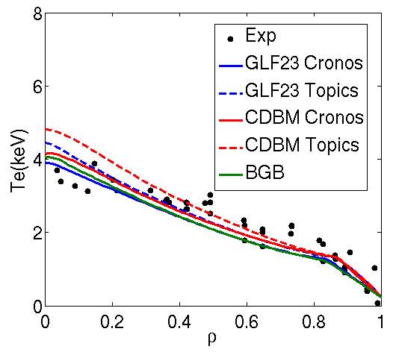
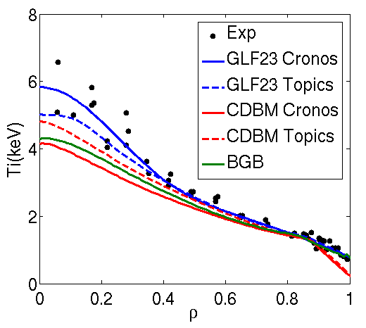
JT-60U H-mode: 33655
High density H-mode with a low population of fast ions
Very flat density profile
Three transport models tend to agree with experimental data
Agreement is better for GLF23.
Agreement between CRONOS and TOPICS

Slide 14
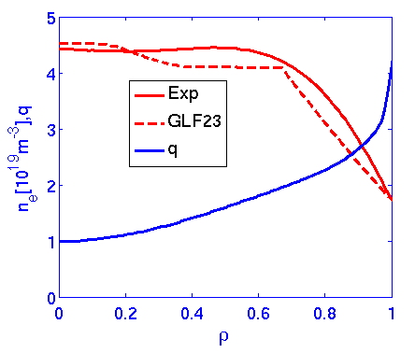
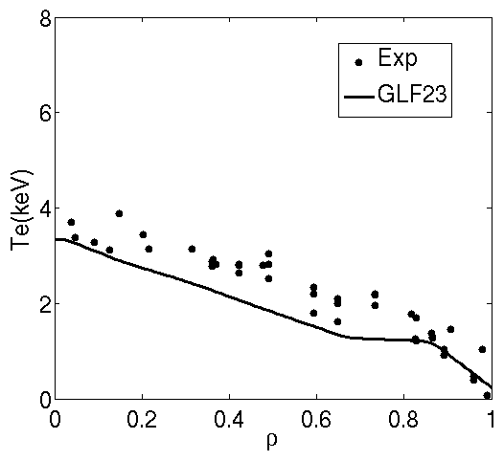
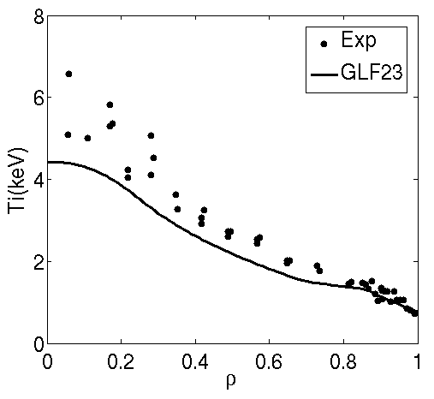
JT-60U H-mode: 33655
Density is simulated with GLF23. Density pedestal is fixed to experimental value as done for shot 33654
Only NBI particle source considered
Density is simulated with reasonable agreement (again slighlty more peaked close to axis)
Sligltly lower temperature obtained compared to fixed profile simulations.
Some problems at the edge appear.

Slide 15
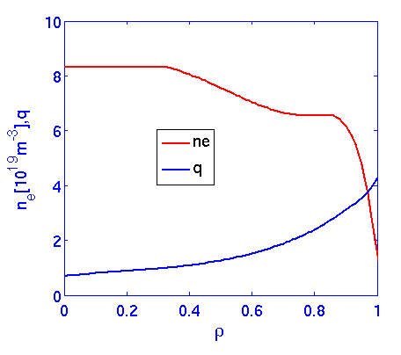
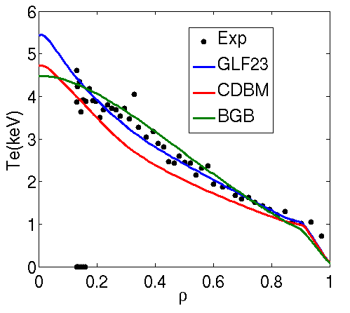
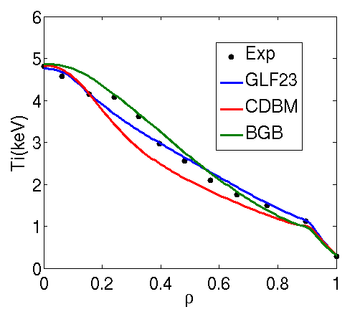
JET H-mode: 73344
JET H mode with high triangularity and density (and high pressure pedestal) and relatively low current Ip=2.5MA
As it happens in JT-60U, density is not highly peaked
Three models are in reasonable agreement with experiment
GLF23 is the one closest to experimental data
No model for the sawteeth considered

Slide 16
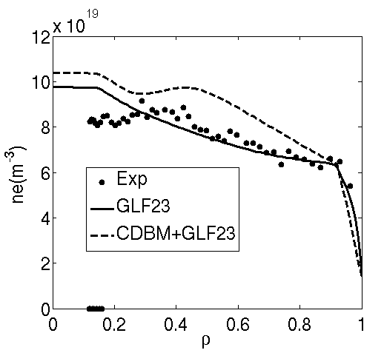
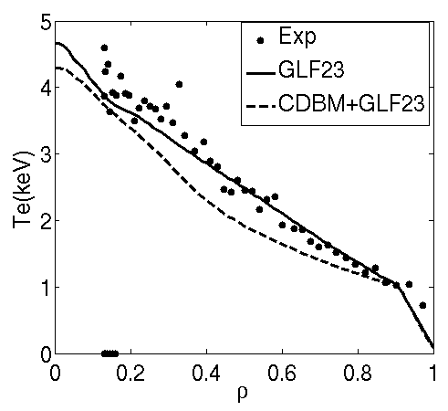
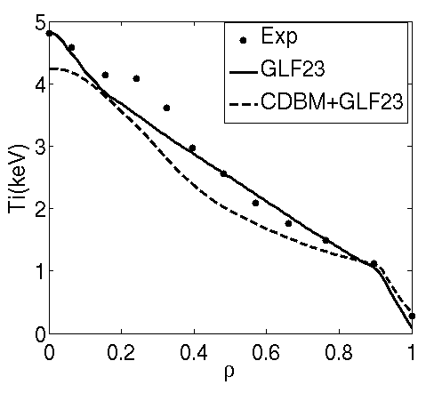
JET H-mode: 73344
Density is simulated with GLF23 and CDBM+GLF23(for density).
Density pedestal is fixed to experimental value by assuming that turbulent transport is reduced to neoclassical levels
Only NBI particle source considered
Density is simulated with reasonable agreement mainly for just GLF23.
The combination of CDBM+GLF23 sligtly overstimates density.
Temperatures are in agreement with experimental data mainly for GLF23

Slide 17
JET H-mode: 74175

Slide 18
Conclusion on H mode simulations
Good agreement between TOPICS and CRONOS when simulating JT-60U shots
In general temperatures are well simulated for the transport models considered for JT-60U and JET
GLF23 tends to slightly overstimate density peaking but profile is close to experimental data for both devices
For H-modes scenarios on JT-60SA GLF23 should be used with priority

Slide 19
JT-60U and JET Hybrids

Slide 20
Hybrid shots
Discharge | q₉₅ | κ/δ | Bt (T) | β_{N/}β_{p} | n/n_{Gw} | Ip (MA) | Pin (MW)
Hybrid JT-60U #48158 | 3.2 | 1.40/0.33 | 1.5 | 2.6/1.5 | 0.50 | 0.9 | 7.5
Hybrid JET #77922 | 4.3 | 1.7/0.38 | 2.3 | 2.7/1.2 | 0.70 | 1.7 | 17
Hybrid JET #75225 | 4.1 | 1.64/0.24 | 2.0 | 3.0/1.3 | 0.45 | 1.7 | 17
Typical advanced scenarios selected for both devices.
JT-60U shot 48158 is a standard high Beta-p advanced shot obtained in that device
High performance sustained for 27s with low density and high central NBI power
JET hybrid shots 75225 and 77922 are representative of low delta/low density and high delta/high density carbon hybrid scnearios

Slide 21
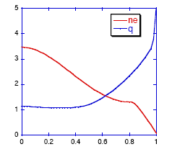
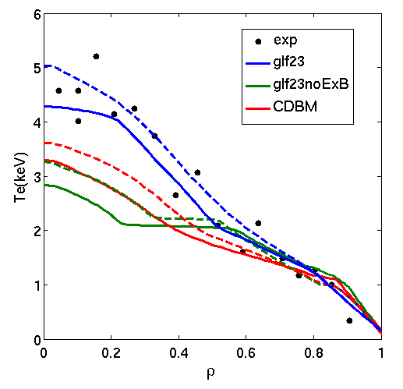
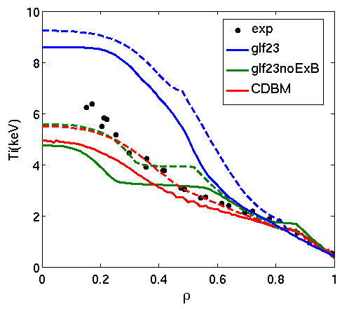
JT-60U Hybrid : 48158
Broad region of flat q profile with very high density peaking
Very low rotation.
General good agreement between TOPICS and CRONOS
Flat temperature regions obtained with GLF23 w/o EXB.
Including EXB effect, αExB=1.35, these regions disappear.
GLF23 give good Te profiles but highly overstimates Ti.
Temperatures obtained with CDBM are slightly lower than experimental but closer than GLF23 for ions.

Slide 22
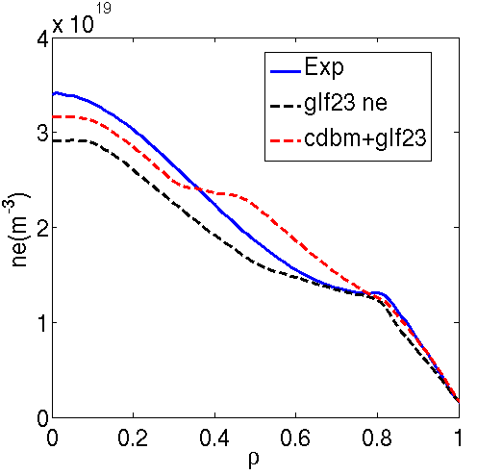
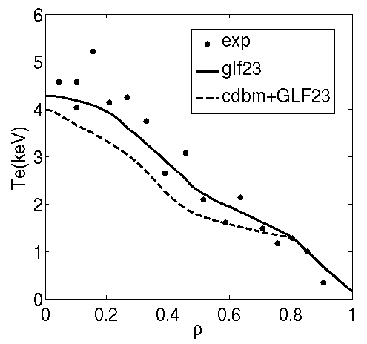
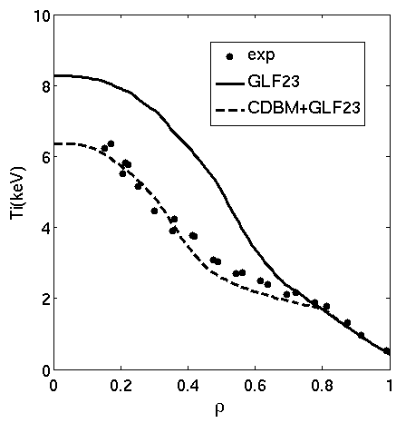
JT-60U Hybrid : 48158
Density is simulated with GLF23. Density pedestal is fixed to experimental value by reducing diffusivity to neoclassical value.
Only NBI particle source considered
Temperatures are simulated with both CDBM and GLF23.
Density is simulated with reasonable agreement for both models
Temperature profiles are similar than fixed density simulations, including EXB.
The ion temperature is much beter simulated with CDBM

Slide 23
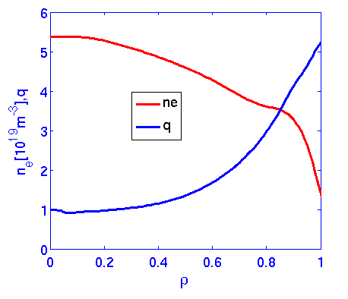
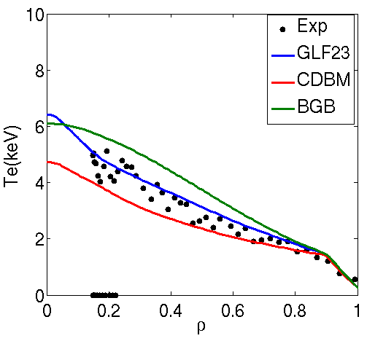
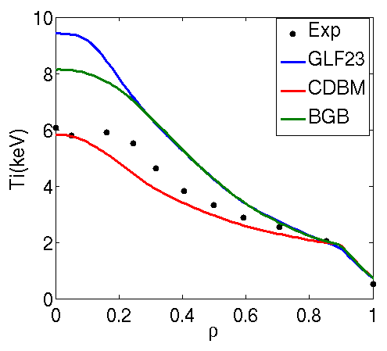
JET Hybrid : 77922
Broad region of flat q profile with high density peaking higher than H-modes but lower than JT-60U case
Low fraction of fast ions and very high pedestal pressure
Good Te obtained from GLF23. CDBM and BGB slightly deviate from experimental data
BGB and GLF23, with αExB=1.35, highly overstimate ion temperature.
CDBM give good Ti profile.

Slide 24
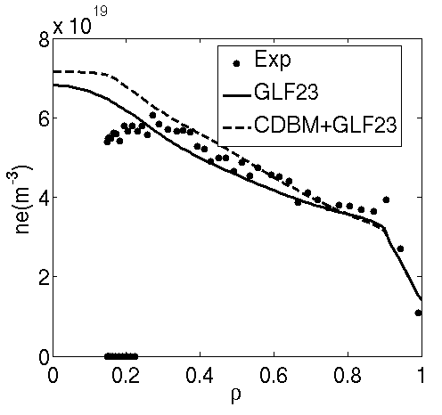
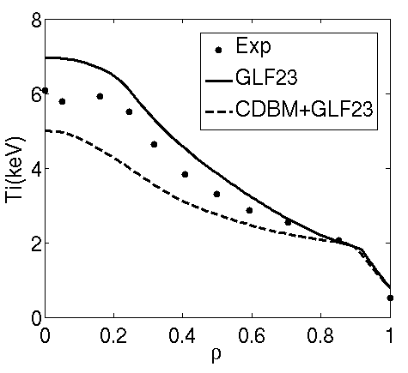
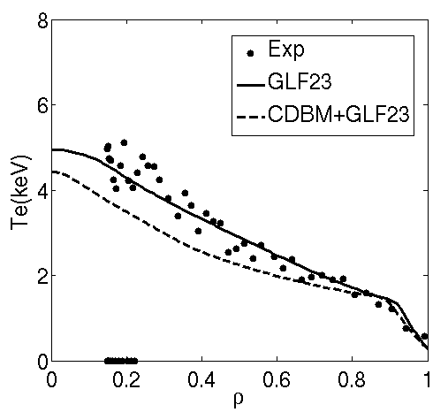
JET Hybrid : 77922
Density is simulated with GLF23. Density pedestal is fixed to experimental value by reducing diffusivity to neoclassical value.
Only NBI particle source considered
Temperatures are simulated with both CDBM and GLF23.
Density is simulated with reasonable agreement for both models
Both models give slighlty lower temperatures than in fixed density case.

Slide 25
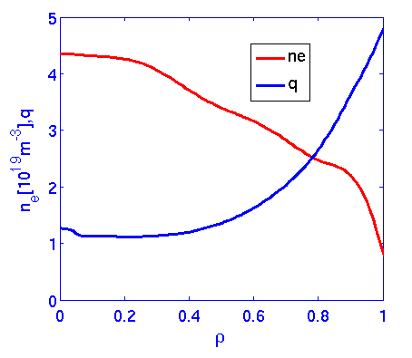
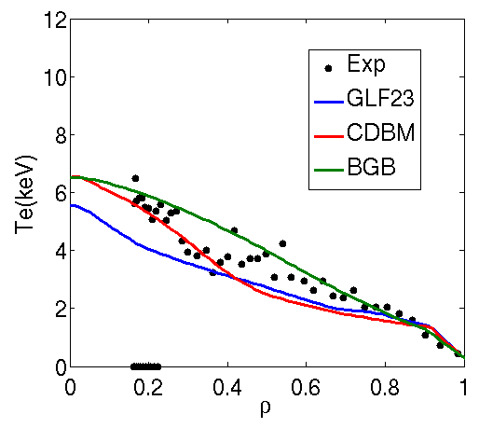
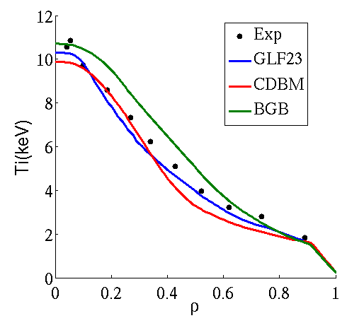
JET Hybrid : 75225
Broad region of flat q profile with high density peaking higher than H-modes and close to the JT-60U case
Very high fraction of fast ions
All models are close to experimental data, mainly for ions with GLF23 and CDBM for electrons.

Slide 26
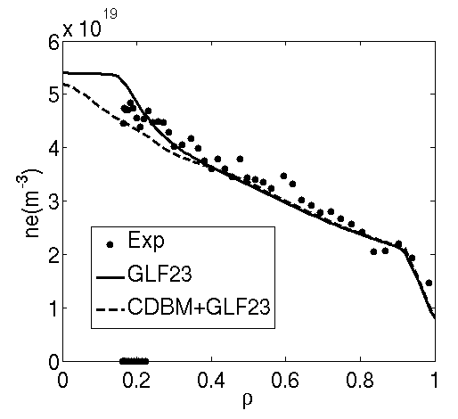
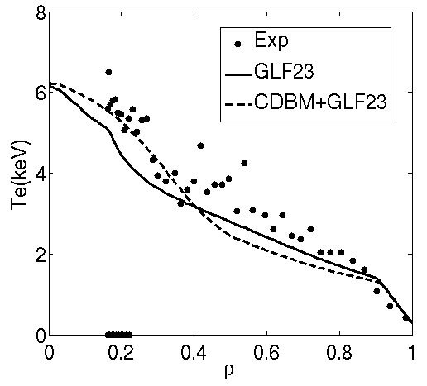
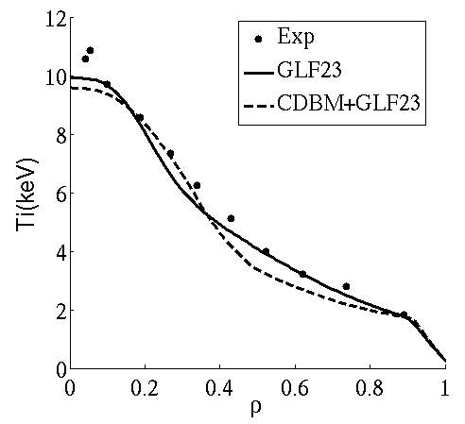
JET Hybrid : 75225
Density is simulated with GLF23. Density pedestal is fixed to experimental value by reducing diffusivity to neoclassical value.
Only NBI particle source considered
Temperatures are simulated with both CDBM and GLF23.
Density is simulated with reasonable agreement for both models
Temperatures similar to the ones obtained in fixed density simulations.

Slide 27
Conclusions on hybrid scenarios
Good agreement between TOPICS and CRONOS when simulating JT-60U shot 48158
The agreement of CDBM for advanced scenarios tend to be higher than GLF23
The combination of CDBM for heat transport and GLF23 for particule transport seems to be a good choice for the extrapolation of advanced scenarios to JT-60SA

Slide 28
Physics analysis of results: Role of fast ions and ExB shear on advanced scenarios

Slide 29
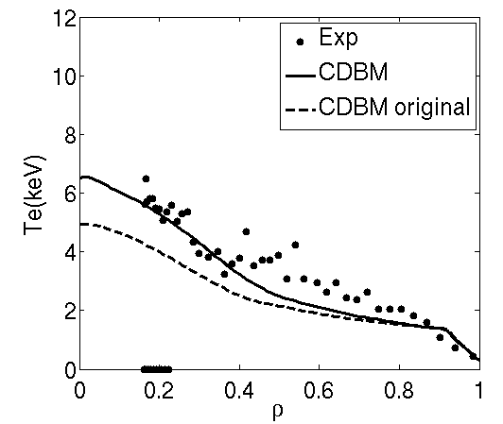
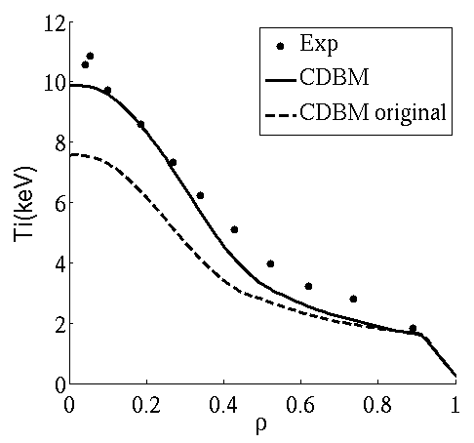
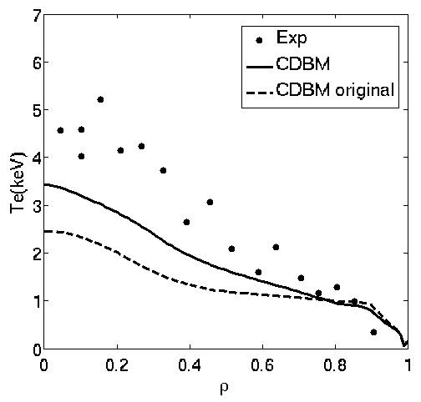
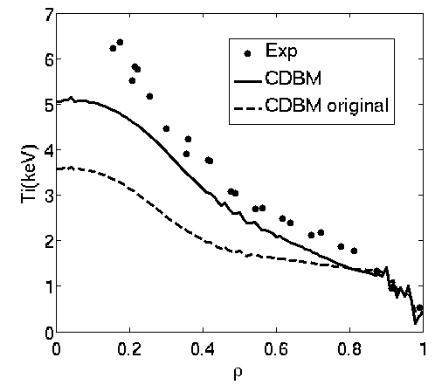
Physics analysis: Impact of fast ions on advanced scenarios
The impact of fast ions is analyzed for hybrid scenarios JET 75225 and JT-60U 48158
The original version of the CDBM is compared to the one used in this study
For both discharges the temperatures obtained with the original model highly deviate from experimental data
This shows the importance of fast ions on hybrid scenarios.
More systematic analysis will be carried out

Slide 30
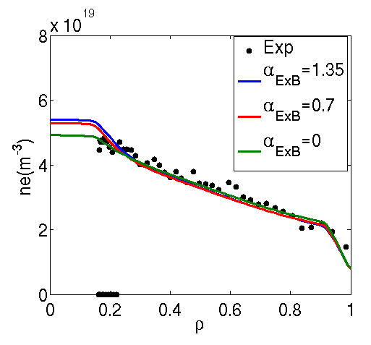
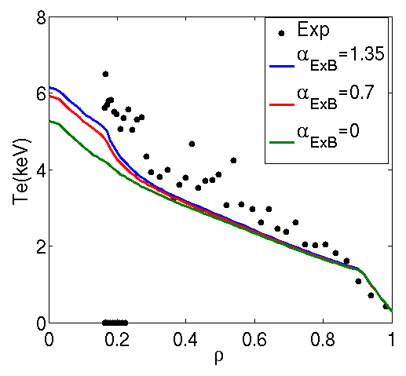
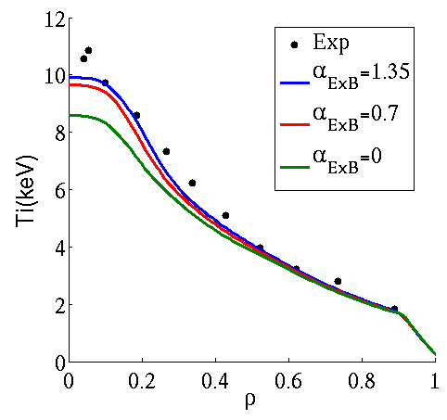
Physics analysis: Impact of ExB shear on advanced scenarios
The impact of ExB is analyzed in shot 75225.
The density profile almost does not change.
Temperature decreases and deviates from experimental data.
Temperature pedestal is kept fixed. Full simulation (including pedestal dynamics) is necesasry to full understand the process.

Slide 31
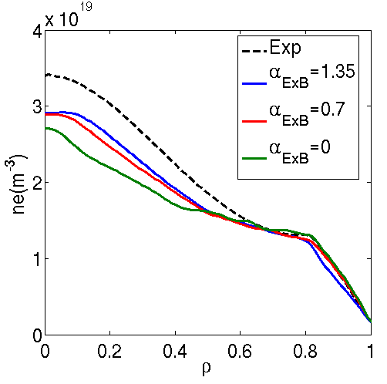
Physics analysis: Impact of ExB shear on advanced scenarios
The impact of ExB is analyzed in JT-60U shot 48158.
Unlike in the fixed density case, when density is simulated, no flat temperature regions appear.
The density profile tends to be less peaked.
Temperature decreases and deviates from experimental data in the palsma core , mainly for electrons. But this effect is not very strong
The trend is similar to the JET shot.
Fast ions seem to be more important is this kind of discharges

Slide 32
Fully self-consistent simulations

Slide 33
Fully self-consistent simulations
Self consistent simulations perfomed with CRONOS for 2 H-modes and 2 hybrids discharges form JET and JT-60U
Current diffusion+ heat and particule transport+ pedestal height calculated
All sources calculated
Sawteeth model applied when possible for H-modes
GLF23 transport model applied for turbulent particle transport
Density pedestal obtained by reducing turbulent transport to neoclassical transport
Pedestal temperature obtained by using Cordey scaling for the energy content of the pedestal
CDBM and GLF23 models applied for heat transport

Slide 34
Fully self-consistent simulations: JT-60U 33654
Density is reasonably well simulated by using this scheme but always more peaked with both models
Pedestal temperatures are close to experimental data
Temperatures a slightly understimated by using CDBM

Slide 35
Fully self-consistent simulations: JET 73344
Very well pedestal features obtained both for density and temperatures
Again GLF23 is better than CDBM

Slide 36
Fully self-consistent simulations: JT-60U 48158
No current diffusion made for this shot
Density is reasonably well simulated by using this scheme.
With GLF23 density peaking is similar to experimental data
Electron temperature similar for both models
Ion temperature much better for CDBM
Pedestal is well simulated

Slide 37
Fully self-consistent simulations: JET 75225
Density is reasonably well simulated by using this scheme altough a bit better for GLF23
Temperatures are reasonably well simulated

Slide 38
Conclusions

Slide 39
Conclusions
Physics analysis of JET and JT-60U discharges done
Sistematic becnhmark with TOPICS using JT-60U shots done with good agreement
GLF23 model has best results for H-modes for JET and JT-60U
CDBM starts to be better for advanced regimes (hybrids)
Scenarios with ITB will be also analyzed
Full simulations of current, heat+particle transport+pedestal height done
This type of simulation allows physics sensitivity analysis which will be carried out in the future
Using CDBM and GLF23 give a region of confidence for the extrapolation to JT-60SA

