Slide 1
Activity within ISM
E. Barbato
Associazione Euratom-ENEA sulla Fusione, C.P. 65-I-00044-Frascati, Rome, Italy

Slide 2
Outline
2012 activity: LHCD simulations by ASTRA/FRTC of JET discharges presented at ISM meeting on 24/10/12 and at 2 TF meetings at JET on 6/9/2012 and 20/11/2012. Paper in preparation
Activity in this week:
Continuing the comparison between NBI in ASTRA and NBI in TRANSP
Status of the art (we already discuss yesterday in the Irina talk)
Start JT60_SA scenario 5 simulation:
Equilibrium by SPIDER with a fixed boundary
Preliminary profiles
Starting to use GLF23 transport model

Slide 3
LHCD simulations of JET discharges by ASTRA/FRTC
Philosophy: close comparison with available exp. data (li, ECE signals..
Aim: try to understand LHCD “hot” physical issues within the limit of the linear propagation model
The role of the NRCA in JET (“observed” for the first time NEW !)
The role of wave accessibility in high density discharges, (associated to small variation of the edge density and of the n|| spectrum) where LHCD effects abruptly disappear. (new!)
Current diffusion time in different conditions i.e. rump up and main heating phase.

Slide 4
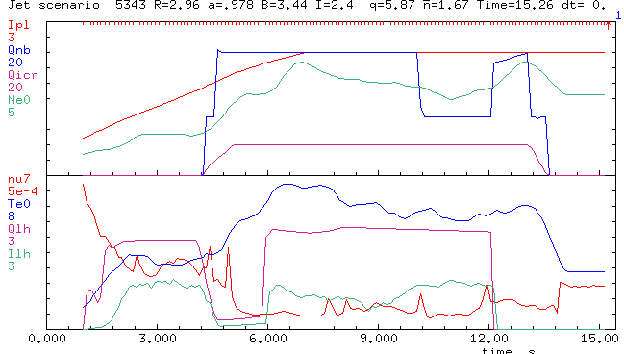
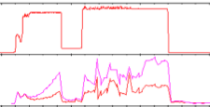
53430 simulation: time evolution
Calculated I_{LH} has a delay ~2 sec with respect to the launched P_{LH}
Clear correlation between I_{LH} increase and ν_{ei} decrease
1.5 s DELAY of ILH in fair agreement with ECE emission signal
NBI
F
R
O
M
A
S
T
R
A
I_{P}
n_{e0}
ICRH
ν_{ei}
T₀
P_{LH}
I_{LH}
P_{LH}
FROM PPF
Edge ECE emission
E. Barbato ISM meeting 24/10/12

Slide 5
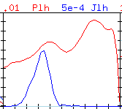
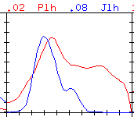
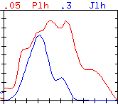
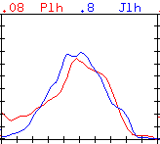
What the ILH delay is due to? NRCA is important in the early LH phase!
t=1.1s
t=1.5s
P_{LH} and J_{LH} profiles are different
Peripheral CA dominates at the beginning (first 3 times) avoiding LH current generation.
NRCA
NRCA
t=1.7s
t=3.5s
NRCA
E. Barbato ISM meeting 24/10/12

Slide 6
≠77601 LHCD during the ramp
IP
FROM ASTRA
PLH_LAUNCH
ILH
PLH_ABS
Lack of wave accessibility causes I_{LH} and P_{LH_ABS} to drop in temporal agreement with the ECE emission behaviour
FROM PPF
Low f ECE emission
NBI
PLH
E. Barbato ISM meeting 24/10/12

Slide 7
Conclusions (NRCA)
NRCA is “observed” in LHCD JET discharges simulations in the early phase of the current ramp up (when the plasma is still collisional) in 2 discharges.
It accounts for the temporal delay of I_{LH} (with respect to the launched power) experimentally documented by the DS ECE emission. NRCA stops as soon as νei decreases and therefore it does not prevent LHCD to affect the current profile later on during the current ramp.
Due to the “low JET plasma collisionality” NRCA is negligible elsewhere and cannot be responsible of the lack of penetration of LHCD in high density JET plasmas.
In 2 of the high density discharges (77601,77893) analyzed so far, I_{LH} drops due to total or partial lack of the accessibility exactly at the time where the ECE drops. In 77601 the I_{LH} drop is total (as ECE). In 77893 the drop is partial (50%).
Small variations of the density in the edge and of n|| spectrum lead to a partial lack of accessibility also in the case of 72835.
E. Barbato ISM meeting 24/10/12

Slide 8
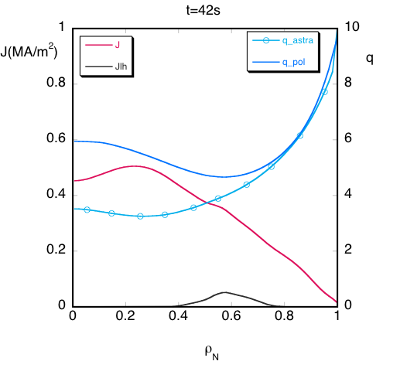
Conclusions (q-profile)
During the current ramp (≠77601) remarkable difference in simulated and measured q-profile 0.5 s after the start (where q profile are chosen equal)
neoclassical current diffusion is much faster then measured during the current ramp.
On the contrary during the current flat top, simulated and measured q profiles are in good even though q₀ is always lower in the simulation
E. Barbato ISM meeting 24/10/12

Slide 9
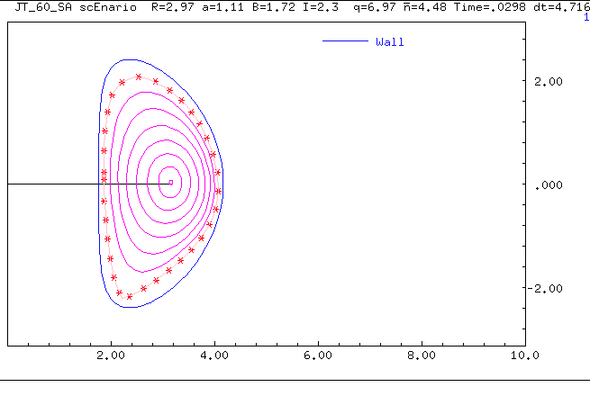
JT60_SA scenario 5: equilibrium found with ASTRA/SPIDER
Ip(MA) = 2.299
B(T) = 1.72
q95= 5.957
R(m)= 2.97
a(m) = 1.108
k = 1.905
delta (av)= 0.4455
V(m^3) = 124.9
beta = 5.359
betap = 1.885
betaN = 4.44
<ne>(10^19 m^-3) = 4.209
<Te>(keV) = 2.913
<Ti>(keV) = 2.819
Wth(MJ) = 7.975
Pnbi1(MW) = 10.07
Pnbi2(MW) = 20.06
PEC(MW) = 6.999
taue(s) 0.225 s

Slide 10
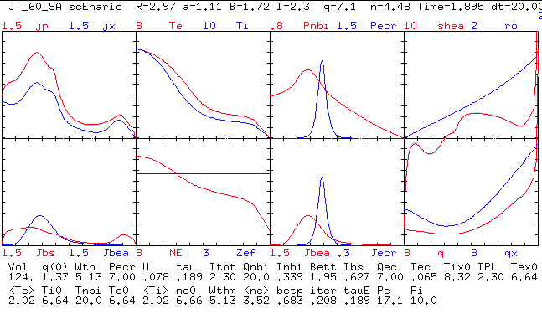
ASTRA output profiles/ preliminary

Slide 11
Next steps
Finalizing the ISM paper on the 2012 activity
Repeat the ASTRA/NBI-LHCD simulation for JET discharges, changing the equilibrium to the fixed boundary.
JT60_SA scenario 5/1 simulations by BGB and GLF23

