Slide 1
studying scenarios for West with metis
Clarisse Bourdelle, Jean-François Artaud
and the WEST Scientific Program team
2nd ISM working session
June 3rd 2013

Slide 2
outline
Analyzing 4 JET pulses with METIS
Summary of “rules” that worked on 4 JET pulses (with different B, fuelling, triangularity)
Applying these rules for 13 WEST scenarios
Conclusions and perspectives

Slide 3
JET pulses
First pair: 82541 and 82536, with NBI 17MW, I_{p}=2.5MA, B=2.6T, q₉₅=3.3, high triangularity. The fuelling being 1.6x10²² e/s in 82541 and 4x10²² e/s in 82536
Second pair: 82120 and 82123, with NBI 10.5 MW, I_{p}=2MA, low triangularity, same fuelling 2.5x10²² e/s, two B: B=2.1T and q₉₅=3.2 (82120); B=2.7T and q₉₅=4.1 (82123)

Slide 4
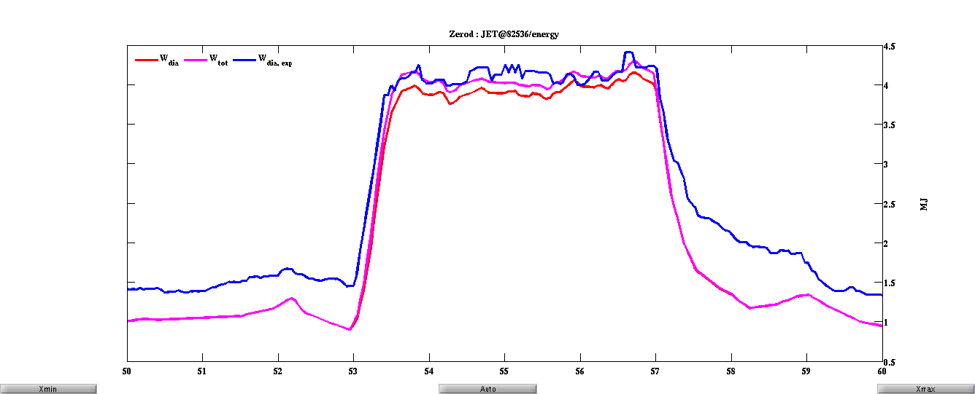
Rules used in METIS: energy content
H factor adjusted to reproduce energy content: 0.7 for 82123, 82536, 82541; 0.85 for the lowest B (highest β) 82120

Slide 5
Rules in METIS: impurities and radiated power
Z_{eff} flat in JET, value as measured ~ 1.3-1.5
Be and C, such that n_{C}/n_{Be}=0.02
W such that n_{W}/n_{e} at separatrix = 10⁻⁴
W accumulation factor for W such that n_{W} profiles similar to Mantica 2012
P_{rad} using Post coefficients

Slide 6
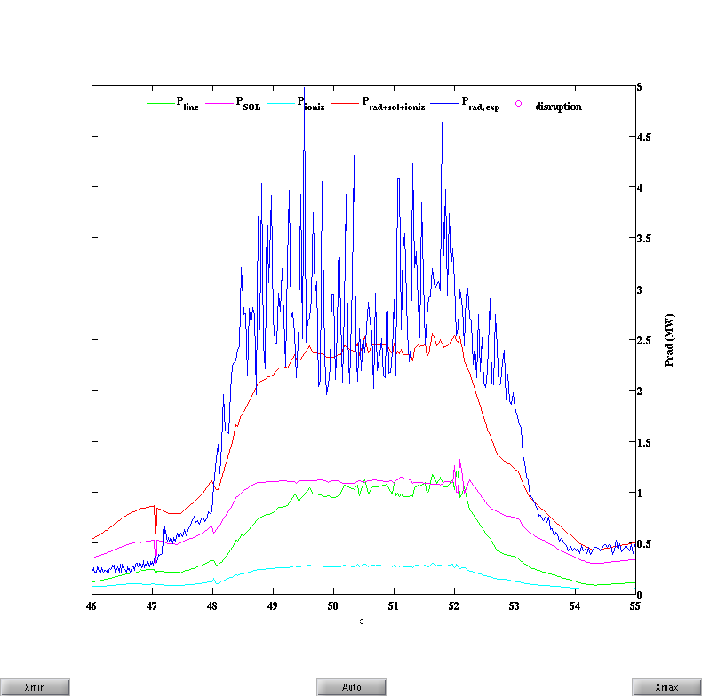
Rules in METIS: radiated power
NB: Cases for 82536 and 82541 where P_{SOL} =0, normal?

Slide 7
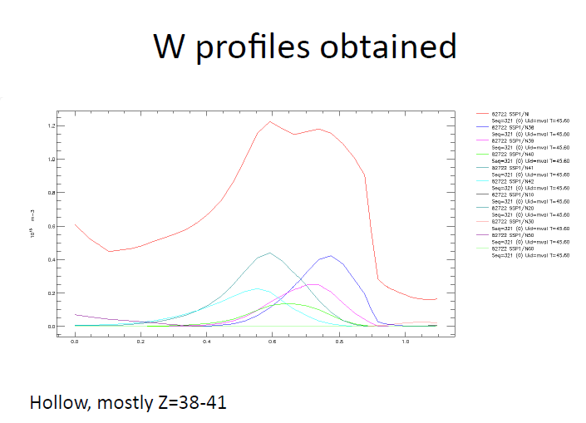
Mantica et al 2012
Using SXR and spectrometers in JET ILW
W slightly hollow with n_{W} max ~ 1.2 10¹⁵m⁻³

Slide 8
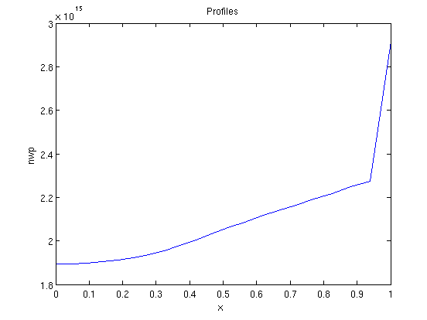
Rules in METIS: W content

Slide 9
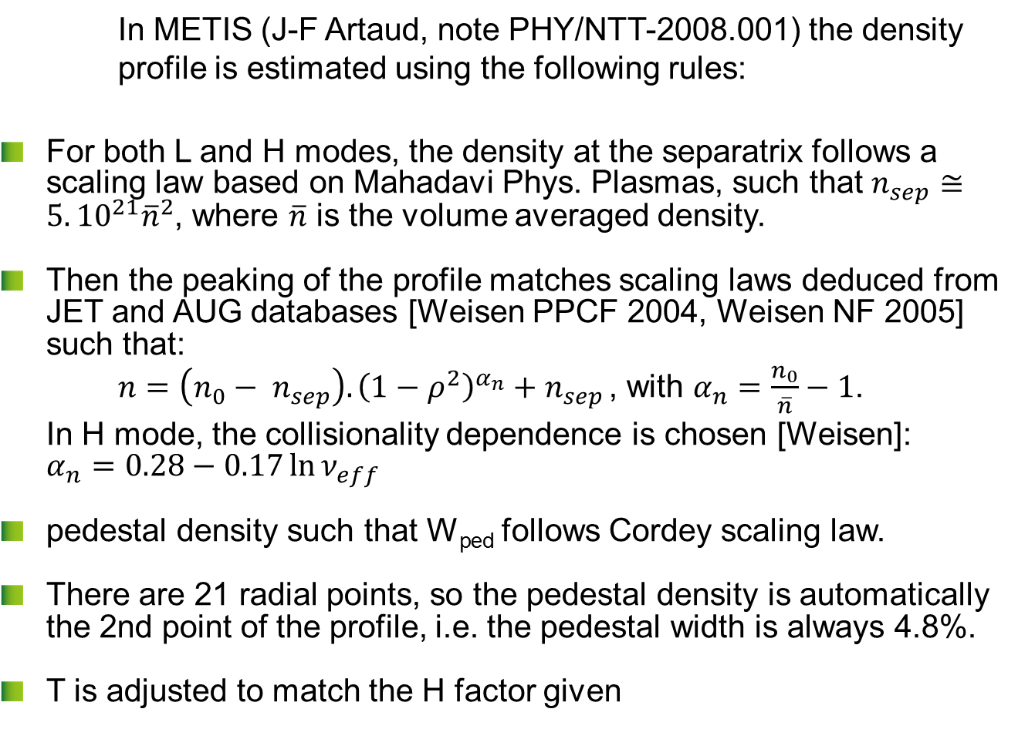
Rules in METIS : Density profiles
In METIS (J-F Artaud, note PHY/NTT-2008.001) the density profile is estimated using the following rules:
For both L and H modes, the density at the separatrix follows a scaling law based on Mahadavi Phys. Plasmas, such that $n_{sep}≅5.{10}^{21}{\overline{n}}^{2}$, where $\overline{n}$ is the volume averaged density.
Then the peaking of the profile matches scaling laws deduced from JET and AUG databases [Weisen PPCF 2004, Weisen NF 2005] such that:
$n={\left(n_{0}− n_{sep}\right).{\left(1−ρ^{2}\right)}^{α_{n}}+n}_{sep }$, with $α_{n}=\frac{n_{0}}{\overline{n}}−1$.
In H mode, the collisionality dependence is chosen [Weisen]: $α_{n}=0.28−0.17\ln{ν_{eff}}$
pedestal density such that W_{ped} follows Cordey scaling law.
There are 21 radial points, so the pedestal density is automatically the 2nd point of the profile, i.e. the pedestal width is always 4.8%.
T is adjusted to match the H factor given

Slide 10
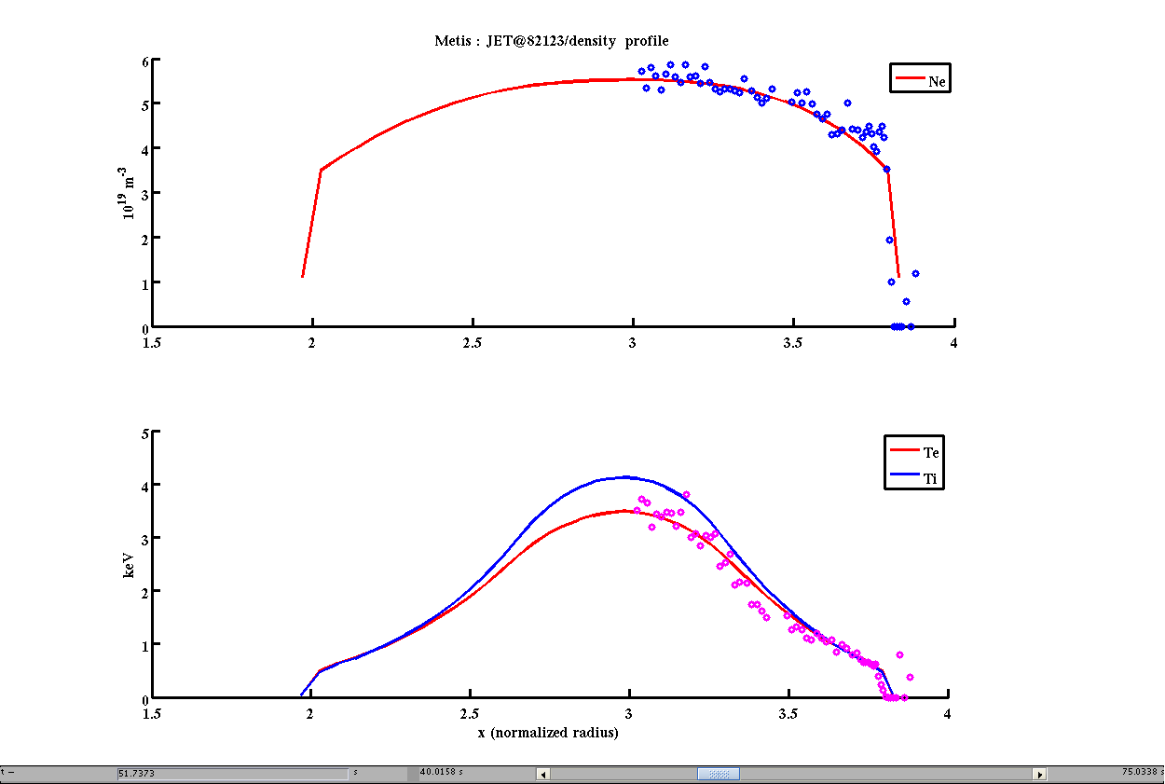
Rules in METIS : Density profiles

Slide 11
outline
Analyzing 4 JET pulses with METIS
Summary of “rules” that worked on 4 JET pulses (with different B, fuelling, triangularity)
Applying these rules for 13 WEST scenarios
Conclusions and perspectives

Slide 12
List of choices made for WEST metis simulations
As for JET pulses:
Low Z_{eff}=1.3, flat
density profiles: peaking with ν_{eff}
W source (n_{W}/n_{e} at separatrix = 10⁻⁴) and same accumulation factor
P_{rad} using post coefficient
H₉₈=0.7 (1, and 1.2 explored too)
Additional choices
LH:
to optimize accessibility N//=2
2 densities: one compatible with the cold approximation accessibility: n=6.5 10¹⁹m⁻³, another with an upshift <0.2: n=8.5 10¹⁹m⁻³
LH deposition at ρ=0.3 with a width of 0.3 (similar to last high LH power in Tore Supra 2011)
CD: Goniche scaling law
ICRH:
No ripple losses, although expected high (~25%)
55.5MHz, to have central 1H layer at nominal B
n_{ϕ}=25
n_{H}/n_{e}=7%

Slide 13
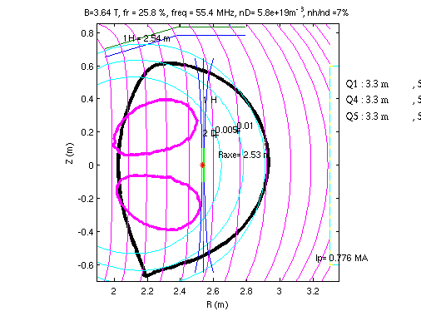
List of choices made for WEST metis simulations: ICRH
55.5MHz to have central 1H absorption layer

Slide 14
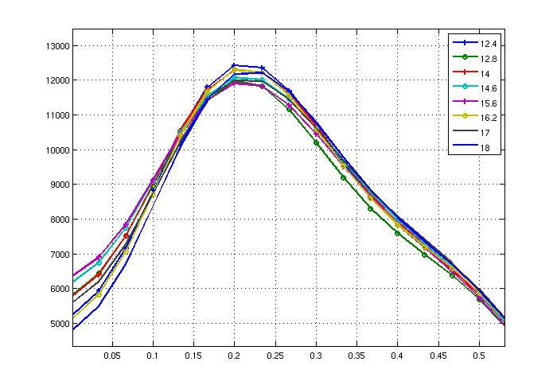
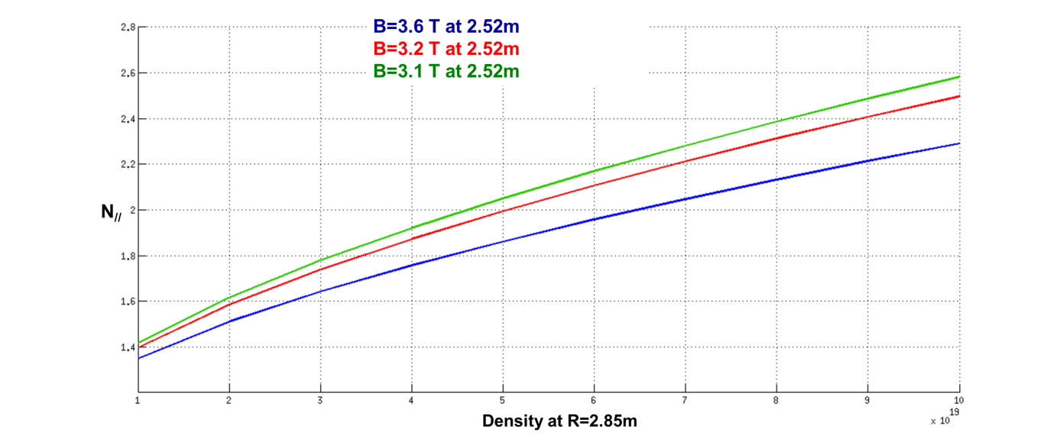
List of choices made for WEST metis simulations: LH
Hard X rays, TS 48161, LH=4MW
Illustration of the LH accessibility formula in the cold approximation
N//=2.2
N//=2

Slide 15
WEST scenarios
Scenario | High power |  |  |  |  |  | standard |  |  |  |  | High fluence
I_{p} (MA) | 0.776 | 0.465 | 0.776 | 0.465 | 0.776 | 0.776 | 0.776 | 0.465 | 0.776 | 0.465 | 0.776 | 0.465 | 0.465
X point height (cm) | 1.7 | 10.1 | 1.7 | 10.1 | 1.7 | 1.7 | 1.7 | 10.1 | 1.7 | 10.1 | 1.7 | 10.1 | 10.1
B_{T} (T) | 3.6 | 3.5 | 3.6 | 3.5 | 3.6 | 3.6 | 3.6 | 3.5 | 3.6 | 3.5 | 3.6 | 3.5 | 3.5
q₉₅ | 3.1 | 4.1 | 3.1 | 4.1 | 3.1 | 3.1 | 3.1 | 4.1 | 3.1 | 4.1 | 3.1 | 4.1 | 4.1
H₉₈ | 0.7 | 0.7 | 0.7 | 0.7 | 1 | 1.2 | 0.7 | 0.7 | 0.7 | 0.7 | 1 | 0.7 | 1
n_{e} (10¹⁹m⁻³) | 8.5 | 8.5 | 6.5 | 6.5 | 8.5 | 8.5 | 8.5 | 8.5 | 6.5 | 6.5 | 8.5 | 5 | 5
f_{GW} | 0.7 | 0.9 | 0.55 | 0.7 | 0.7 | 0.7 | 0.7 | 0.9 | 0.55 | 0.7 | 0.7 | 0.52 | 0.52
P_{heat} (MW) | 15 | 15 | 15 | 15 | 15 | 15 | 12 | 12 | 12 | 12 | 12 | 10 | 10
LHCD (MW) | 6 | 6 | 6 | 6 | 6 | 6 | 6 | 6 | 6 | 6 | 6 | 7 | 7
ICRH (MW) | 9 | 9 | 9 | 9 | 9 | 9 | 6 | 6 | 6 | 6 | 6 | 3 | 3
P_{L-H} (MW) | 6 | 5 | 4.5 | 4 | 6 | 6 | 6 | 5 | 4.5 | 4 | 6 | 3.5 | 3.5
P_{rad} (MW) | 1.70 | 1.59 | 1.04 | 0.96 | 1.74 | 1.74 | 1.72 | 1.61 | 1.02 | 0.96 | 1.73 | 0.58 | 0.59
n_{W} (10¹⁵m⁻³) at ρ=0.5 | 2.4 | 2.8 | 1.6 | 1.5 | 2.2 | 2.1 | 2.6 | 2.9 | 1.2 | 1.6 | 2.4 | 0.8 | 0.8
ρ of q=1 | 0.45 | 0.35 | 0.5 | 0.1 | 0.4 | 0.3 | 0.5 | 0.4 | 0.4 | 0.1 | 0.4 | no | no
l_{i} | 1.07 | 1.23 | 1.29 | 1.11 | 1.03 | 0.98 | 1.13 | 1.29 | 0.98 | 1.18 | 1.08 | 1.00 | 0.85
β_{p th} | 1.12 | 2.09 | 1.00 | 1.86 | 1.63 | 1.98 | 1.05 | 1.95 | 0.93 | 1.73 | 1.51 | 1.45 | 2.12
W_{th} (MJ) | 0.64 | 0.40 | 0.57 | 0.36 | 0.91 | 1.09 | 0.60 | 0.38 | 0.53 | 0.38 | 0.85 | 0.29 | 0.41
Bootstrap (MA) | 0.16 | 0.11 | 0.14 | 0.14 | 0.24 | 0.31 | 0.13 | 0.10 | 0.15 | 0.11 | 0.22 | 0.13 | 0.23
LHCD (MA) | 0.18 | 0.14 | 0.25 | 0.20 | 0.21 | 0.23 | 0.19 | 0.15 | 0.25 | 0.22 | 0.23 | 0.33 | 0.38
Flat-top (s) (14 Wb consumed) | 20 | 37 | 36 | 79 | 39 | 62 | 18 | 33 | 30 | 67 | 34 | 227 | recharge

Slide 16
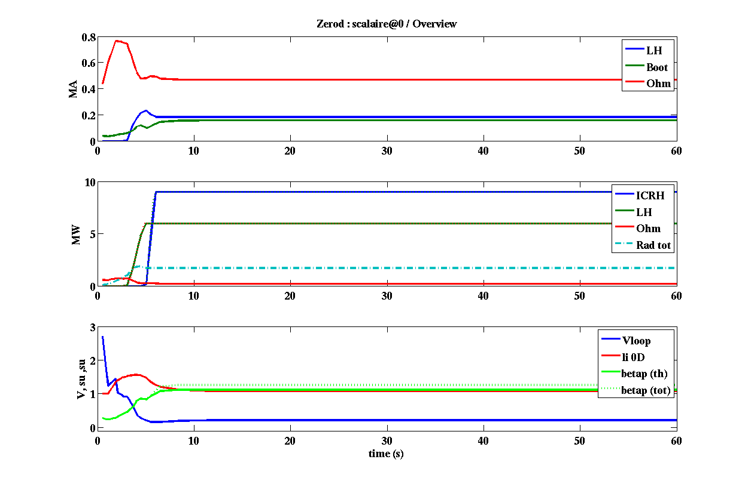
15 MW, 0.776 MA, 8.5 10¹⁹m⁻³, H=0.7

Slide 17
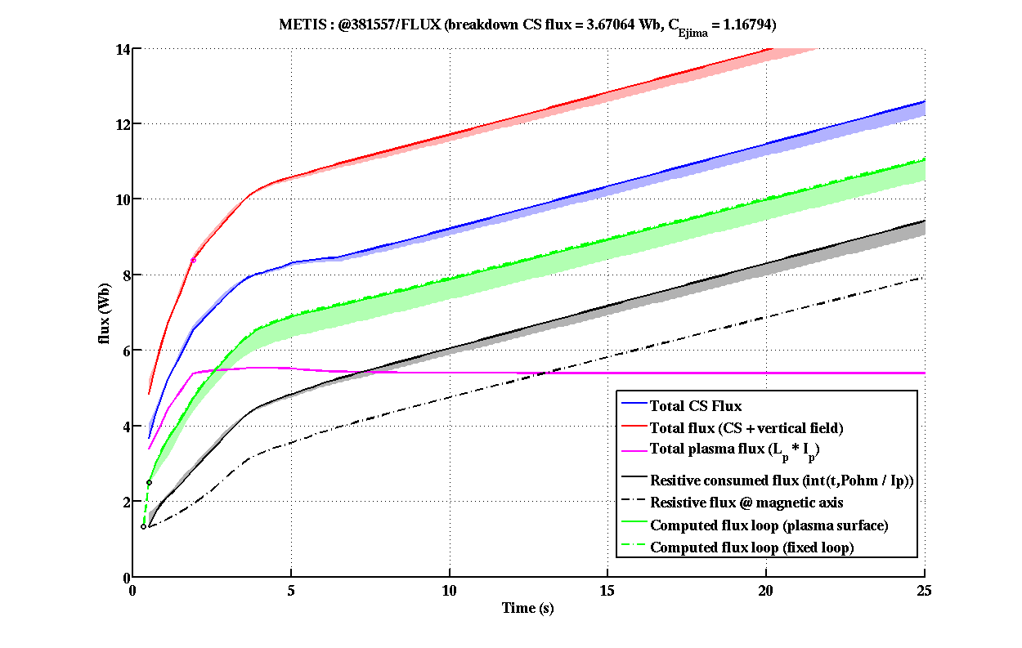
15 MW, 0.776 MA, 8.5 10¹⁹m⁻³, H=0.7

Slide 18
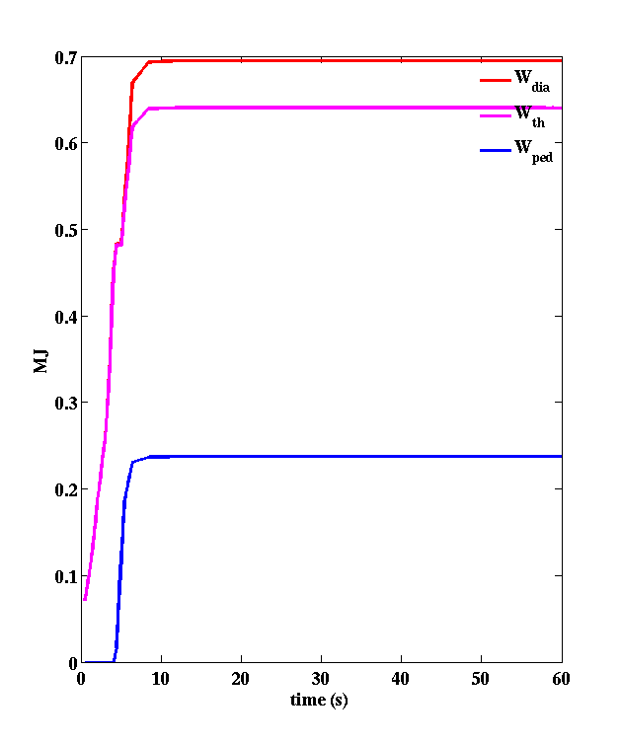
15 MW, 0.776 MA, 8.5 10¹⁹m⁻³, H=0.7

Slide 19
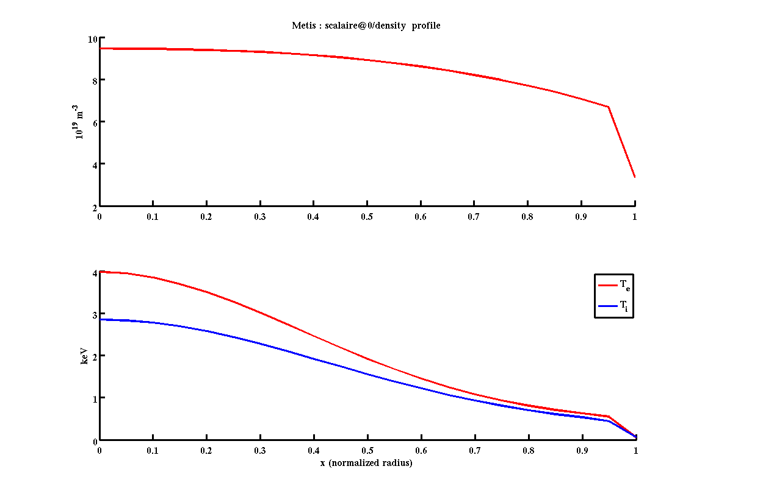
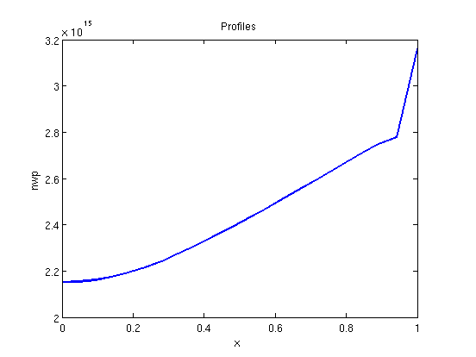
15 MW, 0.776 MA, 8.5 10¹⁹m⁻³, H=0.7
10.10¹⁹m⁻³
n_{e}
n_{ped}~7.10¹⁹m⁻³
3.2.10¹⁵m⁻³
n_{W}
4keV
T_{e}
T_{i}
T_{ped} ~550eV

Slide 20
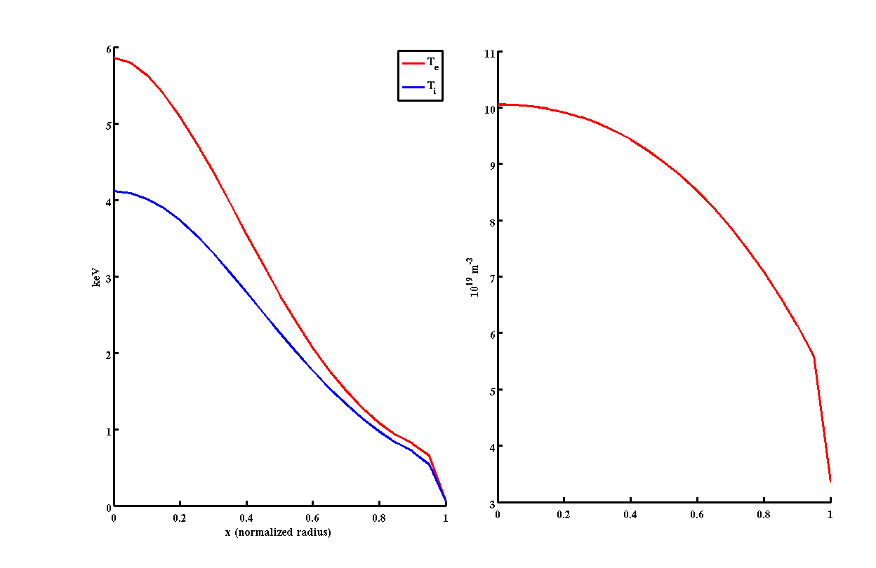
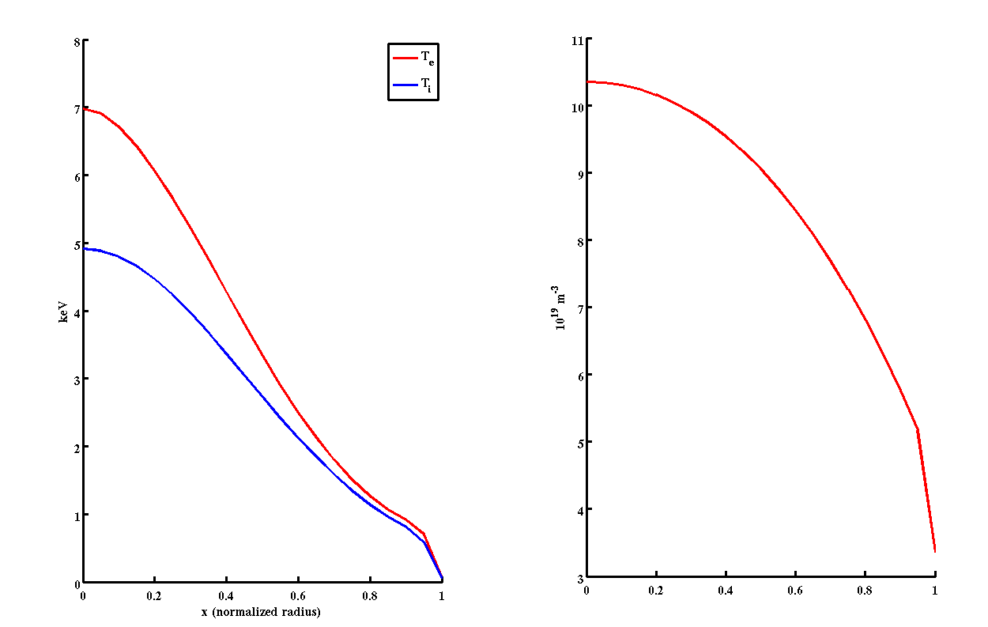
Pedestal, 15 MW, 0.776 MA, 8.5 10¹⁹m⁻³
6keV
T_{e}
H=1
T_{i}
7keV
T_{e}
H=1.2
T_{i}
T_{ped} ~700eV

Slide 21
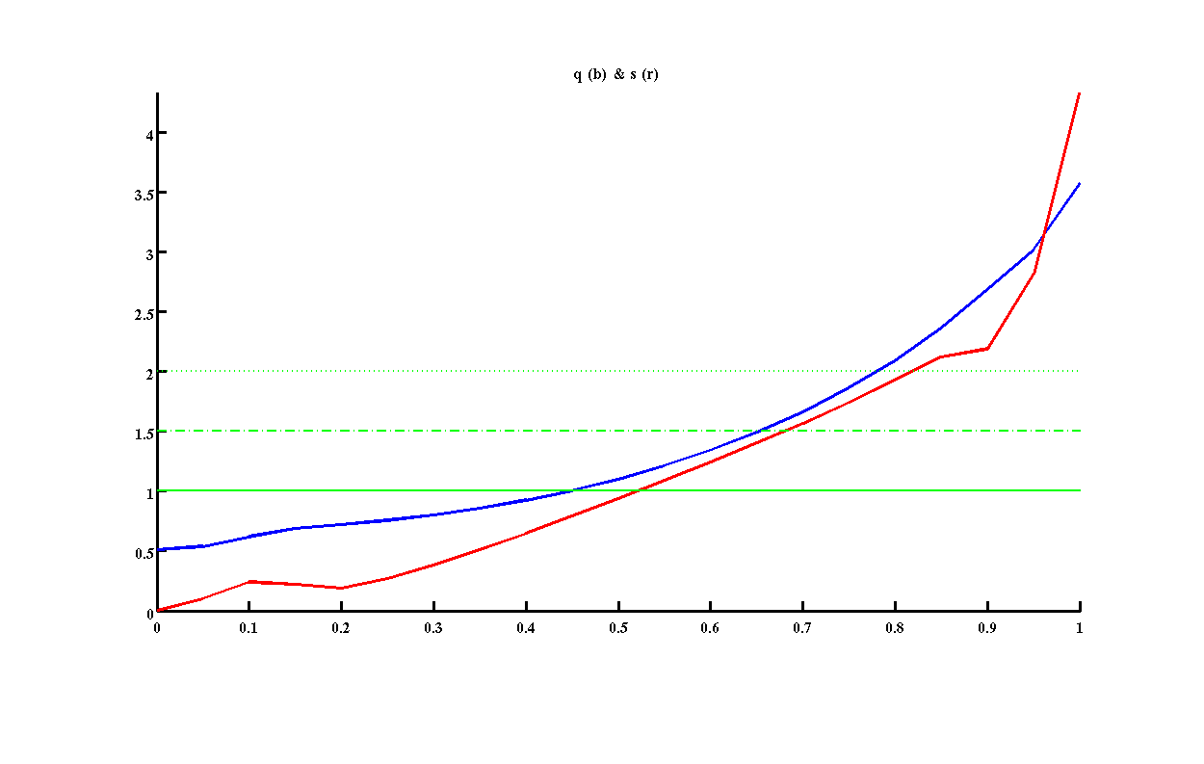
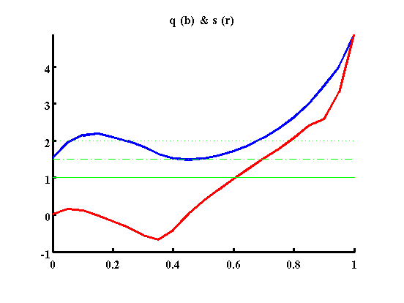
Q profiles, H=0.7
6 LH + 9 IC MW, 0.776 MA, 8.5 10¹⁹m⁻³
7 LH + 3 IC MW, 0.465 MA, 5 10¹⁹m⁻³
q=1 at mid-radius
s always positive
q>1 at all radii
s<0 until mid radius

Slide 22
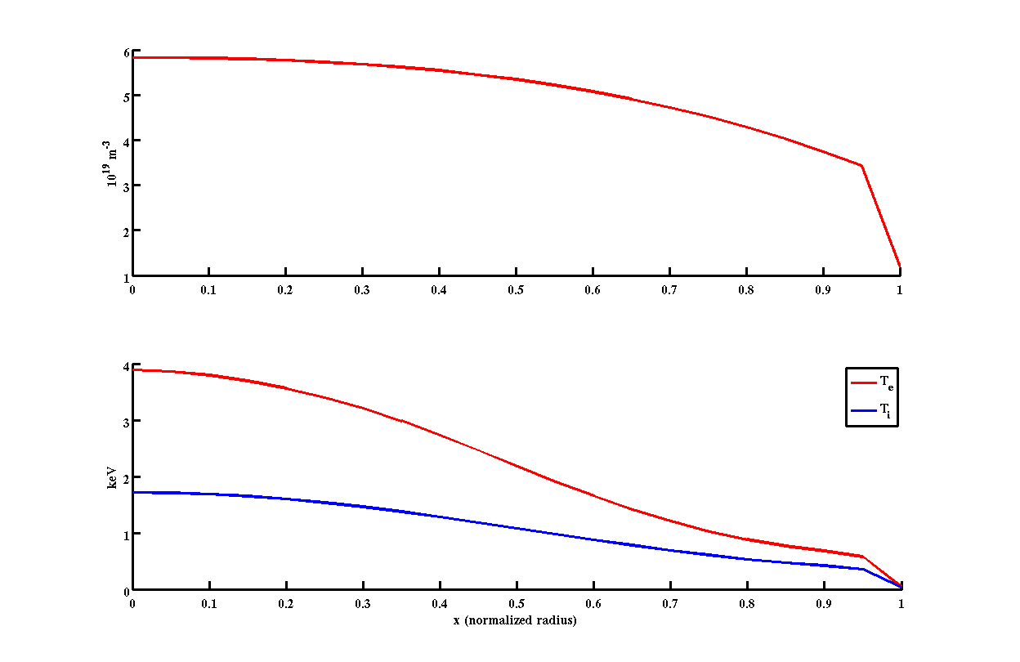
T and density profiles, H=0.7
6 LH + 9 IC MW, 0.776 MA, 8.5 10¹⁹m⁻³
7 LH + 3 IC MW, 0.465 MA, 5 10¹⁹m⁻³
10.10¹⁹m⁻³
n_{e}
6.10¹⁹m⁻³
n_{e}
n_{ped}~3.10¹⁹m⁻³
n_{ped}~7.10¹⁹m⁻³
4keV
T_{e}
4keV
T_{e}
T_{ped} ~600eV
T_{i}
T_{ped} ~550eV
T_{i}

Slide 23
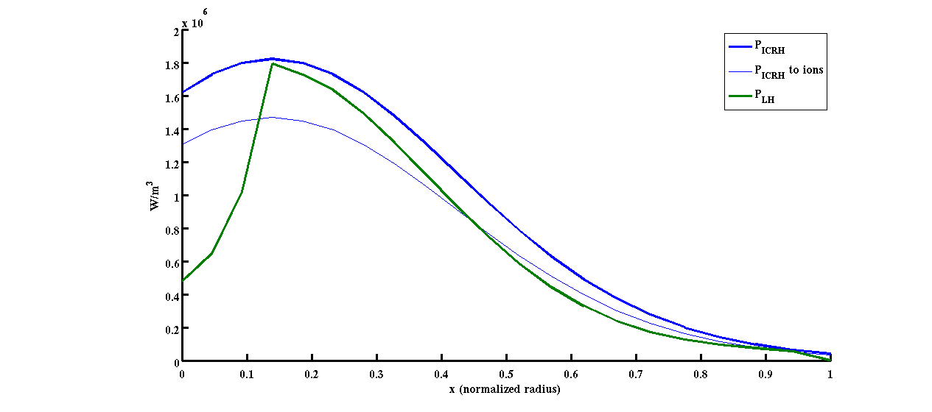
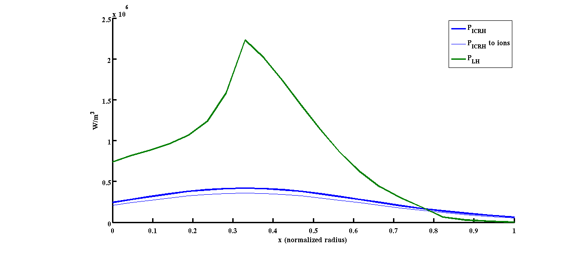
ICRH, LH power depositions, H=0.7
6 LH + 9 IC MW, 0.776 MA, 8.5 10¹⁹m⁻³
7 LH + 3 IC MW, 0.465 MA, 5 10¹⁹m⁻³
P_{LH}
P_{ICRH}
P_{LH}
P_{ICRH}

Slide 24
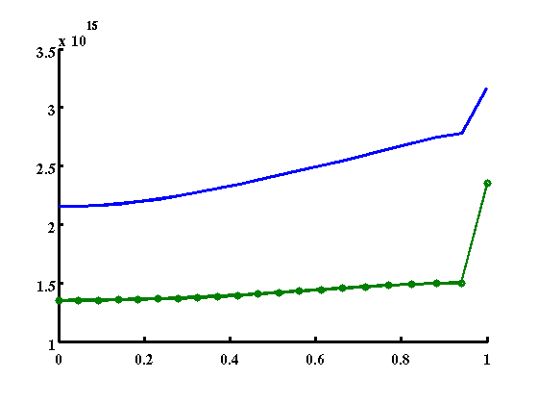
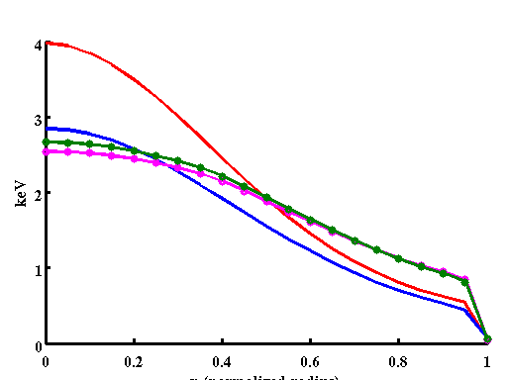
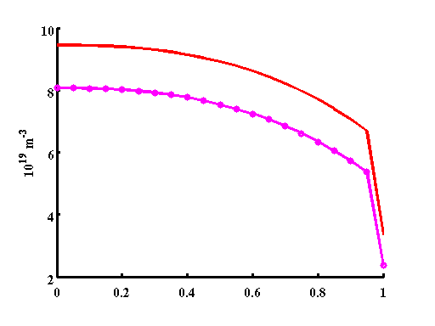
WEST T pedestal lower and density ped higher
WEST 15MW, 0.8MA, 8.5 10¹⁹m⁻³ vs JET 82541: more W, higher ne but lower T_{e} for r/a>0.5
WEST, n_{W}
JET, n_{W}
WEST, T_{e}
JET, T_{i}
WEST, n_{e}
JET, T_{e}
JET, n_{e}
WEST, T_{i}

Slide 25
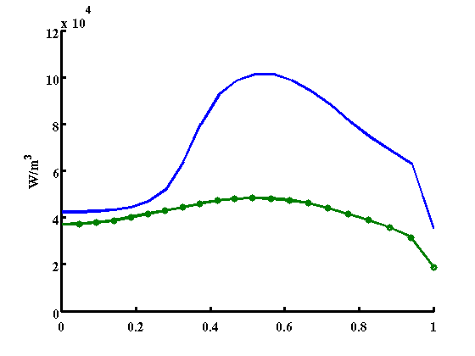
Why Prad low in west?
Because smaller volume! In MW/m³ larger P_{rad} in WEST than JET as expected!
WEST, P_{rad}
JET, P_{rad}

Slide 26
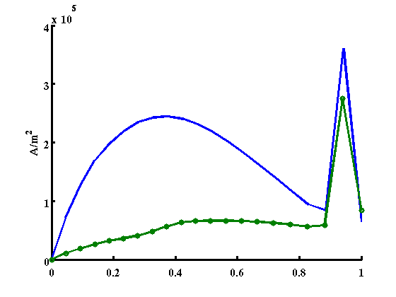
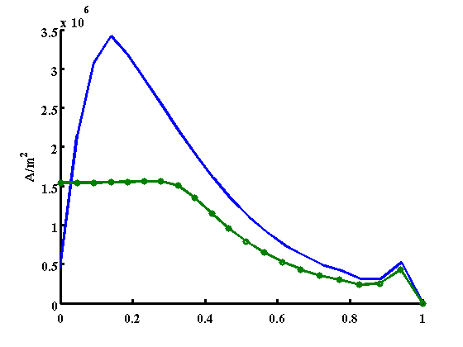
More corE bootstrap in WEST
bootstrap in pedestal similar, and elsewhere larger in WEST due to higher fraction of trapped
WEST, j_{boot}
j_{tot}
JET, j_{boot}

Slide 27
outline
Analyzing 4 JET pulses with METIS
Summary of “rules” that worked on 4 JET pulses (with different B, fuelling, triangularity)
Applying these rules for 13 WEST scenarios
Conclusions and perspectives

Slide 28
Summary of west scenarios
Using 4 JET pulses: chose 10⁻⁴ for n_{W}/n_{e}, H ~0.7, hollow W profiles, density peaking and separatrix values
LH deposition arbitrary (based on last TS campaign) 0.3 with a width of 0.3, N//=2
ICRH 7% of n_{H}/n_{e}, 55.5 MHz
With these choices, low level of P_{rad}, but P_{rad}/m³ is higher in WEST as expected due to higher density. But since the volume is smaller, P_{rad} is lower in WEST at most 14%.
Large level of core bootstrap due to large fraction of trapped. Fraction bootstrap max around 1/3
T pedestal weak, density pedestal large
q profiles can be reversed at low density large LH. Or wide region of q<1 for high density cases.

Slide 29
perspectives
Test impact of W peaking factor on P_{rad} results
Vary ratio n_{W}/n_{e} 10⁻⁴ to higher values, compare to COREDIV
Test impact of density scaling on T_{ped}, explore T_{ped} / edge bootstrap range
LH: double issue of CD efficiency and accessibility. Will influence strongly the scenarios. Need LUKE estimates of both
Add ICRH only scenario, at various B
Check consistency of pedestal with MHD peeling/ballooning stability
Compare T and n profiles/pedestals with CRONOS tuned for JET/JT60-U
Estimate LH ripple losses in worse case scenario (low n and high I_{p})
ICRH: ripple losses are expected at 25% range. Not accounted for here. Need to estimate using EVE/SPOT type of tool.
ICRH deposition with EVE, power to ions?
MHD stability of q profiles

Slide 30
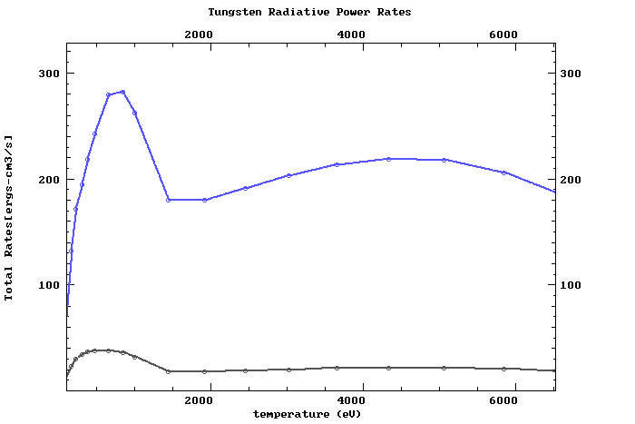
Why Prad is low in WEST scenarios? Radiated power from W
Radiated power per volume unit increases with higher electron density and sensitive to T_{e} below 2 keV, not much above
10²⁰m⁻³
10¹⁹m⁻³
http://www-amdis.iaea.org/FLYCHK/ZBAR/csd074.php

