Slide 1
ITER Integrated Scenario Modelling needs
Alberto Loarte
for the ITER Organization-Plasma Operation Directorate
The views and opinions expressed herein do not necessarily reflect those of the ITER Organization

Slide 2
Introduction
Introduction
Core plasma energy and particle transport
Pedestal Transport/Edge Impurity control
Edge/core integration
Plasma Fuelling
Conclusions
Notes:
2
The point here

Slide 3
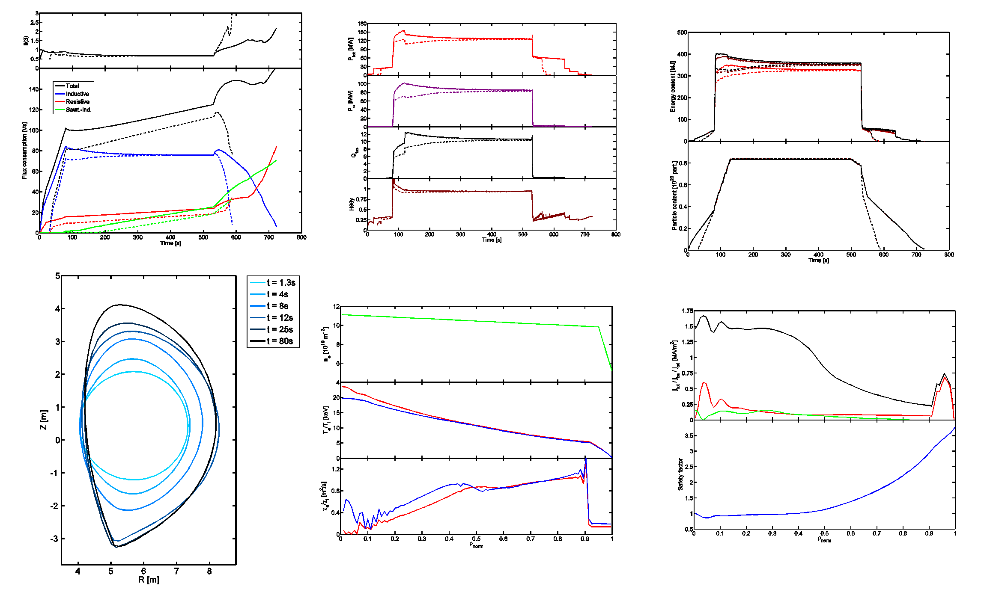
Introduction
ITER’s success requires the achievement of high fusion performance → modelling of all phases of the discharges required not just the burning phase → ISM
Parail, NF 2013
Notes:
3

Slide 4
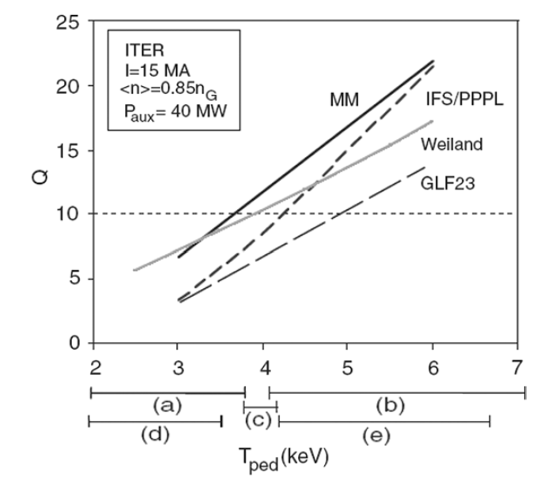
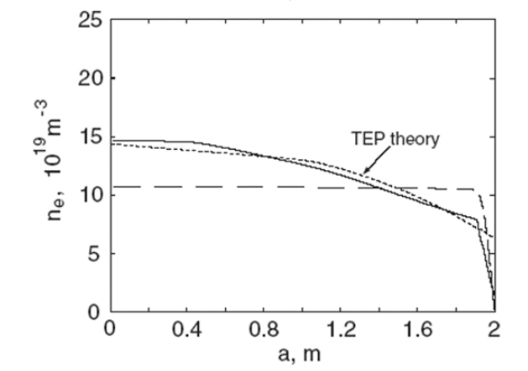
Core Plasma Energy and Particle Transport - I
Significant advances in understanding core turbulent transport in order to predict ITER’s burning plasmas profiles
Inclusion of physics based particle transport in ITER scenarios needs to be strengthened
IPB 2007
GLF23
Notes:
4

Slide 5
Core Plasma Energy and Particle Transport - II
Inclusion of physics-based main ion and impurity transport models to evaluate stationary phases of scenarios is the next required step → control of density profiles by heating schemes
Notes:
5

Slide 6
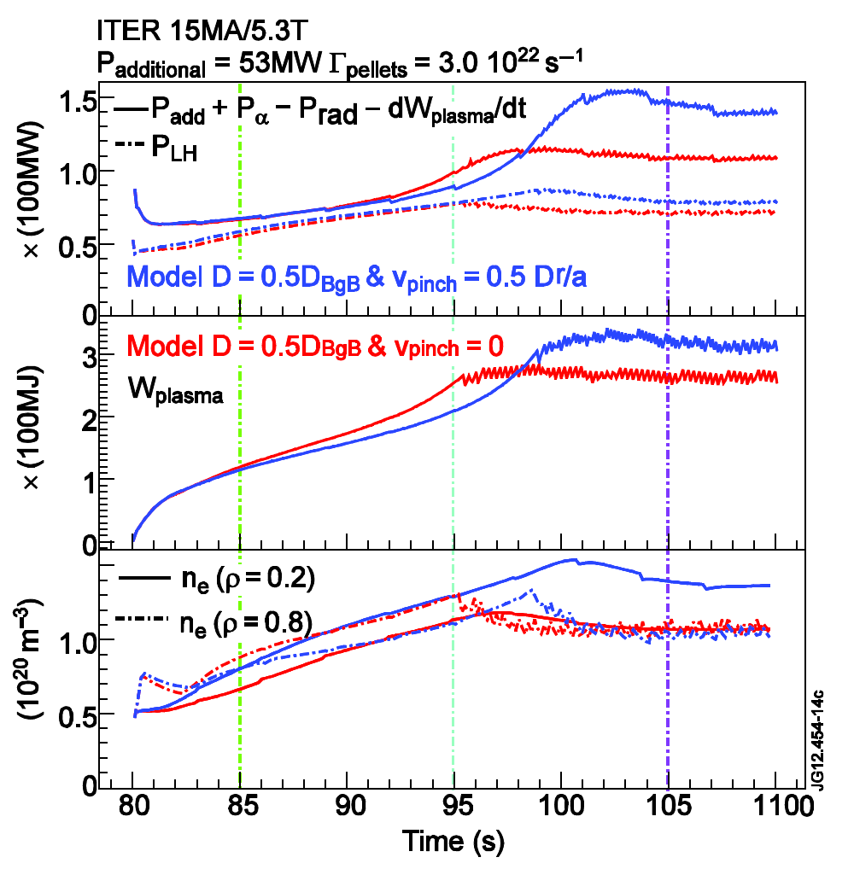
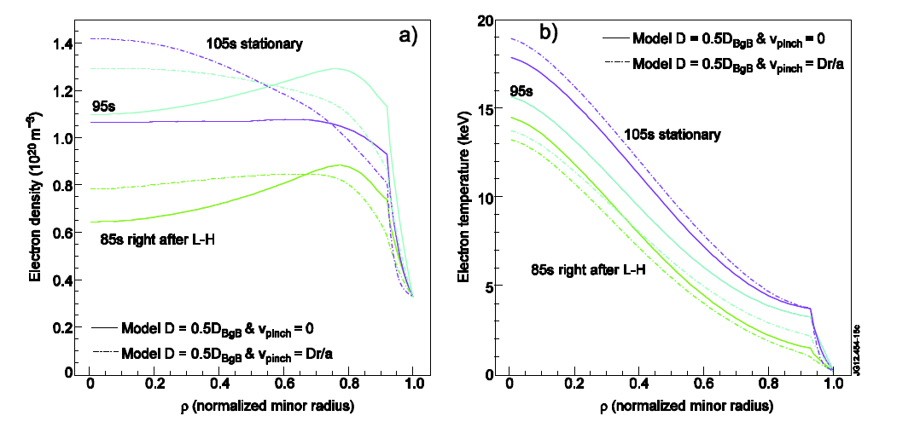
Core Plasma Energy and Particle Transport - III
Prediction of plasma behaviour during transient phases of scenarios is required to define plasma control (heating + fuelling strategies) for access to burn, exit from burn and exit from H-mode
Notes:
6

Slide 7
Core Plasma Energy and Particle Transport - IV
Integrated modelling of edge/core relation during H-L transition is particularly important to define control and mitigation actions
Notes:
7

Slide 8
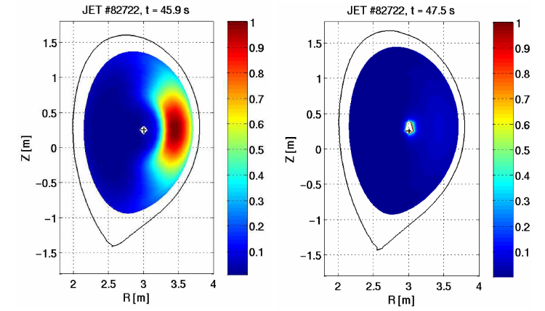
Core Plasma Energy and Particle Transport - V
Physics-based integrated modelling of high Z impurity transport in ITER scenarios is require as transient phases may require different control strategies than stationary phases
W density
NEO+GKW
Angioni EPS 2013
Hollow n_{e} phase
Peaked n_{e} phase
Notes:
8

Slide 9
Edge-Core Pedestal Transport and ELMs - I
Impurity transport of impurities needs to be included in ITER scenario simulations in self-consistent way → compatibility with loads on PFCs can affect significantly high Z impurity transport
  Large grad-T|_{ped} → good temperature screening
  Small grad-n|_{ped} (because of high n_{sep} for divertor power load control) → small inwards pinch
ITER-STRAHL-Dux & Fable -EPS 2013
Pedestal Impurity peaking
n_{sep} range for q_{div} control
Notes:
9

Slide 10
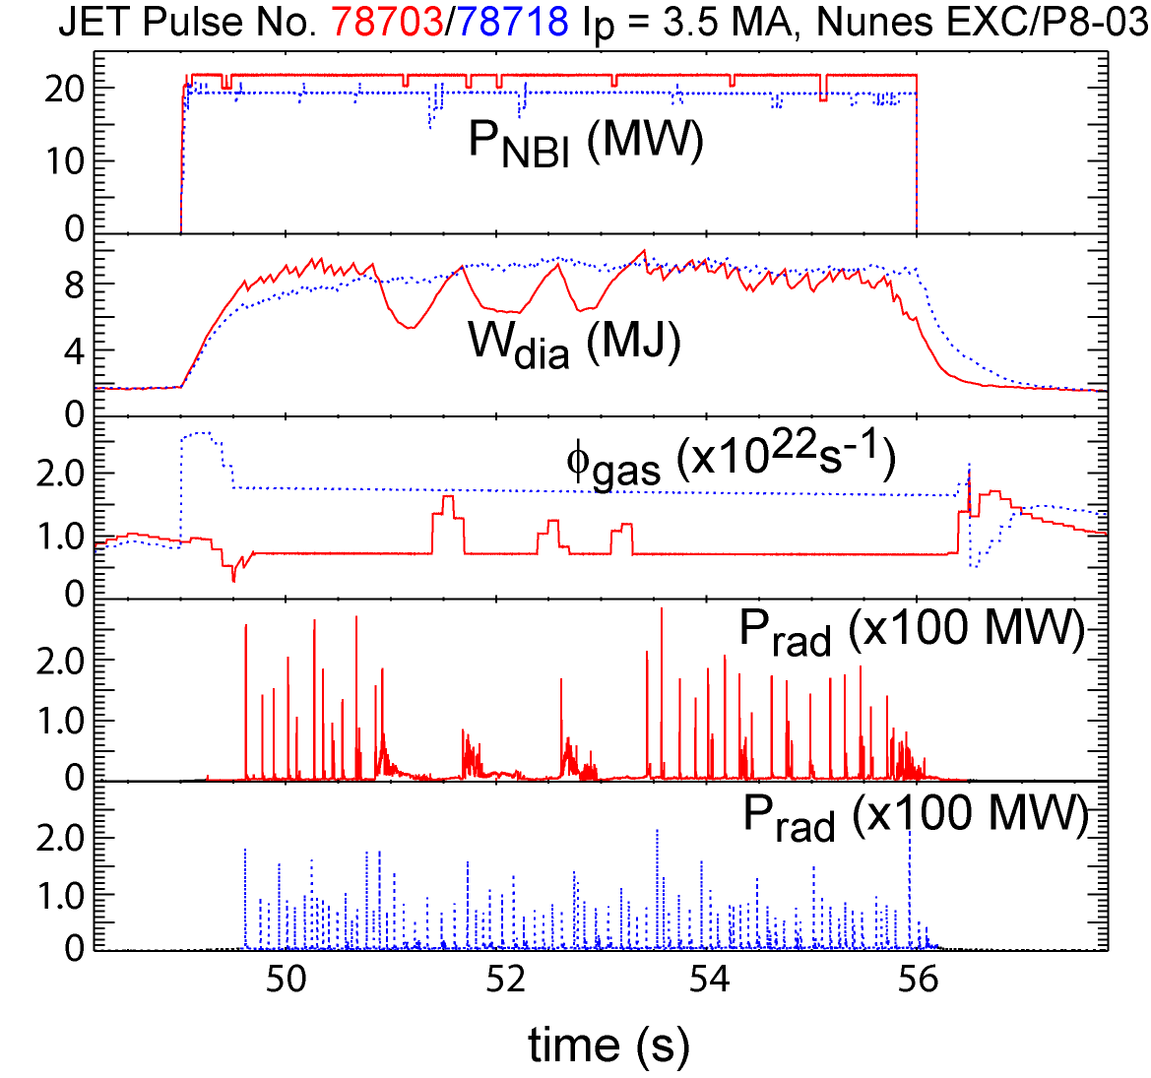
Edge-Core Pedestal Transport and ELMs - II
Inclusion of effects of ELMs on particle losses & dynamics required :
  Determine effectiveness of ELMs to expel (high Z) impurities (diffusive-like ELMs can cause n_{Z} increase)
  Understand high Z transient radiation behaviour during ELMs (can drive plasma back to L-mode)
ITER- Dux and Fable – EPS 2013
Notes:
10

Slide 11
Pedestal Transport and ELMs - III
Modelling of ELMs requires integrated modelling including SOL and divertor
ITER- Coster – EPS 2013
Integration of pedestal/edge modelling into ITER scenarios required to derive ELM control requirements for core impurity control through all phases of the discharge
Notes:
11

Slide 12
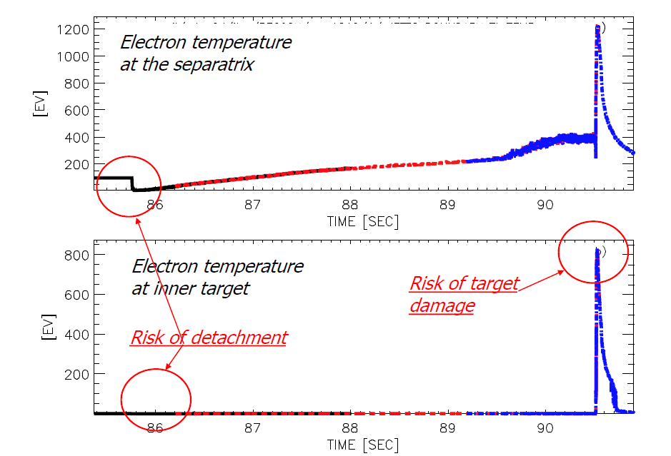
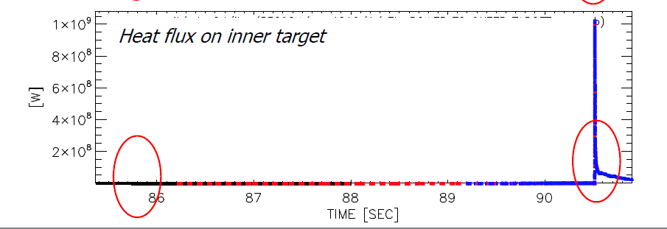
Edge-Core Integration
Requirements for separatrix density and impurity seeding control for power load control evaluated for stationary phases of scenarios
Requirements for power load control and strategies need to be included in scenario simulations
ITER-JINTRAC- Parail
Notes:
12

Slide 13
Plasma Fuelling - I
Incorporation of realistic fuelling/pumping assumptions in scenarios are required to optimize control
Optimization of evolution of separatrix and pedestal density by optimization of gas and pellet fuelling required for optimum evolution from L-mode → H-mode → burn (fusion power, impurities, etc.)
Notes:
13

Slide 14
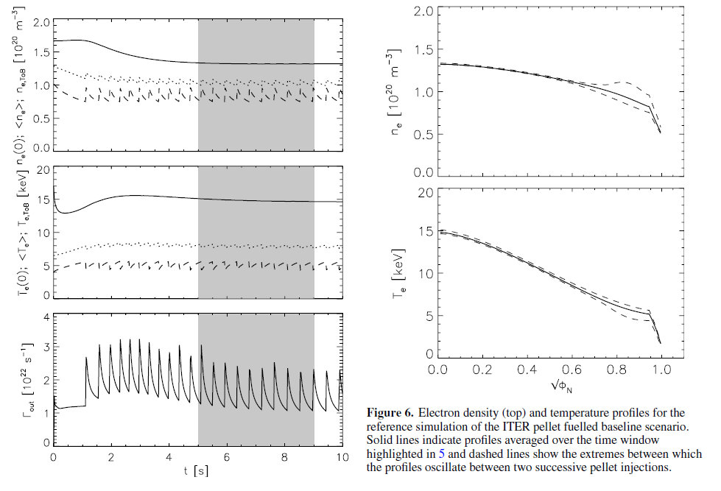
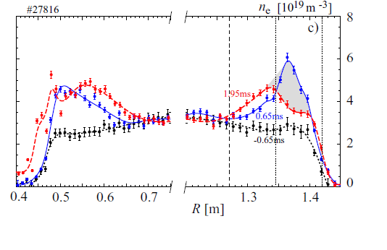
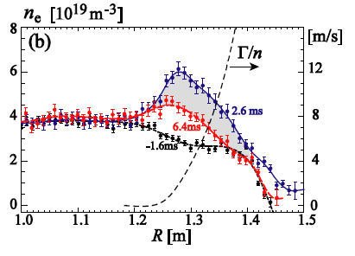
Plasma Fuelling - II
Improved treatment of pellet fuelling in scenarios is required (stationary phases and transients) to optimize fuelling:
  Including particle loss by ELM triggering (from MHD codes)
  Including physics-based model of post-pellet hollow density profile relaxation
ITER-JINTRAC-Garzotti
MAST-Valovic
Notes:
14

Slide 15
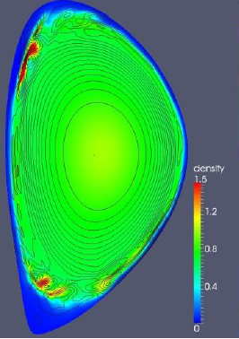
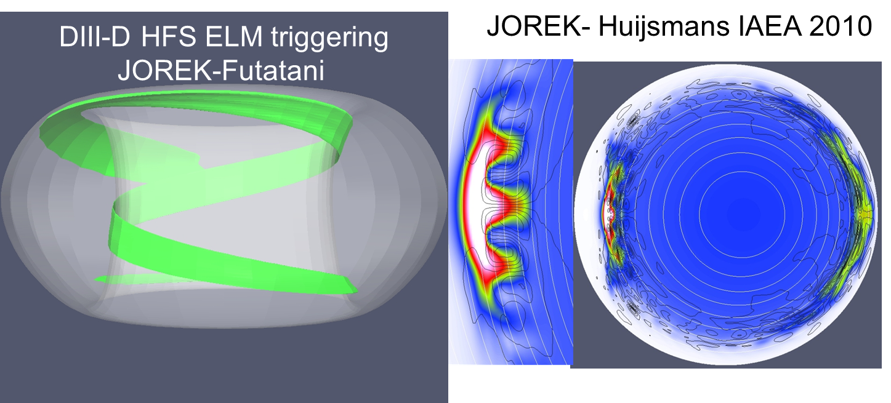
Plasma Fuelling - III
HFS pellet injection posses interesting questions that need to be understood for ITER (ELM triggering and plasma fuelling) :
  Triggering of ELM-like instabilities in the HFS
  Relaxation of hollow density profiles following symmetrization of pellet cloud
Density
Pressure
HFS
R
Notes:
15
Here the point of the density is to understand particle transport during transient hollow profiles. It is linked to slide 5. Our fear is that inwards diffusion is rather slow and thus the edge density that we deposit by pellets is likely to be expelled by the next ELM.

Slide 16
Conclusions
ITER integrated scenario simulations carried out so far have provided key input to define the specifications of PF coils, and to evaluate the feasibility of the ITER reference scenarios with the existing heating systems
Transient phases have been analyzed in less detail although they can present specific control challenges
Definition and optimization of scenarios now requires inclusion of:
  Physics-based description of particle transport in stationary phases and during transients (including hollow density profiles phases)
  Impurity transport (particularly of W)
  Gas and pellet fuelling into scenario simulations
  ELM control (impurity control) and power control to PFCs during all phases of the scenarios
  ….
Obviously this is a long programme and will be subject to uncertainties in the models used → having a range of the predictions and possible control schemes to avoid problems is much better than ignoring the problem
Notes:
16
The point here

