Slide 1
Particle transport with theory-based models
J. Garcia
6 June 2013

Slide 2
Context
Simulate temperatures and densities for JET and JT-60U H-mode inductive and hybrid scenarios with GLF23 and CDBM
1st step: Plasma boundary prescribed
2nd step: Simulation of density and temperature at the pedestal
3rd step: particle transport, current diffusion, and pedestal pressure
4th step: Use this knowledge for predicting performance in future experiments and devices like JT-60SA
5th step: Compare pedestal pressure with Peeling-Balloning calculations. If something dramatically wrong, back to point 2.
The results give an operational window of the expected performance for JT-60SA
CRONOS code used for this analysis: Provides heating and particle sources, neoclassical transport, equilibrium

Slide 3
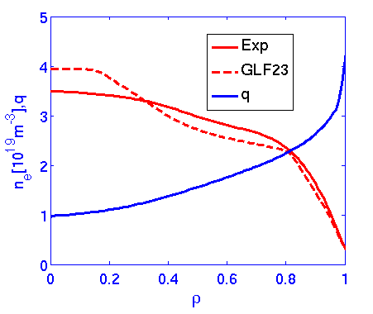
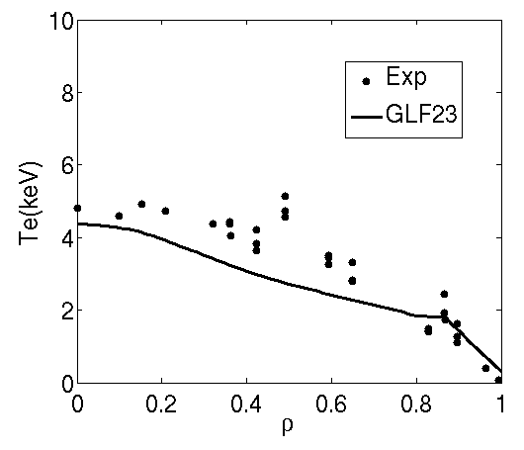
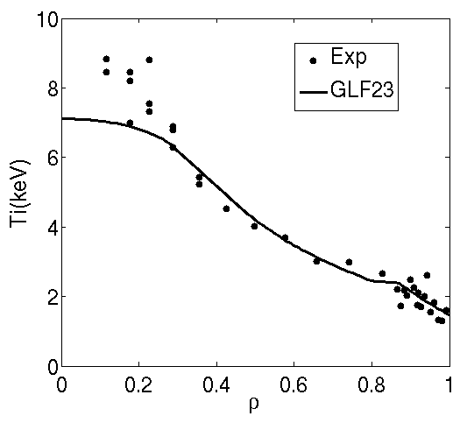
JT-60U H-mode: 33654
Density is simulated with GLF23. Density pedestal is fixed to experimental value
Only NBI particle source considered (particle source at the edge on the way)
Density is simulated with reasonable agreement(slightly more peaked)

Slide 4
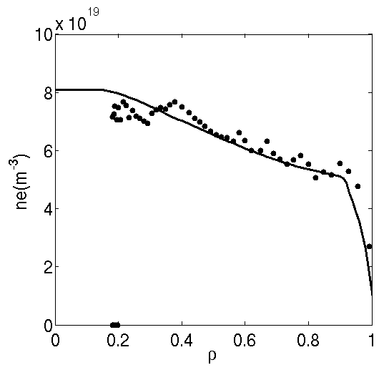
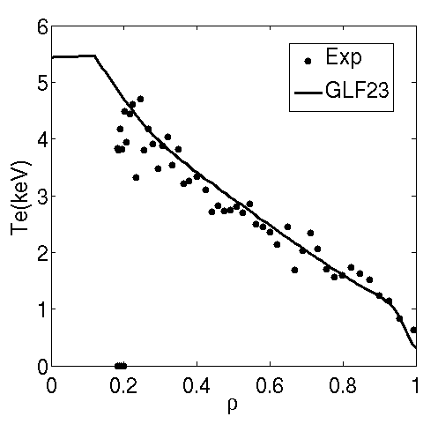
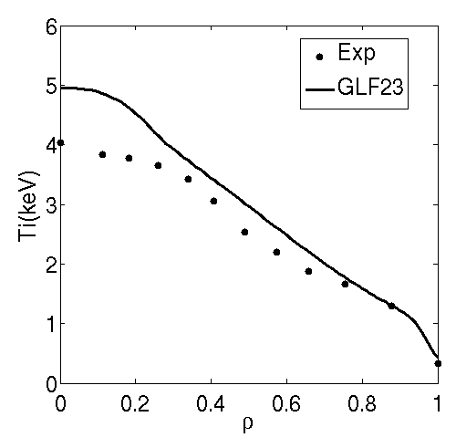
JET H-mode: 77070
Density is simulated with GLF23.
Density pedestal is fixed to experimental value by assuming that turbulent transport is reduced to neoclassical levels
Only NBI particle source considered
No sawteeth considered
Density is simulated with reasonable agreement.Temperatures are close to experiment.

Slide 5
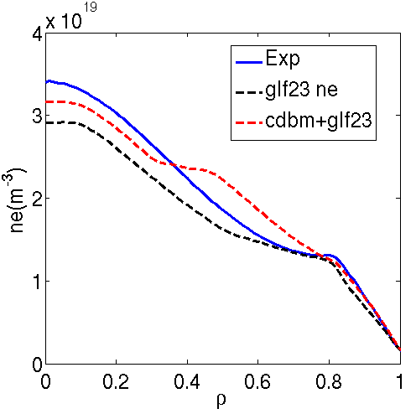
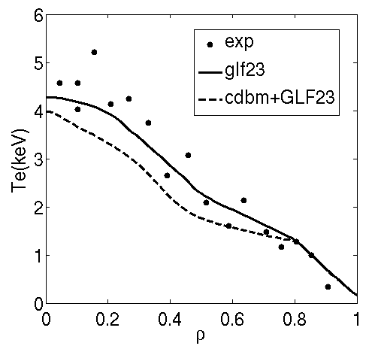
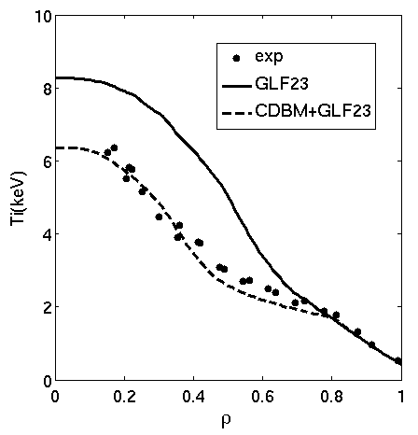
JT-60U Hybrid : 48158
Density is simulated with GLF23. Density pedestal is fixed to experimental value by reducing diffusivity to neoclassical value.
Only NBI particle source considered
Temperatures are simulated with both CDBM and GLF23.
Density is simulated with reasonable agreement for both models
Temperature profiles are similar than fixed density simulations, including EXB.
The ion temperature is much beter simulated with CDBM

Slide 6
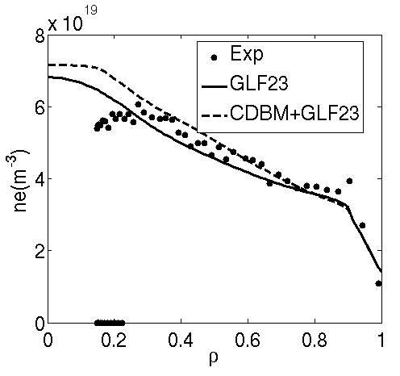
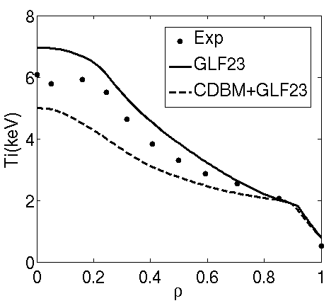
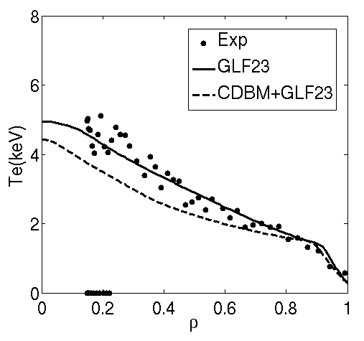
JET Hybrid : 77922
Density is simulated with GLF23. Density pedestal is fixed to experimental value by reducing diffusivity to neoclassical value.
Only NBI particle source considered
Temperatures are simulated with both CDBM and GLF23.
Density is simulated with reasonable agreement for both models
Both models give slighlty lower temperatures than in fixed density case.

Slide 7
Fully self-consistent simulations

Slide 8
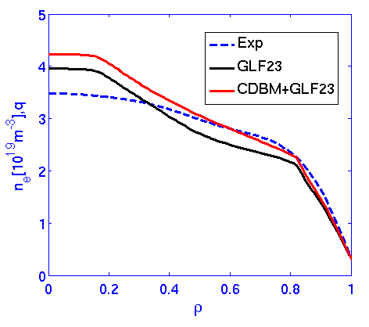
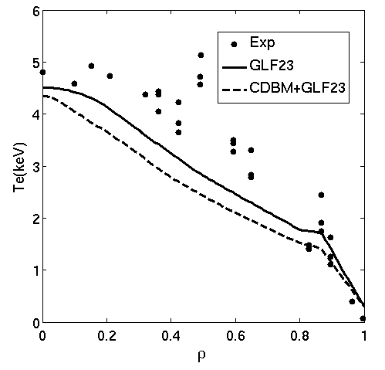
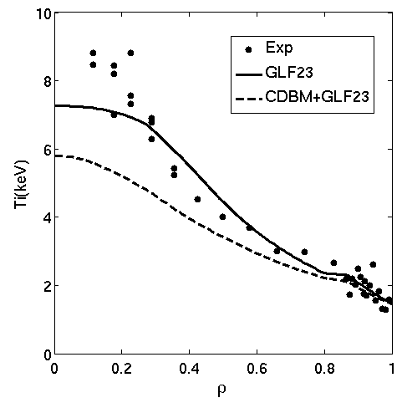
Fully self-consistent simulations: JT-60U 33654
Density is reasonably well simulated by using this scheme but always more peaked with both models
Pedestal temperatures are close to experimental data
Temperatures a slightly understimated by using CDBM

Slide 9
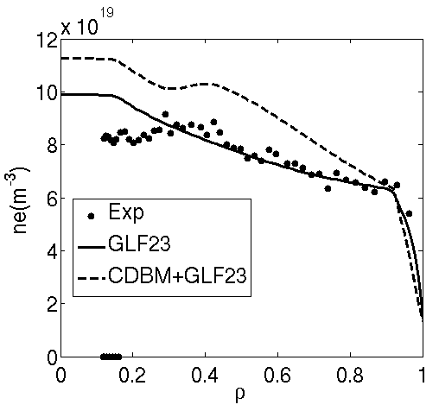
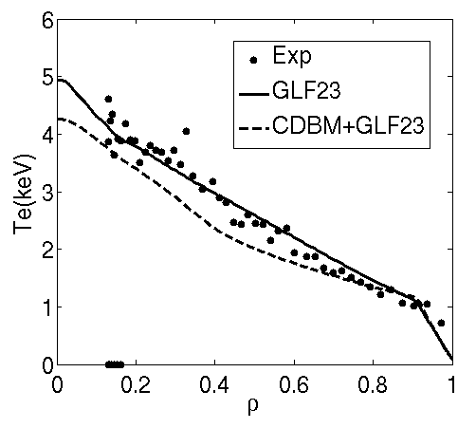
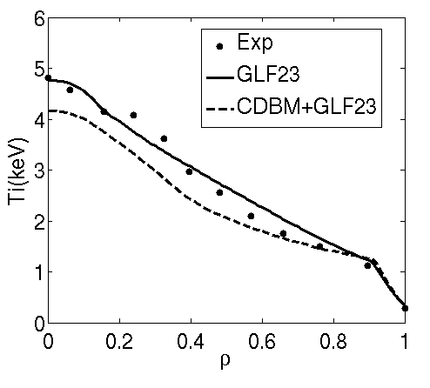
Fully self-consistent simulations: JET 73344
Very well pedestal features obtained both for density and temperatures
Again GLF23 is better than CDBM

Slide 10
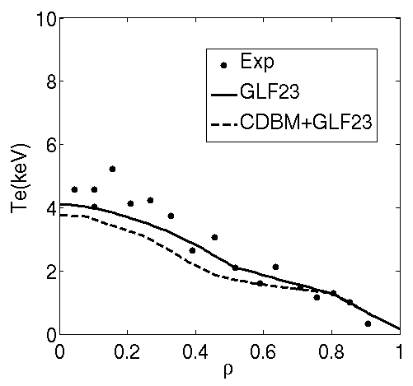
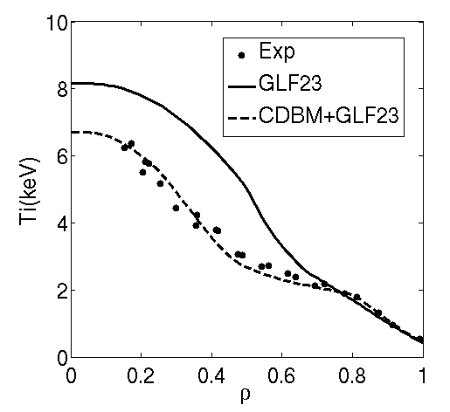
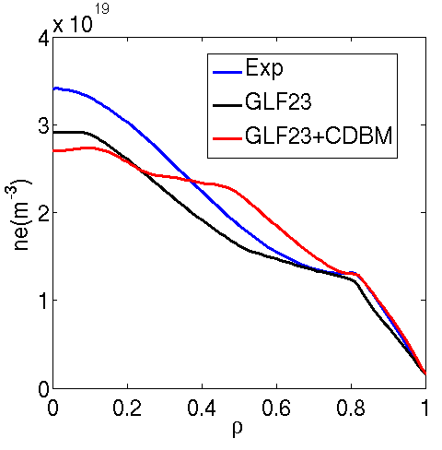
Fully self-consistent simulations: JT-60U 48158
No current diffusion made for this shot
Density is reasonably well simulated by using this scheme.
With GLF23 density peaking is similar to experimental data
Electron temperature similar for both models
Ion temperature much better for CDBM
Pedestal is well simulated

Slide 11
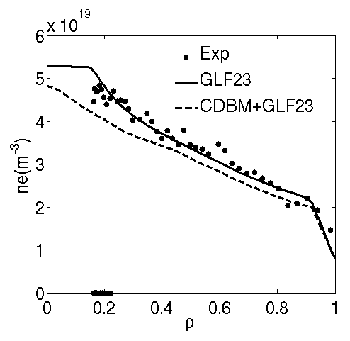
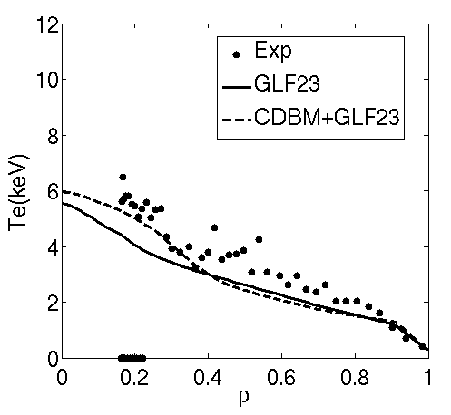
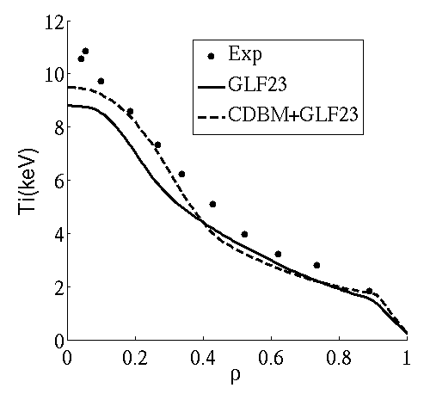
Fully self-consistent simulations: JET 75225
Density is reasonably well simulated by using this scheme altough a bit better for GLF23
Temperatures are reasonably well simulated

Slide 12
Conclusions

Slide 13
Conclusions
Temperatures and densities are reasonably simulated with GLF23 for H-mode inductive scenarios in both devices
The combination of CDBM (heat)+GLF23 (particle) is good for advanced scenarios
The pedestal density can be simulated by asuming neoclassical transport with some margin of confidence
Cordey scaling gives reasonable temperature at the pedestal
First simulations performed for JT60-SA give encouraging results

