Slide 1
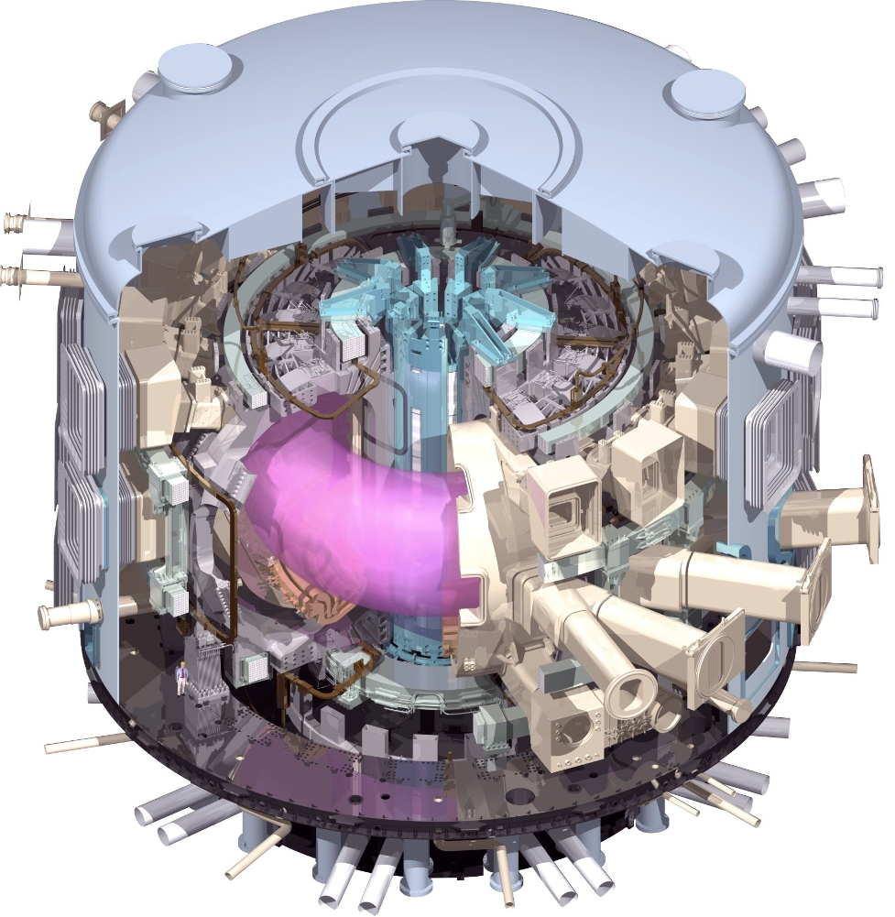
ITER Integrated Modelling Tools: Status and Outlook
SD Pinches with thanks to M Hosokawa, T Casper and IM Design Team
ITER Organization
The views and opinions expressed herein do not necessarily reflect those of the ITER Organization

Slide 2
STATUS of ITER Integrated ModeLling Tools (IMAS)

Slide 3
Integrated Modelling & Analysis Suite
Integrated Modelling & Analysis Suite (IMAS) is the set of tools that will:
Support operations
Robust, reliable tools that can be used to validate pulses, perhaps with constraints on runtime
Support research
More sophisticated tools that can be used to unpick complex physics questions and address the science coming out of ITER
These tools can also be used to advance the simpler (perhaps more empirical) tools used to support operations
Support construction
Present-day tools that can holistically model the future conditions in ITER to aid and support on-going design questions

Slide 4
Stages of IMAS Development
2011-2013: Conceptual design, initial infrastructure and physics
Implement prototype infrastructure (Data Model, workflows, access layer, version control and documentation) and physics models
Train ITER staff (“alpha users”) to use and evaluate effectiveness
2014-2016: Extend infrastructure and physics
Complete development of basic workflows and other supporting infrastructure
Establish fundamental basis for all types of pulse planning
Plasma Simulator evaluates confinement properties and response to H&CD and fuelling systems
Coupled PS-PCS system addresses whether the control system has the capability to reach the desired operating conditions using feedback control without violating system constraints
2017-2020: Full Physics for Pulse Planning, begin Reconstruction / Analysis
Implement broad range of physics components and applications for Pulse Planning
Physics models will undergo extensive V&V against data from other devices
Planning for pulse execution, analysis and research commences

Slide 5
Status of Integrated Modelling
IM Programme now has prototype IMAS Framework:
Data Model (v0.34)
Undergoing internal/external review before full adoption
Data Access
Physics Universal Access Layer (PUAL)
Workflow Engine
Based on Kepler
Distributed Revision Control System
Git: Supports simultaneous development in IO and Members
First simple workflows for Plasma Simulator implemented
Based on CORSICA
Example coupling of IMAS-based Plasma Simulator with PCS Simulation Platform

Slide 6
Status of Data Model and Storage
ITER Physics Data Model standardises data exchange
Describes both experimental and simulation data
Many different use cases
Composed of Interface Data Structures
Equivalent of ITM CPOs
Rules & Guidelines underpinning Data Model
Externally reviewed
Presently internally reviewing
Temporary database for storage
Links to on-going work within CODAC on ITER Archiving

Slide 7
Training
Training (14th February, 18/19th February, 7th March)
6 half-day sessions to familiarise IO staff with prototype installation
IO has now integrated CORSICA into IMAS and implemented first workflows
Fixed boundary, core transport
Free boundary

Slide 8
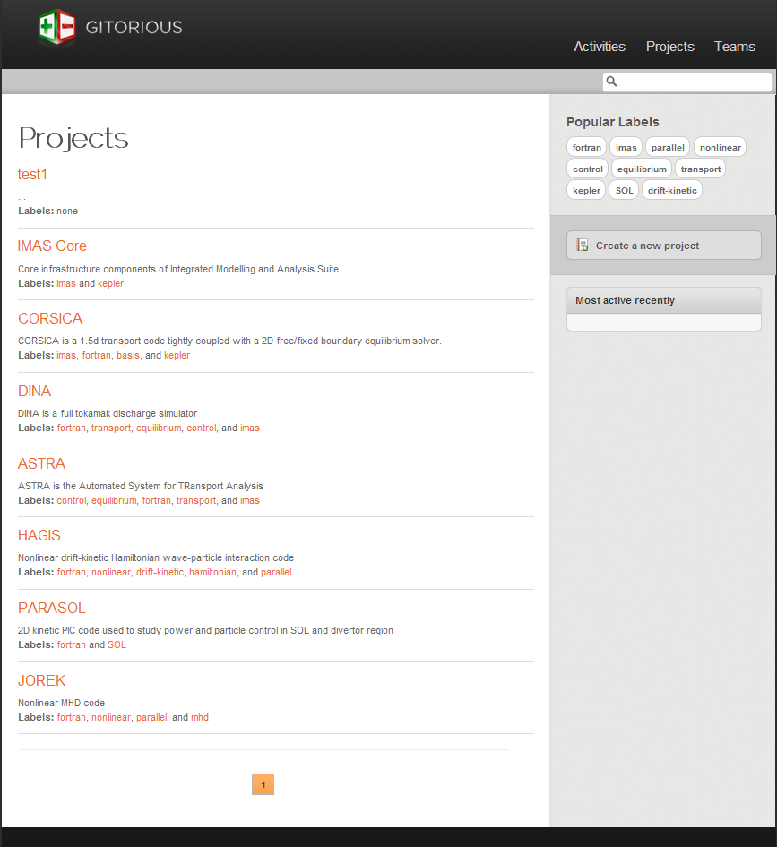
Infrastructure: Revision Control
IM Programme will benefit from using a distributed revision control system for all components
Parallel development in IO and ITER Members
Git selected
Gitorious being trialled to manage development
Merge changes
Code review

Slide 9
Plasma Simulator for PCS Evaluation
Started development of Plasma Simulator (PS) to test, refine and extend Plasma Control System (PCS)
CORSICA integrated into IMAS
Coupled PS-PCS Simulation Platform will form basis for pulse preparation and validation
High priority application for prototyping IM infrastructure
Successfully demonstrated prototype coupling in a co-simulation of IMAS and PCS-SP

Slide 10
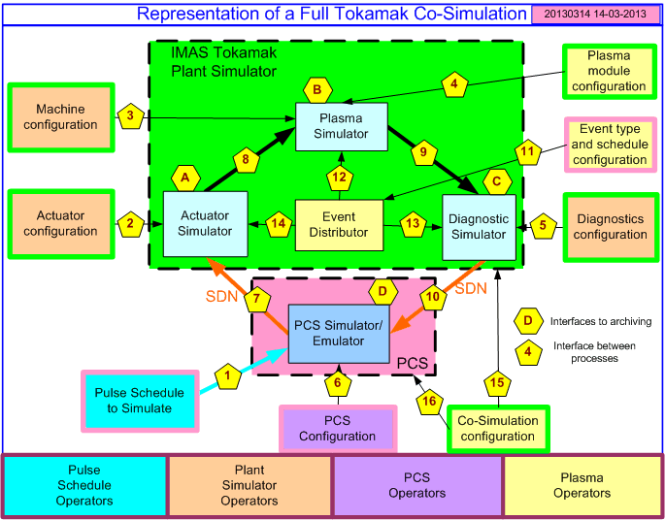
Interfaces in coupling IMAS Plasma Simulator to PCS Simulation Platform

Slide 11
Development of CORSICA Workflow
First “Plasma Simulator” workflow created with support from IM Design Team
CORSICA integrated within IMAS Workflow Engine (Kepler) as a complete entity
Execution of Workflow controlled from within Workflow Engine
Data exchanged (imported/exported) via Remote Procedure Calls (RPC)
Initially, two cases considered: Fixed boundary core transport & free boundary simulation
CORSICA dispatched remotely from Workflow Engine (ssh)
CORSICA output stored in IMAS Database using ITER Physics Data Model
IDSs stored each time step: Core Profiles, Equilibrium and PF Coils
Scenario evolution can be examined/plotted during run
Workflow uses mixed language actors coded in C/C++ and Fortran90
Over course of this year extend workflow to couple to PCS Simulation Platform
Co-simulation with Simulink-based PCSSP
Workflow and Actors version controlled using Git (access controlled)
git clone [username]@hpc-login4.iter.org:/work/repos/git/corsica-kwf.git

Slide 12
Overview of CORSICA Workflow
Initialise IMAS Database (with “ualinit”)
Start CORSICA RPC Server on remote machine (using ssh) (t = t₀)
Communicate with CORSICA (using BASIS*) to advance to t = t + t_{adv} and retrieve evolved data (t = t₀ + t_{adv})
Store data in IMAS Database using “ualslicecollector”
Loop back to step 3 if t < t_{end}
Terminate CORSICA server
Finalize IMAS Database with “ualclose”
Kepler & Actors on HPC login node
[hpc-login4.iter.org]
CORSICA Server on HPC Cluster
[c01b01.iter.org – c01b04.iter.org]
IMAS Infrastructure
corsicainitialize
BASIS
CORSICA modules
eq
ctr
csc
corsica
corsicaparse
corsicaterminate
SSH
RPC
rpc
* BASIS is a scientific programming language developed by LLNL and a development environment providing with an interpreter, graphics, terminal logs, etc.

Slide 13
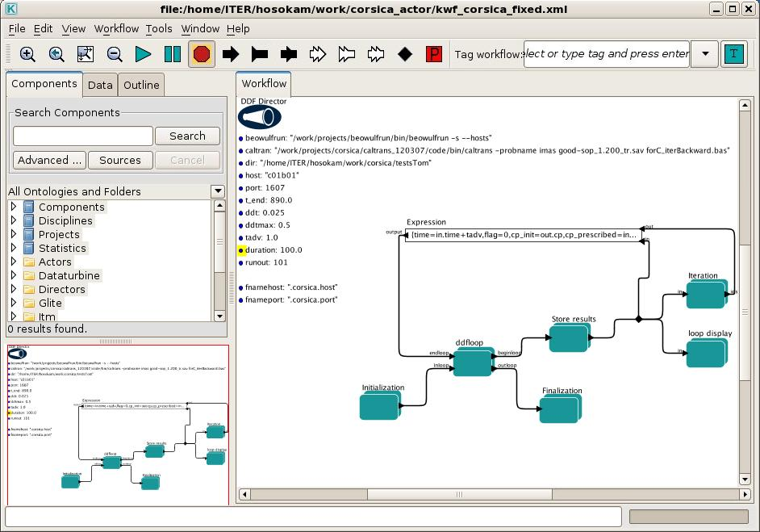
CORSICA Workflow in Kepler
M Hosokawa & T Casper

Slide 14
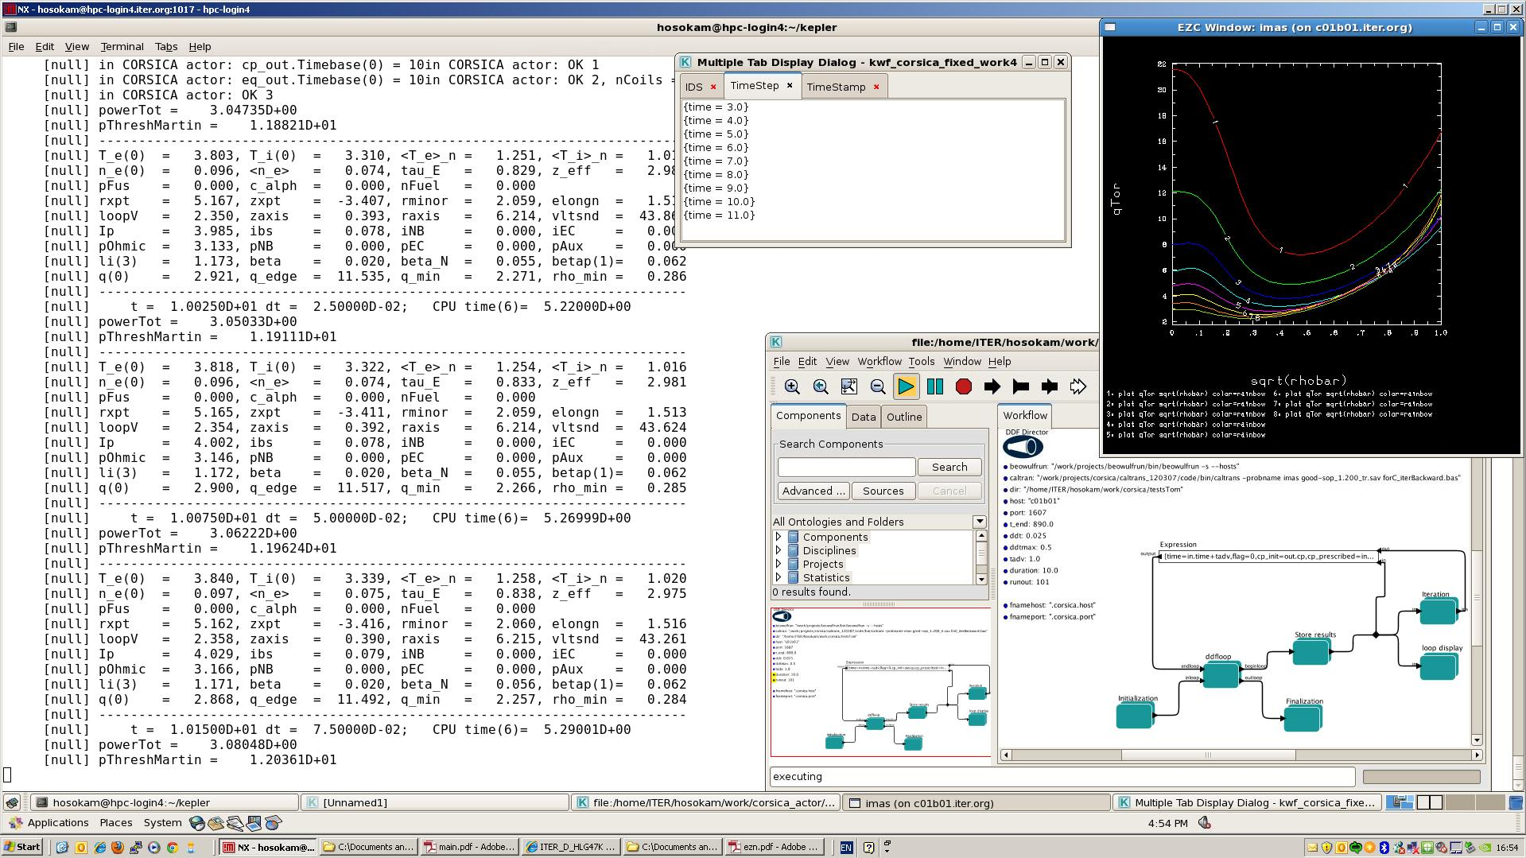
CORSICA Workflow During Execution
M Hosokawa & T Casper

Slide 15
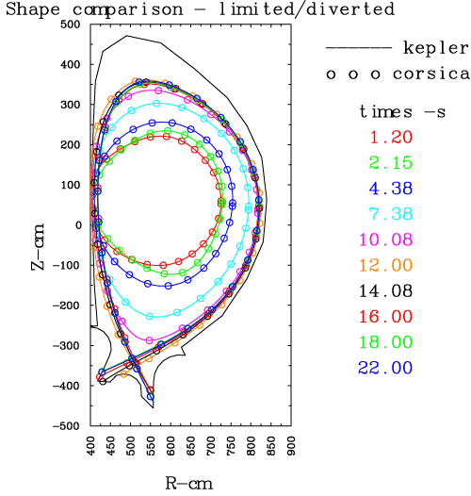
Comparison with standalone CORSICA
Shape evolution from plasma limited on inside wall (TRANSMAK result) to a diverted plasma with initiation of auxiliary heating after plasma diverts
Results are from “backing out” mode of simulation that uses a prescribed boundary evolution followed by a free-boundary calculation at each time step to evaluate system constraints
e.g. Coil current and field limits and forces on coils
M Hosokawa & T Casper

Slide 16
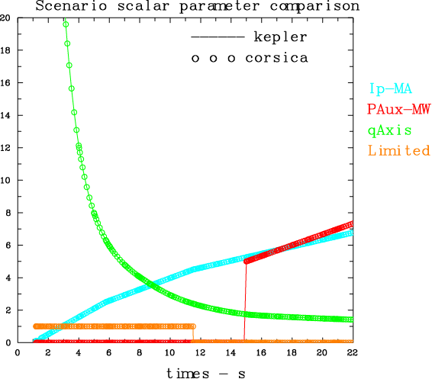
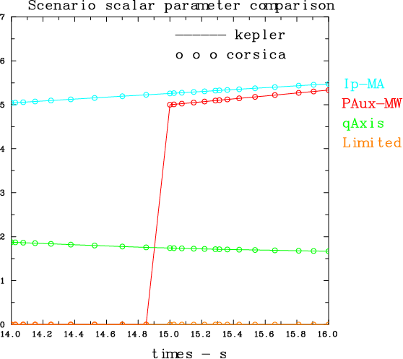
Comparison with standalone CORSICA
M Hosokawa & T Casper

Slide 17
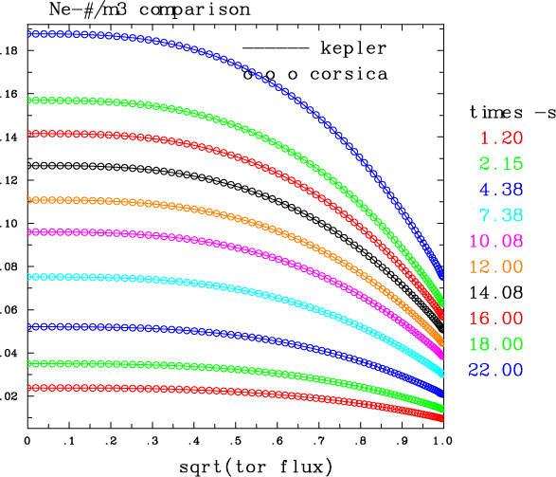
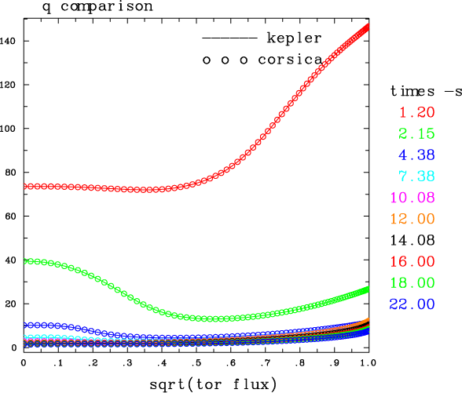
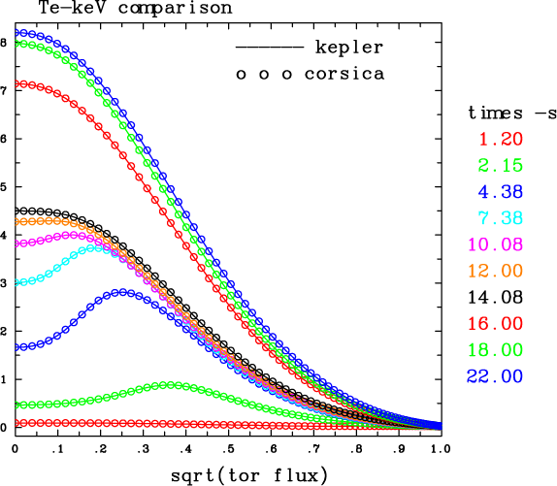
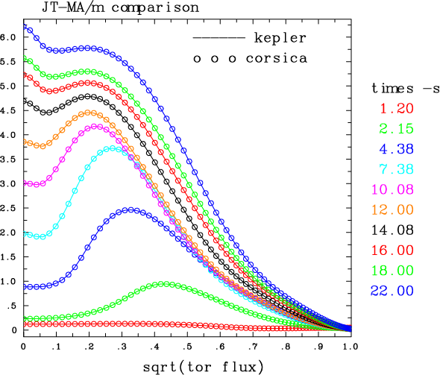
Comparison with standalone CORSICA
M Hosokawa & T Casper

Slide 18
Outlook for ITER Integrated ModeLling Tools

Slide 19
Future Work
Data Model
Finalise Rules & Guidelines for ITER Physics Data Model
Agree release versions of IDSs
Equilibrium, Core Profiles, PF, …
Encourage use for ITER modelling work
ITPA, ISM,…
Plasma Simulator for PCS Simulation Platform
Extend IMAS Plasma Simulator (CORSICA workflow) to couple with PCS Simulation Platform
Workflow Engine
Improve performance

Slide 20
Future Work
Integrate other physics codes
Start to develop workflows based around ASTRA and DINA
Licencing and MoUs
Access Layer and Archiving Database

