Slide 1
Progress on simulations of density profiles in hybrid plasmas
Luca Garzotti, Sara Moradi, Irina Voitsekhovitch (and others)

Slide 2
Summary so far
High power hybrid shots exhibit core particle higher core particle diffusivity (factor 1.5, 2) with respect to standard Bohm/gyro-Bohm transport model.
Low power shot exhibit higher χ/D inside ETB with respect to high power shots.
In no cases an inward particle pinch had to be invoked to explain the observed level of density peaking.
Triangularity does not seem to be playing a major role (density pedestal height?).
GLF23 simulations (see Irina’s paper) also predict density over-peaking. Agreement recovered if ExB stabilisation term is reduced).
QuaLiKiZ analysis of fluxes not conclusive (no clear prediction that an outward particle pinch, which would explain the extra flattening of the density profile, should exist).

Slide 3
Statement in EPS paper
“The reasons for an increased core particle diffusivity are not clear yet. However, one could speculate that, at the lower shear and higher β characteristic of the hybrid scenario, ion temperature gradient (ITG) modes are stabilized and other modes become dominant, resulting in higher particle fluxes. Linear and non linear analysis with the GYRO gyrokinetic code [5] that can test this hypothesis is under way, but it is at a too early stage to draw conclusions on this point.”

Slide 4
Proposals to proceed
Hypothesis (from EPS paper): at β_{N}~3 something changes in the particle/energy transport. Some evidence (77922) that KBM become important (GYRO simulations).
Extend GYRO simulations to all four shots to see whether there is any difference between shots with and without enhanced core particle transport. Possibly non linear simulations to analyse the fluxes. Extended Simulations to two shots, including non linear runs.
Also, deploy GS2 to complement GYRO. (Or vice versa).
Statistical study at low collisionality to see whether the spread in density peaking depends on β_{N}.and whether the high β_{N} shots are actually hybrid scenarios. From preliminary discussions with a few people it looks like this might not be the case but worth doing it thoroughly? Not promising, abandoned.
Connect with Irina’s work on rotation.
Compare with baseline scenario at same I_{p}/B_{T} . Analysis of matching baselaine shots well under way.

Slide 5
Progress made
It looks like in hybrid KBMs are unstable for r/a< 0.3 (unlike BL, which are ETG dominated) whereas for r/a>0.3 ITG dominate, as in BL.
WE NEED TO CONVINCE OURSELVES THAT THIS IS INDEED THE CASE!
If the previous point holds, beta scans show that there is no beta threshold but rather a mode switch when one moves inside r/a~0.3.
In particularit looks like KBMs are unstable already at low beta but become dominant at higher beta (or, alternatively, at some radial point when one moves towards the plasma axis).

Slide 6
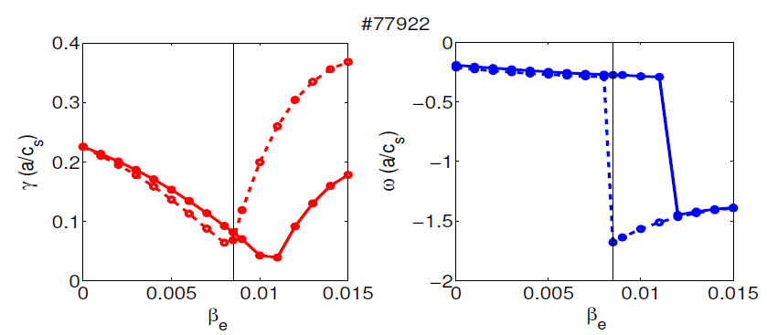
Linear β scan

Slide 7
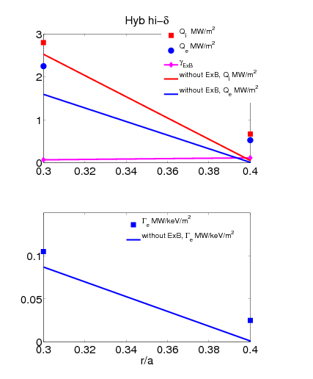
Non linear results

Slide 8
What to do with them
Linear growth rates as a function of beta without ExB shear at r/a=0.3.
Two points showing the linear growth rate with and without ExB shear, extracted from the linear phase of non linear runs.
Same picture for r/a=0.5.
This would illustrate the onset of KBM.
Characterise fluxes (particle and energy).

Slide 9
Ideal picture
r/a=0.3
r/a=0.5
γ
γ
With ExB shear
Operational point
linear
KBM
linear
Operational point
Without ExB shear
Without ExB shear
ITG
KBM
ITG
With ExB shear
non linear
β
non linear
β

Slide 10
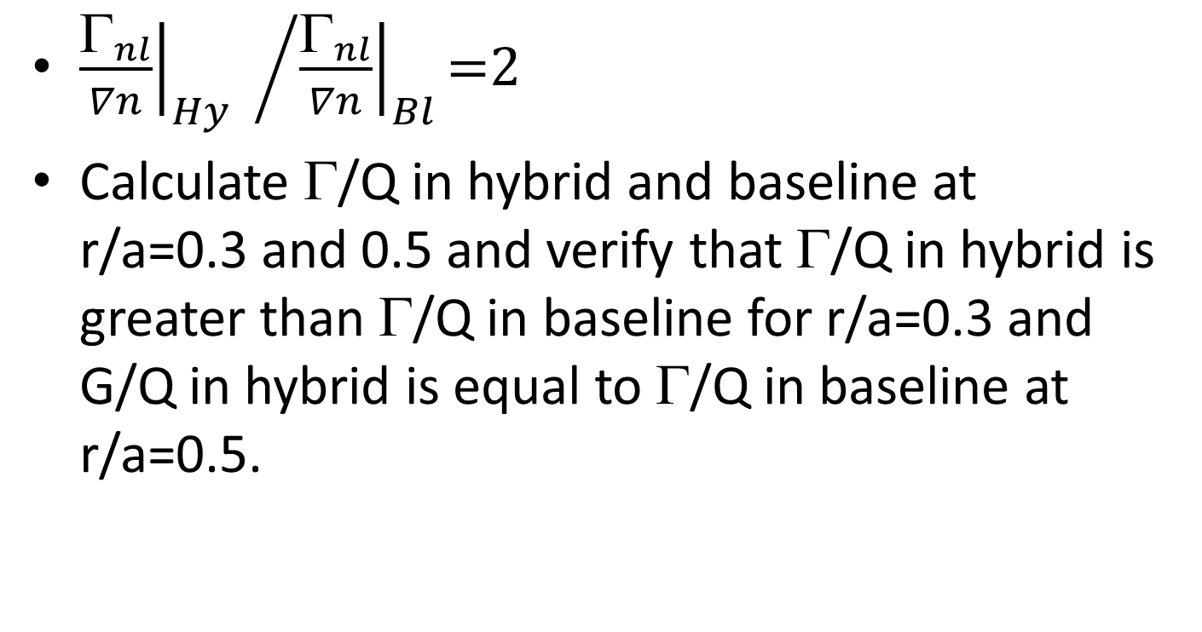
Fluxes: what are we hoping to find?
${{\left.\frac{{\text{G}}_{nl}}{∇n}\right|}_{Hy} }/{{\left.\frac{{\text{G}}_{nl}}{∇n}\right|}_{Bl}\text{=2} }$
Calculate Γ/Q in hybrid and baseline at r/a=0.3 and 0.5 and verify that Γ/Q in hybrid is greater than Γ/Q in baseline for r/a=0.3 and G/Q in hybrid is equal to Γ/Q in baseline at r/a=0.5.

Slide 11
Non-linear fluxes vs r/a
Note that the in Hybs at r/a<0.5 (KBM dominated) the ExB shear is actually destabilizing the mode, our preliminary assumption is that it can be due to destabilization of Parallel Velocity Gradient (PVG) modes with high toroidal rotation. This is under investigation, but there are very few works done on KBM/PVG’s, so for now, this is an unknown territory for me.

Slide 12
Non-linear fluxes ratios vs r/a
Note that the high ratios is because there is almost zero particle flux in BL shot!

Slide 13
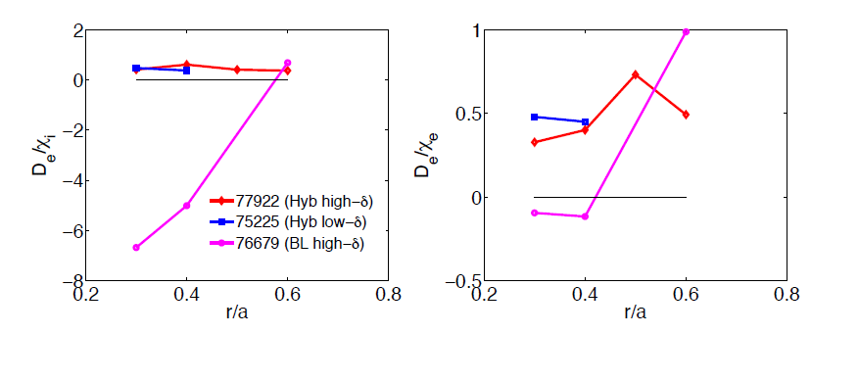
Diffusivities

