Slide 1
Transport analysis of JET H-mode and hybrid plasmas using Qualikiz, TGLF and GLF23
B. Baiocchi, J. Garcia
7th June 2013

Slide 2
On going work
SELF CONSISTENT SIMULATIONS OF HEAT TRANSPORT
USING CRONOS+TGLF (no rotation effect) and QUALIKIZ (GLF23)
H-modes: 73342, 73344 -> good agreement of TGLF and Qualikiz
with experimental data and GLF23
Hybrid: 75225, 77922 -> differences among models and with the experimental data
-> JET hybrid discharge (and H-modes)
TURBULENCE ANALYSIS:
spectrum of growth rate;
threshold study of ITG, TEM;
EFFECT OF THE ROTATION:
self-consistent simulations;
analysis of fluxes and spectra;
EFFECT OF THE GEOMETRY/EM:
self-consistent simulations;
analysis of fluxes and spectra;

Slide 3
Qualikiz, TGLF and GLF23 features
specifics of the transport models in the simulations done until now :
Qualikiz: - electrostatic
- s-alpha geometry
- no effect of rotation;
TGLF: - electromagnetic/electrostatic
- Miller geometry/s-alpha geometry
- ExB shear effect (quench rule/
spectral shift model);
GLF23: - electrostatic
- s-alpha geometry
- ExB shear effect (quench rule).

Slide 4
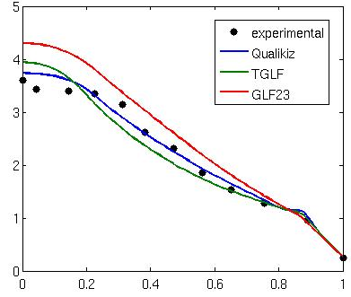
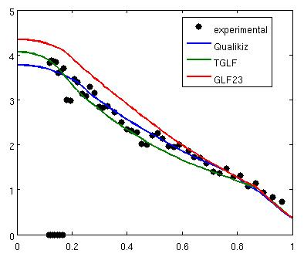
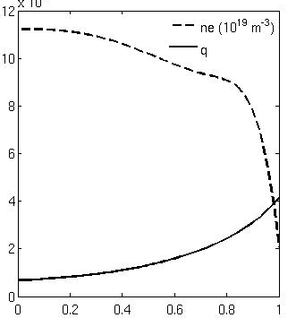
H-mode: JET shot 73342
t = 20.1 s
Ti (KeV)
Te (KeV)
ρ
ρ
ρ
Very good agreement between Qualikiz and experimental data
TGLF is in good agreement (experimental data slightly underestimated)
GLF23 overestimates slightly the data
ρ_{tn} < 0.3: presence of sawteeth that are not simulated
Qualikiz , TGLF and GLF23 reproduce reasonably well the T profiles

Slide 5
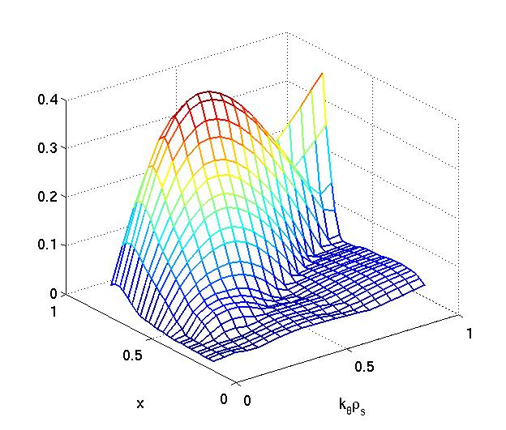
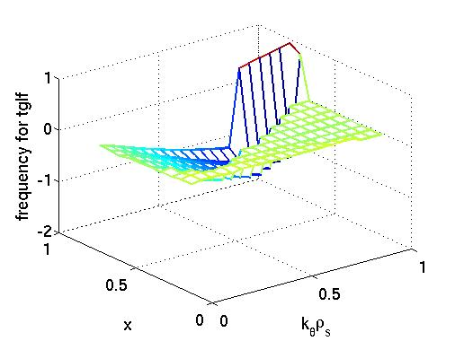
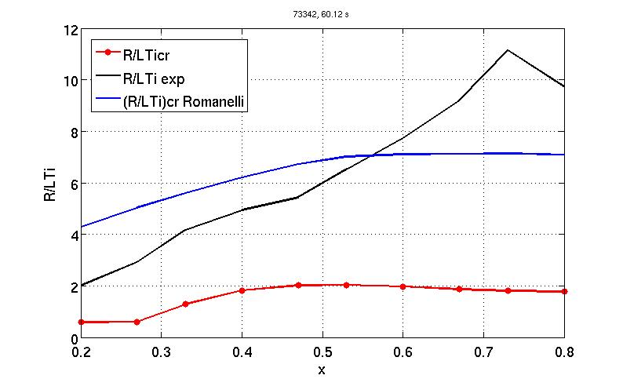
H-MODE: JET shot 73342
TGLF
Electromagnetic, Miller geometry
normalized rowth rate
normalized frequency
R/LTi profile
much over
the ITG threshold
Study of
ITG threshold
ITG regime

Slide 6
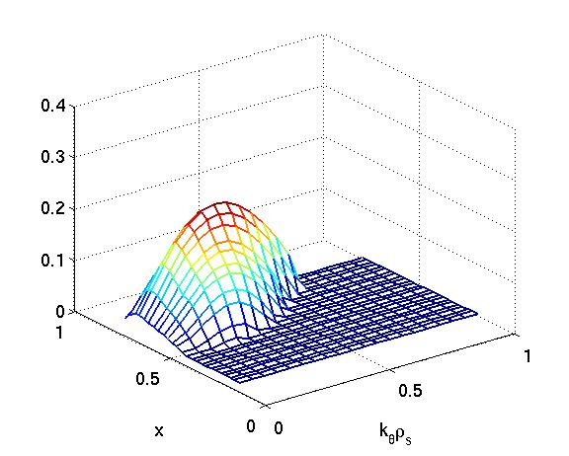
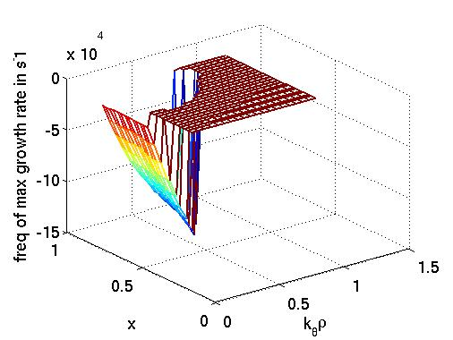
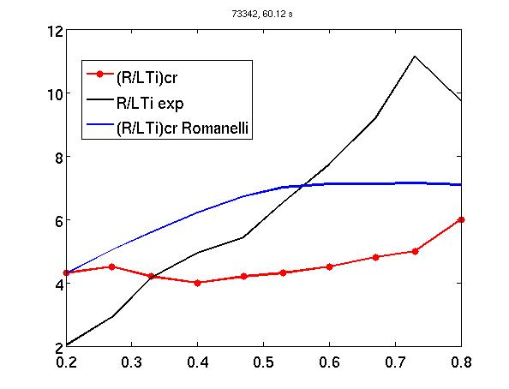
H-MODE: JET shot 73342
Qualikiz
Electrostatic, s-alpha geometry
normalized growth rate
Relative frequency
R/LTi profile
over
the ITG threshold for x > 0.3
Study of
ITG threshold
ITG regime

Slide 7
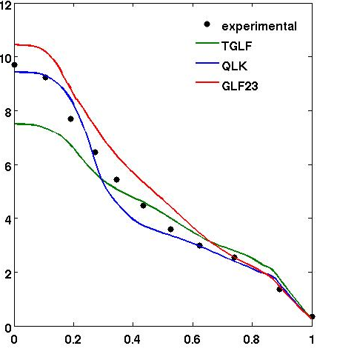
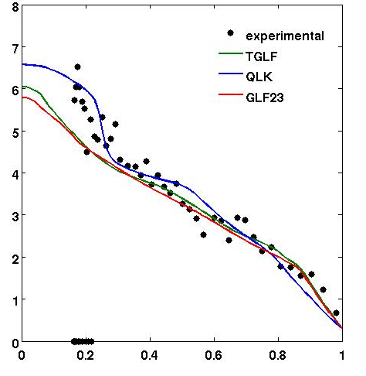
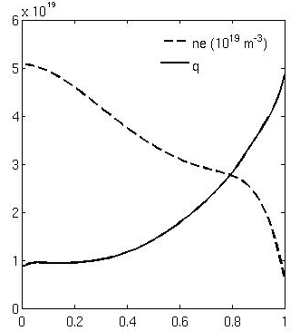
hybrid: JET shot 75225 self consistent simulations
t = 6 s
Ti (KeV)
Te (KeV)
ρ
ρ
ρ
Low density, n₀ = 5 10¹⁹ m⁻³
High rotation, v_{tor} = 1 10⁵ rad/s
TGLF underestimates ions in the inner region, it is similar to GLF23 for electrons
Qualikiz overestimates the reduction of the transport in the centre for ions and electrons; in the electron pedestal region it doesn’t reproduce the data
GLF23 overestimates ion T, and not too far from electron experimental profile

Slide 8
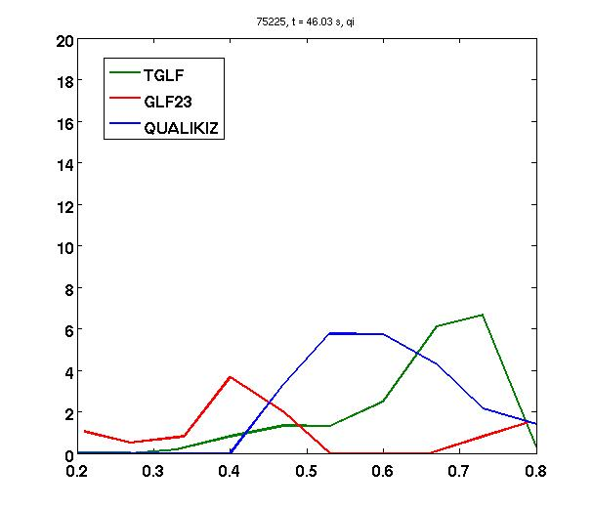
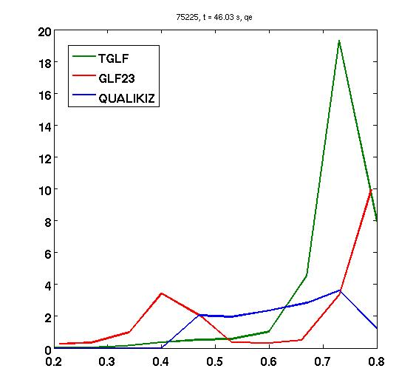
hybrid: JET shot 75225 HEAT FLUXES AND GROWTH RATES
stand alone study
Qualikiz: fluxes = 0
inside ρ = 0.4, where s = 0
GLF23: fluxes very low around ρ = 0.6
Qi/QgB
Qe/QgB
TGLF: fluxes max in the outer region
k = 0.3
γ
ω
In the region of k typical of ITG tglf and glf23 similar, QLK not so far even different in the inner region

Slide 9
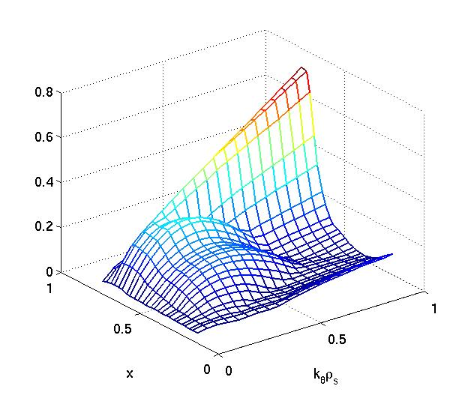
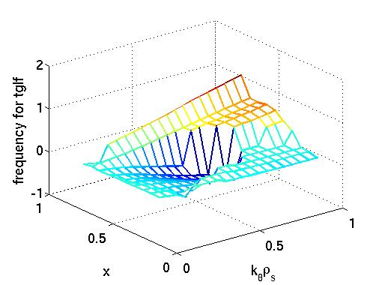
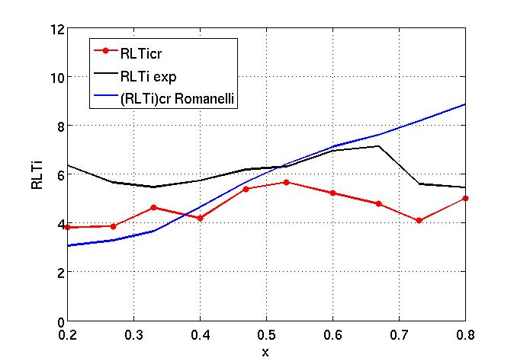
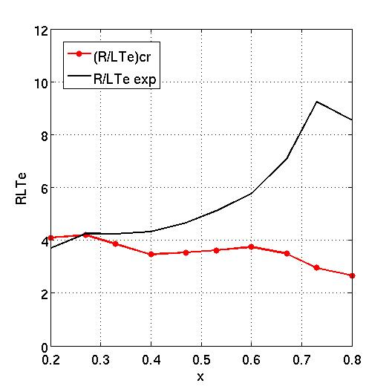
HYBRID: JET shot 75225 ThreshoLD with tglf
TGLF
Electromagnetic, Miller geometry
normalized growth rate
normalized frequency
Study of
ITG threshold
Study of
TEM threshold
R/LTi profile
close to ITG threshold
Important role of TEM

Slide 10
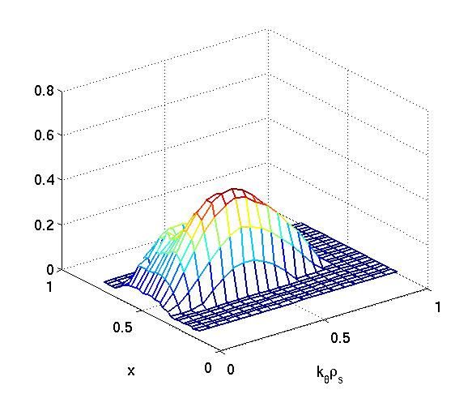
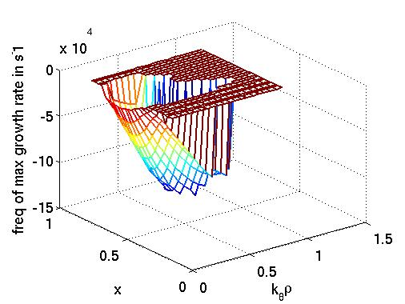
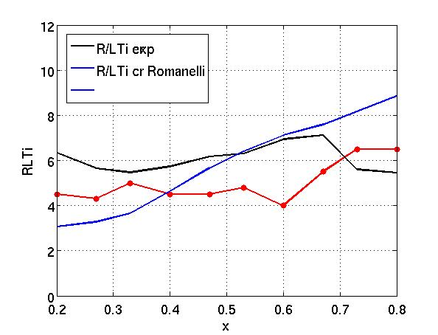
HYBRID: JET shot 75225 threshold with qualikiz
QUALIKIZ
Electrostatic, s-alpha geometry
normalized growth rate
relative frequency
R/LTi profile
close to ITG threshold
Study of
ITG threshold
(Qualikiz too stable with respect to the TEM, particularly for higher k)

Slide 11
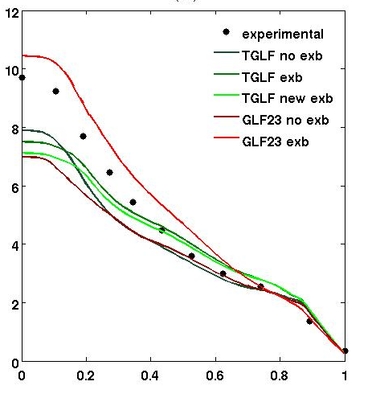
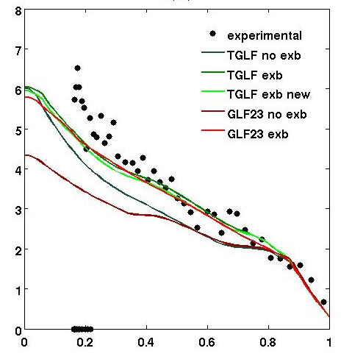
hybrid: JET shot 75225 EFFECT OF ROTATION shear
Ti (KeV)
Te (KeV)
TGLF: quench rule/spectral shift model
GLF23: quench rule
when rotation shear, exb shear and v par shear
TGLF: effect of rotation shear and good agreement with experiment for ρ > 0.2
GLF23: large effect of rotation shear: ions overestimated, good for electrons

Slide 12
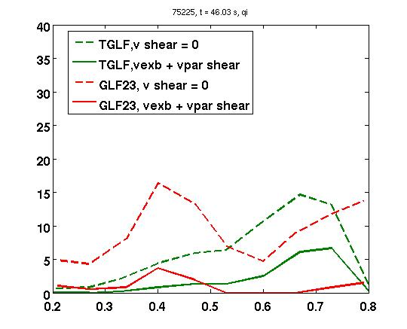
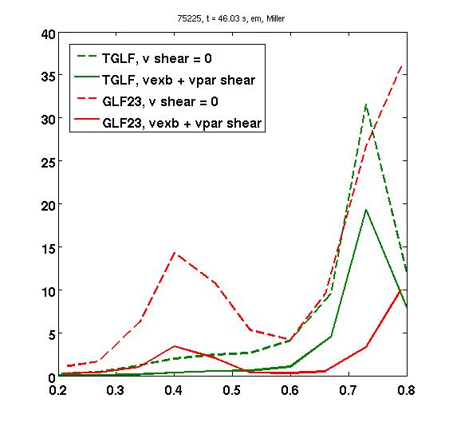
hybrid: JET shot 75225 ROLE OF ROTATION, STAND ALONE ANALYSIS
Qi/QgB
Qe/QgB
For GLF23 effect of rotation shear very high in the inner region -> maybe too much!
Study of the effect of parallel velocity shear: not a big effect

Slide 13
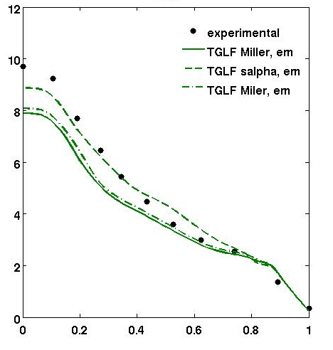
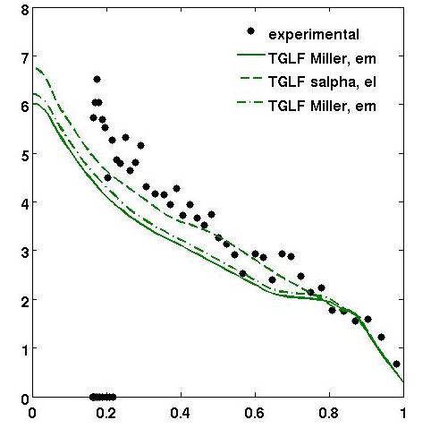
hybrid: JET shot 75225 GEOMETRY AND EM EFFECTS
Ti (KeV)
Te (KeV)
Em effects don’t affect much the self consistent simulations
different geometry gives different T profiles

Slide 14
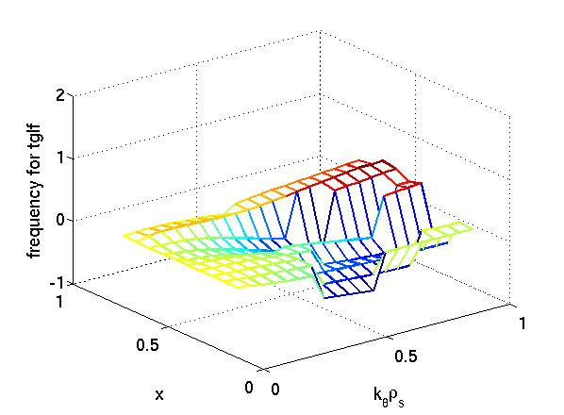
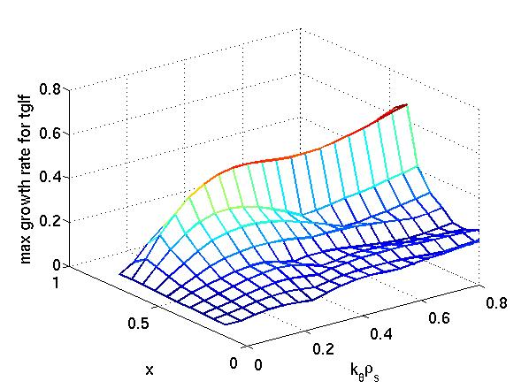
HYBRID: JET shot 75225 geometry and eM effects, stand alone analysis
TGLF
Electromagnetic, Miller geometry
normalized growth rate
normalized frequency
Electrostatic, s-alpha geometry
normalized growth rate
normalized frequency

Slide 15
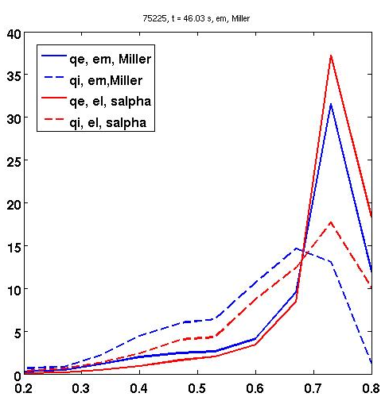
γ
k = 0.3
ω
γ
For ions fluxes different
k for γ max
It is evident in growth rate for k = 0.3,
Less if we compare the max growth rate
ω

Slide 16
Considerations
H-MODES:
- ITG regime described by TGLF and Qualikiz
HYBRIDS:
- Turbulence: Qualikiz and TGLF describe a plasma close to ITG threshold;
importance of TEM from TGLF;
Rotation: effect important outside ρ = 0.2 using TGLF, less than for GLF23
(that seems to be too strong)
Geometry and em effects: em effects not really important;
geometry more accurate gives differences
T profiles: - Qualikiz too stable where s = 0, Ti and Te overpredicted;
- TGLF (em, Miller geometry, effect of rotation) predicts well
electron temperatures, for ion temperature good agreement
with experimental data outside ρ = 0.3

Slide 17
OUTLOOK
H-modes
- ne simulations
Hybrids
Other hybrids simulations are running (77922, 77760..)
ne simulations
Rotation simulations
…BUT
Other physics very important for hybrid: fast particles?

Slide 18
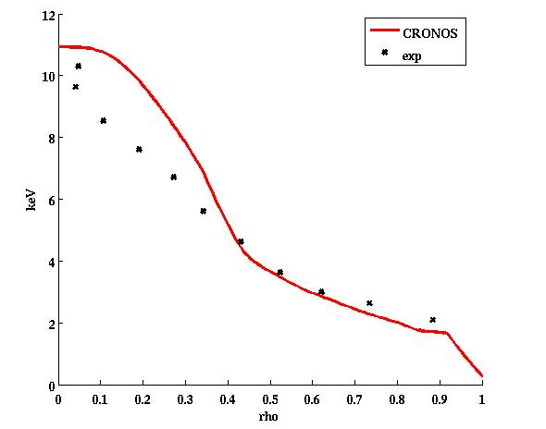
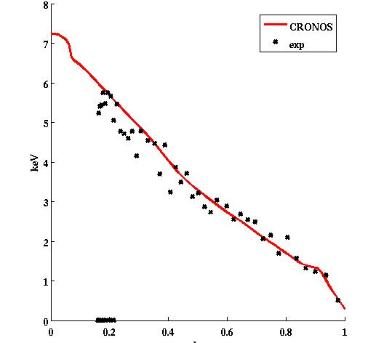
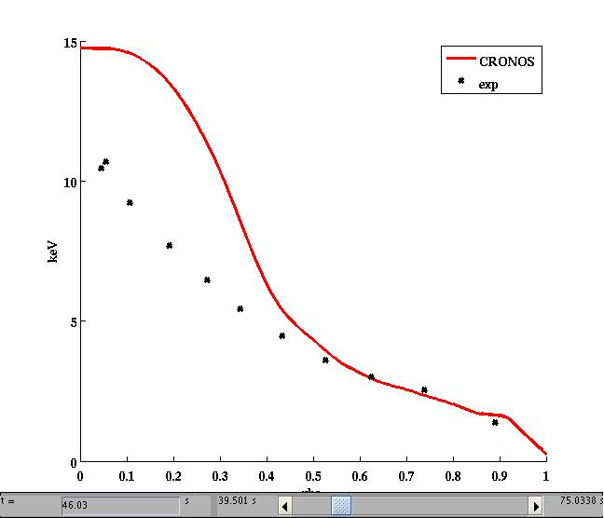
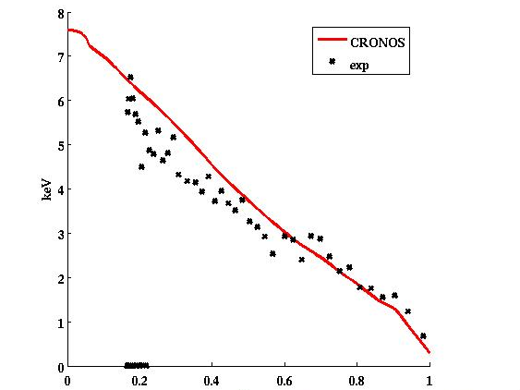
HYBRID: JET shot 75225 QUALITATIVE effect of fast ions
t = 5.8 s
TGLF
Fast ions as impurities (dilution)
Ti (KeV)
Te (KeV)
t = 6 s
Big effect in the inner part of the plasma
Ti (KeV)
Te (KeV)

Slide 19
DSM IRFM Service
Commissariat à l’énergie atomique et aux énergies alternatives
Centre de Cadarache | 13108 Saint Paul Lez Durance Cedex
T. +33 (0)4 42 25 46 59 | F. +33 (0)4 42 25 64 21
Etablissement public à caractère industriel et commercial | RCS Paris B 775 685 019

