Slide 1
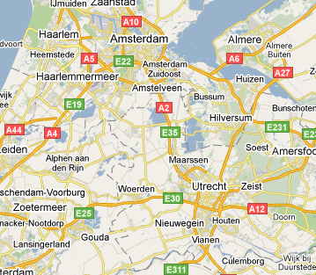
Next ISM Working Session July 4-8 2011:
hosted by FOM Institute for Plasma Physics “Rijnhuizen”, Netherlands
Amsterdam Schiphol airport
Frequent train airport → Utrecht (4 ICs per hour; 30 min travel time)
hotels
Rijnhuizen
Hotels are near the Central Utrecht station, shuttle services will be provided to Rijnhuizen

Slide 2
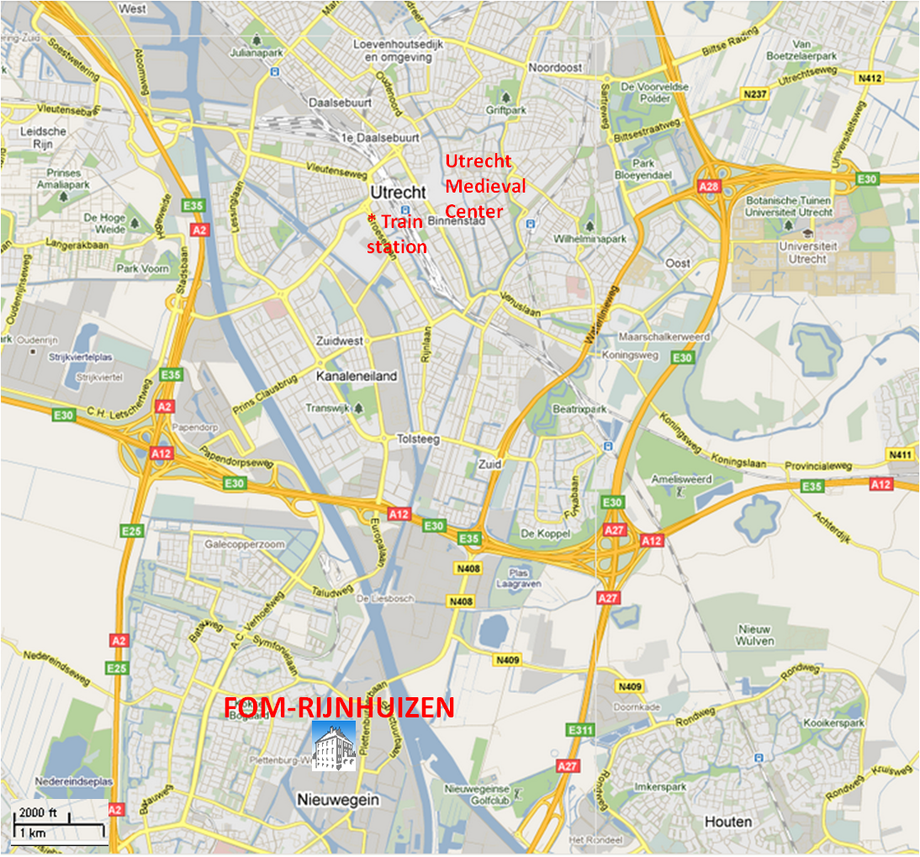

Slide 3
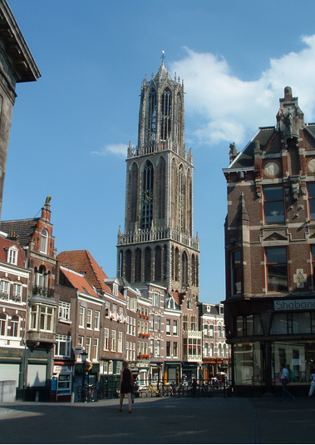
Hotels located 5-10 minutes walk from Utrecht City Center
Utrecht medium-sized city (~.25M)
Medieval city centre surrounded
by canals;
Large university
Size and atmosphere not unlike
Oxford
FOM Rijnhuizen located 7km away from Utrecht Center: bus services will be provided from hotels. Public transport and a cycle commute also possible with ease

Slide 4
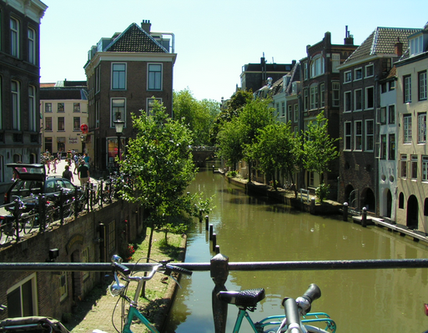
Utrecht Oudegracht

Slide 5
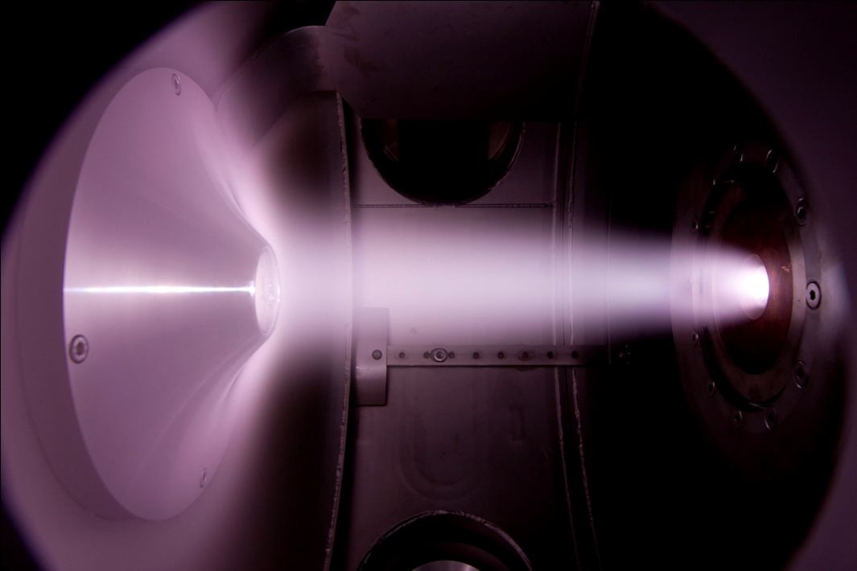
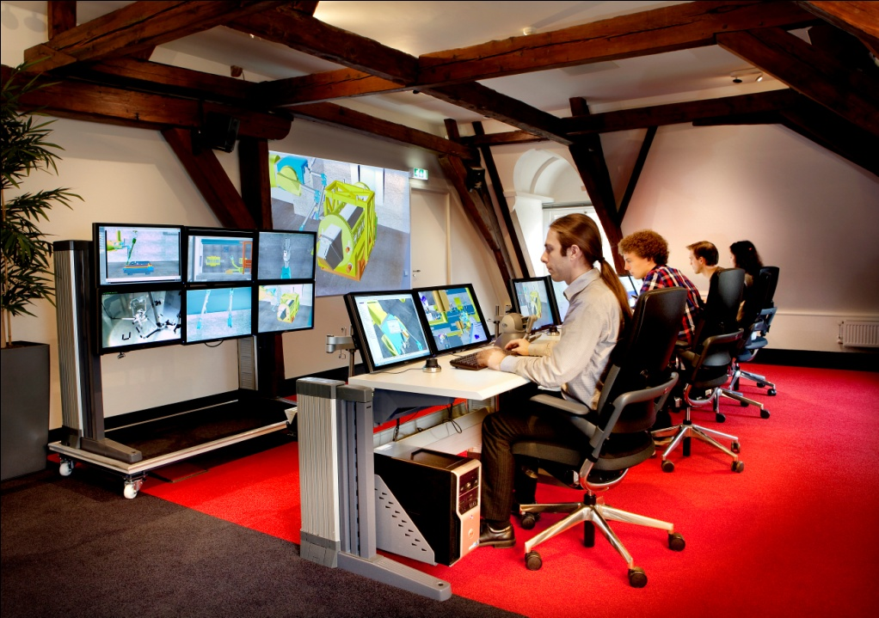
FOM Institute for Plasma Physics “Rijnhuizen”:
Long standing tradition in fusion research
small / medium size devices in ‘70s-’90s (last tokamak: RTP)
in ‘00s TEC collaboration on TEXTOR (Germany); collaborations with JET and AUG
ITER contributions (ECRH, CXS, Remote handling)
Since ~10 years also focus on fusion-related PSI
[large linear machine Magnum-PSI under construction]
Other research lines in the institute:
Free Electron Laser FELIX → molecular dynamics studies
nano-surface interaction [mainly paid by industry]

Slide 6
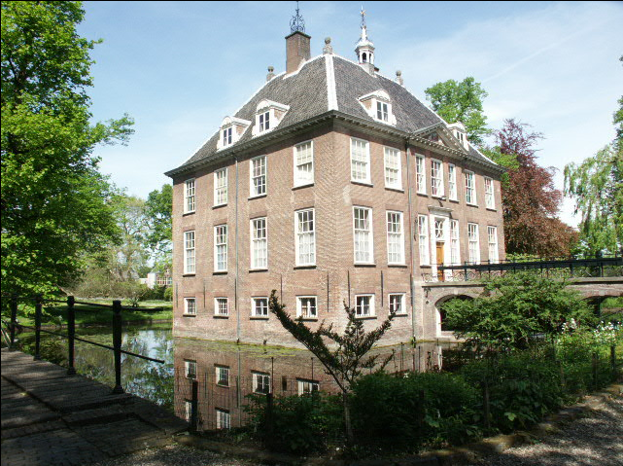
FOM Institute for Plasma Physics Rijnhuizen: the ISM working session will take place in the 18th century manor (July 4-8th 2011)

Slide 7
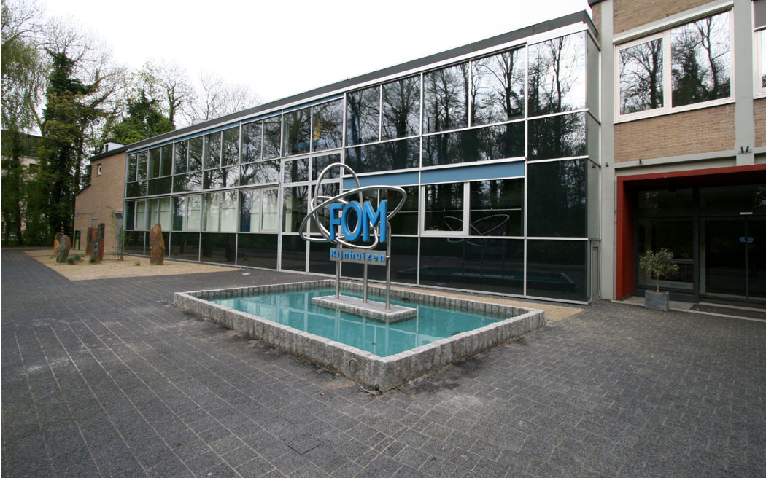
FOM Institute for Plasma Physics Rijnhuizen: modern wing

Slide 8
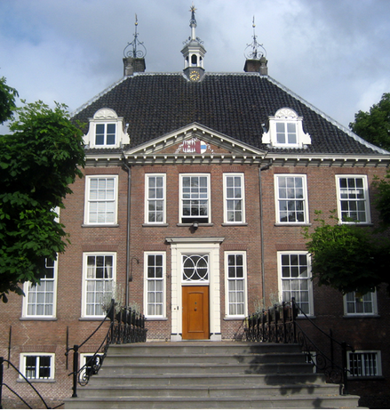
Manor, front view

Slide 9
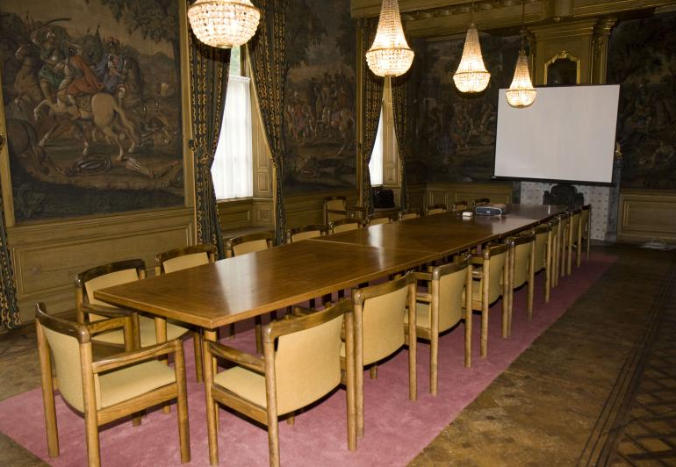
Working session office 1: “Alexanderzaal”

Slide 10
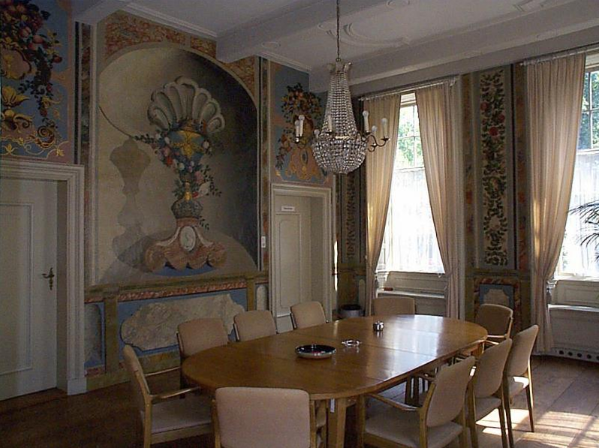
Working session office 2: “Tuinkamer”

Slide 11
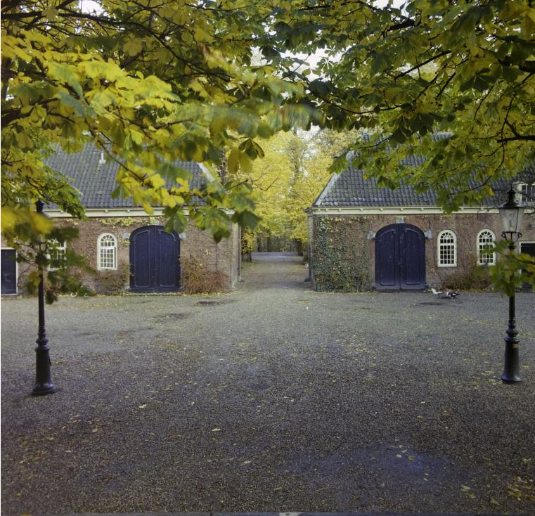
Additional space will be available in the converted coach houses opposite the castle
wifi access available throughout the grounds

Slide 12
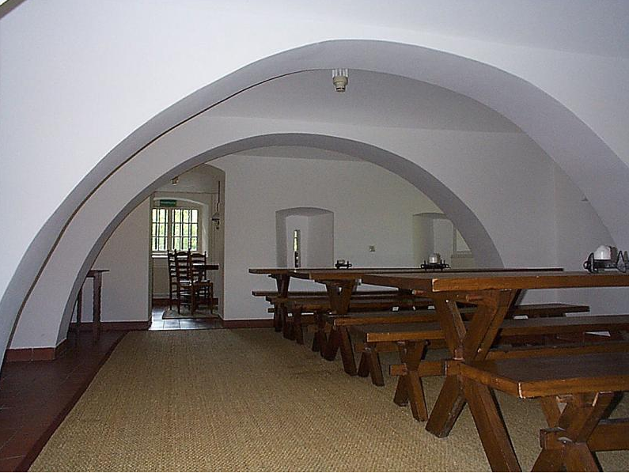
Catered meals will be taken in the castle cellar

Slide 13
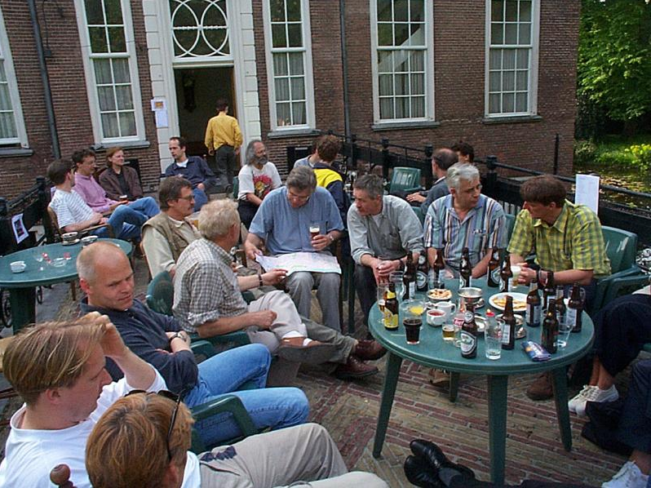
And if the weather allows…

Slide 14
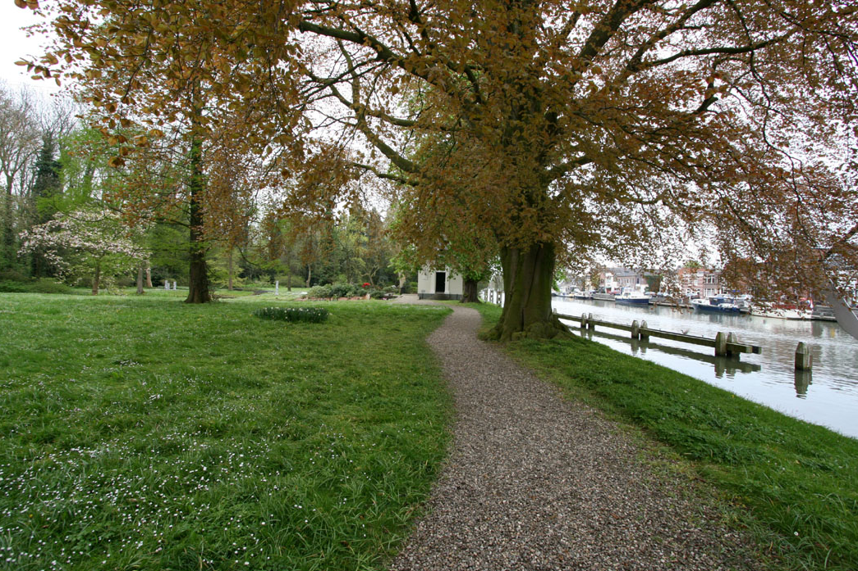
The castle is surrounded by extensive gardens, for stretching the legs.

Slide 15
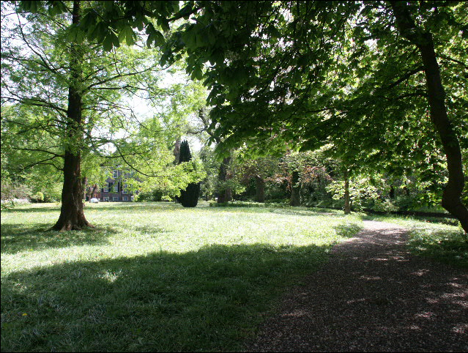

Slide 16
ISM Working Session FOM Rijnhuizen July 4-8 2011: see you there!
More information (hotel reservation, etc. etc.) will follow!

