Slide 1
SOAF: A Grid-based framework for Integrating Large-scale Long-run Applications
ITER IM Technology Workshop
Jun 8-10, 2011, Cadarache, France
Japan Atomic Energy Agency (JAEA)
Center for Computational Science and e-Systems (CCSE)
Takayuki Tatekawa, Yoshio Suzuki, Hiroshi Takemiya
Naka Fusion Institute
Nobuhiko Hayashi, Isao Kamata

Slide 2
Index
Background
Current state and our approach
Development of Simple Orchestration Application Framework (SOAF)
Application
Summary

Slide 3
I. Background
By the development of simulation techniques and computers, various simulations have been carried out.
By the integration of several simulation codes, we can carry out more detailed simulations.
For example, in atomic energy research:
Burning Plasma Integrated Code
3D virtual plant vibration simulator
consists of several parts of nuclear reactor (pressure vessel, cooler, pipes).
Simulation for Predicting Quake-Proof Capability of Nuclear Power Plants
consists of codes about earthquake, thermal hydraulics, nuclear system, and so on.
We have developed new framework which can carry out various integrated simulations without substantial change in each simulation code.
Notes:
By the development of simulation techniques and computers, various simulations have been carried out.
By the integration of several simulation codes, we can carry out more detailed simulations. For example, in atomic energy research, following simulations are considered.
Burning plasma integrated code shown today
3D virtual plant vibration simulator consists of several parts of nuclear reactor.
It can achieve a behavior analysis in the whole facilities.
“Simulation for …” consists of codes about earthquake, thermal hydraulics, nuclear system, and so on.
For these researches,
We have developed new framework which can carry out various integrated simulations without substantial change in each simulation code.

Slide 4
II. Current state and our approach
We roughly categorized the scenarios of cooperative execution of integrated simulation.
  Here we notice 4 patterns of scenarios.
A
A
E
C
D
B
B
(a)
F
C
(b)
case 1
A
A
B
case 1
C
B
Job is
Executing.
job
case 2
File flow
C
(c-1)
case 2
(c-2)
(a) Sequential type (b) Pipeline type
(c-1) Static conditional branch type (c-2) Dynamic conditional branch type
Current techniques which cooperates simulation codes on grid infrastructure
  Workflow tool :Kepler, UNICORE workflow engine, TME,.....
  GridRPC
  Grid-enabled MPI :STAMPI, MPICH-G, PACS MPI,....
Notes:
I’d like to talk the current state and our approach.
We roughly categorized the scenarios of cooperative execution of integrated simulation.
Here we notice 4 patterns of scenarios.
In sequential type, jobs are executed sequentially.
In pipeline type, jobs are executed concurrently. Then the file transfers between jobs occur.
In static conditional branch type, next job is determined by the condition of previous job.
In dynamic conditional branch type, another job is executed by the running job.
These are current techniques which cooperates simulation codes on grid infrastructure.
As workflow tool,….
Remote Procedure Call (RPC) and MPI are enabled to grid infrastructure.

Slide 5
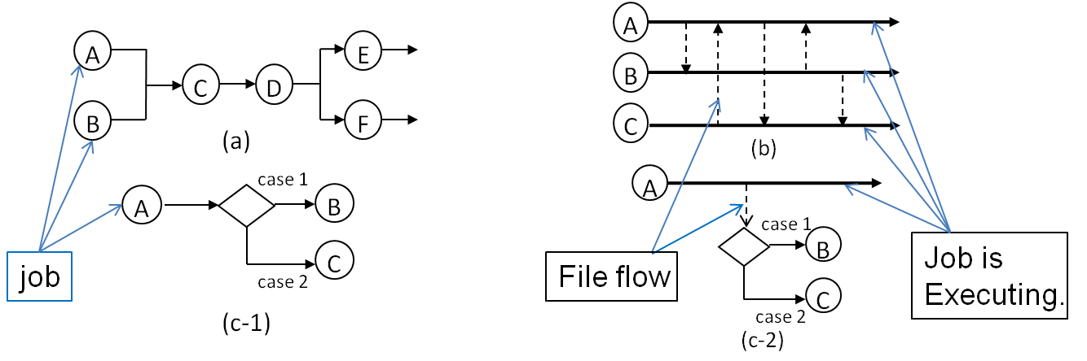
II. Current state and our approach (Problem)
Problem 1 It is hard to make the present techniques adapt themselves to all scenarios.
Workflow tools : Adaptable scenarios are limited.
GridRPC, Grid-enabled MPI : Substantial modification for each code is needed.
Problem 2: It is hard to continue the cooperative execution for long-time.
The integrated simulation is carried out during several days or weeks.
During execution, unexpected outage would be occurred.
-> It is hard to inspect the stop point and restart the cooperative execution.
We have developed the framework which solves these problems.
Notes:
Here we point out 2 problems.
First, it is hard to make the present techniques adapt themselves to all scenarios.
With workflow tools, adaptable scenarios are limited.
GridRPC and Grid-enabled MPI can be adapted to all scenarios. But, substantial modification for each code is needed.
Second, It is hard to continue the cooperative execution for long-time.
The integrated simulation is carried out during several days or weeks.
During execution, unexpected outage would be occurred. It is hard to restart the cooperative execution.
We have developed the framework which solves these problems.

Slide 6
II. Current state and our approach (Policies)
Policies for problem solving
For Problem 1
1. Easy to operate various scenarios of cooperative simulation.
2. Minimize the modification of each simulation code for cooperative
execution
For Problem 2
  3. Fault-tolerant mechanism for long-time execution
We propose 2 solutions based on above policies.
Notes:
We consider policies for problem solving.
For problem1,
The new technique can operate various scenarios of cooperative simulation easily.
The technique minimizes the modification of each simulation code for cooperative execution.
For problem 2
Fault tolerant mechanism for long-time execution is implemented.
We propose 2 solutions based on above policies.

Slide 7
II. Current state and our approach (Approach)
For example, we consider cooperation of code A and B.
Problem 1 Adaptation to all scenarios
Solution 1 File transfer is trigger of execution of new code.
We notice file flow between codes. The timing of job submission is decided by the file flow.
Wall clock time
Computer1
Client PC
Code A
controller
File 1
File 2
Computer2
Code B
For execution,
File1 is needed.
Problem 2 Long time simulation
Solution 2 Code A and B are categorized to master and slave code, respectively. When all master codes finish normally, the integrated simulation finishes. In all other case, jobs are re-submitted.
Notes:
For example, we consider cooperation of code A and B.
Code A executes in whole time on Computer A. Code B is executed on Computer B by the request from Code A. It requires file1 from Code A.
For problem 1, file transfer is trigger of execution of new code. Thus, we notice file flow between codes. The timing of job submission is decided by the file flow.
For problem 2, we categorize the code to master and slave codes. When all master codes finish normally, the integrated simulation finishes. In all other case, jobs are re-submitted.
These solutions are controlled from client PC.

Slide 8

III. Development of Simple Orchestration Application Framework (SOAF)
Solution 1: File flow monitoring function
As a mark of file generation and transmission completion, flag file is generated. Sentinel monitors the flag file.
When controller on Client PC receives the message from the sentinel, the controller manages file transfer and submits new job.
The execution codes are required only addition of generation function of flag files.
Code A
1. Job A (Code A) submission
Sentinel
flag
File 1
2. Output completion
Computer1
4. File transfer completion
3. File transfer
controller
flag
File 1
Configuration file
Sentinel
Computer2
Code B
Client PC
5. Job B (Code B) submission
Notes:
For the solutions, we have developed Simple Orchestration Application Framework (SOAF).
For solution 1, we’ve developed file flow monitoring function.
As a mark of file generation and transmission completion, flag file is generated. Sentinel beside code monitors the flag file.
When controller on client PC receives the message from the sentinel, the controller manages file transfer and submits new job.
The execution codes are required only addition of generation function of flag files.

Slide 9
III. Development of Simple Orchestration Application Framework (SOAF)
Solution 2: Fault-tolerant function
Slave codes are waiting for execution by the request from master codes. When all master codes finish normally, all job execution finishes.
{
Wall clock time
A
master
B
{
a
a
a
slave
b
b
Sentinel tell the end of master codes.
Detection of abnormal end -> resubmission
Controller
end
By the detection of abnormal end for any code, the controller re-submits
jobs again. We can execute long-time simulation automatically.
Notes:
For solution 2, we have developed fault-tolerant function.
We categorize the codes to master codes and slave codes.
Slave codes are waiting for execution by the request from master codes.
When all master codes finish normally, all job execution finishes.
By the detection of abnormal end for any code, the controller re-submits jobs again. We can execute long-time simulation automatically.

Slide 10

III. Development of Simple Orchestration Application Framework (SOAF)
Solution 2: Fault-tolerance function
When the cooperative execution is stopped by unexpected outage,
the controller automatically recovers by the execution on substitution computers.
1. Job A (Code A) submission
2. Back up restart file
and transferred file
Code A
Computer1
Computer3
3. Detection of Computer 1 outage
controller
4. Send restart file
and transferred file
Computer2
Configuration file
Code B
Code A
Client PC
5. Job A (Code A) re-submission
: restart file
AEGIS
Notes:
When the cooperative execution is stopped by unexpected outage,
the controller automatically recovers by the execution on substitution computers.
The required files (Restart file and transferred files) are transferred from Computer 1 to client PC.
When the unexpected outage occurs, the controller detects the outage.
Then the controller transfers the files to Computer 2 and re-submits jobs.
This function can re-submit the job to same computer (Computer 1).
This function recovers only outage of supercomputers or network. If the client PC causes error, the function cannot recover it.

Slide 11
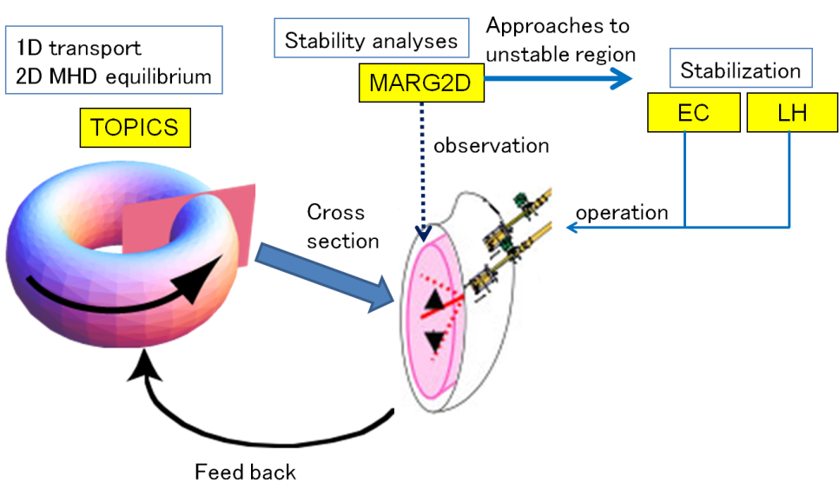



IV. Application - “Burning Plasma Integrated Code”
“Burning Plasma Integrated Code” consists of 4 simulation codes, as an example.
These codes are implemented to 3 computers on Atomic Energy Grid Infrastructure (AEGIS).
We verify the file flow monitoring function (Solution 1) with this cooperative execution.
USB e-Token
Linux PC
Controller
110km
JAEA Ueno (in Tokyo)
Altix350
Altix3700Bx2
PC Cluster
Sentinel
Sentinel
Sentinel
JAEA Tokai, Naka (in Ibaraki)
Dynamic Conditional Branch type
Notes:
We applied SOAF to “Burning Plasma Integrated Code” consisting of 4 simulation codes as an example. The master code is 1.5D transport code TOPICS. MARG2D analyzes the stability of plasma. EC and LH codes are actuators to stabilize the plasma. This simulation is categorized to dynamical conditional branch type.
The simulation codes are installed to 3 computers on JAEA Tokai or Naka site in Ibaraki.
The client PC is located in JAEA Ueno in Tokyo.
Here we verify the file flow monitoring function with this simulation.

Slide 12
IV. Application - “Burning Plasma Integrated Code”
Scenario 1
0
1
2
3
4
5
sec.
TOPICS
Situation of the simulation
LH
Time(sec.) | Events
0 | TOPICS starts
1 | MARG2D executes
2 | LH executes
4 | EC executes
5 | TOPICS finishes
MARG2D
EC
3
TOPICS
3
MARG2D
1
4
2
TOPICS requests execution of other 3 codes.
1
EC
LH
The files are transferred between
TOPICS and other 3 codes.
The number besides arrow
means number of files.
The whole codes: about 300,000 lines, modification: about 200 lines
-> The modification of codes for cooperative execution is minimized.
The simulation requires about 40 minutes. The overhead of SOAF is only 2 minutes.
We verified solution 1.
Notes:
The situation of the simulation is shown by this table and diagram.
The simulation time is only 5 seconds. During simulation, TOPICS requests execution of other 3 codes. The files are transferred between TOPICS and other 3 codes.
The length of the whole codes is about 300,000 lines. The modification is only about 200 lines.
The simulation requires about 40 minutes. The overhead of SOAF is only 2 minutes.

Slide 13
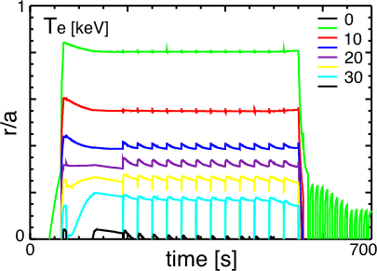
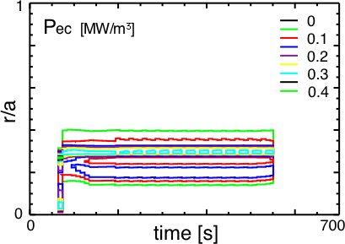
IV. Application - “Burning Plasma Integrated Code”
We applied SOAF to long-time scenario.
Scenario 2
ITER hybrid operation scenario with NB, IC and EC
Almost one day simulation with PC cluster
Only integration between TOPICS and EC code is operated by SOAF.
Notes:
We applied SOAF to long-time scenario. Scenario 2 is based on ITER hybrid operation scenario with NB, IC and EC. Almost one day simulation with PC cluster. Here we consider only the integration between TOPICS and EC code is operated by SOAF. These figures show contour plots of time evolution of profiles of electron temperature and EC power.

Slide 14
IV. Application - “Burning Plasma Integrated Code”
Scenario 2
Simulation Time(sec.) | Clock Time (min.) | Events
0 | 0 | TOPICS starts
64 | 79 | EC executes (step 1)
74 | 112 | EC executes (step 2)
… | …
Every 10 sec. | … | EC executes
… | …
554 | 1580 | EC executes (step 50)
700 | 1721 | TOPICS finishes
0
64
554
700
sec.
TOPICS
EC
When TOPICS causes abnormal end (interruption), SOAF controller detects the end.
Then the controller sends files and resubmits the job during several minutes.
We verified solution 2.
Notes:
At t=64 seconds, TOPICS requests to execute EC code. After this, TOPICS requests to execute EC code every 10 seconds.
At t=554 seconds, TOPICS requests final execution of EC code (50 steps).
Then TOPICS finishes at t=700 seconds.
This simulation requires about 29 hours. When TOPICS causes abnormal end (interruption), SOAF controller detects the end. Then the controller sends files and resubmits the job during several minutes. Most of the required time is for file transfer.
We verified solution 2.

Slide 15
Maintainability, extensibility, and sustainability
The difficulty of addition of functionalities depends on layer
(Grid middleware, API, or applications).
For example,
Applications
SOAF API
SOAF API
 | Controller | Sentinel
Language | C | Perl
Length (lines) | 9456 | 152
Operation System | Linux OS | Linux OS, UNIX
Common client API
AEGIS middleware
SOAF API uses common client (Authentication, Job management,
file transfer) API.
Notes:
The difficulty of addition of functionalities depends on layer (grid middleware, API, or applications). For example, the length of source code of SOAF API is about 10,000 lines.
SOAF API uses common client API which operate authentication, job management, and file transfer.
If there are common client API which user same interface, SOAF can be used on other grid middle ware.

Slide 16
User community
AEGIS is based on IT-Based Laboratory project (National project, FY2001-).
64 universities and institutes (JAEA , RIKEN, JAXA, NIMS, NIED, JST etc).
Budget: FY2001 2.7 billion yen, FY2002 1.1 billion yen, ….
For maintenance and operation of AEGIS middleware:
CCSE/JAEA: 3 engineers, other institute: 1 engineer
Germany
HLRS
12000GFlops
SX-8
Super SINET (10Gbps)
SINET(1Gbps)
0.083TFlops
pSeries690
8.785TFlops
0.021TFlops
0.128TFlops
WAN
0.008TFlops
0.032TFlops
PrimePower
SX-8
Onyx300
SX-6
45.87TFlops
13.60TFlops
1.79TFlops
120TFlops
0.282TFlops
12.4TFlops
1.689TFlops
13.1TFlops
0.768TFlops
0.409TFlops
0.391TFlops
0.008TFlops
Altix ICE
Altix4700
SR16000
FX1
SX-7/32
PC cluster
Altix3700Bx2
Prism
Altix350
HyperBlade
SX-6i
Notes:
AEGIS is based on IT-Based Laboratory project. This is national project which has started from 2001. The project includes 64 universities and institutes in Japan.
The budget is 2.7 billion yen in FY2001. (about 20 million euro)
For maintenance and operation of AEGIS middleware, 3 engineers work in CCSE/JAEA. In other institute, 1 engineer works.

Slide 17
V. Summary
We have developed Simple Orchestration Application Framework (SOAF) which adapts various scenarios of cooperative execution without substantial modification for each simulation code.
From the application to “Burning Plasma Integrated Code”, we verified that the problems has been solved by SOAF.
  Various types of cooperative execution is controllable by just definition of a file flow between the simulation codes.
  Substantial modification for each simulation code is not needed.
  (original codes: about 300,000 lines, modification: about 200 lines)
  Job re-submission can be carried out automatically by the fault-tolerance function.
More following things were indicated from the application result.
  The length of the configuration file for the controller is quite shorter than that of original codes. (Scenario 1: about 120 lines)
  The overhead of SOAF is neglectable in whole execution codes.
  (Scenario 1: 2 min. vs 38 min. )
Notes:
We have developed SOAF which adapts various scenarios of cooperative execution without substantial modification for each simulation code.
From the application to “Burning Plasma Integrated Code”, we verified that problem has been solved by SOAF.
***
More following things were indicated from an application result.
***

Slide 18
Future work
We implemented fault-tolerant mechanism for job execution.
Using this mechanism, we have succeeded to execute more than one day simulation.
But,
For long-time simulation, we should notice file transfer between codes.
(outage of network during transfer, damage of files)
We will implement fault-tolerant mechanism for file transfer.
Our fault-tolerant mechanism cannot avoid error of client PC (controller).
-> Reconnection function of client PC to AEGIS is required.
Notes:
We implemented fault-tolerant mechanism for job execution.
Using this mechanism, we have succeeded to execute more than one day simulation.
In fact, we already succeeded to execute 10-days simulation. (Seismic response)
For long-time simulation, we should notice file transfer between codes.
During simulation, if outage of network occurs during transfer, File would be broken.
We will implement fault-tolerant mechanism for file transfer.
Then our fault-tolerant mechanism cannot avoid error of client PC or controller.
So reconnection function of client PC to AEGIS is required.
Mounting to AEGIS is considering.
英語だと分かりにくいので。
長時間連携実行には、ファイル転送エラーに対する耐障害性が必要だと思います。
この方法は、SOAFではなく別のところで開発、テスト済です。
クライアントPCの停止に対する耐障害性は、今回はまだ対応できていません。
PCのAEGISへの接続を解除、再接続する機能について検討し、開発を進めています。
これはSOAFだけでなく、SOAFで用いるAPIの仕様も変更になるので、若干大掛かりです。
その他、シミュレーション後の出力データに対するポスト処理、管理機能をAEGISで
制御することも進めています。これを組み合わせることも有りかと思います。

Slide 19
supplementation

Slide 20
Wall clock time
A
A
E
C
D
B
B
F
C
(a)
(b)
job
case 1
A
A
B
case 1
C
B
Job is
Executing.
case 2
File flow
C
(c-1)
case 2
(c-2)

Slide 21
Procedure of file transfer
Computer1
Computer2
CodeA
File1
CodeB
flag_
File1
flag_
File1
send sentinel
sent_
File1
recv sentinel
Sentinel detects output file and operates file transfer.
Flag file is a mark of completion of file output and transfer.
For generation and detection of flag files, the modification of the simulation codes is required.
The function of flag files in the simulation codes is supplied by API.

Slide 22
Configuration for supercomputers
The sentinel is installed beside the execution codes (or the execution scripts).
The sentinel detects file transfer, preparation of job restart, and job finish.
Supercomputer
Sentinel
recv
Execution
code
send
restart
void
Notes:
The sentinel is installed beside the execution codes.
The sentinel detects file transfer, preparation of job restart, and job finish.

Slide 23
Configuration file for controller
Configuration file includes information of simulation codes
and file flows between codes.
For simple case
FLOWNUM 2 FLOW alias codeA_0 type 1 send File1 codeB_0 recv File2 codeB_0 END FLOW alias codeB_0 type 0 recv File1 codeA_0 send File2 codeA_0 END
PROGRAMNUM 2 PROGRAM program codeA name codeA_0 (info. about codeA) END PROGRAM program codeB name codeB_0 (info. about codeB) END
Master code
Slave code
Notes:
The configuration file for controller consists of the information of simulation codes and the file flows between codes.
For simple case, I show the configuration file.
The information of the codes includes the name of code, path, number of cores, job queue, and so on.
The file flow includes the type of code and the source and the destination of the file transfer.
Type 1 means master code. Type 0 means slave code.

Slide 24
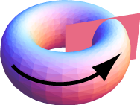
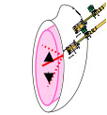

An example of Burning Plasma Simulation
Burning Plasma Simulation codes are developed by
Naka fusion institute, JAEA.
Approaches to
unstable region
1D transport
2D MHD equilibrium
Stability analyses
Stabilization
MARG2D
EC
LH
TOPICS
observation
Cross
section
operation
Feed back
TOPICS requests to execute other codes.
Notes:
The integrated simulation consists of 4 codes.
TOPICS simulates 1D transport and current diffusion, MHD equilibrium on the 2D plane.
In other words, TOPICS simulates time evolution of the burning plasma.
MARG2D analyzes stability of the burning plasma.
ECCD and LHCD codes simulate control and stabilization of the burning plasma.
This cooperative execution is categorized to Dynamical conditional branch type.

Slide 25
III. Development of Simple Orchestration Application Framework (SOAF)
Solution 2: Fault-tolerance function
When the cooperative execution is stopped by unexpected outage,
the controller automatically recovers by the execution on substitution computers.
Computer A
Unexpected outage
Computer B
Substitution computer
Files
Forwarded beforehand
controller
Files
Before re-submission,
these are forwarded.
Client PC
Job control, safekeeping of files
We can handle unexpected outage during long-time simulations.
Notes:
For solution 2, we’ve developed fault-tolerant function.
When the cooperative execution is stopped by unexpected outage,
the controller automatically recovers by the execution on substitution computers.
The required files for re-submission are transferred from Computer A to client PC.
When the unexpected outage is occurred, SOAF transfers the files to Computer B and re-submits jobs.

Slide 26
III. Development of Simple Orchestration Application Framework (SOAF)
Solution 2: Fault-tolerant function
Wall clock time
Comp. 1
A
1
1
Comp. 2
1
A
1
2
2
3
3
1
2
2
3
3
Comp. 3
a
1
a
a
Sentinel tells the end of master codes.
Detection of abnormal end
-> resubmission
Controller
end
Notes:
Here we suppose computer 1, 2, 3 and client PC.
Code A is master code. Code a is slave code.
First, the job of code A is submitted to computer 1. The transferred files and restart file are transferred to controller at each step.
After 1 step execution, the job causes abnormal end (unexpected outage).
The sentinel beside code A tells abnormal end to controller (client PC). The controller resubmits the job to alternative computer (computer 2).
The job restarts just after step 1 on computer 2.
When the job of code A ends normally, the sentinel beside code A tells “normal end” to the controller.
Finally the controller ends.
If computer 1 causes outage, the grid middleware tells abnormally to the controller. Then the controller resubmits the job to alternative computer.

Slide 27
IV. Application - “Burning Plasma Integrated Code”
Scenario 3
LH
IC
2
3
1
2
TOPICS
1
3
4
3
EC
MARG2D
0
5
10
15
20
sec.
TOPICS
LH
IC
EC
MARG2D

Slide 28
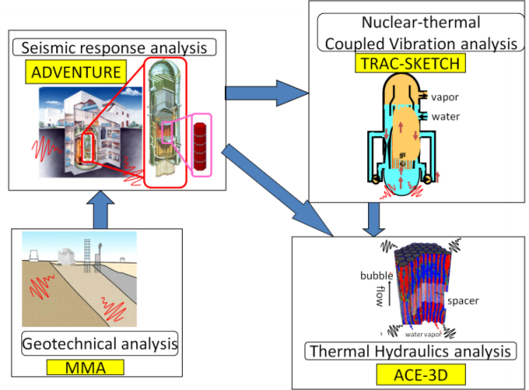
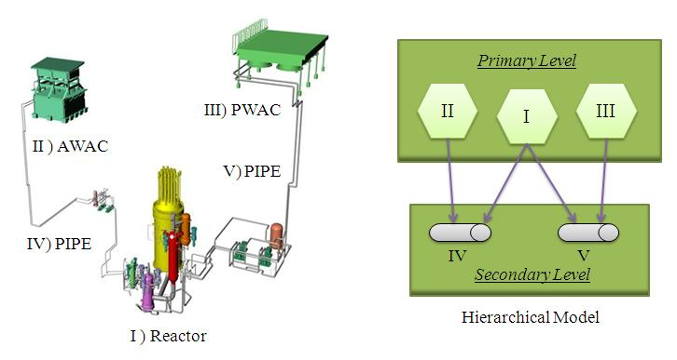
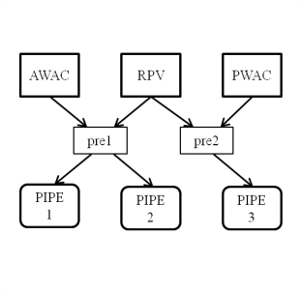
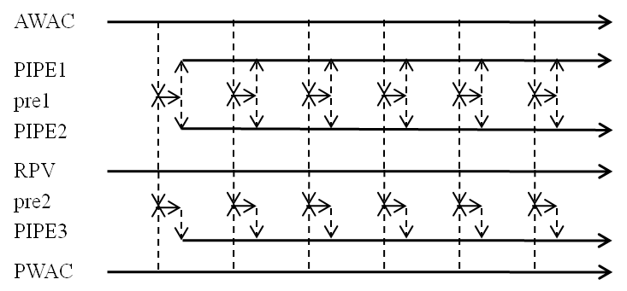
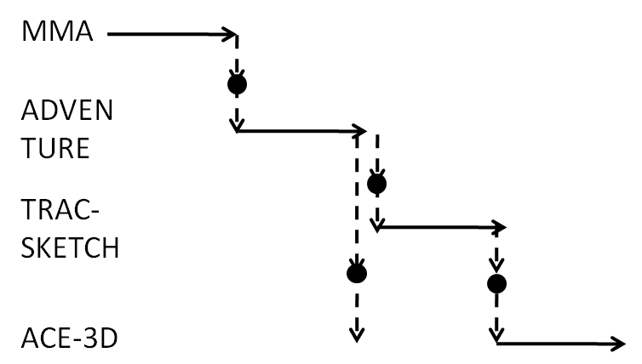
IV. Application –several scenarios-
Solution 1: Verification of file flow monitoring function 2
We have verified the function with other scenarios.
Simulation for Predicting Quake-Proof
Capability of Nuclear Power Plants
3D virtual plant vibration simulator
For these scenarios, we can execute cooperative operation by the definition
of file flows between the codes.
-> SOAF can be applied to various scenarios.
Notes:
We have verified the file flow monitoring function with various scenarios.
3D virtual plant vibration simulator is categorized to pipeline type cooperation.
Simulation for Predicting Quake-Proof Capability of NPP is categorized to sequential type cooperation.
For these scenarios, we can execute cooperative operation by the definition of file flows between the codes.
左側は実コードでFault-tolerant機能も使って実行しました（約10日間）。右側のシナリオは疑似コードを用いました。

Slide 29
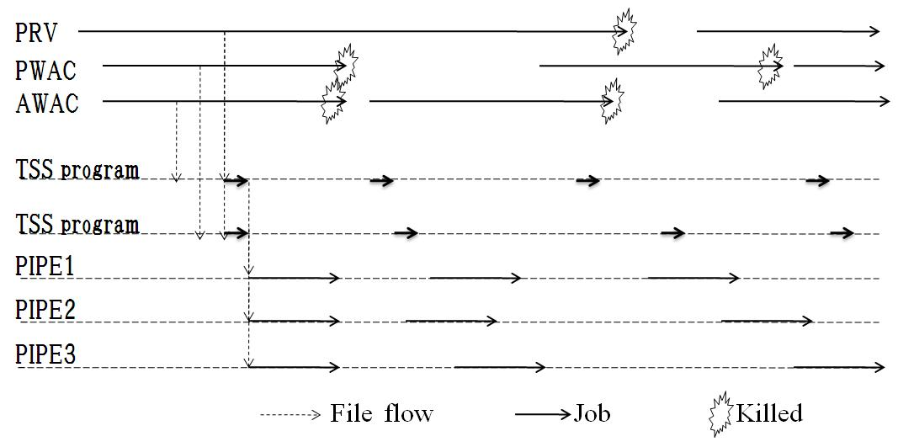
IV. Application –several scenarios-
3D virtual plant vibration simulator
During the whole simulation time of about 160 hours (100 time steps), all of data files were transferred to their target directories in pipelined scenario.
Immediate resubmissions of jobs killed due to time limit exceed were done for total simulation period.: RPV(1times), PWAC(3times), AWAC(9times)
Schematic view of jobs flow chart between six job classes and two TSS programs

Slide 30

IV. Application –Fault-tolerant function-
Solution 2: Verification of Fault-tolerant function
We have verified the resubmission of the running job at computer scheduled outage.
-> We verified that fault-tolerant function works on hardware outage.
file
file
Code
A
Code
B
Code
A
Code
B
JAEA Ueno p690
(Works on Mon-Fri)
JAEA Tokai Altix350
(Substitute computer)
Restart file
Transferred files between codes
Transferred before shutdown
Controller
After shutdown,
all files are transferred.
Client PC
Notes:
We verified fault-tolerant function with test codes.
P690 in JAEA Ueno works from Monday to Friday. We submitted code A and code B to p690.
Files are transferred from code A to code B.
During cooperative execution, restart file and transferred files between codes are forwarded to Client PC.
When p690 is stopped, the controller detects the stop. Then the files are transferred to alternative computer and resubmits jobs.
次に疑似コードを用いて耐障害機能について検証します。
上野に設置されたp690は毎週末にシャットダウンします。p690上でコードA, B を実行し、これらの間でファイルが転送されます。
p690がシャットダウンされると、コントローラは停止を検知し、事前に受信し保管していたファイルを代替計算機のAltix350に一斉転送し、その後ジョブを投入します。この事により、コードA, B の連携実行が再開されます。

Slide 31
IV. Application –Fault-tolerant function-
Comp. 1
Comp. 2
Comp. 3
Controller
Code A
Code A
Code B
1
1
Controller receives restart file from comp 1.
1
1
2
2
2
2
Controller detects outage at comp 1.
3
3
3
3
Controller sends restart file and transferred files to comp 2.
1
2
3
1
2
3
3
3
3
3
4
4
4
4
5
5
5
5
Notes:
Here we suppose Client PC and computer 1, 2, 3.
Code A is installed to computer 1 and 2. Code B is installed to computer 3.
Code B starts after receive file from Code A.
The transferred files are sent to controller.
Restart file is sent to controller per 2 steps.
Between 3 and 4 steps, computer 1 causes unexpected outage. The controller detects the outage and transfers restarts file and transferred files to alternative computer (computer 2). Then the job is resubmitted.
The job is restarted before step 3, because the restart file includes the data just after step 2.

Slide 32
The construction of SOAF
 | Controller | Sentinel
Language | C | Perl
Length (lines) | 9456 | 152
Operation System | Linux OS | Linux OS, UNIX
Configuration file (Scenario 1): 125 lines

Slide 33
3
TOPICS
3
MARG2D
1
4
2
1
EC
LH
0
1
2
3
4
5
sec.
TOPICS
LH
MARG2D
EC

