Slide 1
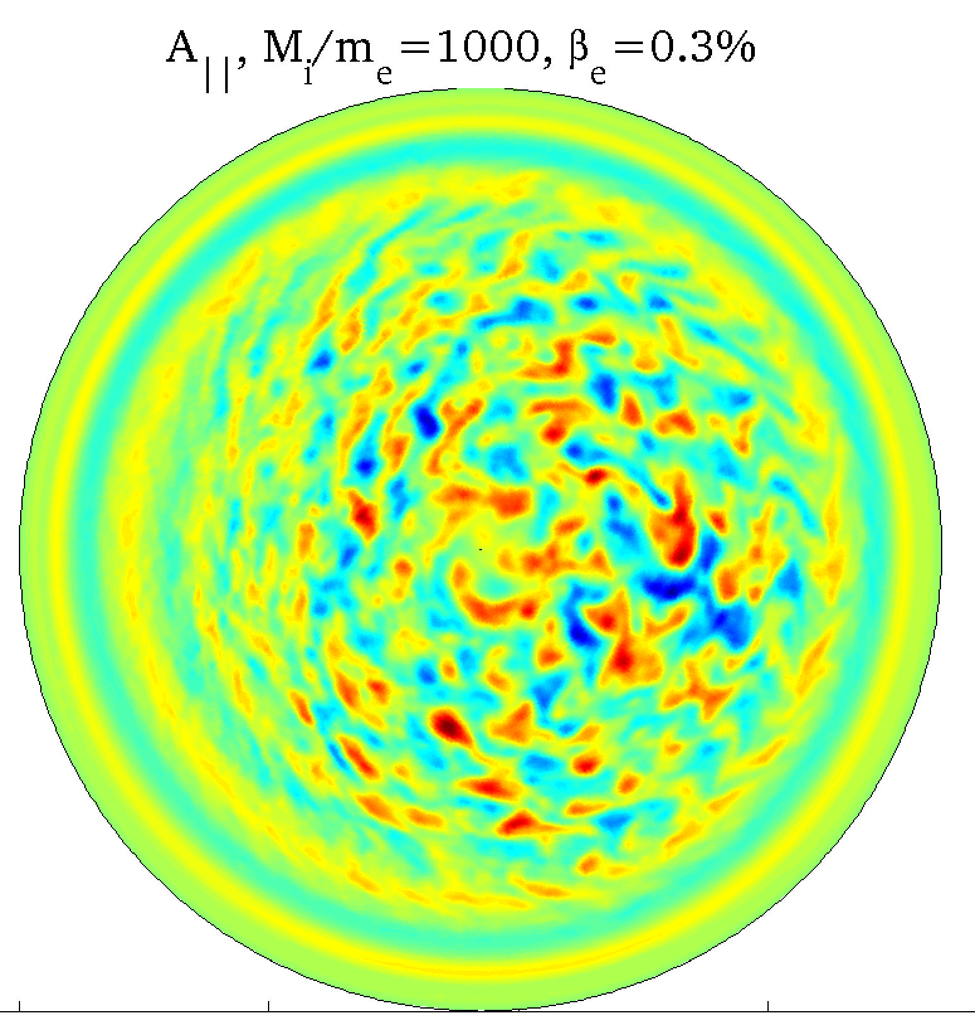
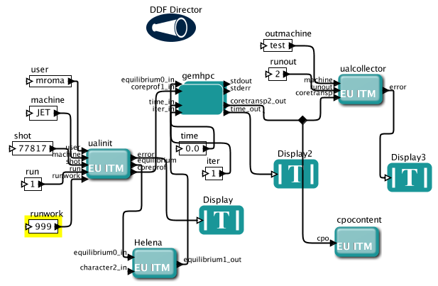
Benchmarking European core turbulence codes
within ITM Framework
Purpose: cross-verification of the leading core and edge turbulence codes, benefitting of the use of ITM standards
The core benchmark test case
The test case consists of a synthetic shot
of a medium size, ASDEX like tokamak operating in circular L-like-mode.
Profiles
Parameters:
R = 1.65 m, a = 0.5 m, B₀ = 2 T, Z_{eff}=2,
T₀ = 5 keV, n₀ = 6 x 10¹⁹ m⁻³
Advantages of code cross-verification within ITM framework:
All involved codes share the same input file in the form of CPOs and a well defined HDF5 file is used as output (in future turbulence_CPO)
A general interface has been developed which provides the link of the particular turbulence code to ITM communication standards via XML and CPO’s
Easily extended to other benchmark cases, including experimental data from the ITM database
Common Interface
Communication between the ITM infrastructure and the turbulence codes is handled by a special designed interface, i.e. CPO read/write and XML-parsing.
The codes keep their original structures and are provided as subroutines using standard Fortran or C arguments for the necessary input parameters and for the output of computations.
- Initial profiles are stored in ITM database in the form of CPOs to run in Kepler workflows (Gateway) and in ASCII files for FORTRAN workflows to run on the HPC-FF
Status and perspectives
- So far, approximately 1M CPU/hours used on the HPC-FF
Ongoing effort, first stage will be finalized by the end of this year
Extend by a similar verification effort using experimental data of leading European fusion devices from ITM database
Participating fluid and gyrokinetic European turbulence codes
ATTEMPT^{[1]}: four field fluid edge code
CENTORI^{[2]}: full toroidal, two-fluid code
GEM(R)^{[3,4]}: gyro-fluid core/edge code
dFEFI^{[5]}: delta-f gyrokinetic core/edge code
ELMFIRE^{[6]}: PIC full-f gyrokinetic core code
GENE^{[7]}: delta-f gyrokinetic core code
NEMORB^{[8]}: PIC full-f gyrokinetic core code
Vector potential from NEMORB^{[8]}
Kepler workflow, using experimental/synthetic JET data,
coupling the equilibrium code Helena and the turbulence code GEM^{[3]}. GEM is executed in batch on the HPC-FF.
References
^{[1]} Reiser PP 12 122308 (2005),^{[2]} Fitt pro. Ins. Mat. ECMI 1047 (2008)
^{[3]} Scott PP 12 102307 (2005), ^{[4]} Kendl PP 17 072302 (2010)
^{[5]} Scott PP 17 102306 (2010), ^{[6]} Heikkinen Contrib PP 44 (2004)
^{[7]} Dannert PP 12 072309 (2005), ^{[8]} Hatzky PP 9 898 (2002)
Electrostatic potential from GENE^{[7]}
36.000 CPUh on HPC-FF

