Slide 1

IMP5 2012 overview
D Farina, T Jonsson, G Vlad on behalf of contributors to IMP5
TF Leader : G. Falchetto,
Deputies: R. Coelho, D. P. Coster
EFDA CSU Contact Person: D. Kalupin
ITM General Meeting
Innsbruck, December 2012

Slide 2
IMP5 goals
Codes in the field of ECRH, LHCD, ICRH, NBI, alpha particles and fast particle interaction with instabilities integrated in the ITM framework
For each physics area two levels:
one basic and less detailed, enabling fast computations, providing, e.g., sources for the ETS code, i.e., profiles of absorbed power and driven current densities, dP/dV and J_{cd}
one advanced, but computationally expensive, enabling detailed computations of the distribution functions of electrons and ions during heating and current drive, ultimately incorporating non-linear effects of instabilities.
In 2012 main effort in point 1, in 2013 we shall put effort to advance also in point 2.
2

Slide 3
2012 IMP5 Activities
WP12-ITM-IMP5 | Topic | Support
ACT1 | Creation, testing and benchmarking of Kepler Actors. | PS/BS
ACT2 | Integration in ITM workflows | PS
ACT3 | Synergy models and self-consistent coupling of IMP5 heating codes | PS
ACT4 | Fast particle codes | BS
“Active” IMP5 codes in 2012 :
8 - electron physics
14 - ion physics
5 - fast particle physics
+ a few other codes
➔
IMP5HCD workflow
3

Slide 4
EC+LH codes
CODE | Topic | Responsible | Status
TORAY-FOM | EC ray-tracing code | Westerhof, DIFFER | Actor in 4.10a
TORBEAM | EC beam-tracing code | Poli, IPP, Garching | Testing Actor in 4.10a
GRAY | EC beam-tracing code | Farina, Figini, CNR, Milano | Actor in 4.10a
TRAVIS | EC ray-tracing code | Marushechenko, IPP- Greifswald | Actor in 4.09
RELAX | Electron FP code | Westerhof, DIFFER | Testing Actor in 4.10a
C3PO-LUKE | raytracing+FP code | Peysson, CEA | Actor in 4.09
FWTOR | EC full-wave code | Tsironis et al, Greece | Ported to the gateway
RAYLH | LH ray tracing code | Cardinali, ENEA, Frascati | Actor in progress
In 2012: successful EC benchmark
in ITM workflow under 4.09
4

Slide 5
IC & NBI codes
CODE | TOPIC | Responsible | Status
TORIC | ICRF full-wave | Bilato, IPP Garching | Actor in 4.10a
EVE | ICRF full-wave | Dumont ,CEA | Actor in 4.10a
LION | ICRF full-wave | Sauter/Villard, CRPP | Actor in progress
ICCOUP | ICRF coupling | Johnson, VR | Actor in 4.10a
FPSIM | ICRF Fokker-Planck | Eriksson, EC Brussels, Johnson, VR | Testing Actor in 4.09a
Stix_redist | ICRF Fokker-Planck | Lerche/Van Eester, ERM/KMS | ported to the gateway
SELFO-light | Self-consistent Wave/FP/Source | Hellsten/Johnson, VR | ported to the gateway
BBNBI | NBI source module | Asunta, TEKES | Actor in 4.10a
NEMO | NBI source module | Schneider, CEA | Actor in 4.09a
SNBI | NBI source module | Goloborod'ko, ÖAW | Testing Actor in 4.10a
ASCOT | Fast ion Fokker-Planck | Sipilä/Asuta, TEKES | Testing Actor in 4.10a
FIDIT | Fast ion Fokker-Planck | Goloborod'ko, ÖAW | Testing Actor in 4.10a
SPOT | Fast ion Fokker-Planck | Schneider, CEA | Actor in progress
RISK | Fast ion Fokker-Planck | Schneider, CEA | Actor in progress
NBIsim | Fast ion Fokker-Planck | Johnson, VR | Actor in 4.10a
5

Slide 6
Fast particle codes
CODE | TOPIC | Responsible | Status
HYMAGYC | Hybrid MHD-gyrokinetic | Vlad, ENEA | Actor and Kepler workflow 4.10a.1
HMGC | Hybrid MHD-gyrokinetic | Vlad, ENEA | Actor and Kepler workflow for equilibrium interface 4.10a
ARENA | Electron runaway | Csépány/Pokol, BME, NTI, VR | Testing actor in 4.09a
NuclearSim | Nuclear sources | Johnson, VR | Actor in 4.10a
AFSI | Nuclear sources | Äkeslompolo, TEKES | Actor in progress
Benchmark activity among analytical, HMGC and HYMAGYC done in 2012
6

Slide 7
main achievements
Most of the IMP5 codes adapted to the latest datastructure release
  very time demanding activity
  Caveat: transition to new datastructure needed although not trivial for IMP5
IMP5HCD workflow – integration of all heating schemes
  Integrated in the ETS
Verification
  EC codes in ITM framework
  codes on energetic particles
  agreed roadmap for ICRH code for 2013
7

Slide 8
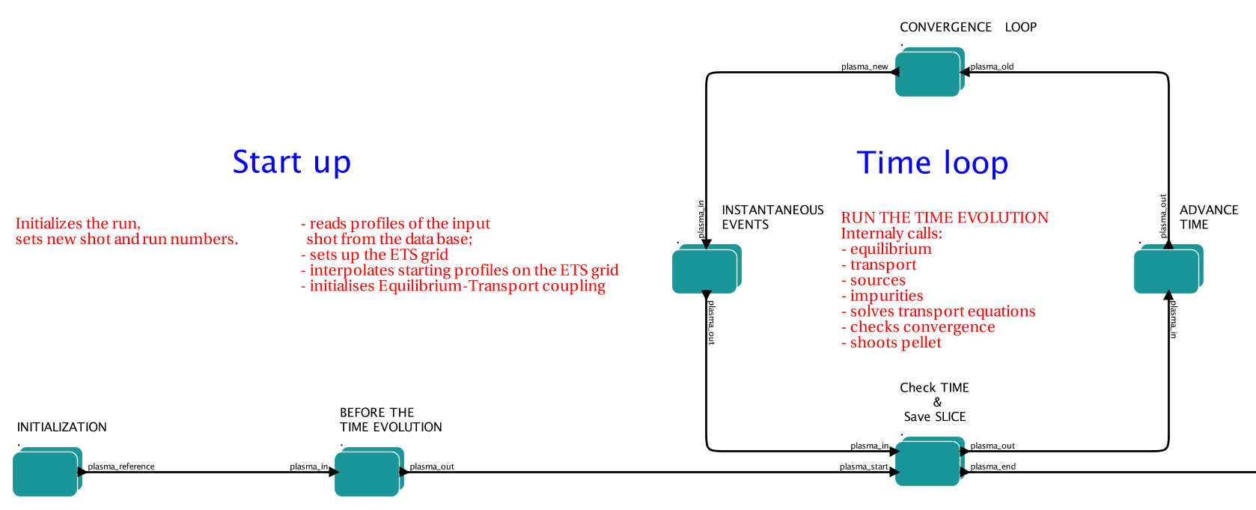
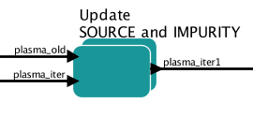
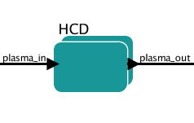
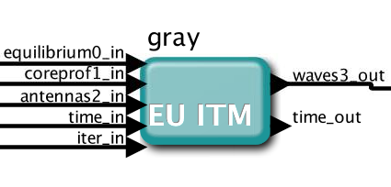
EC benchmark
Five European EC beam/ray-tracing codes involved within the project IMP5
C3PO, GRAY, TORAY-FOM, TORBEAM, TRAVIS
  Input CPOs: coreprof, equilibrium, antennas
  Output CPO: waves
  Can be run in the same exact workflow, in order to benchmark the results
The 5 codes address the “same” physics but use different models for propagation, absorption and current drive calculations
GRAY
TORAY-FOM
C3PO/LUKE
TORBEAM
TRAVIS
8

Slide 9
EC benchmark
ITER scenario 2
Standard inductive H-mode ITER "Scenario 2”
(B₀ = 5.3 T, I_{p}= 15 MA)
Ordinary mode at 170 GHz from the Equatorial (EL) and Upper Launcher (UL):
  Divergent beam from EL at small toroidal launching angle: core H&CD
  Same as 1), with larger toroidal launching angle: off-axis H&CD
  Focused beam from the UL
Case | R₀ (m) | z₀ (m) | α (º) | β (º) | w₀ (m) | d (m)
1 (EL25) | 9.27 | 0.62 | 0 | 25 | 0.030 | 0.00
2 (EL40) | 9.27 | 0.62 | 0 | 40 | 0.030 | 0.00
3 (UL) | 6.90 | 4.18 | 48 | 18 | 0.021 | 1.62
(R₀,z₀): launching point
α: poloidal angle
β: toroidal angle
w₀: beam waist
d: focus distance
9

Slide 10
EC benchmark
EL40
Good agreement in all the cases:
Trajectories within δR~10 cm after 4m path
|δI_{CD}/ I_{CD}|< 15%
δ(dP/dV)/ dP/dV ~ |δJ_{CD}/ J_{CD}| ~ 10%
peaking positions match within δρ~0.02
EL25
EL40
UL
ITM-TF valuable environment for code benchmarking and coupling into complex integrated simulations
Codes easily interchanged in the same ITM workflow (same interface for data input/output)
Sources of discrepancy in benchmarks are minimized

Slide 11
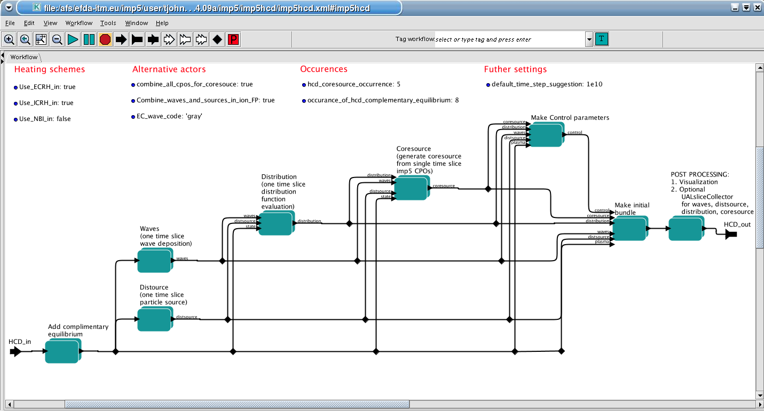
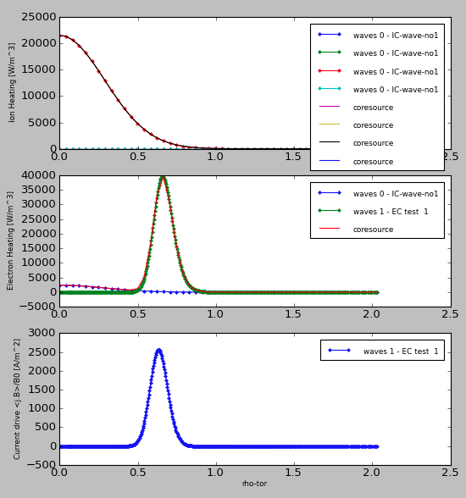
IMP5HCD workflow
IMP5 has an actor, IMP5HCD, that combines all heating schemes
Each CPOs is filled by one composite actor
svn: http://gforge.efda-itm.eu/svn/keplerworkflows/trunk/4.09a/imp5/imp5hcd/imp5hcd.xml
website: https://www.efda-itm.eu/ITM/html/imp5_workflow__imp5hcd.html
ETS output
python graphs
Physics modules
CORESOURCE
DISTRIBUTION
WAVES
DISTSOURCE
NOTE: this is an actor – to be plugged into any workflow

Slide 12
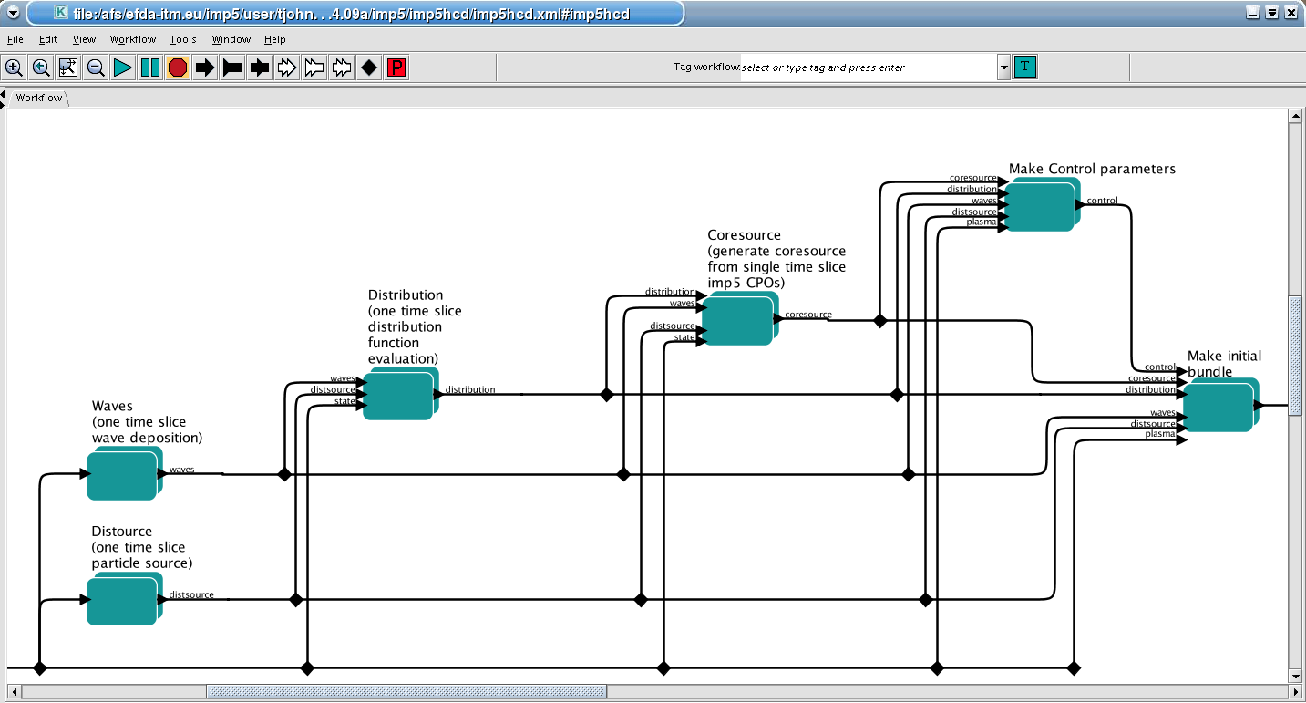
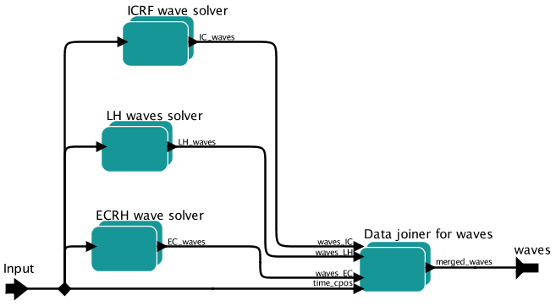
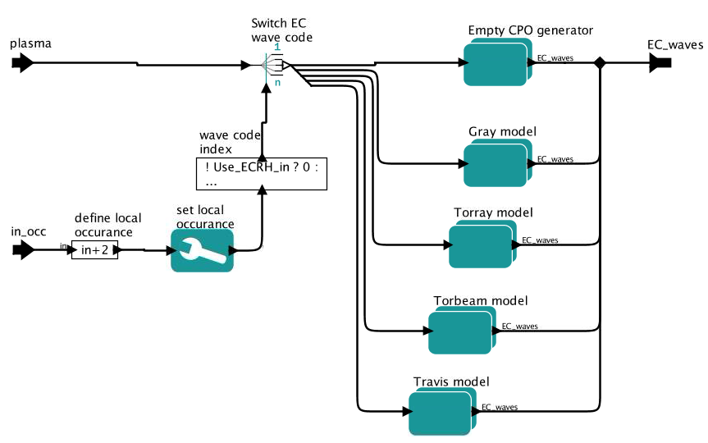
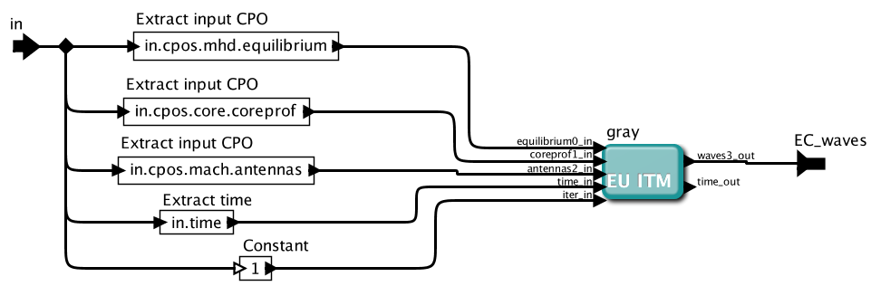
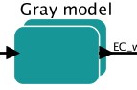
Layered composite actors
IMP5HCD has many layers of composite actors
e.g. consider the Waves actor…
Open composite actor
The CPOs needed for GRAY are extracted
from the ITM Plasma Bundle, which is a
bundle of CPO, and control parameter
and the time.
see https://www.efda-itm.eu/ITM/html/itm_conventions.html#itm_conventions_20

Slide 13
Status of the IMP5HCD
The IMP5HCD is running in
  standalone workflow
  the ETS-A and ETS-C
    Physics codes inside IMP5HCD (4.10a):
      EC: Gray, TorayFOM
      (testing: Relax, Torbeam; in 4.09a: Travis, C3PO/Luke)
      NBI/alphas: BBNBI, Nuclearsim, NBIsim
      (testing: Ascot, Nemo)
      IC: ICcoup
      (testing: Eve, Toric, Lion, FPsim)
      LH: (in progress: LHRAY)

Slide 14
HYMAGYC progresses and benchmarks
Analytic energetic particle response compared with HYMAGYC and HMGC, assuming:
unperturbed particles motion
no mirroring term in the parallel velocity equation
only linear terms in Vlasov equation
large aspect ratio ε₀=a/R₀ <<1
circular magnetic flux surfaces
flat q profile
circulating energetic particles with ρ_{H}/a<<1
electromagnetic fields with scalar potential ϕ and vector potential δA⊥<<δA||.
Bi-Maxwellian distribution function with:
T_{H⊥}/T_{H||} ➔ 0, (m,n)=(4,4),
ϕ, δA|| ∝ ϕ(r), δA||(r) × exp[iωt+i(mθ+nφ)],
ω/ω_{A0}=(0.3+i 0.01),
R₀/a=100, ρ_{H}/a=0.001, v_{Hth}/v_{A}=0.1
Response of the perturbed components at x₁=0.5
Analytical response: black (Real) and red (Imm); HYMAGYC response: blue (Real) and orange (Imm); HMGC response: green (Real) and pink (Imm)
(m-1,n)
(m,n)
(m+1,n)

Slide 15
HYMAGYC progresses and benchmarks
Compare HYMAGYC and HMGC, relaxing some of the prev. restrictions (no analytic. sol. available):
perturbed particles motion ON
mirroring term in the parallel velocity equation ON
relaxation term of the energetic part. initial distr. function in the Vlasov equation ON
large aspect ratio ε₀=a/R₀ <<1
circular magnetic flux surfaces
flat q profile
circulating energetic particles with ρ_{H}/a<<1
electromagnetic fields with scalar potential ϕ and vector potential δA⊥<<δA||.
Bi-Maxwellian distribution function with:
T_{H⊥}/T_{H||} ➔ 0,
ϕ, δA|| ∝ ϕ(r), δA||(r) × exp[iωt+i(mθ+nφ)],
ω/ω_{A0}=(0.3+i 0.01),
(m,n)=(4,4),
R₀/a=100,
ρ_{H}/a=0.001
v_{Hth}/v_{A}=0.1
Response of the perturbed components at x₁=0.5
HMGC response: black (Real) and red (Imm); HYMAGYC response: blue (Real) and green (Imm)
(m-1,n)
(m,n)
(m+1,n)

Slide 16
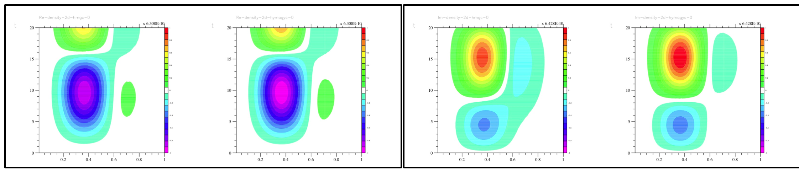
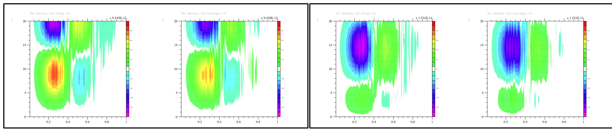
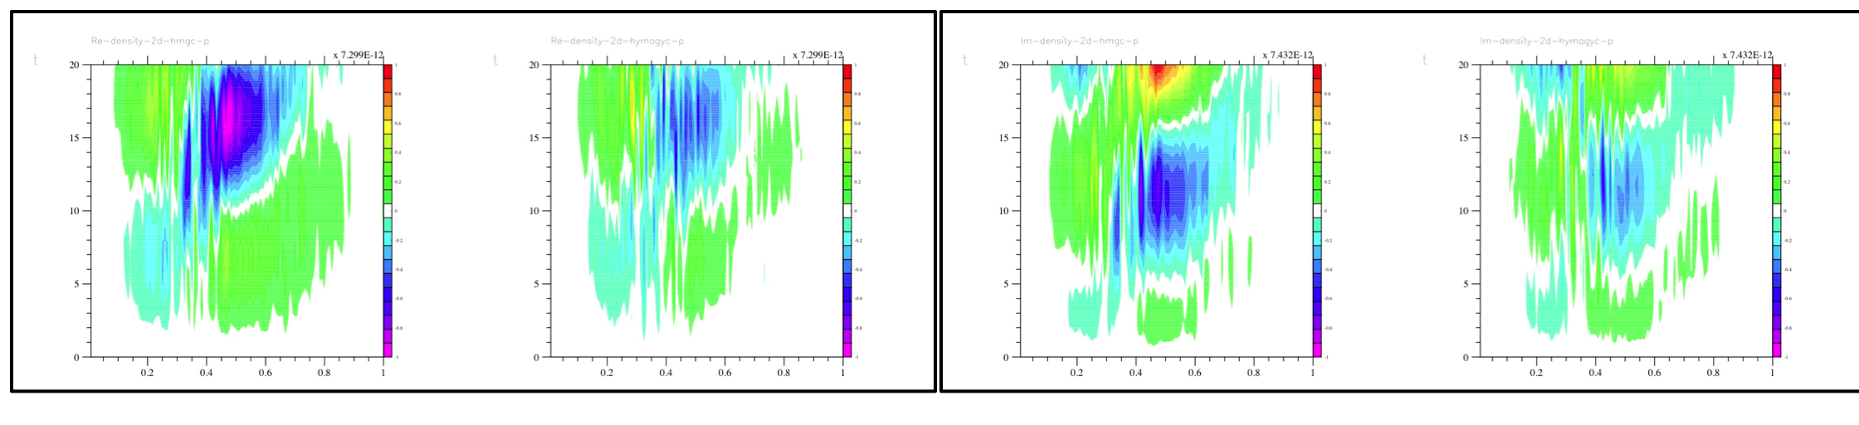
HYMAGYC progresses and benchmarks
Comparing HMGC and HYMAGYC , relaxing some of the previous restrictions (no analytical solution available):
Model and parameters as before but: Maxwellian distribution function; (2) (m,n)=(2,1)
Contour plots of the perturbed density response in the plane (r/a, t) for HMGC and (x1,t) for HYMAGYC:
HMGC (Real) HYMAGYC
HMGC (Imm) HYMAGYC
(m,n)
(m-1,n)
(m+1,n)

Slide 17
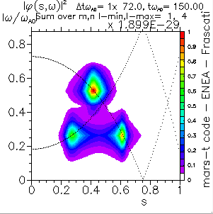
HYMAGYC progresses and benchmarks
Comparing HMGC and HYMAGYC , relaxing some of the previous restrictions (no analytical solution available):
More deeper comparisons are required for the φ-components and satellites of the divergence of the pressure tensor (the divergence of the pressure tensor is the actual drive terms which enters in the extended MHD equations giving the feedback of the energetic particles to fields evolution…)
Simulations using complete versions (self-consistent evolution of fields and energetic particles) of HMGC and HYMAGYC (n=2, m=1,…,4); below is a scan on energetic particle density (intensity of the drive). Note that the details of continuous damping is different between the two codes…)
n_{H0}/n_{i0}=0.002

