Slide 1
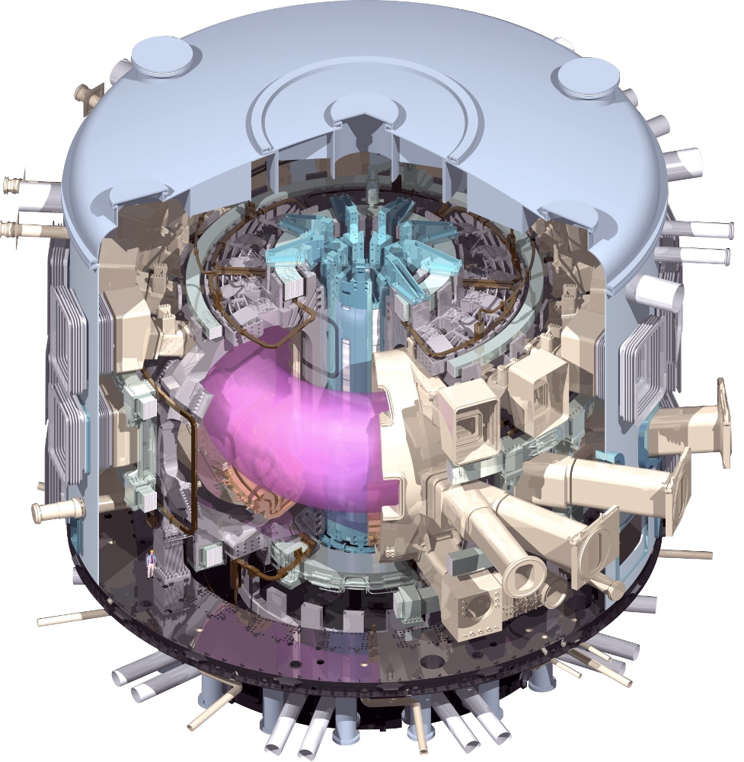
Integrated Modelling for ITER
SD Pinches
ITER Organization
The views and opinions expressed herein do not necessarily reflect those of the ITER Organization

Slide 2
Recent Progress on
ITER Site

Slide 3
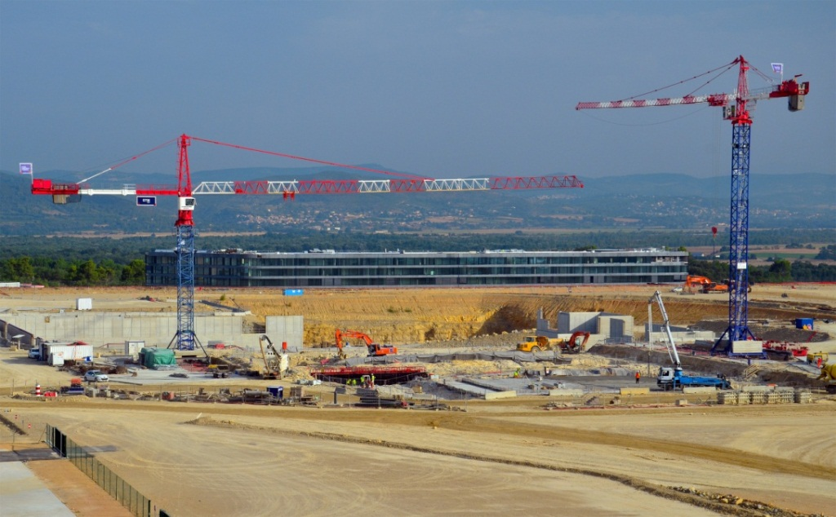
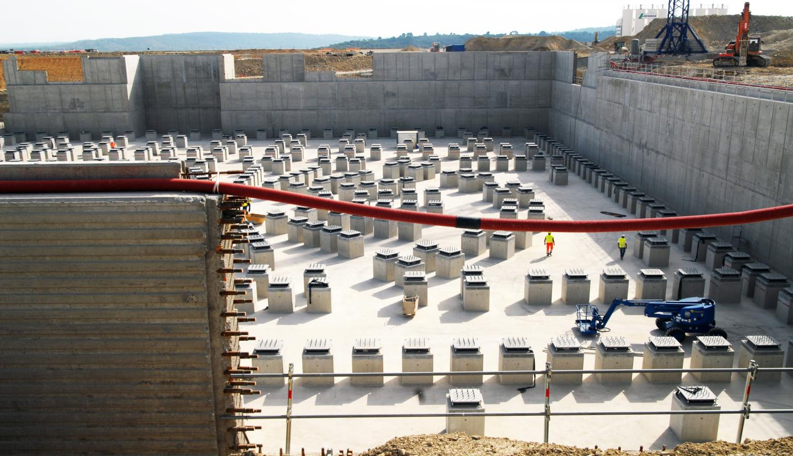
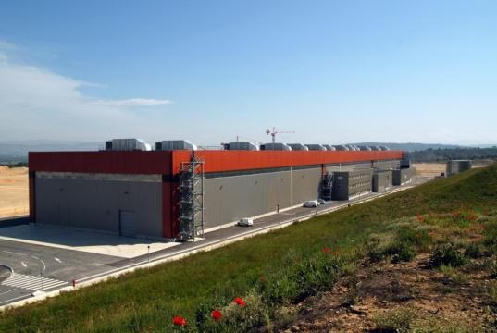
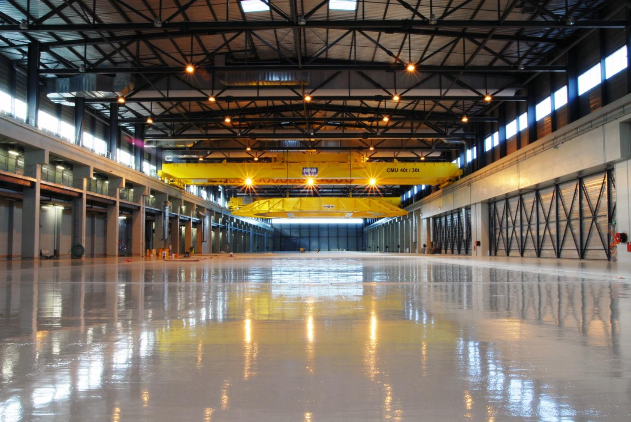
Site Construction Progress
Lower basemat and
anti-seismic isolators
View of on-site construction
PF coil winding building
Inside PF winding building

Slide 4
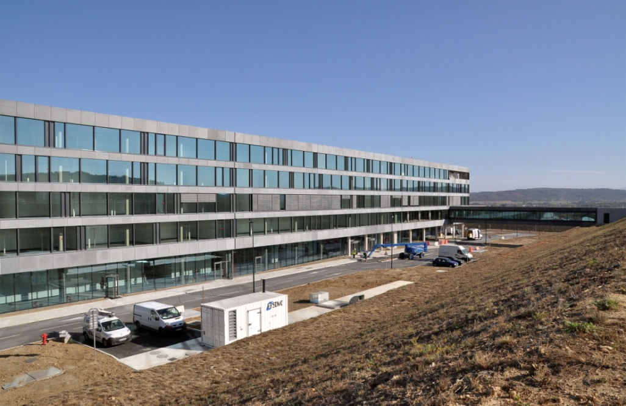
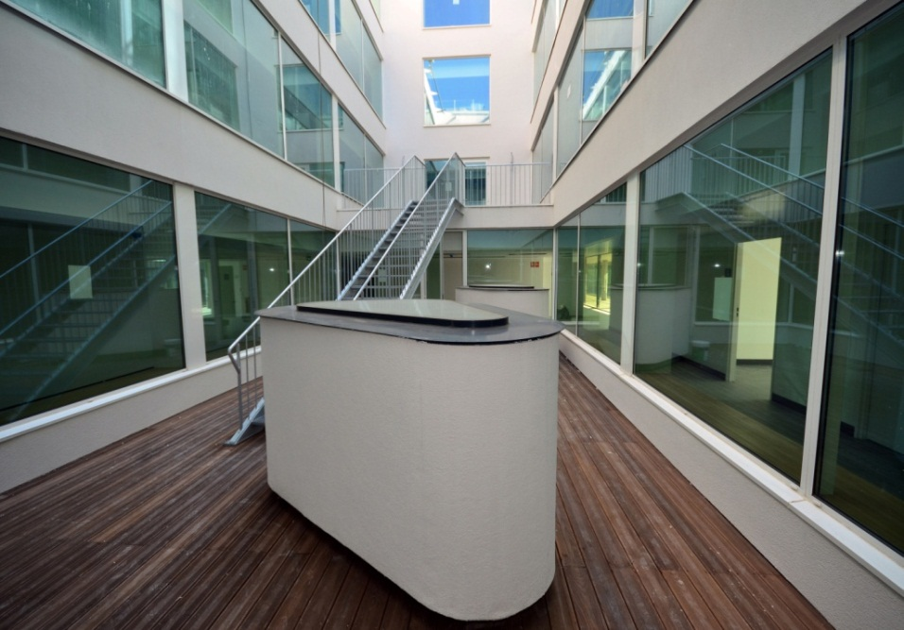
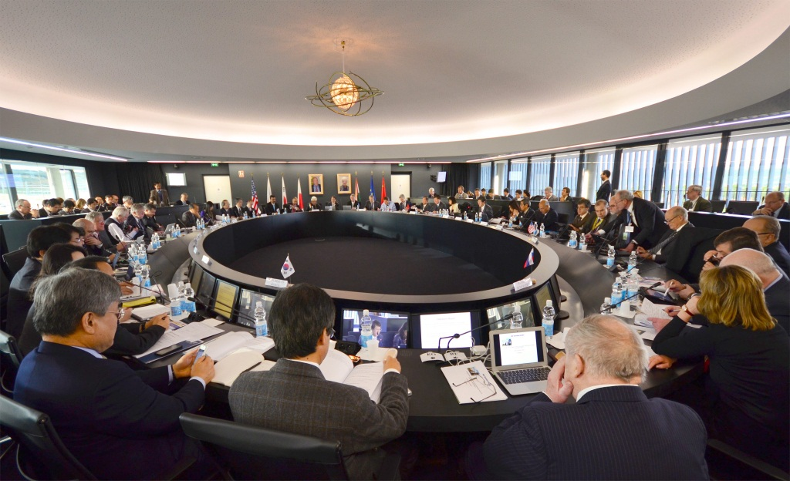
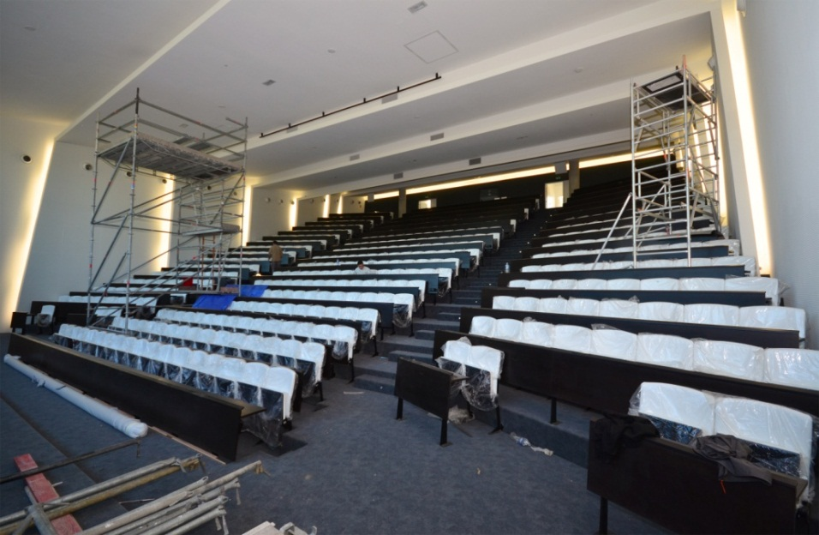
Site Construction Progress
New ITER Headquaters Building
Inside Headquarters Building
ITER Council Room
New ITER Ampitheatre

Slide 5
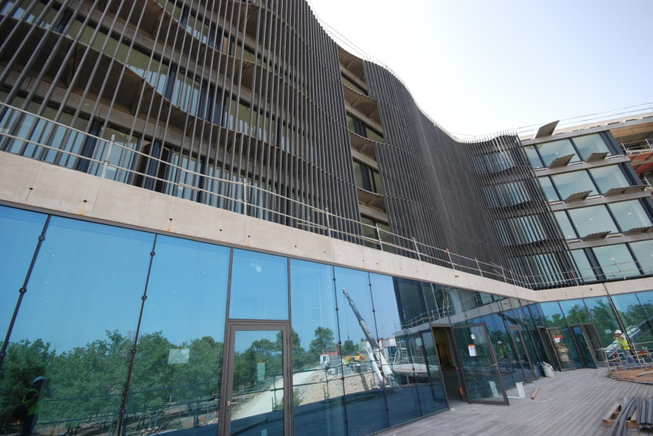

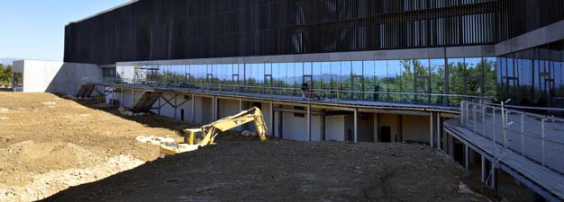
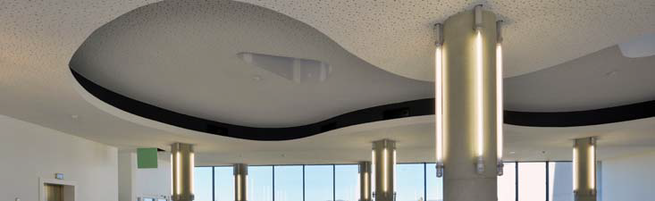

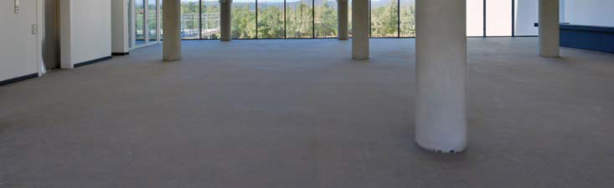
Staff Move to New ITER HQ Complete
Plasma Operations directorate
amongst
last to move
on 16th/17th
November

Slide 6
ITER Integrated ModeLling Programme

Slide 7
ITER Integrated Modelling Programme
ITER needs a well established, strong basis upon which to fulfil the demands of it’s IM Programme
  Supporting operations
    Robust, reliable tools that can be used to validate pulses, perhaps with constraints on runtime
  Supporting research
    More sophisticated tools that can be used to unpick complex physics questions and address the science coming out of ITER
    These tools can also be used to advance the simpler (perhaps more empirical) tools used to support operations
  Support during construction
    Present-day tools that can holistically model the future conditions in ITER to aid and support on-going design questions

Slide 8
Supporting Plasma Operations
Requires physics modelling tools for:
  Validation of pulses prior to operation
  During shots for plasma control (forecasting) and live display
  Post-pulse for comprehensive reconstruction using full set of diagnostic measurements
Tools must be computationally efficient, robust, well-documented and interface with other systems
Managed by IO and accessible to all ITER Members
Describe macrosopic behaviour that improves as ITER explores new physics domain of burning plasmas
Integrated Modelling Analysis Suite (IMAS)

Slide 9
IMAS Components
Data Model
  Applicable for all physics usages
Physics Codes
  To support Plasma Operations and Plasma Research
Framework
  Provides easy workflow management
Framework
Physics codes
Data Model
As far as possible, each element is independently exchangeable

Slide 10
Supporting Plasma Research
Requires much more extensive set of modelling tools to be used both prior to operation and post-operation
  Examination of microscopic behaviour
  Investigation of more rigorous theoretical or computational behaviour
  Exploration of new physics
Primary basis for model improvement and validation
Applied to selected shots, segments or time-slices
Will often require significant high performance computing (HPC) facilities
Emphasis on incorporating these development components during construction of IMAS

Slide 11
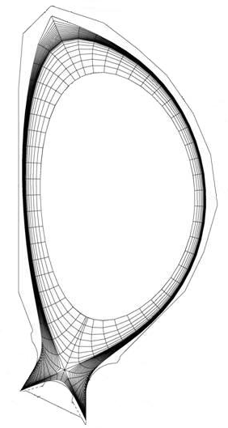
Physics Integration Challenges
Legend
Legend
Magnetic surface features
Magnetic surface features
Plasma on closed flux surfaces
Plasma on closed flux surfaces
Plasma on open flux surfaces
Plasma on open flux surfaces
Limiting material surfaces
Limiting material surfaces
Scrape
Will ultimately require:
  Coupling of all spatial plasma domains (core, edge, scrape-off layer & divertor)
  Dynamic coupling of individual physics models relevant to each domain
  Interaction between plasma and PFCs
  Coupling of plasma with external circuits, H&CD, fuelling, pumping and other systems to confine and control plasma
Scrape
-
-
off
Scrape
off
Scrape
-
-
off
off
layer (SOL)
layer (SOL)
layer (SOL)
layer (SOL)
Edge
Edge
Edge
Edge
(closed gridded
(closed gridded
(closed gridded
(closed gridded
region)
region)
region)
region)
Core
Core
Core
Core
(grid suppressed)
(grid suppressed)
(grid suppressed)
(grid suppressed)
Separatrix surface
ρ
ρ
ρ
Inside: closed field lines
Inside: closed field lines
o
o
o
o
Outside: open field lines
Magnetic axis
Outside: open field lines
Magnetic axis
Magnetic axis
Magnetic axis
(O
(O
(O
(O
-
-
-
-
point)
point)
point)
point)
Chamber
Chamber
Chamber
Chamber
wall
wall
wall
wall
Poloidal
Poloidal
field
Poloidal
field
Poloidal
field
Divertor
field
Divertor
Divertor
Divertor
null (X
null (X
-
-
point)
null (X
point)
null (X
-
-
point)
Inner
point)
Inner
Inner
Inner
divertor
divertor
divertor
divertor
target
target
target
target
Private flux
Private flux
Private flux
Private flux
Outer divertor target
Outer divertor target
Outer divertor target
Outer divertor target
Divertor dome
Divertor dome
Divertor dome
Divertor dome

Slide 12
Computation Challenges
Parareal technique (time parallelisation) investigated as approach to accelerate ITER transport simulations performed with CORSICA
  2D equilibrium package + transport models + source modules developed by Lawrence Livermore National Laboratory, USA
  Computationally intensive
  Parareal algorithm relies upon ability to create coarse / fine runs and the ability to restart
With analytic source terms: Gain of 8.32 on 12 processors
With NBI source terms: Gain of 10.13 on 32 processors
Debasmita Samaddar, ITER Monaco Postdoctoral Fellow

Slide 13
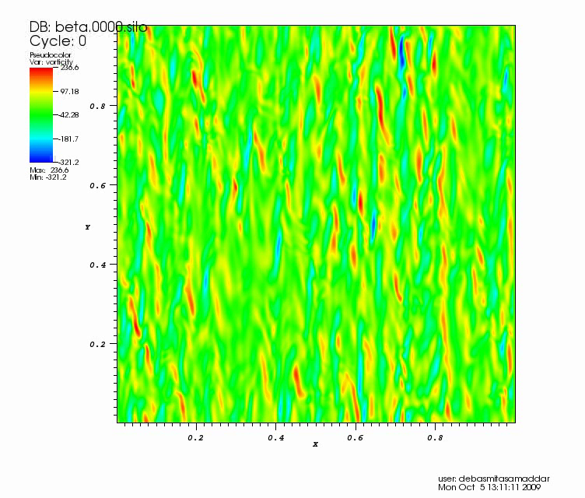
Parareal Algorithm and Turbulence
Serial Solution
Parareal Solution
(8.805× faster on 88 procs.
Using IPS: 10× on 80 procs.)
Debasmita Samaddar, ITER Monaco Postdoctoral Fellow

Slide 14
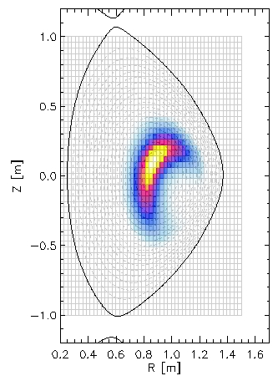
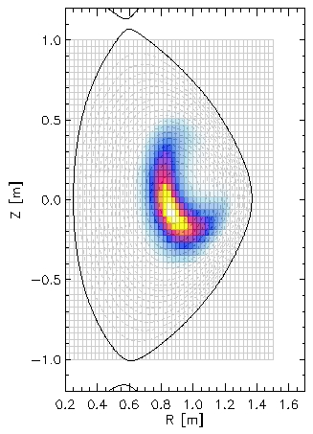
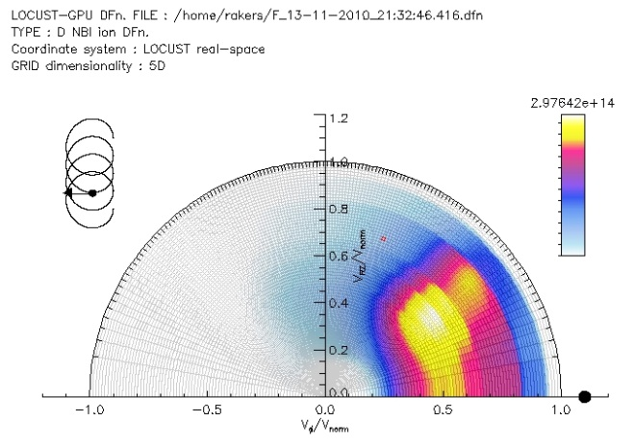

Address wall clock restrictions using new computational techniques: e.g. GPGPUs
Smooth, accurate, high resolution fast ion distributions in MAST
Speed-up over single core ~×50 (×200 using four GTX480 cards)
>10⁶ neutral beam ions can be tracked to thermalisation / hour by using GPGPU technology
Z [m]
Z [m]
R [m]
R [m]
V_{perp}/V_{norm}
V_{perp}/V_{norm}
V||/V_{norm}
V||/V_{norm}
Rob Akers, CCFE

Slide 15
Coordination of IM with ITER Members
Central Engineering & Plant Directorate
Fuel Cycle Engineering
ITER Organization
Domestic Programs
Plasma Operation Directorate
Divertor and Plasma Wall Interaction
Transport and Confinement Physics
Stability and Control
Plasma Operations
Integrated Modelling
Tokamak Directorate
Internal Components
Magnet
Vessel
Safety, Quality & Security Department
Safety Control
Quality Assurance
CODAC, Heating & Diagnostics Directorate
CODAC
Heating
Diagnostics
Visiting Researchers
Postdoctoral Fellows
IMEG
IM Programme & Components
ITPA
Physics Models & Validation
CN
EU
IN
JP
KO
RF
US

Slide 16
Plasma Simulator for PCS Evaluation
Development of a Plasma Simulator (PS) to test, refine and extend Plasma Control System (PCS)
The coupled PS-PCS system will be used for pulse preparation and validation
  High priority application for prototyping IM infrastructure
  Develop control strategies from plasma initiation to burn control and refine response to various events
    L-H transistion, power supply interuption, diagnostic degradation / failure
Troubleshoot PCS during operations
Coupled system can guide physics model development

Slide 17
Plasma Simulator for PCS Evaluation

Slide 18
IM Support During Construction
IM Programme will support design basis of ITER facility by:
  Evaluating candidate plasma operating scenarios
  Assisting in development of plasma control strategies
  Preparing for analysis of experimental results during operation
Anticipated that the supporting physics R&D programme will make continuous progress in developing more comprehensive models as a result of validation against results from domestic facilities
  Partnership involving IO – ITPA – Domestic Programmes

Slide 19
Model Validation and Improvement
Critical for improving control of ITER operating conditions and for optimising plasma performance
Until ITER commences operation, validation must be done using data from domestic programmes
During ITER operation, domestic facilities can continue to help validate and improve models by accessing data:
  Over a broader range of scales
  By isolating specific physics, e.g. with new diagnostic methods
Primary responsibility for model validation & improvement over broadest range of conditions rests with domestic programmes

Slide 20
Stages of IMAS Development
2011-2013: Conceptual design, initial infrastructure and physics
  Implement prototype infrastructure (Data Model, APIs, workflows, version control and documentation) and physics model
  Train ITER staff (“alpha users”) to use and evaluate effectiveness
2014-2016: Extend infrastructure and physics
  Complete the development of basic workflows and other supporting infrastructure
  Establish fundamental basis for all types of pulse planning
    Plasma Simulator evaluates confinement properties and response to H&CD and fuelling systems
    Coupled PS-PCS system addresses whether the control system has the capability to reach the desired operating conditions using feedback control without violating system constraints
2017-2020: Full Physics for Pulse Planning, begin Reconstruction / Analysis
  Implement broad range of physics components and applications for Pulse Planning
  Physics models will undergo extensive V&V against data from other devices
  Planning for pulse execution, analysis and research commences

Slide 21
Next Steps?
ITER IM Programme would benefit from a practical demonstration of ITM approach
  Show not only workable but demonstrate capabilities and benefits
    Start to push real experimental data around framework
    Demonstrate sufficiency of (ITER) Data Model (through real usage) and drive extension where necessary
  Start process of validation and model improvement
Demonstrate HPC capabilities of framework
  cf. CORSICA acceleration using Parareal approach and IPS

Slide 22
Summary
Integrated Modelling for ITER poses challenges and opportunities to fusion community
ITER is appreciative of strong EFDA commitment to IM
  EFDA ITM-TF has build a firm foundation from which to help advice ITER on its IM Programme
Your help and experience is not just welcome, it’s needed
Its important we maintain a strong and healthy working relationship

Slide 23
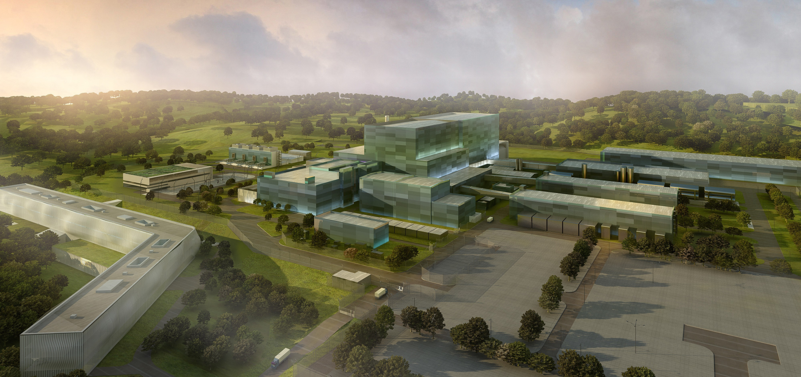
Projected Appearance of Completed ITER Site

