Slide 1
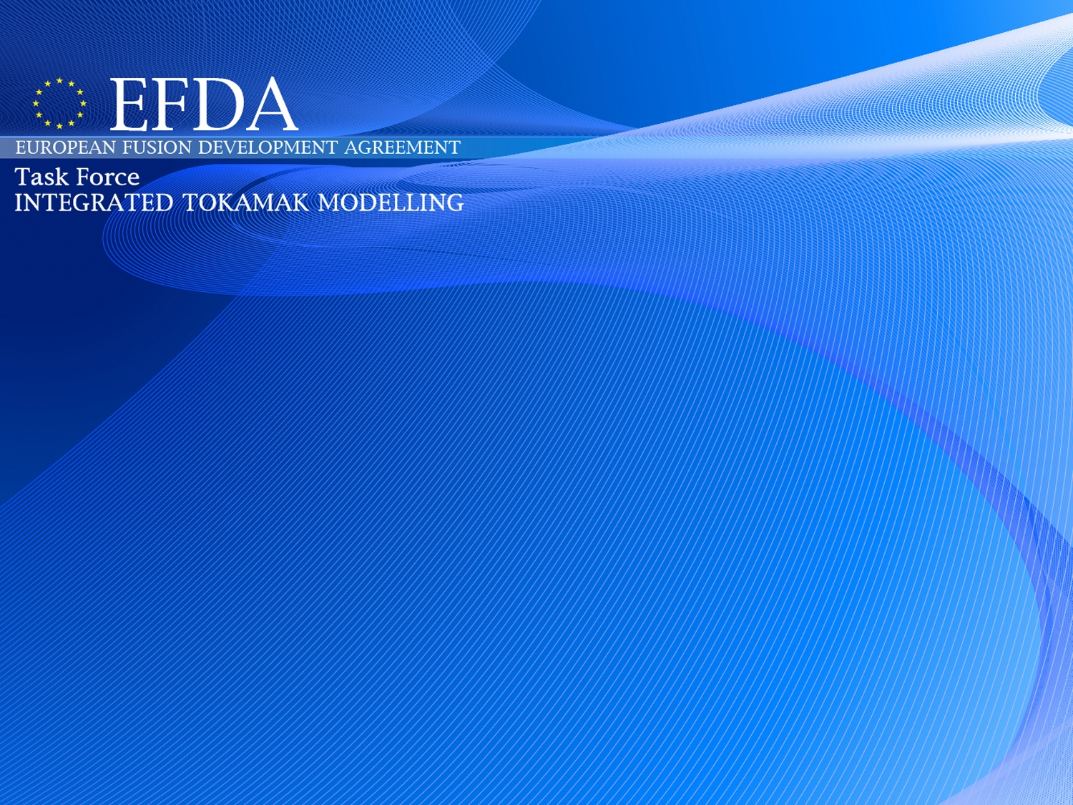
AMNS + IMP3
Presented by D. Coster on behalf of AMNS + IMP3
TF Leader : G. Falchetto
Deputies: D.Coster, R. Coelho
EFDA CSU Contact Person: D. Kalupin
ITM Annual Meeting
21 November 2013
https://www.efda-itm.eu/
AMNS + IMP3, Coster, ITM Annual Meeting, Nov 2013
1

Slide 2
AMNS + IMP3
AMNS
  no new AMNS data structure introduced (changes pending for the next release)
  consolidation of existing work
  number of UAL related issues seem to have been solved
IMP3
  core
    ETS-A
      HCD modules
      transport modules
      impurities
    ETS-C
      NTM
      Free Boundary Equilibrium (FBE)
  edge
    core-edge coupling
    BIT1
    ERO
    SOLPS (Carre, grid extension to wall)

Slide 3
IMP3-Core
Main efforts concentrated on increasingly powerful core workflows:
  ETS-A
    Applied to a large number of Tokamaks
    Extensive HCD modules
    Extensive transport modules
    Impurities
    Neutrals
  ETS-C
    Extensively benchmarked against CRONOS
    Significant work on FBE
    NTM
Significant benefit from having two efforts
  cross-check that modules work in both
  slightly contrasting philosophies allow the user a choice
  keeps more people involved!

Slide 4
ETS-C
Philippe HUYNH, Vincent BASIUK
There are 4 main activities
  Coupling with Free Boundary Equilibrium Codes (Cedres++ and Freebie)
  Coupling with an Impurity Transport Solver
  Coupling with NTM modules
  Validation of Electron Density Simulation

Slide 5
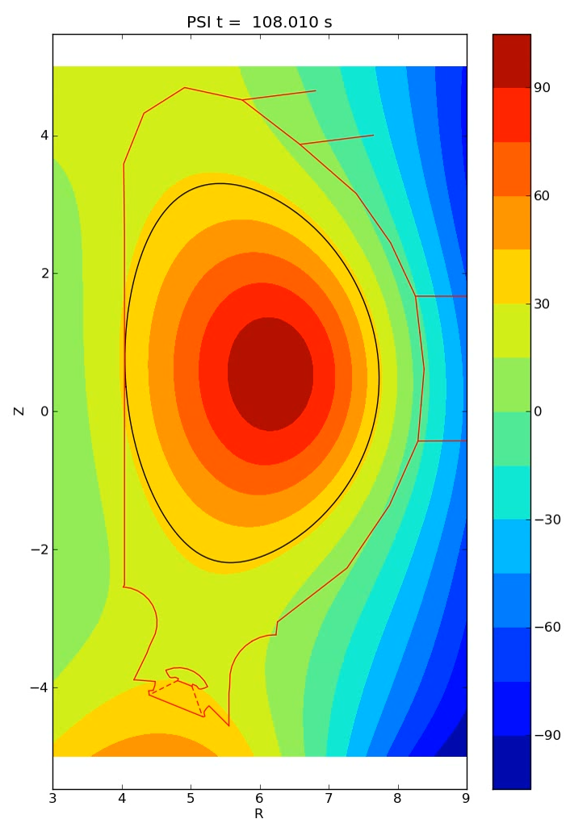
ETS + Free Boundary Equilibrium workflow
The ETS workflow now includes
a Free-Boundary Equilibrium (FBE) solver (CEDRES++, or FREEBIE):
a switch in the workflow allows to select
a FBE solver in place of a fixed-boundary solver.
Toroidal current
(visualization from CPOs)
Simulation of a VDE in ITER.
The initial plasma has I_{p}=11.8 MA,
elongation κ=1.49, limited on the HFS.
PF voltages are set to 0.
Falchetto et al NF submitted
simulation by E Nardon
visualisation from CPO
courtesy D Coster
5

Slide 6
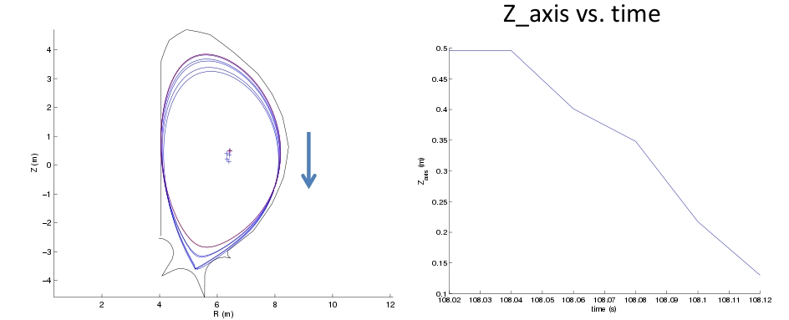
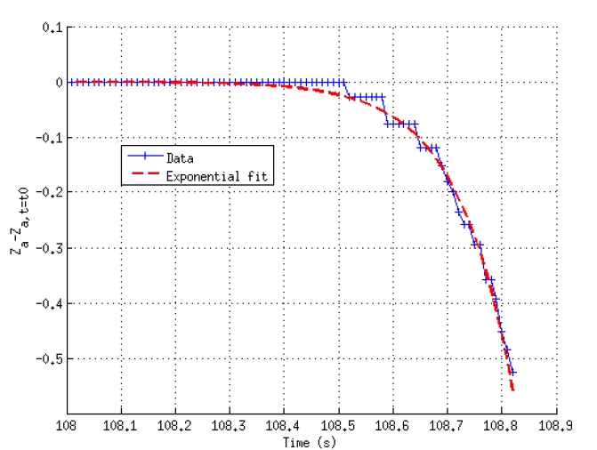
ETS-C with Free Boundary Equilibrium
Freebie (J.Urban) and Cedres++ (E.Nardon, C.Boulbe) are coupled with ETS-C.
Cedres++ demonstrate a VDE on a ITER simulation (see E.Nardon report).
The magnetic axis vertical position Za has an exponential behaviour with a constant time value coherent with what it is expected for ITER.

Slide 7
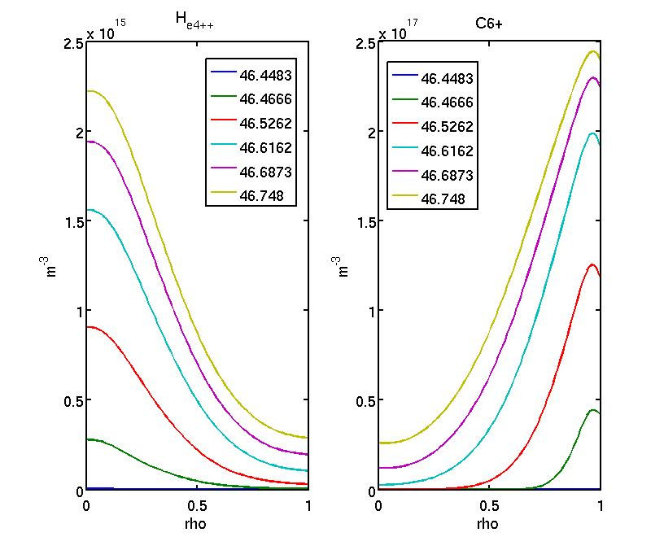
ETS-C with Impurities
An Impurity Module (Irena Ivanova-Stanik, Roman Stankiewicz) is coupled with ETS-C.
Verification was done on a first test-case in the following conditions:
JET geometry, a given analytic He4++ source, a given analytic carbon source flux at the edge, constant transport coefficients, neoclassical coefficient computed.
The results are qualitatively consistent with what it is expected : ashes accumulation in the center of the plasma, fully ionized Carbon propagation up to the center of the plasma, ...

Slide 8
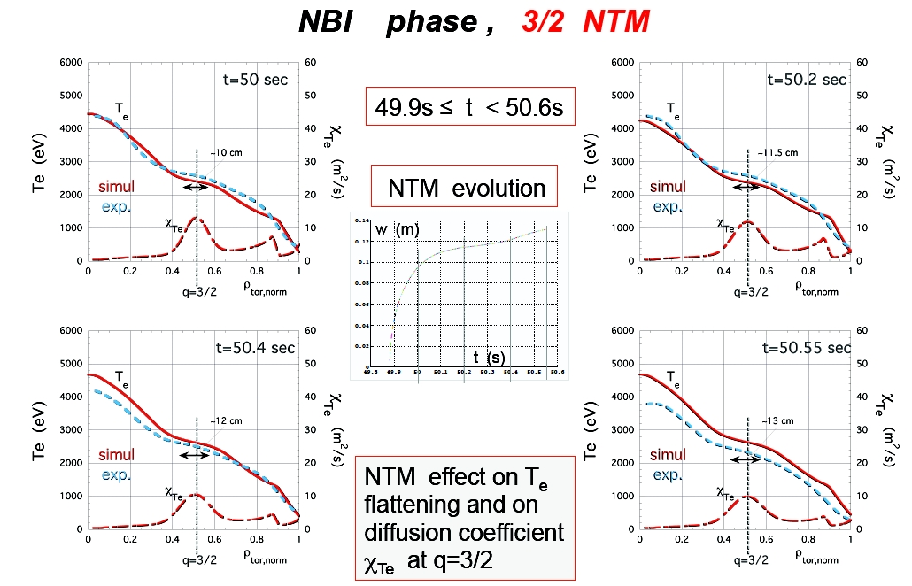
ETS-C with NTM
NTM Modules (S.Nowak, O.Sauter) is coupled with ETS-C.
Validation work was done on the JET shot 76791 (cfr Nowak)

Slide 9
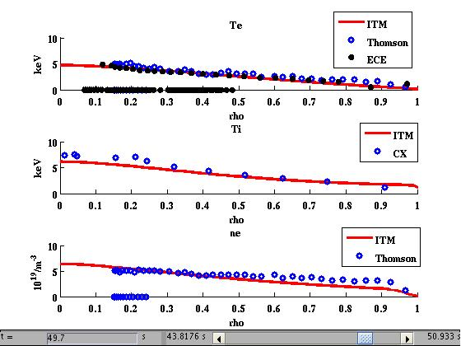
ETS-C: Electron Density Simulation
Validation of electron density evolution with some computed sources (cold neutral, fusion source) by comparison with the experiment.
JET shot 76791, simulation of around 6s of the beginning of the shot (end of ramp-up and ramp-down) and part of the flat-top phase. The NBI source are prescribed (come from a CRONOS/SPOT simulation). The cold neutral source and the fusion source are computed. The gas puff is a free parameter.
Fair agreement between measurement and simulation

Slide 10
ETS-A
Yesterday’s presentation by Denis
Impurities
Extensive
  HCD
  Transport modules
Visualizations
AMNS + IMP3, Coster, ITM Annual Meeting, Nov 2013

Slide 11
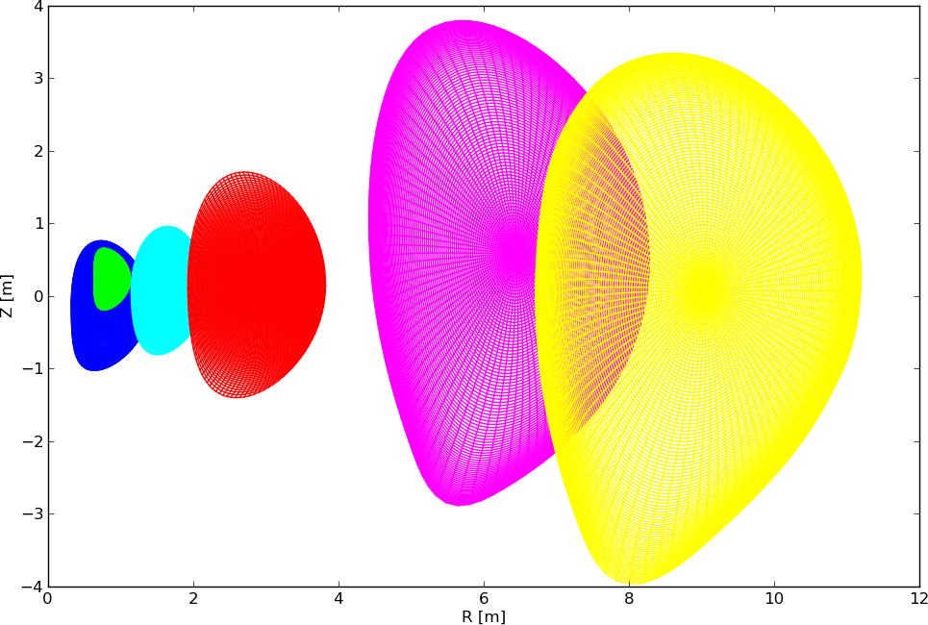
ETS Core Transport Workflows
Core workflows running under Kepler for
MAST, TCV, AUG, JET, ITER, DEMO
ETS grid

Slide 12
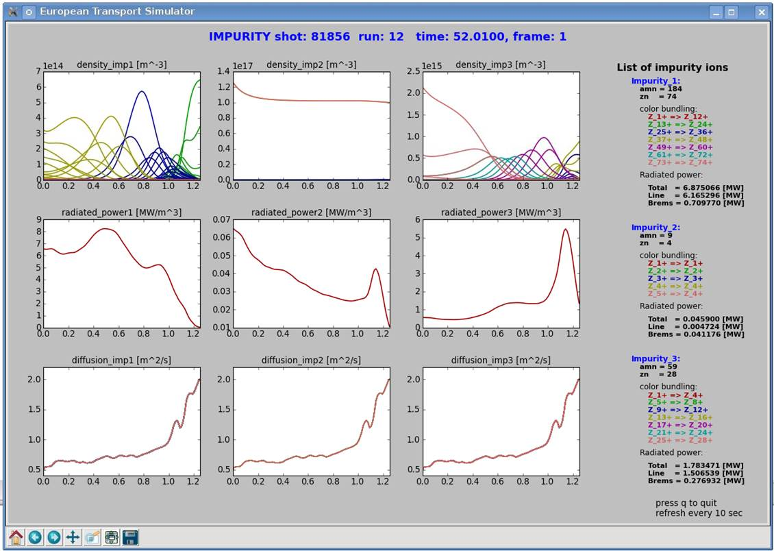
Impurity transport workflow
ETS with impurity module: evolves impurity density for arbitrary number of impurities in all ionization states (density sources for each include ionization, recombination & charge-exchange; rate coeffs. from ADAS via ITM-TF interfaces)
JET# 81856 L mode
W
Ni
Be
transport coeff. for impurity ion assumed equal to that of D
! lack anomalous transport module for impurities

Slide 13
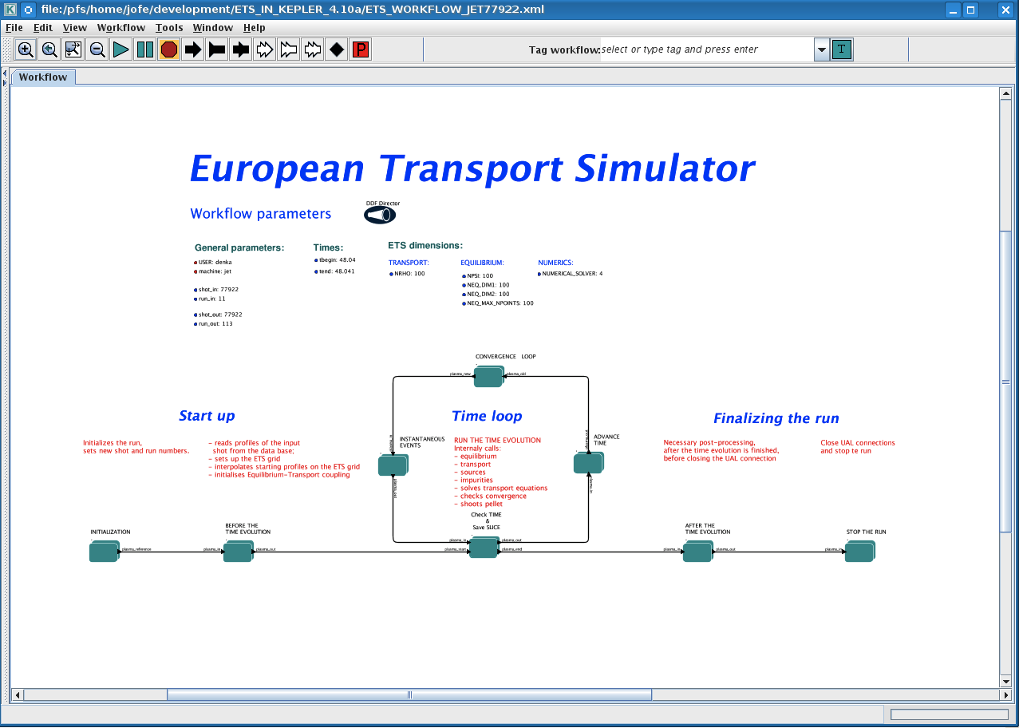
ETS-A: basic design

Slide 14
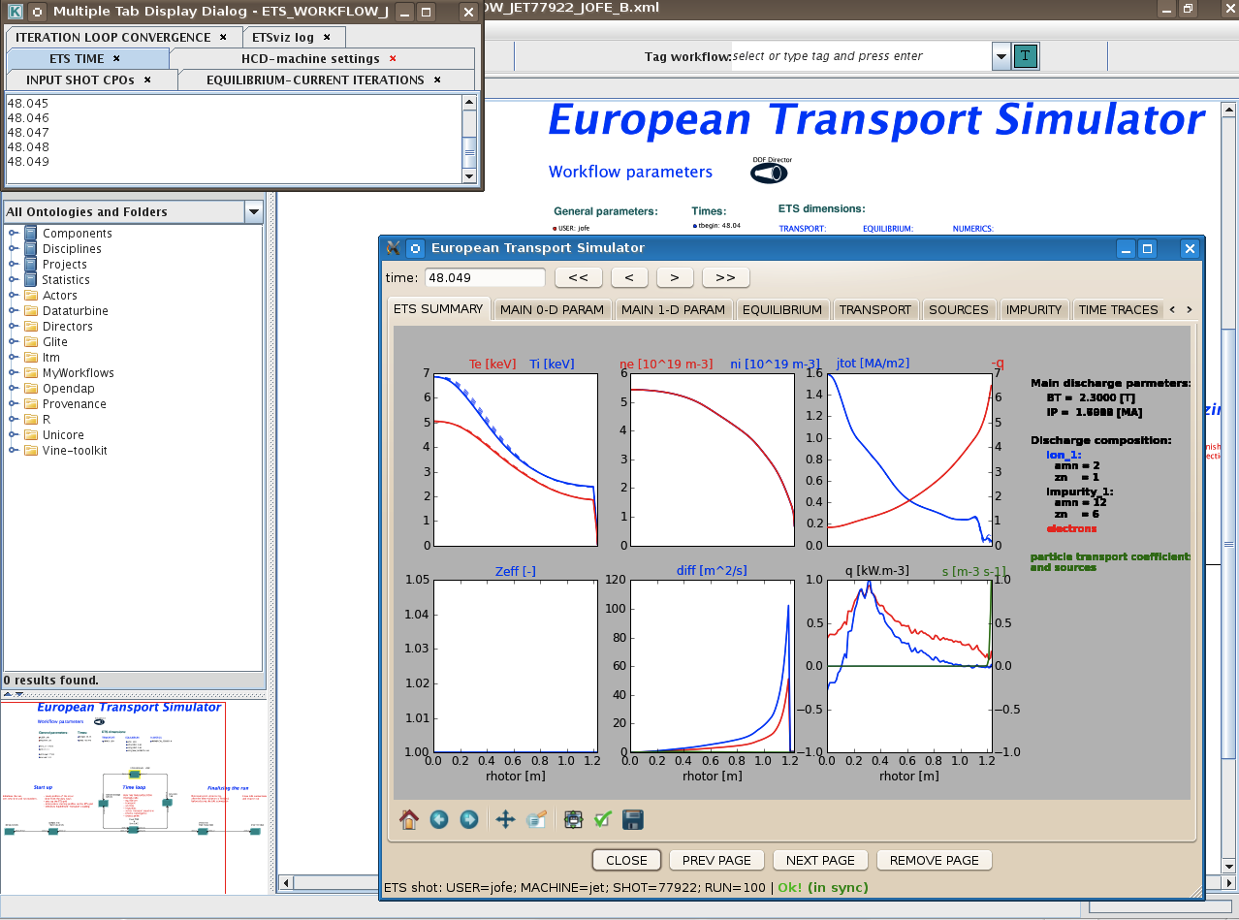
ETS-A: basic design

Slide 15
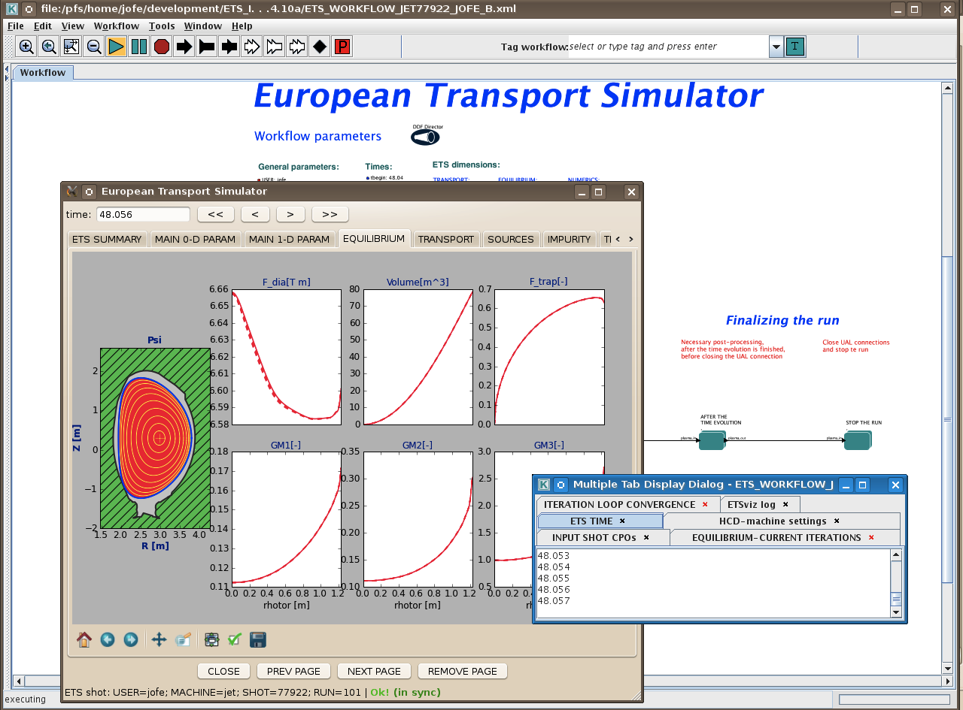
ETS-A: basic design

Slide 16
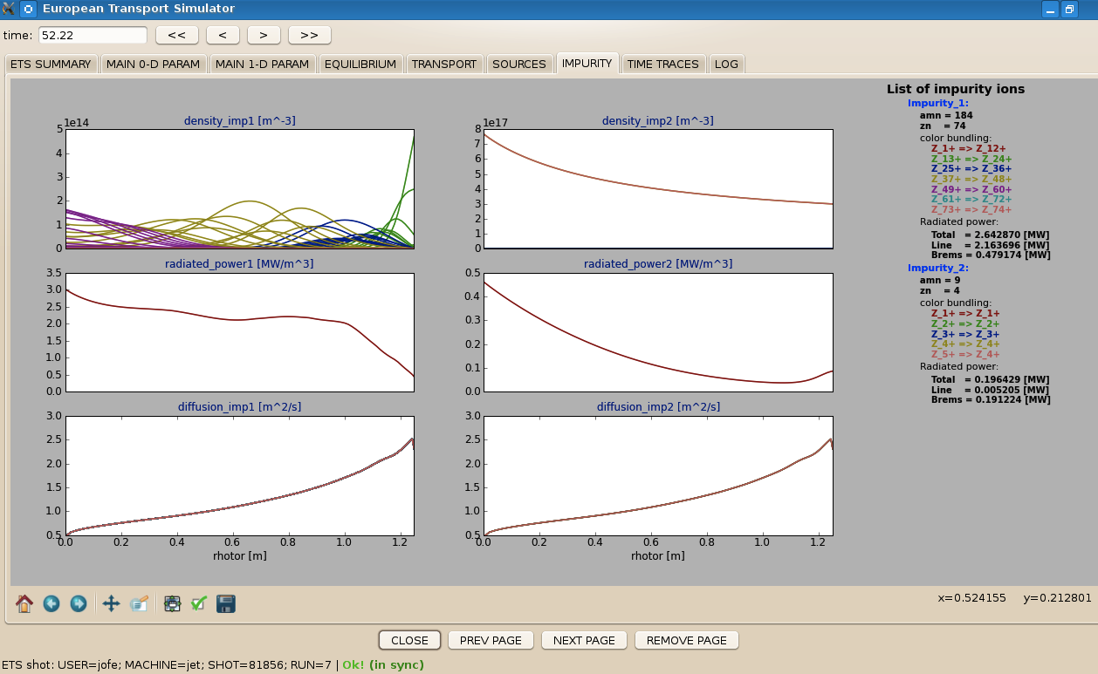
ETS-A: basic design

Slide 17
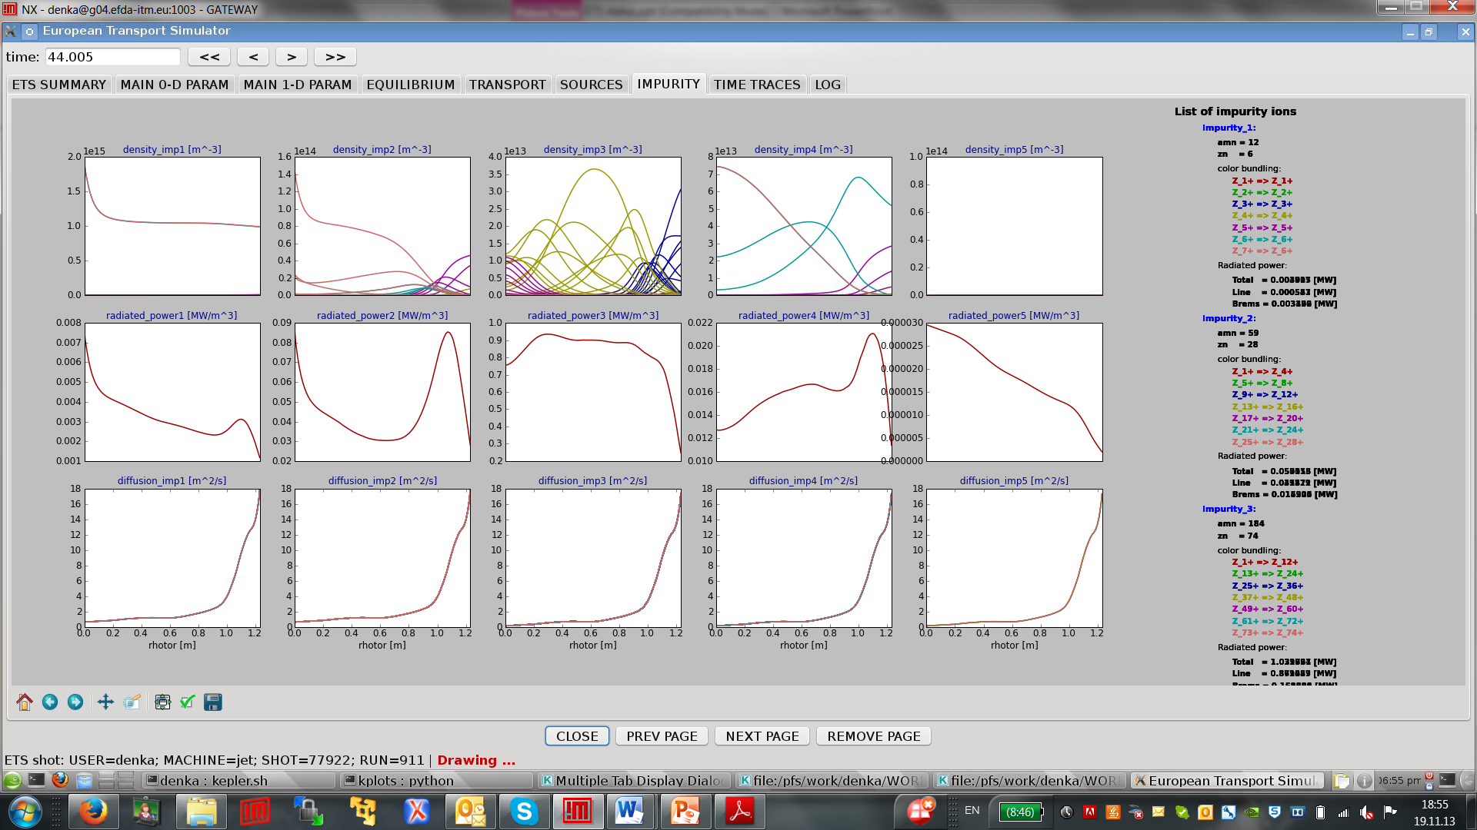
ETS-A: basic design

Slide 18
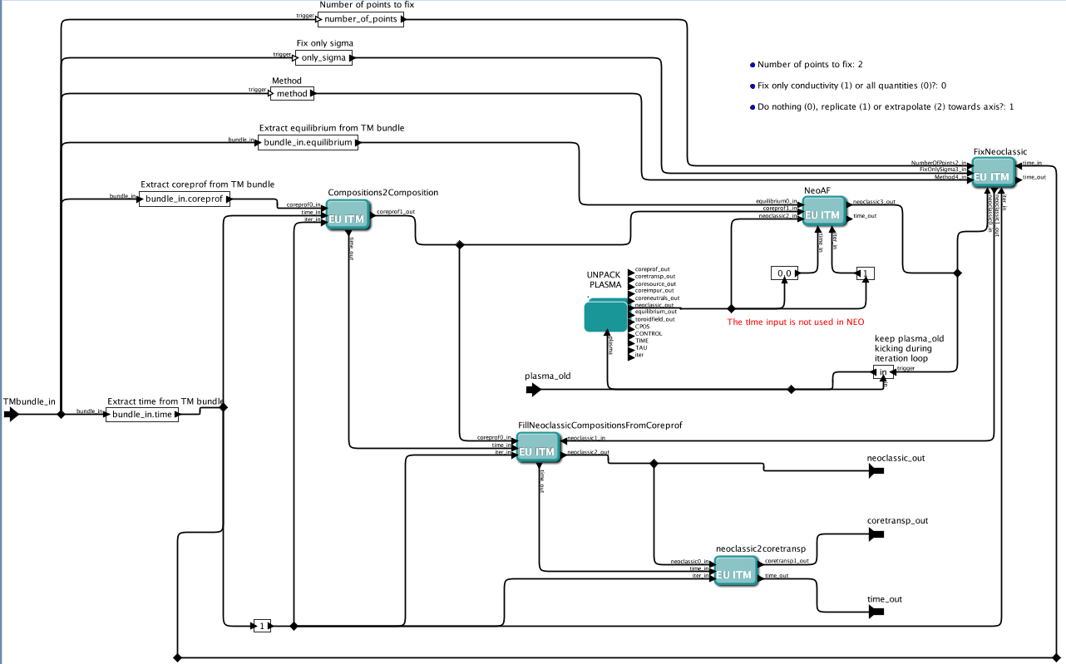
NCLASS from ETS-C and NEOS
Integration of the NCLASS actor from ETS-C in ETS-A

Slide 19
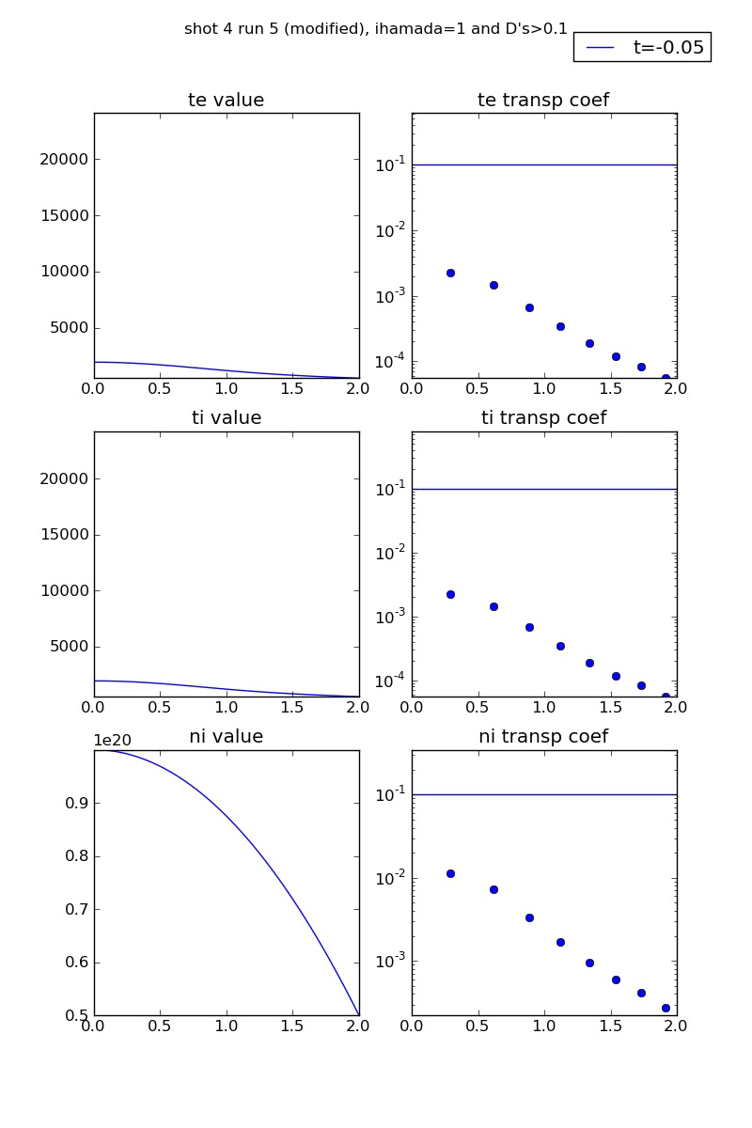
GEM - ETS workflow
Tightly coupled simulation:
reduced ETS workflow with transport coefficients provided by turbulence code
circular equilibrium ITER size
the workflow simulates 5 sec
GEM is called at each time step and runs 8 fluxtubes for 10 τ_{GB}
turbulence transport coefficients effective above a background transport threshold
density profiles not solved
GEM uses Hamada coordinates
grid 128x128 x32 (radial, drift-angle, parallel)
Workflow run on 128 cores on ITM Gateway
100 tsteps ~ 10hsCPU
courtesy O. Hoenen
19

Slide 20

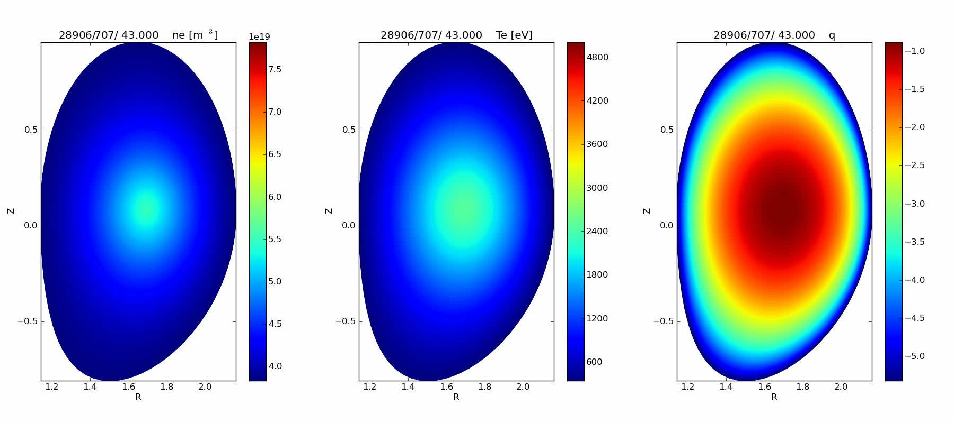
Equilibrium-Turbulence-Transport
Workflow
Within EC-FP7 project “MAPPER” (Multi-scale Applications on European e-Infrastructures”)
  gyro-fluid turbulence code GEM (8 flux tubes)
  CHEASE equilibrium code
  ETS core transport code
  300 steps in 20 hours on 256 cores
  Runs on ITM Gateway, HELIOS, other EU resources
http://www.mapper-project.eu/
courtesy of D. Coster O. Hoenen, B.Scott
20

Slide 21
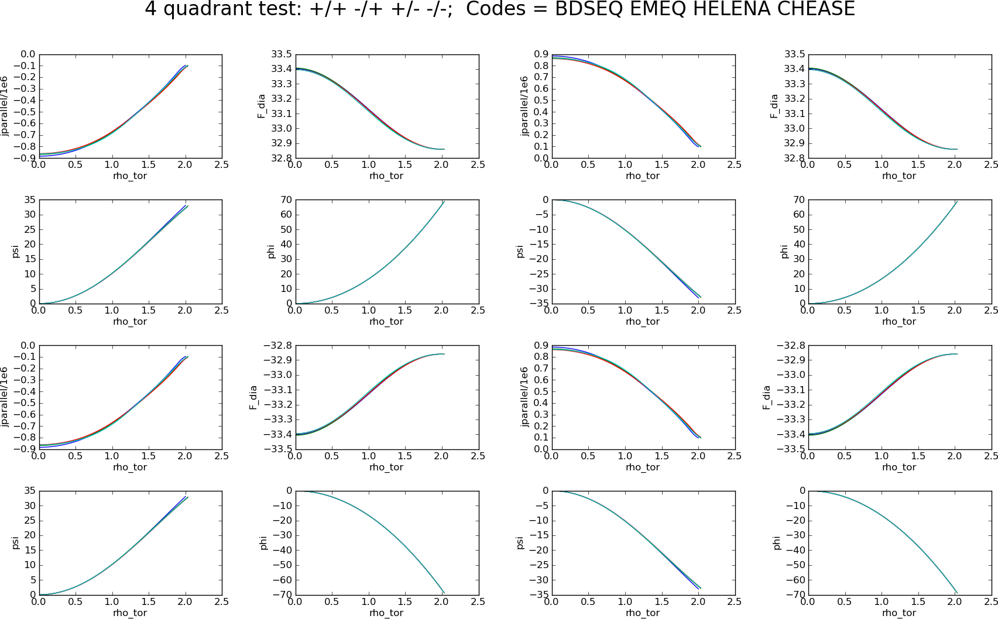
Importance of COCOS:
B₀ and I_{p} have signs!
B₀
I_{p}
AMNS + IMP3, Coster, ITM Annual Meeting, Nov 2013
21

Slide 22
IMP3-Edge
BIT1-ITM
ERO
SOLPS-ITM
AMNS + IMP3, Coster, ITM Annual Meeting, Nov 2013
22

Slide 23
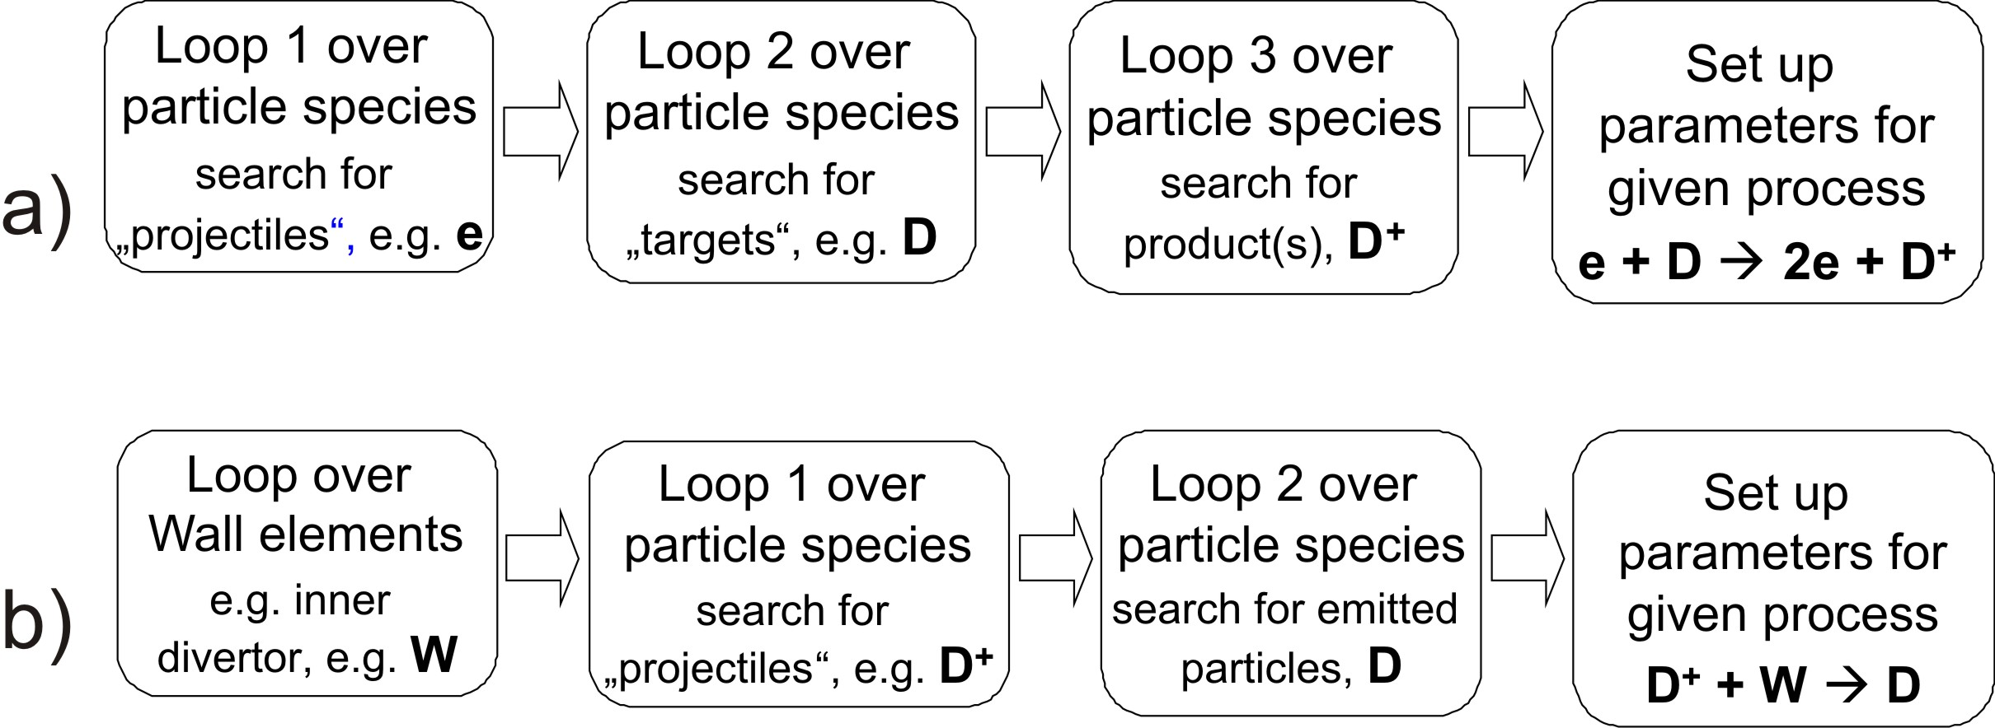
Development of BIT1- ITM
BIT1 is a massively parallel full kinetic nonlinear PIC code for simulation of the plasma edge.
Number of simulated impurity and main ion species is limited just by available atomic and PSI data (at present more than 200 processes are implemented).
Typical input: more than 1000 parameters (input file contains ~10 pages), at least 200 of them have to be updated for each new model.
Implementation into the ITM platform has to be done into two steps:
Development a user friendly version, BIT1-ITM by strong simplification of the code specific I/O and adjusting to the existing CPO format
Development of the corresponding actor
Auto-parameterization of the atomic and PSI processes
No need in specifying which processes have to be activated. This is done self-consistently throught multiple loops over particle species and wall elements.
AMNS + IMP3, Coster, ITM Annual Meeting, Nov 2013
23

Slide 24
Development of BIT1- ITM
Updates allow reduction of the input parameters to the minimum (<100).
BIT1-ITM is an user-friendy code, full cpo-ization is ongoing.
Comparison of poloidal profiles of the plasma density and temperature in the SOL from test runs of the original and updated codes

Slide 25
Progress towards Kepler actor “ERO”
ERO/ITM 2013 activities focus on edge and wall CPO compatibility in dataversion 4.10a
Conversion of necessary data in edge CPO’s into ERO-readable format was completed
  Fluid plasma quantities needed as plasma background in ERO
  Wall geometry information contained in 2D grids
Upgrade of edge CPO I/O routines into dataversion 4.10a has been partially completed
Implementation of an output routine to wall CPO has been partially completed. ERO will store:
  Wall geometry as wall2d and wall3d
  Surface densities (x,y) of modelled atomic species in the surface layer
  Plasma flux (x,y)
  Average energy of plasma particles (x,y)
  Surface temperature (x,y)
Notes:
25

Slide 26
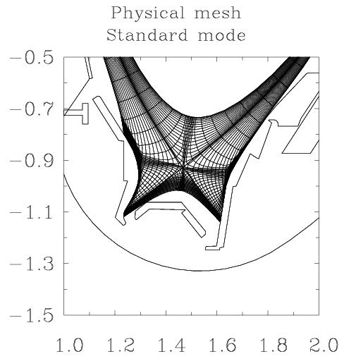
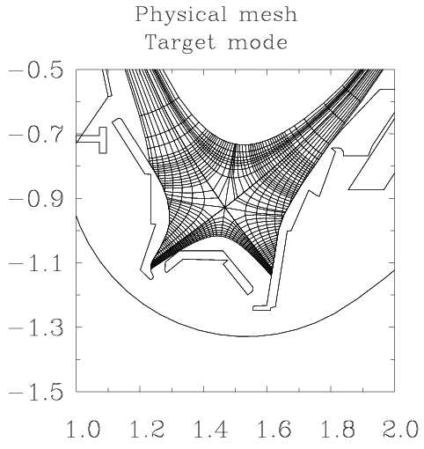
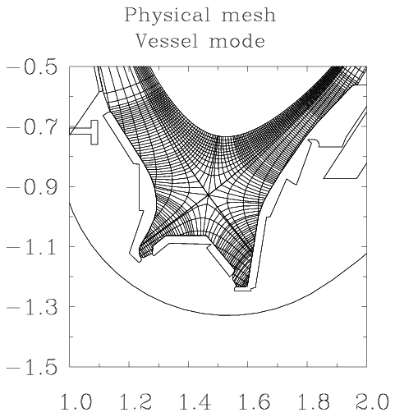
CARRE2
CARRE2
CARRE2: A grid generator for the ITM
Creates field-aligned grids in ‘standard’, ‘target’ and ‘vessel’ modes
  Standard mode: distorted grids aligned with vessel geometry, limited by first tangency point
  Target mode: no distortion near targets, but triangular cells and ‘shaved’ flux tubes at target contacts, limited by first tangency point
  Vessel mode: as target mode, but covers the entire vacuum vessel volume
grid CPO output

Slide 27
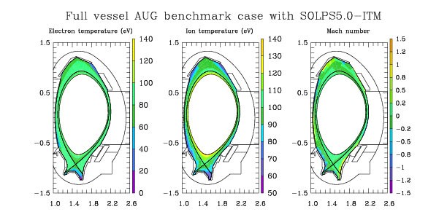
SOLPS5.0-ITM
SOLPS5.0-ITM
Coupled to ETS
Uses grid/edge/core CPO for cross-module communication
Extended grid coverage to the vacuum vessel wall now available with fluid neutrals
Full backward compatibility to older versions

Slide 28
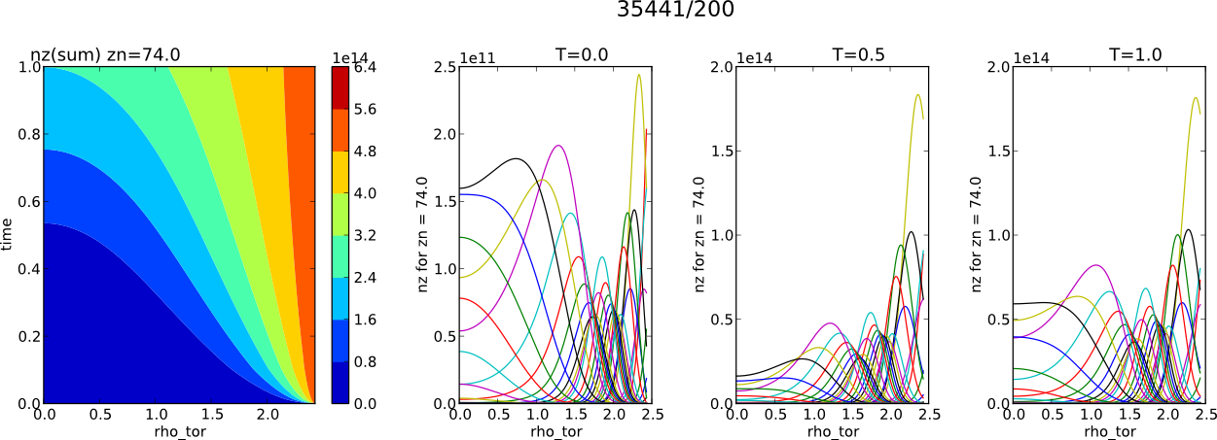
Core-Edge Direct Coupling
Running as time-dependent Fortran workflows
  1 time-step core (1ms – 100 ms) [ETS + impurity + neutrals]
  1 time-step edge (0.01 ms) [SOLPS-B2]
  ITER case : D+T+Be+He+Ne+W
28

Slide 29
IMP3 Contributors
Irina Voitsekhovitch
Vincent Basiuk
Philippe Huynh
Thierry Aniel
Jean-François Artaud
Jeronimo Garcia
Claudio Di Troia
Heinz Isliker
Yannis Kominis
Theophilos Pisokas
Roman Stankiewicz
Irena Ivanova-Stanik
Jorge Ferreira
António Figueiredo
Pär Strand
Luis Fazendeiro
Derek Harting
Cedric Reux
João Bizarro
Denis Kalupin
Xavier Bonnin
Chris Dritselis
David Coster
Hans-Joachim Klingshirn
Markus Airila
David Tskhakaya
Xavier Bonnin
Yannick Marandet
Hugo Bufferand
Guido Ciraolo

Slide 30
AMNS
Atomic data
  rate coefficients: satisfactory
  cross sections: more work needed
Molecules
  initiated work with Guzman in Madrid
    Cross sections from fundamental data are used by kinetic codes
    Resolution of processes could be critical
    three kind of molecular states have been defined in order to be included in CPOs : (N1,N2,N3) where:
      N1 = number of metastables / ground states of the system,
      N2 = number of averaged metastables,
      N3 = number of representative ordinary states.
    First comparisons will be performed for (1,0,0) and upgrade will be done for (2,2,1) in order to compare.
    Work is ongoing.
Surface data
  more work needed
Nuclear
  have the basic thermonuclear data
  will need to do more work on diagnotic data

Slide 31
Also production of new data
Some work is also being done on the production of new data
  mostly under BS
Károly Tőkési
  Experimental study of the interactions between low energy carbon ions and tungsten surface. The aim is to measure the sputtering yield as a function of the ion flux as accurate as possible and at low ion energies.
  Work on the multi-electron classical code – optimization of the basic structure of the code.
  Improve of the fitting function of tungsten elastic cross section at low energies.
Data from Viorica Stancalie
Reactant particles | Reaction products | Data | Data format: | Model calculation/ Full relativistic/Code | Acc. | Comments
h ν + C²⁺ | C^{2+**} | Cross sections | Table | The Feshbach projection operator approximation / energy profile of the photo-recombination (PR) cross sections including quantum interference between dielectronic (DR) and radiative recombination (RR). Cross sections for DR, RR and Photo-Ionization are also available. | 20% | Data from V Stancalie (EPJD 2013)
e –C | C* | a) 88 fine-structure levels energy, b) A_{ij}, f_{ji}, Sij c)Cross sections | Table | a) Multi-configurational Dirac-Fock (GRASP) for structure calculation; b) Comparisons with NIST and Flexible Atomic Code (FAC) for data assessment; c) Dirac-Atomic R-matrix (DARC) for scattering | 20% | Data from V Stancalie;

Slide 32


Calculate state selective cross sections for collisions
of hydrogen atoms with Ar¹⁸⁺ using the AO-CC method
K. Igenbergs, A. Veiter, F. Aumayr, Vienna University of Technology / IAP
In co-operation with J. Schweinzer, IPP Garching
Notes:
Our AO-CC code has been improved to handle the large number of atomic states (up to 1000) involved. This required novel approaches especially in the computational implementation of the problem. The problems have been solved and the calculations are currently being performed at the Vienna Scientific Cluster VLC2.
32

Slide 33
AMNS: Contributors
Vasily Kiptily
Martin O'Mullane
Francisco Guzman
Karoly Tokesi
Klaus Schmid
Viorica Stancalie
Vasile Pais
Florina Andreea Mihailescu
Friedrich Aumayr
Veiter Alexander
Denifl Stephan
Harnisch Martina
Tanzer Katrin
Puschnigg Benjamin
Angelines Alberto
Rafael Mayo
David Tskhakaya

Slide 34
Issues and Challenges
UAL stability
  problem for both AMNS and IMP3 activities
    seems to have been solved
Data structure enhancements needed
  AMNS
    changes wrt reactants and products
    remove composition / desc_impur / neutcompo (replaced by compositions)
  IMP3
    need a place to keep track of pressure, density, etc from fast particles
    some additional fields needed for both core and edge
Core-Edge workflow needs to be converted to Kepler form Fortran
  main issue is the zoo of inputs needed by SOLPS which expects data in particular places with respect to $PWD and $SOLPSTOP
Edge codes
  need to bring fully into ITM

Slide 35
Next Steps?
Core-Edge workflow needs to be converted to Kepler form Fortran
Edge codes
  need to bring fully into ITM
AMNS
  support for Java and/or Matlab?
Core
  Need a better way of setting up, running and monitoring cases
    Had a phase with significant development activity
    Now need to move to making it easier for users!
  Need
    Neoclassical code(s)
    Transport modules which include impurities

Slide 36
Thanks
Thanks!
I would like to take this opportunity to thank all those
  who have worked with me in IMP3 since it inception
  who have worked with me in AMNS
  all in the ITM who have contributed to its success

