Slide 1
IMP12 at the end of 2013
Presented by D. Yadykin on behalf of the IMP12 team

Slide 2
Contents
ITM statistics in 2013
Tools overview and status:
Free boundary codes
Equilibrium reconstruction codes
Fixed boundary equilibrium codes
MHD stability codes
Other useful tools
Workflows
Future

Slide 3
ITM statistics in 2013
ACT1: Integration of equilibrium and MHD modules into ITM Workflows and Maintenance of IMP12 codes
ACT2: Adaptation of standalone MHD modules and codes
ACT3: Verification and Validation
Assosiations: CCFE, CEA, ENEA-Frascati, ENEA-CNR, Hellenic Republic, IPP, MEdC, IPP.CR, Swiss Confederation, VR
Manpower:
Baseline support 3.94 ppy (4.22 in 2012)
Priority Support 2.05 ppy (2.66 in 2012)

Slide 4
Free boundary equilibrium codes
Take current density, pressure profiles, current or voltage in external conductors and try to find converged equilibrium. Initial value problem: prediction of equilibrium time evolution with or without position, shape control
Codes: CEDRES++, FREEBIE, CREATE-NL, FIXFREE
Code Name | Integration in ITM | Verification | Validation
CEDRES++ | actor | verified | validated*
FREEBIE | actor | verified | in progress
CREATE-NL | integration | in progress | in progress
FIXFREE | actor | verified | validated**
*CEDRES++ is validated on TCV, validation on different existing devices is in progress
** FIXFREE is verified and validated outside ITM. It is a static code, not allowing dynamic evolution

Slide 5
Equilibrium reconstruction codes
Taking magnetic field in the external conductors and assuming shape of the current and pressure profiles calculate equilibrium. Least square problem: equilibrium is reconstructed using experimental measurements
Codes: EQUAL, EQINOX, CLISTE
Code name | Integration in ITM | Verification | Validation
EQUAL | actor | verified* | validated*
EQUINOX | actor | in progress | in progress
CLISTE | integration
*EQUAL was previously verified against EFIT , and validated against JET data, validation against ASDEX data is ongoing
Verification of EQUINOX against EQUAL is in progress

Slide 6
Fixed boundary equilibrium codes
Taking plasma boundary profile and different forms of the current density and pressure profiles refined equilibrium is calculated (using more dense grid) together with calculating additional quantities (needed for transport , MHD stability or heating)
Codes: CHEASE, HELENA, HELENA+FLOW, SPIDER, CAXE
Code name | Integration in ITM | Verification
CHEASE | actor | verified
HELENA | actor | verified
HELENA+FLOW | actor*
SPIDER | actor | verified
CAXE | use UAL | verified
HELENA+FLOW actor is created including uncompressible flow parallel to the magnetic field. Development of the code version including arbitrary flow direction is in progress

Slide 7
MHD stability codes
Taking equilibrium profiles, kinetic profiles, external structures description calculate characteristics (evolution) of MHD instabilities
Codes: MARS, MARS-F, CarMa, KINX, ILSA, set of NTM evolution codes, sawtooth module
Code name | Integration in ITM | verification/validation
MARS | (inside HYMAGIC) | verified
MARS-F | actor | verified
CarMa | actor
KINX | using UAL | verified
ILSA | actor
NTM | actors | validated
SAWTOOTH | integrated
Sawtooth module is integrated and working in ITM but not updates to the latest UAL version

Slide 8
Other useful tools
COCOS – coordinate transformation for different flux-based coordinate systems. Single number labels certain coordinate system (orientation, flux definition)
INTERPOS – interpolation routine (not only for IMP12)
JALPHA – variation of the edge pressure gradient, edge current density for parametric studies
PROGEN – read input to the fixed boundary equilibrium code from the file or generate it from the analytical models
EddyCurv – electromagnetic description of 3D wall structures. Can be used in stability analysis. Ongoing project, integration in ITM framework is in progress
egcpo – python module for easy access to stored cpos.
xml2eg – a FORTRAN xml parser based on lib2xml which use F90 features to easily read different kind of data.

Slide 9
Workflows
Free boundary
MHD chain
NTM evolution

Slide 10
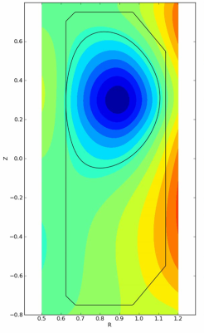
Free boundary: equilibrium+control
Feed-
forward
CEDRES
Target
Collaboration with H. Reimerdes and B. Hoang from CRPP Lausanne
Controller
+
+
+
-
Measured
state
State
Synth. mag. diags.
Validation on a yo-yo discharge
Experiment
Simulation
Movie produced by D. Coster
Z_{a} (m)

Slide 11
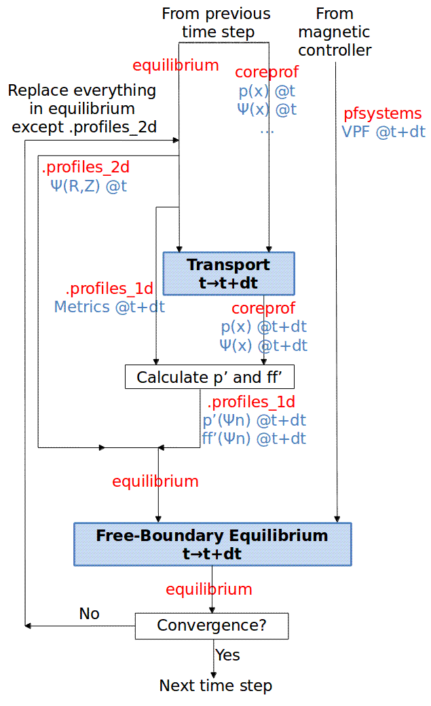
Free boundary: equilibrium evolution
Collaboration with P. Huyhn and V. Basiuk
Z_{a} - Z_{a}(t=t₀)
Simulation of a VDE in ITER
A current sheet grows at the edge of the plasma
j_{φ} (A/m²) at 108.50 s
j_{φ} (A/m²) at 108.82 s
G. Falchetto et al., submitted to Nucl. Fusion

Slide 12
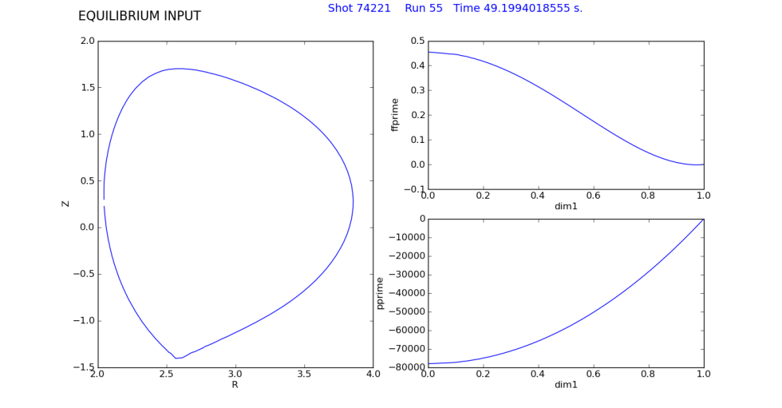
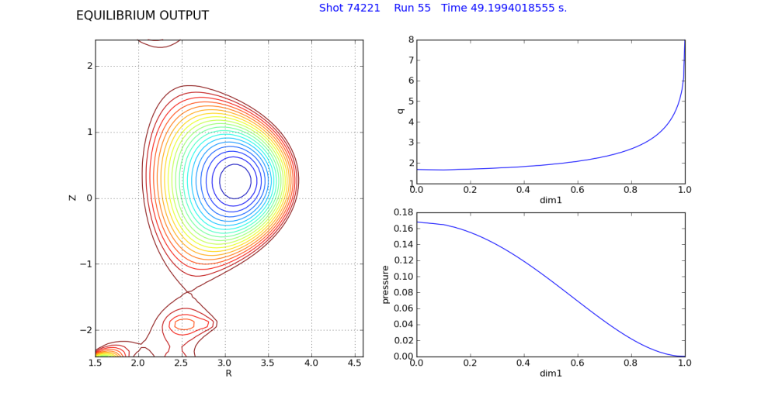
MHD chain: equilibrium reconstruction
Number of CPOs are used as input including PF coils and various diagnostics . Obtained solution (flux map and profiles of pressure and current density) is plotted using python actor

Slide 13
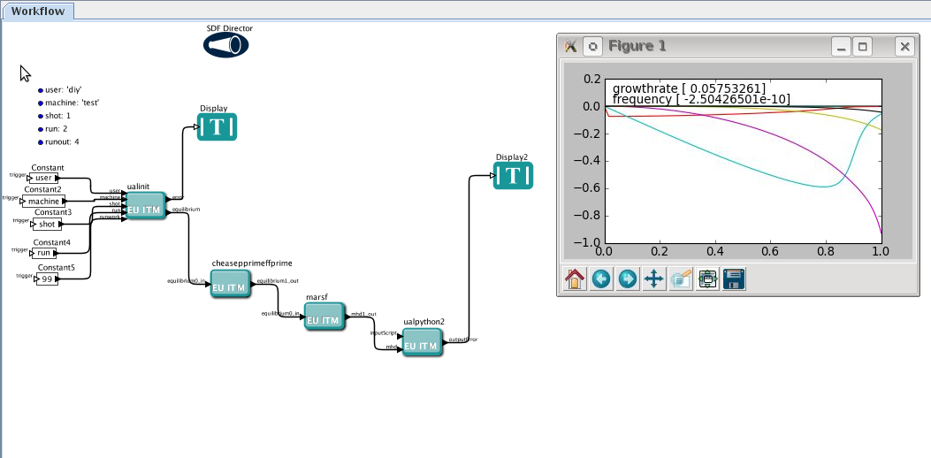
MHD chain: low n kink mode stability
CHEASE-MARS-F
Radial profiles of the poloidal Fourier components of the normal displacement are plotted using python actor . Growth rate of the n=1 ideal kink mode is shown in Alfvén units

Slide 14
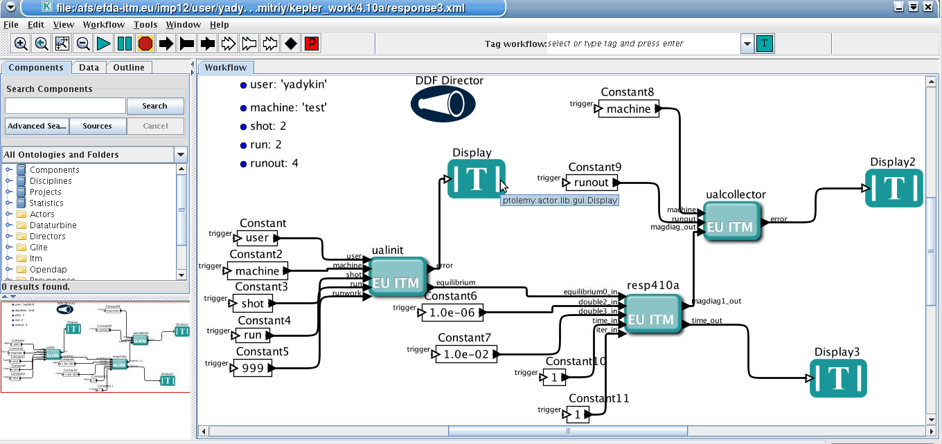
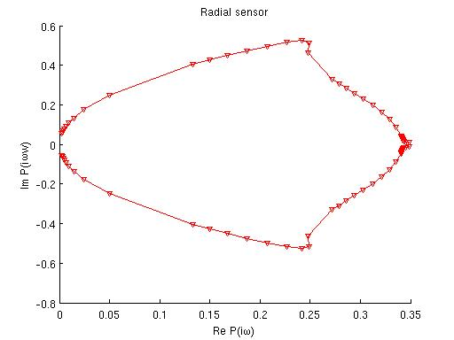
MHD chain: plasma response calculations
Input: equilibrium, frequency
range
Output: magnetic field at the sensor position giving plasma response to the unit current
applied in external coils
This workflow can be used to predict stability boundary or for modeling RWM control

Slide 15
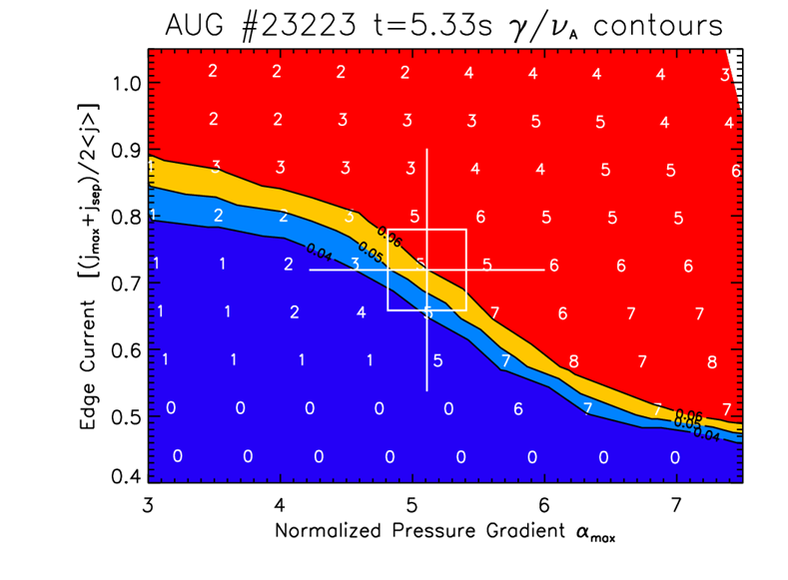
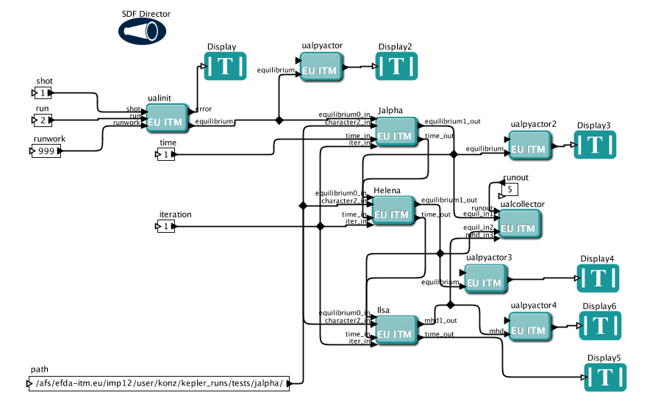
MHD chain: edge stability
JALPHA-HELENA- ILSA
Pressure gradient and current density value at the edge are scanned in JALPHA actor
Growth rate of the peeling-balooning mode is obtained from ILSA

Slide 16
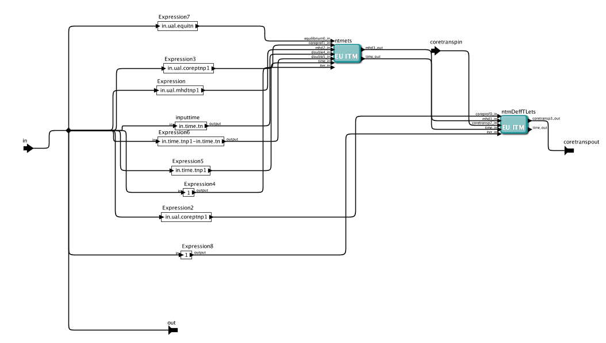
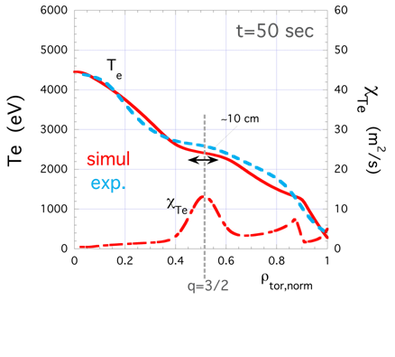
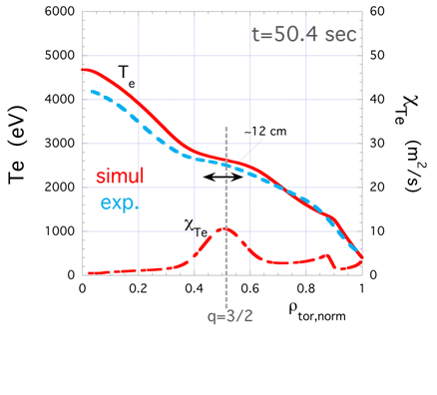
NTM evolution
NTM actors are integrated into ETS
(a)
(a) ntmets for mode evolution
(b) ntmDeffTLets for transp. coeff. calculation
`
(b)
4
Effect on the Te due to a 3/2 mode on JET shot #76791.
comparison of experimental and calculated electron temperature profiles

Slide 17
Conclusions
Number of tools are available for studies of MHD equilibrium and stability
Most of them are fully integrated in the ITM (actors) or use UAL
Verification and validation of the available tools were already performed or in progress
Workflows are developed to investigate several physical problems

Slide 18
Future
Use IMP12 tools and workflows in the frame of Euro-Fusion consortium
Further development of existing and addition new tools
Improvement of documentation

